Slide 1
N3C Short Course Session 5
Jerrod Anzalone
Department of Neurological Sciences

Slide 2
Overview
Data Preparation Requirements
Site Quality Checks
Inclusion/Exclusion Criteria
Study variables
Data Analysis
Homework Overview

Slide 3
Analytic Plan
This is what we’ll be looking at in class today
Primary Exposure: Malnutrition
COVID and No Hx of Malnutrition
COVID and Hx of Malnutrition
COVID and Hospital-Acquired Malnutrition
vs
Covariates
Age
Sex
Race/Ethnicity
Charlson Comorbidity Index
Smoking Status
Region
Outcomes
Death or Transfer to Hospice (primary)
Invasive Mechanical Ventilation
Oxygen Support
Acute Respiratory Distress Syndrome (ARDS)
ECMO
Hospital-acquired pressure injuries
Inclusion Criteria
Age >18
Positive COVID diagnosis or lab test (PCR, Ag)
Exclusion Criteria
Missing age, gender
Data partners with low death reporting and no hospitalizations

Slide 4
Analytic Plan
This is what you’ll be doing for homework!
Primary Exposure: Malnutrition
COVID and No Hx of Malnutrition
COVID and Hospital-Acquired Malnutrition
vs
Covariates
Age
Sex
Race/Ethnicity
Charlson Comorbidity Index
Smoking Status
Region
Outcomes
Death or Transfer to Hospice (primary)
Invasive Mechanical Ventilation
Oxygen Support
Acute Respiratory Distress Syndrome (ARDS)
ECMO
Hospital-acquired pressure injuries
Inclusion Criteria
Age >18
Positive COVID diagnosis or lab test (PCR, Ag)
Exclusion Criteria
Missing age, gender
Data partners with low death reporting and no hospitalizations

Slide 5
Data Preparation Requirements

Slide 6
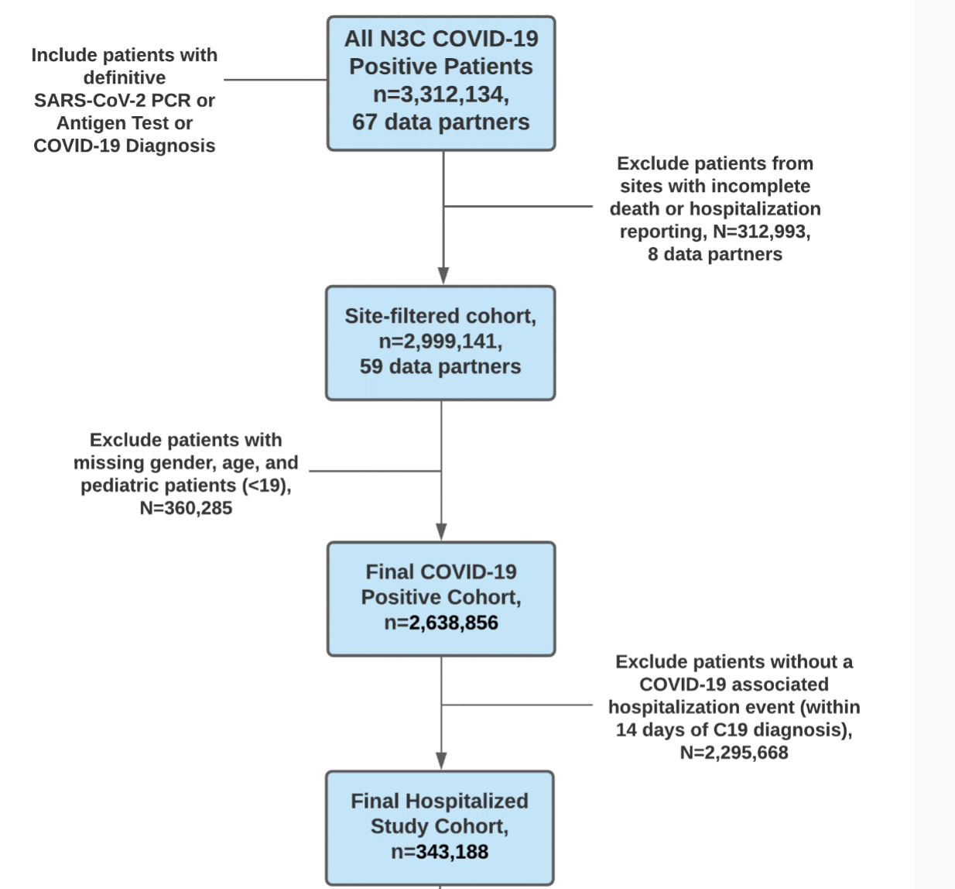

Slide 7
This part is largely taken care of by the LL COVID+ template!

Slide 8
Next step

Slide 9
Site Data Quality Considerations
We decided to filter sites that had: A) ‘incomplete’ death reporting and B) no hospitalization data
We set a cutoff of 1 SD below the mean reporting of deaths at the site level. Why this threshold? This seemed as reasonable as any other starting point.

Slide 10
Site Report Cards (link)

Slide 11
This is straightforward and only requires the LL patient-level table

Slide 12
This requires a definition for what we consider a COVID-associated hospitalization.

Slide 13
Requirements
Remove sites with ‘incomplete’ death reporting and sites with no hospitalization events on record.
Remove patients with missing sex, age, and pediatric patients (<19 years old).
Exclude patients without a hospitalization event documented within 14 days of their COVID-19 diagnosis or positive SARS-CoV-2 PCR or Ag lab test.
Bonus! Restrict the patient window to exclude weird positive results (e.g., before the COVID-19 pandemic) and those that are potentially very close to the current date, which may impact the amount of follow-up time available to accurately capture adverse events (this would be easier with the observation_period table, so we have to get creative).

Slide 14
Inclusion and Exclusion Criteria (link)

Slide 15
Study Variables

Slide 16
Analytic Plan – What else?
Primary Exposure: Malnutrition
COVID and No Hx of Malnutrition
COVID and Hx of Malnutrition
COVID and Hospital-Acquired Malnutrition
Covariates
Age
Gender
Race/Ethnicity
Charlson Comorbidity Index
Smoking Status
Region
Outcomes
Death or Transfer to Hospice (primary)
Invasive Mechanical Ventilation
Oxygen Support
Acute Respiratory Distress Syndrome (ARDS)
ECMO
Hospital-acquired pressure injuries
Inclusion Criteria
Age >18
Positive COVID diagnosis or lab test (PCR, Ag)
Exclusion Criteria
Missing age, gender
Data partners with low death reporting and no hospitalizations
DONE

Slide 17
Analytic Plan – What else?
Primary Exposure: Malnutrition
COVID and No Hx of Malnutrition
COVID and Hx of Malnutrition
COVID and Hospital-Acquired Malnutrition
Covariates
Age
Gender
Race/Ethnicity
Charlson Comorbidity Index
Smoking Status
Region
Outcomes
Death or Transfer to Hospice (primary)
Invasive Mechanical Ventilation
Oxygen Support
Acute Respiratory Distress Syndrome (ARDS)
ECMO
Hospital-acquired pressure injuries
Inclusion Criteria
Age >18
Positive COVID diagnosis or lab test (PCR, Ag)
Exclusion Criteria
Missing age, gender
Data partners with low death reporting and no hospitalizations
DONE

Slide 18
Study Variables (link)

Slide 19
Analytic Plan – Anything else??
Primary Exposure: Malnutrition
COVID and No Hx of Malnutrition
COVID and Hx of Malnutrition
COVID and Hospital-Acquired Malnutrition
Covariates
Age
Gender
Race/Ethnicity
Charlson Comorbidity Index
Smoking Status
Region
Outcomes
Death or Transfer to Hospice (primary)
Invasive Mechanical Ventilation
Oxygen Support
Acute Respiratory Distress Syndrome (ARDS)
ECMO
Hospital-acquired pressure injuries
Inclusion Criteria
Age >18
Positive COVID diagnosis or lab test (PCR, Ag)
Exclusion Criteria
Missing age, gender
Data partners with low death reporting and no hospitalizations
DONE
DONE
DONE

Slide 20
Analytic Plan – Anything else??
Primary Exposure: Malnutrition
COVID and No Hx of Malnutrition
COVID and Hx of Malnutrition
COVID and Hospital-Acquired Malnutrition
Covariates
Age
Gender
Race/Ethnicity
Charlson Comorbidity Index
Smoking Status
Region
Outcomes
Death or Transfer to Hospice (primary)
Invasive Mechanical Ventilation
Oxygen Support
Acute Respiratory Distress Syndrome (ARDS)
ECMO
Hospital-acquired pressure injuries
Inclusion Criteria
Age >18
Positive COVID diagnosis or lab test (PCR, Ag)
Exclusion Criteria
Missing age, gender
Data partners with low death reporting and no hospitalizations
DONE
DONE
DONE

Slide 21
Primary Exposure
We have yet to define our primary exposure, which is malnutrition status before COVID-19 and during the COVID-19 hospitalization event.

Slide 22
Primary Exposure
We created mutually exclusive categories based on our malnutrition concept set
Lookback period
30-Day Post-COVID Window
01-01-2018
SARS-CoV-2 Infection

Slide 23
Primary Exposure
We created mutually exclusive categories based on our malnutrition concept set
Lookback period
30-Day Post-COVID Window
01-01-2018
SARS-CoV-2 Infection
Group 1: No Malnutrition

Slide 24
Primary Exposure
We created mutually exclusive categories based on our malnutrition concept set
Lookback period
30-Day Post-COVID Window
01-01-2018
SARS-CoV-2 Infection
Group 2: Hx of Malnutrition

Slide 25
Primary Exposure
We created mutually exclusive categories based on our malnutrition concept set
Lookback period
30-Day Post-COVID Window
01-01-2018
SARS-CoV-2 Infection
Group 3: Hospital-Acquired Malnutrition

Slide 26
Study Variables (link)

Slide 27
Data Analysis

Slide 28
Data Analysis – What now?
Primary Exposure: Malnutrition
DONE!
COVID and No Hx of Malnutrition
COVID and Hx of Malnutrition
COVID and Hospital-Acquired Malnutrition
Covariates
Age
Gender
Race/Ethnicity
Charlson Comorbidity Index
Smoking Status
Region
Outcomes
Death or Transfer to Hospice (primary)
Invasive Mechanical Ventilation
Oxygen Support
Acute Respiratory Distress Syndrome (ARDS)
ECMO
Hospital-acquired pressure injuries
Inclusion Criteria
Age >18
Positive COVID diagnosis or lab test (PCR, Ag)
Exclusion Criteria
Missing age, gender
Data partners with low death reporting and no hospitalizations
DONE
DONE
DONE

Slide 29
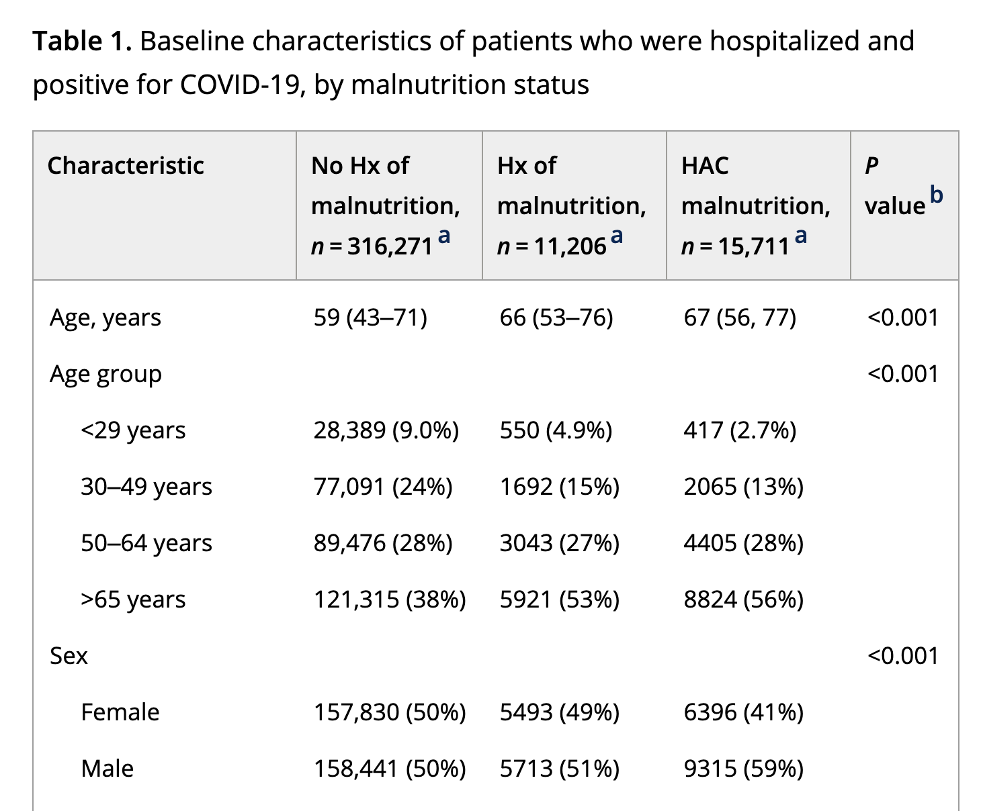
Descriptive Statistics

Slide 30
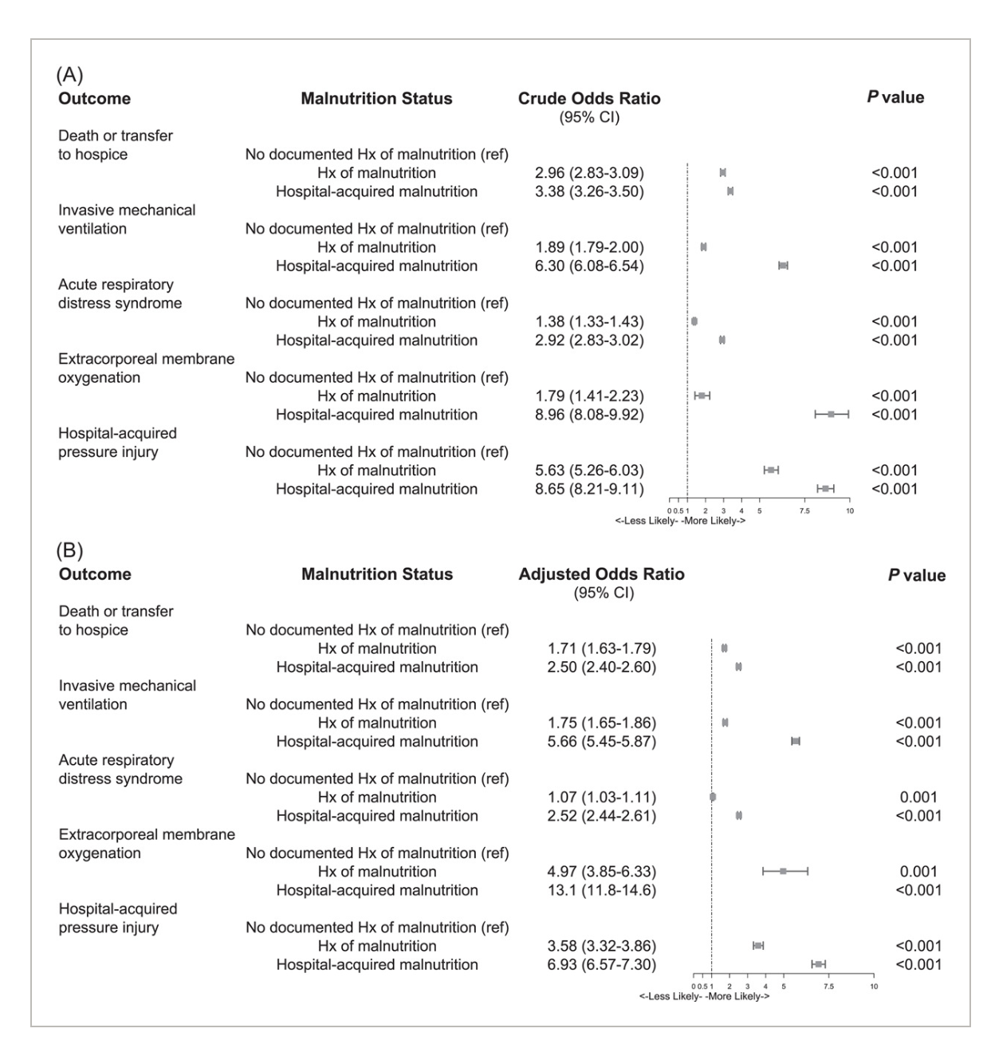
Logistic Regression

Slide 31
Data Analysis (link)

Slide 32
Homework

Slide 33
Malnutrition Concept Set
Concept ID | Concept Name
4123542 | Wasting disease
443082 | Starvation
437832 | Malnutrition of mild degree (Gomez: 75 percent to less than 90 percent of standard weight)
4101278 | Moderate protein energy malnutrition
436078 | Malnutrition of moderate degree (Gomez: 60 percent to less than 75 percent of standard weight)
433163 | Deficiency of macronutrients
4028220 | Malnutrition following gastrointestinal surgery
4098458 | Moderate protein-calorie malnutrition (weight for age 60-74 percent of standard)
4156515 | Malnutrition (calorie)
4276360 | Undernutrition
435227 | Nutritional deficiency disorder
4096196 | Mild protein-calorie malnutrition (weight for age 75-89 percent of standard)
4233565 | Severe protein-calorie malnutrition (Gomez: less than 60 percent of standard weight)
432593 | Kwashiorkor
4029268 | Marasmic kwashiorkor
4337279 | Semi-starvation

Slide 34
Malnutrition Concept Set
Severity | Concept ID | Condition Concept Name
Mild Malnutrition | 437832 | Malnutrition of mild degree (Gomez: 75 percent to less than 90 percent of standard weight)
 | 4096196 | Mild protein-calorie malnutrition (weight for age 75-89 percent of standard)
Moderate Malnutrition | 436078 | Malnutrition of moderate degree (Gomez: 60 percent to less than 75 percent of standard weight)
 | 4101278 | Moderate protein energy malnutrition
 | 4098458 | Moderate protein-calorie malnutrition (weight for age 60-74 percent of standard)
Severe Malnutrition | 4233565 | Severe protein-calorie malnutrition (Gomez: less than 60 percent of standard weight)
 | 4123542 | Wasting disease
 | 432593 | Kwashiorkor
 | 4029268 | Marasmic kwashiorkor
General Malnutrition | 4156515 | Malnutrition (calorie)
 | 4276360 | Undernutrition
 | 435227 | Nutritional deficiency disorder
 | 433163 | Deficiency of macronutrients
 | 4028220 | Malnutrition following gastrointestinal surgery
Starvation and Related Conditions | 443082 | Starvation
 | 4337279 | Semi-starvation

Slide 35
Homework Assignment
We want to see if malnutrition severity is associated with worse outcomes among those with a history of malnutrition.
Using the newly created malnutrition severity type variable, we want to re-run our analyses.
You will each be assigned either:
The multilevel severity measure to compare them collective versus no hx of malnutrition (level 1)
One of these severity types to compare individually to those with no hx of malnutrition (level 2)
Stratified among only those with malnutrition to compare relative differences among those with malnutrition (level 3)

Slide 36
Homework Assignment
Requirements:
If your last name is between A and H, you are group A (level 1)
If your last name is between I and O, you are group B (level 2)
If your last name is between P and Z, you are group C (level 3)
Based on your group assignment:
Create a Table 1 for your cohort (e.g., descriptive statistics) with an overall column and comparison groups. Include p values using the gtsummary package. Be sure to include additional code to censor small counts.
Using the approach we covered in class, run crude and adjusted logistic regression for 30-day all-cause mortality using the exposure group you were assigned above. If you include event rates, include an additional step to censor small cell counts.

Slide 37
Module 5 Homework (link)

