Slide 1
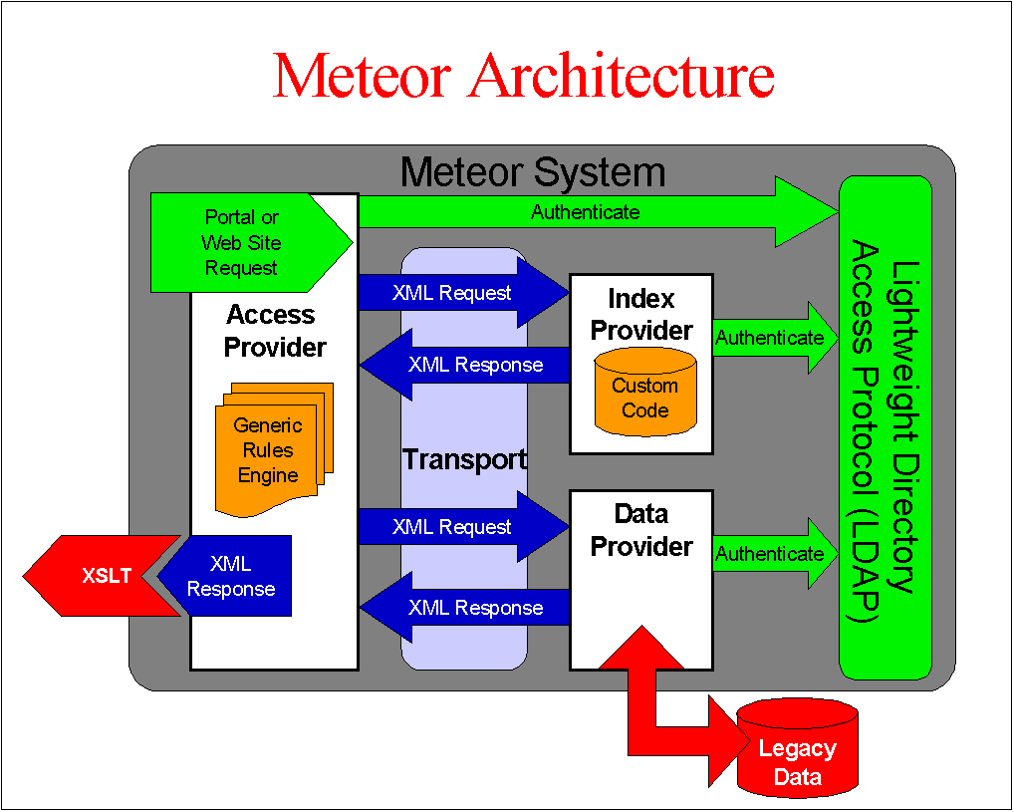

Slide 2
Meteor Architecture
Meteor System
Authenticate
Portal or Web Site Request
UI Provider
Access
Provider
Registry Service
Transport
XML Request
Index Provider
XML Request
Authn
Custom Code
XML Response
Business Rules Engine
Data
Provider
XML Response
XML Request
Authn
XSLT
XML Response
Legacy Data

