Slide 1
JSON
Generate JSON formatted API using PHP
Khirulnizam Abd Rahman
kerul.net

Slide 2
Contents
JSON Concept
Database setup
Mysql database connection
Json_encode() function in PHP
SQL to extract all data
SQL to search data
SQL to verify username & password
SQL to insert data
Exercise on localhost / live hosting

Slide 3
JSON
Format
Notes:
Consider talking about:
Example
Data portability issues
Using JSON in JavaScript
Unsupported native data types

Slide 4
JSON
JSON Concept
JSON: JavaScript Object Notation.
JSON is a lightweight data-interchange format
JSON format is text only, it can easily be sent to and from a server.

Slide 5
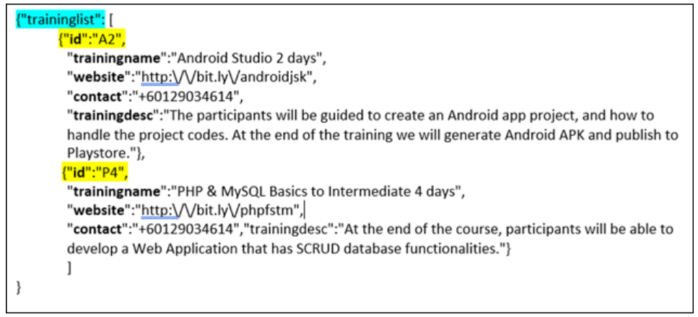

Slide 6
Online database
Concept
Notes:
Consider talking about:
Example
Data portability issues
Using JSON in JavaScript
Unsupported native data types

Slide 7
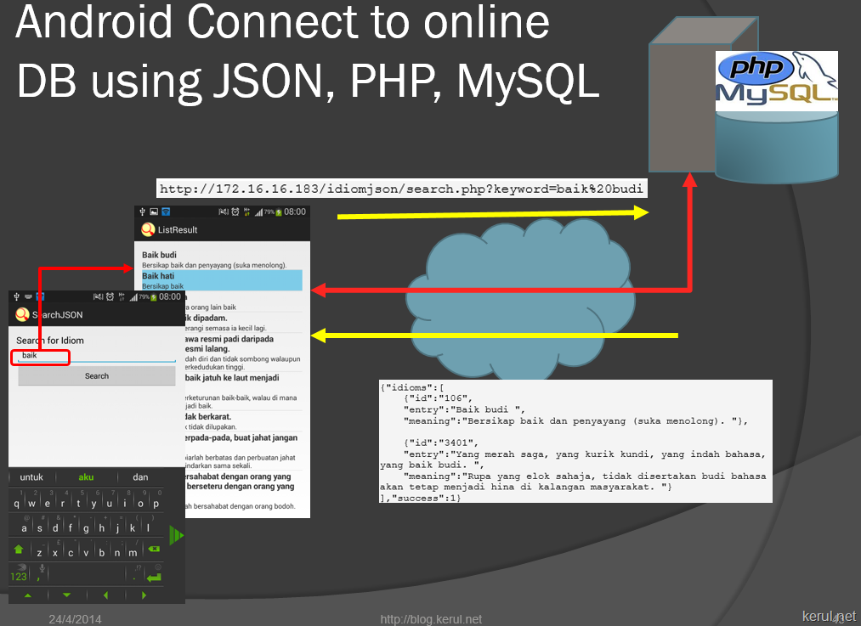

Slide 8
JSON_encode
json_encode() function in PHP
Notes:
Consider talking about:
JSON-RPC
AJAJ

Slide 9
json_encode
//Returns the JSON representation of a value
//FALSE if error generating json formatted data
//Example
$traininglist= array();
$traininglist["id"] = "A3";
$traininglist["trainingname"] = "Android and JSON";
$traininglist["website"] = "http://kerul.net";
$traininglist["contact"] = "0129034614";
$traininglist["trainingdesc"] = "Android mobile connecting to Online database with JSON";
// push single idiom array into final response array
array_push($response["traininglist"], $traininglist);
echo json_encode($response);

Slide 10
TABLE STRUCTURE
Tablename:
training
Notes:
Consider talking about:
JSON Schema

Slide 11
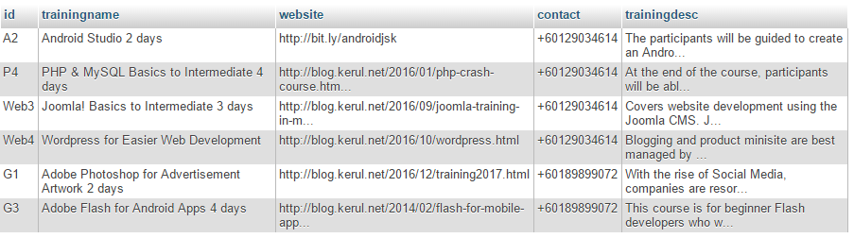
training table

Slide 12
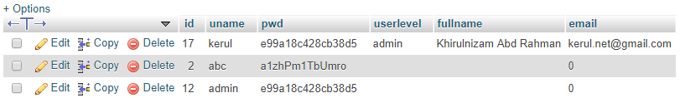
training_user table

Slide 13
SQL
Listing
Search
Admin& password verification
Insert record
Notes:
Consider talking about:
JSON Schema

Slide 14
Listing Search
SELECT * FROM a_training
SELECT * FROM a_training WHERE trainingname LIKE '%$keyword%'

Slide 15
Insert
INSERT INTO a_training VALUES ('$id’, '$trainingname’, '$website’, '$contact’, '$trainingdesc')

Slide 16
Verify Admin & password
SELECT * FROM sd_users WHERE email='$username' AND password=md5('$password')"

Slide 17
Links to Android tutorials to connect Online Database
Listing/Search by JSON bit.ly/listingjson
Insert a record from Android to Online Database bit.ly/insertkerul
Login from Android to Online Database bit.ly/loginkerul

