Slide 1
Setup
1) Connect to the wifi (on your laptop and devices)
Network name:
Password:
2) Go to platform.telerik.com and login
3) Make sure you have the NativeScript app installed on your Android and/or iOS device(s)

Slide 2
NativeScript Deep Dive
TJ VanToll | @tjvantoll
Clark Sell | @csell5
Sebastian Witalec | @sebawita

Slide 3
Agenda
NativeScript intro (TJ)
Lab #1
Data, styling, layouts, and more (Clark)
Lab #2
MVVM, modules, extensibility (Sebastian)
Lab #3

Slide 4
Follow NativeScript
nativescript.org
@nativescript
nativescript.org/blog

Slide 5


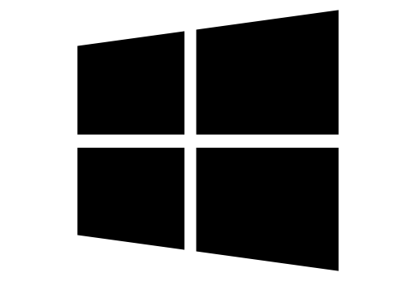
What is NativeScript?
A runtime for building and running native iOS, Android, and Windows Phone apps with a single, JavaScript code base

Slide 6





Bridge

Slide 7
Why NativeScript?
Skills reuse
Standards-based JavaScript, CSS, optionally TypeScript
Code reuse
npm modules, 3rd-party iOS and Android libraries
Easily use native APIs
No wrappers to access native APIs
Use native UI elements
Open source!

Slide 8
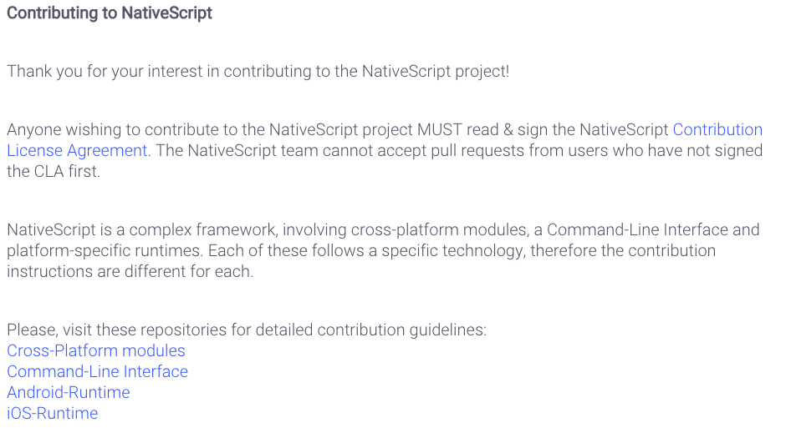
Contribute! (nativescript.org/contribute)

Slide 9
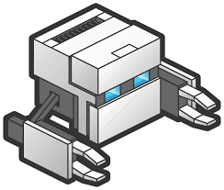
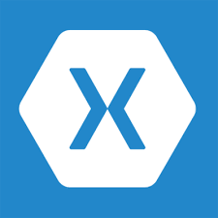
!=
No DOM
!=
No cross compilation

Slide 10
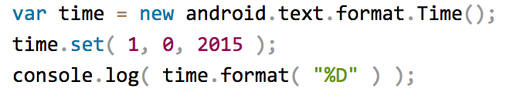

NativeScript Android example
Output:
Notes:
I'll give your brain a minute or two to parse this, because yes, this JavaScript code instantiates a Java android.text.format.Time() object, calls its set() method, then logs the return value of its format() method, which is the string "01/01/15".

Slide 11
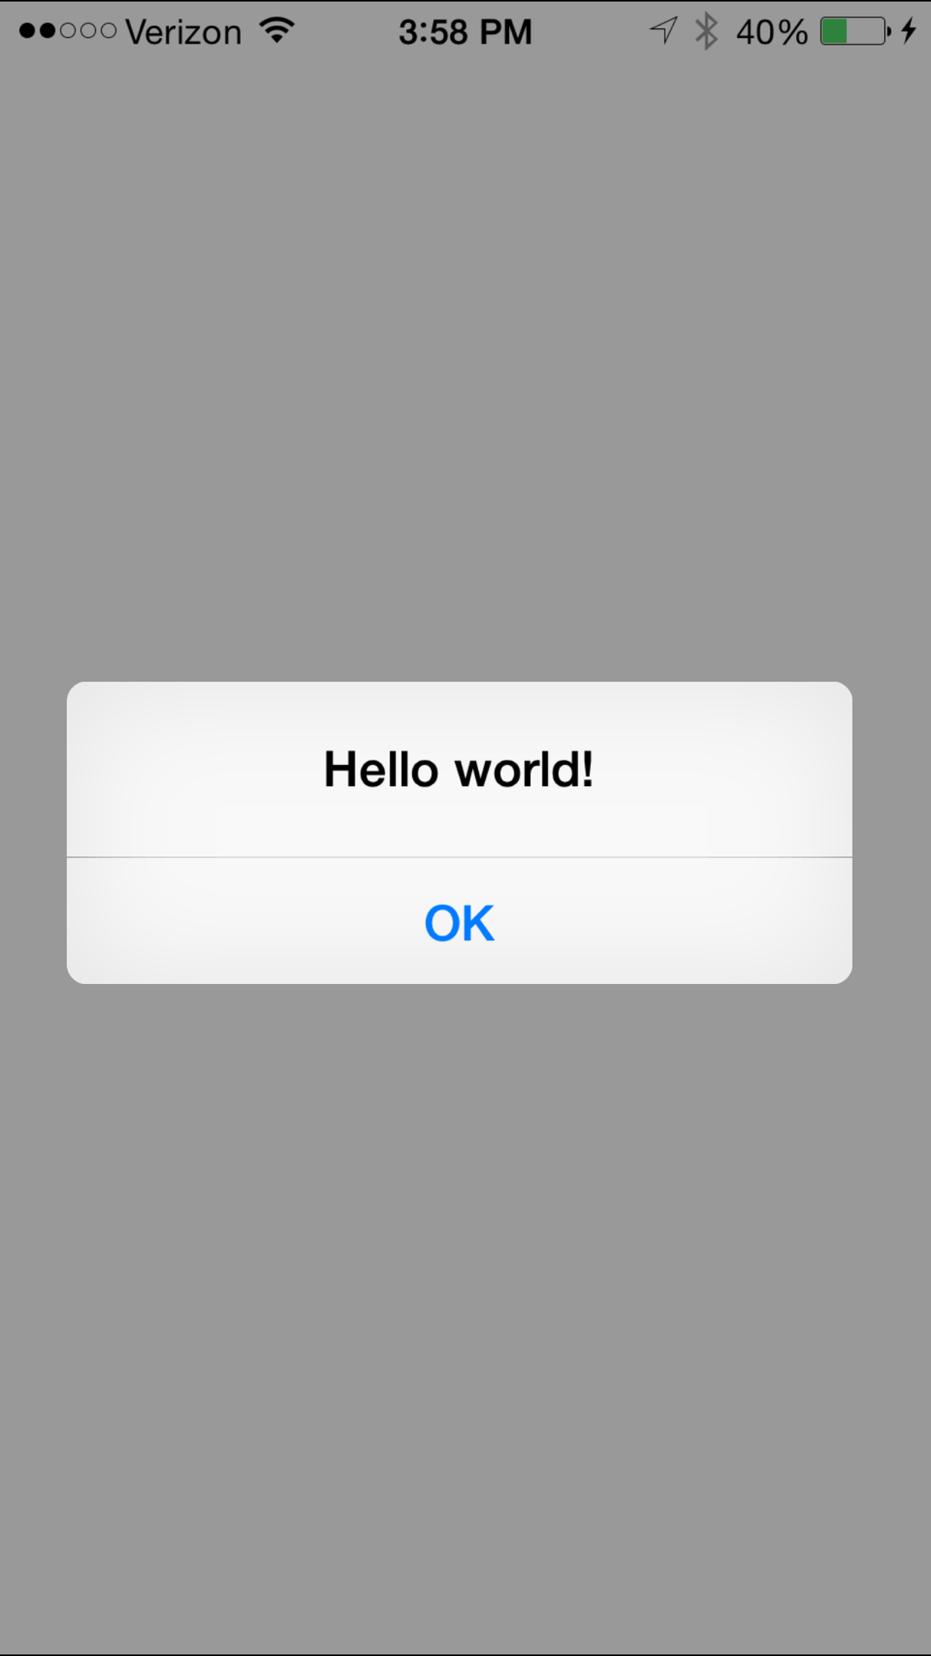
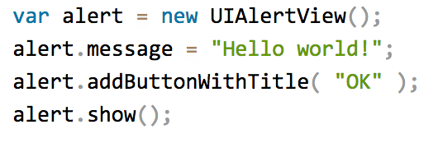
NativeScript iOS example
Notes:
This JavaScript code instantiates an Objective-C UIAlertView class, sets its message property, and then calls its addButtonWithTitle() and show() methods. When you run a NativeScript iOS app with this code you'll see the alert below:

Slide 12
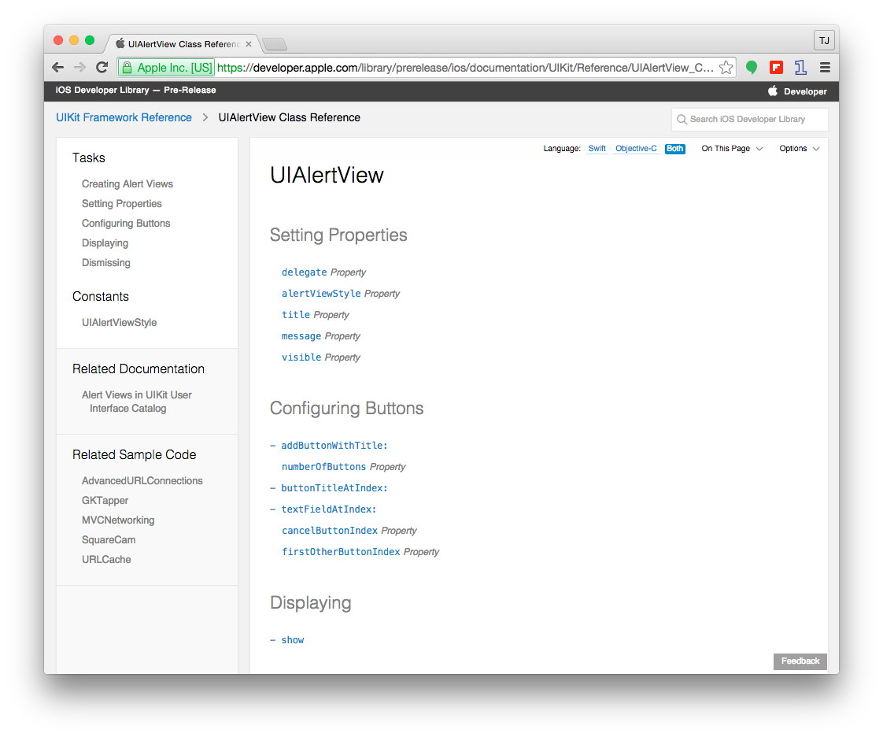

Slide 13
How does this work?

Slide 14
NativeScript and JS VMs
NativeScript runs JavaScript on a JavaScript VM
JavaScriptCore on iOS
V8 on Android
JavaScriptCore on Windows

Slide 15
Runs on V8
Runs on JavaScriptCore

Slide 16
So do you only write native code?
No

Slide 17
NativeScript modules
NativeScript-provided modules that provide cross-platform functionality.
There are dozens of them and they’re easy to write yourself.
NativeScript modules follow Node module’s conventions (CommonJS).

Slide 18



NativeScript file module

Slide 19
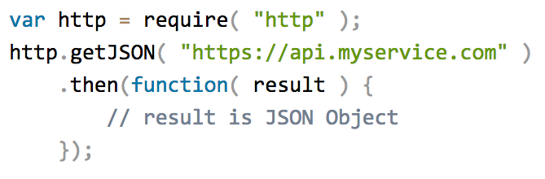
HTTP module example

Slide 20
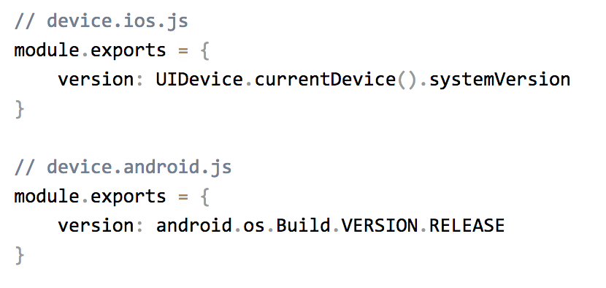
Custom NativeScript modules

Slide 21
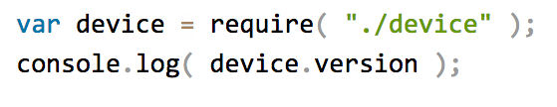
Using the custom device module

Slide 22
But how do I turn this into an app?

Slide 23


Two ways to use NativeScript
1)
2)

Slide 24
http://telerik.com/platform
Backend-as-a-service
Push notifications, cloud data, file storage, and more
Analytics
AppBuilder
Cloud builds (build iOS apps on Windows, Windows Phone apps on a Mac)
NativeScript debugging and tooling
Automated app testing
And more!

Slide 25
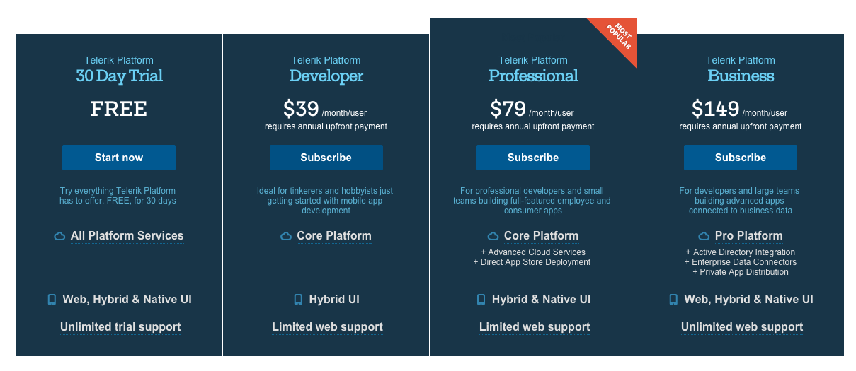
https://www.telerik.com/purchase/platform

Slide 26
Telerik AppBuilder IDE Options
In-Browser Client
Visual Studio Extension
Sublime Text Package
Command-Line Interface

Slide 27
NativeScript CLI
Free and open source
https://github.com/nativescript/nativescript-cli

Slide 28
NativeScript CLI requirements
https://github.com/nativescript/nativescript-cli#system-requirements
JDK, Apache Ant, Android SDK
Xcode, Xcode CLI tools, iOS SDK

Slide 29
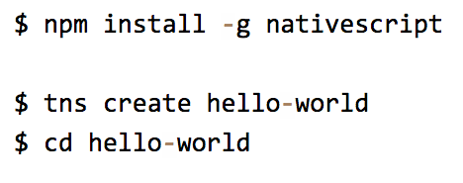
Starting a new project

Slide 30
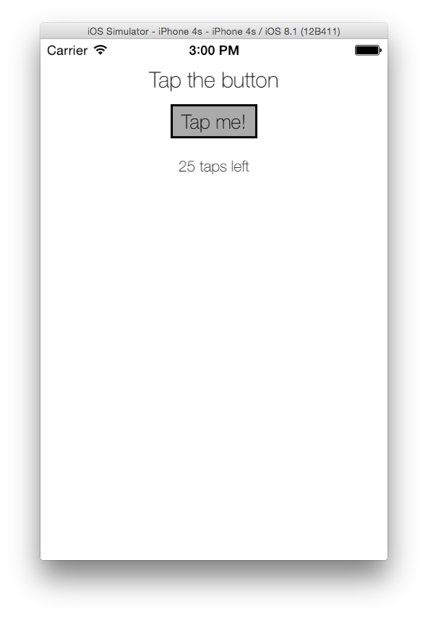

Running on iOS

Slide 31
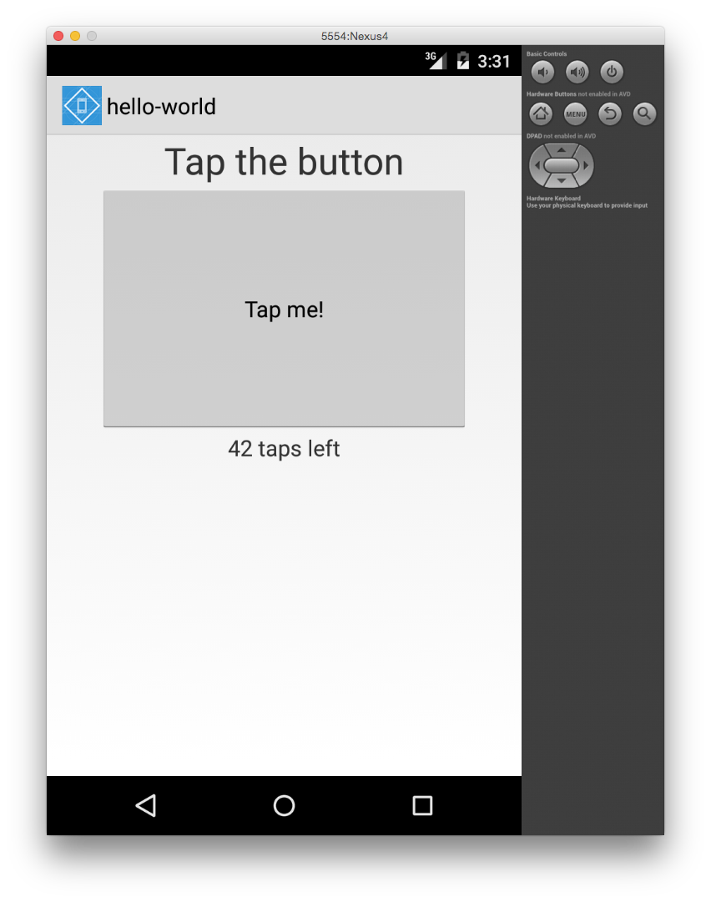

Running on Android

Slide 32
Creating Platform apps
Demo

Slide 33
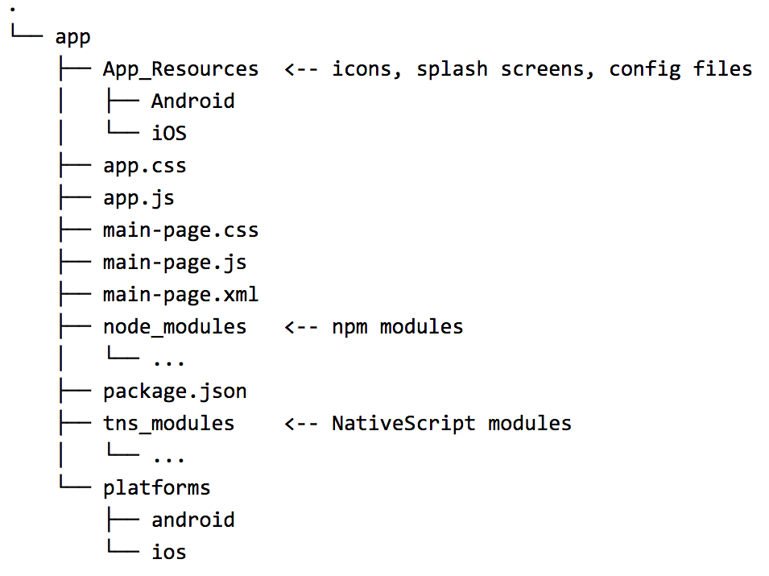

Slide 34
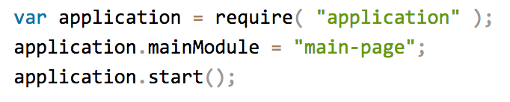
app.js

Slide 35
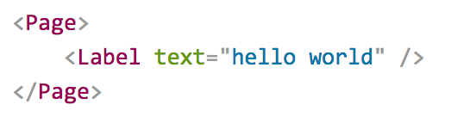
Pages
XML markup structure
Elements (e.g. <Page>, <Label>) are NativeScript modules

Slide 36
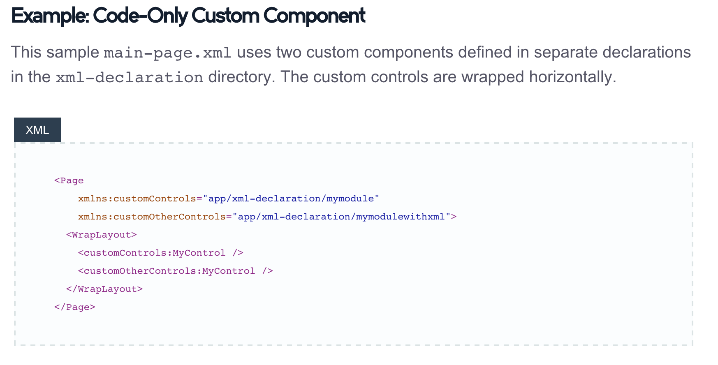
Custom XML Components
http://docs.nativescript.org/ui-with-xml#custom-components

Slide 37
Questions?

Slide 38
Getting started
Clone …?

