Slide 1
Setup
1) Connect to the wifi (on your laptop and devices)
Network name:
Password:
2) Go to platform.telerik.com and login
3) Make sure you have the NativeScript app installed on your Android and/or iOS device(s)

Slide 2
NativeScript Deep Dive
TJ VanToll | @tjvantoll
Clark Sell | @csell5
Sebastian Witalec | @sebawita

Slide 3
Agenda
Welcome to NativeScript (TJ)
Lab #1
Beyond the Basics (Clark)
Lab #2
Diving Deep with {N} (Sebastian)
Lab #3
Q&A

Slide 4
Follow NativeScript
nativescript.org
@nativescript
nativescript.org/blog

Slide 5
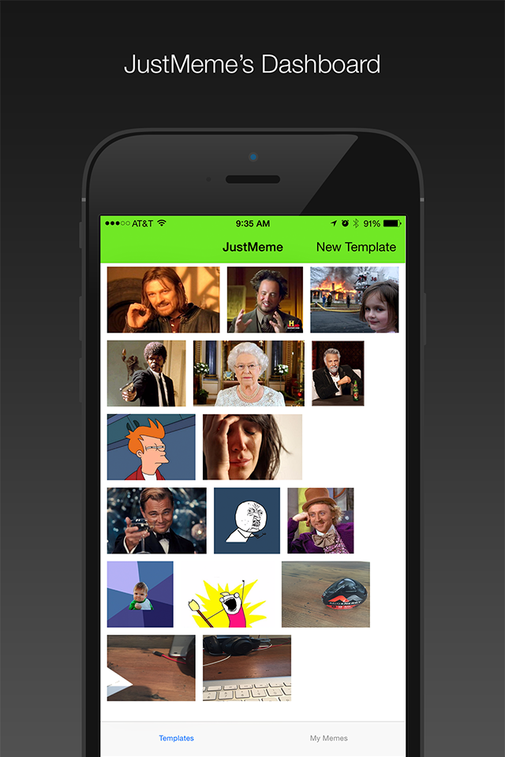

JustMeme

Slide 6
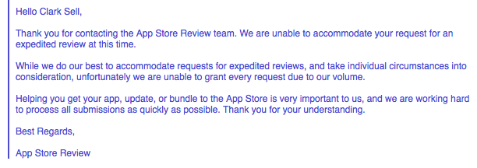
Oh snap

Slide 7
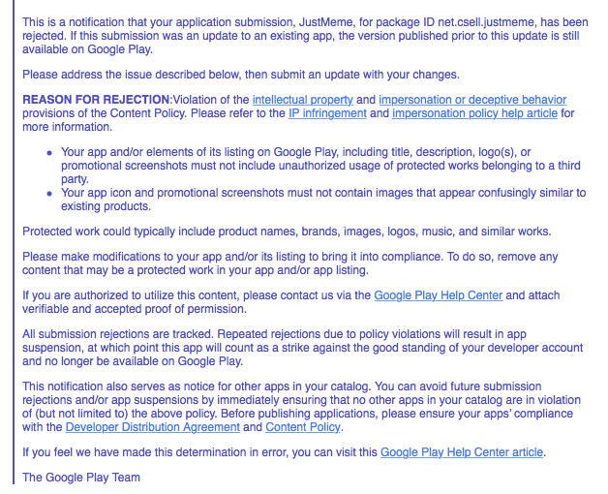
Oh snapppppppp

Slide 8


Slide 9


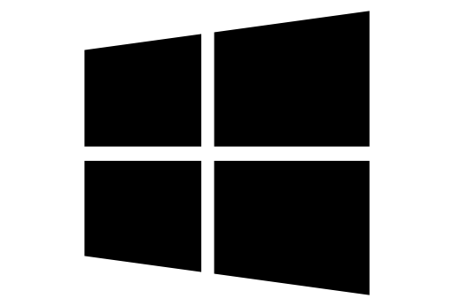
What is NativeScript?
A runtime for building and running native iOS, Android, and (soon) Windows Phone apps with a single, JavaScript code base

Slide 10


Slide 11
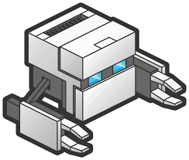
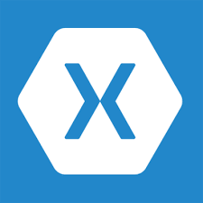


!=
No DOM
!=
No cross compilation
!=
Direct access to native APIs in JS

Slide 12
Why NativeScript?
Skills reuse
Standards-based JavaScript, CSS, optionally TypeScript
Code reuse
npm modules, 3rd-party iOS and Android libraries
Easily use native APIs
No wrappers to access native APIs
Use native UI elements
Open source!

Slide 13
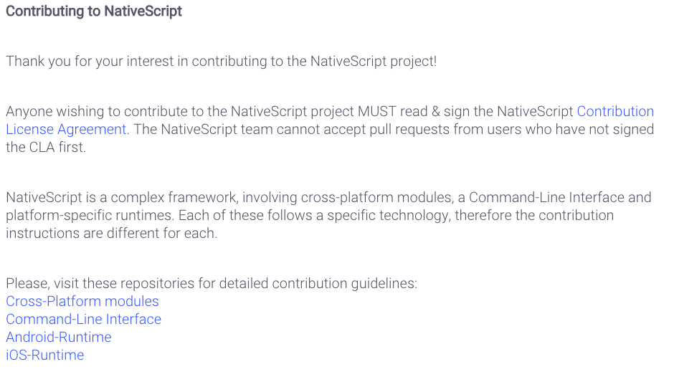
Contribute! (nativescript.org/contribute)

Slide 14





Bridge

Slide 15
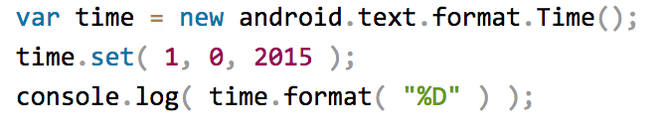

NativeScript Android example
Output:
Notes:
I'll give your brain a minute or two to parse this, because yes, this JavaScript code instantiates a Java android.text.format.Time() object, calls its set() method, then logs the return value of its format() method, which is the string "01/01/15".

Slide 16
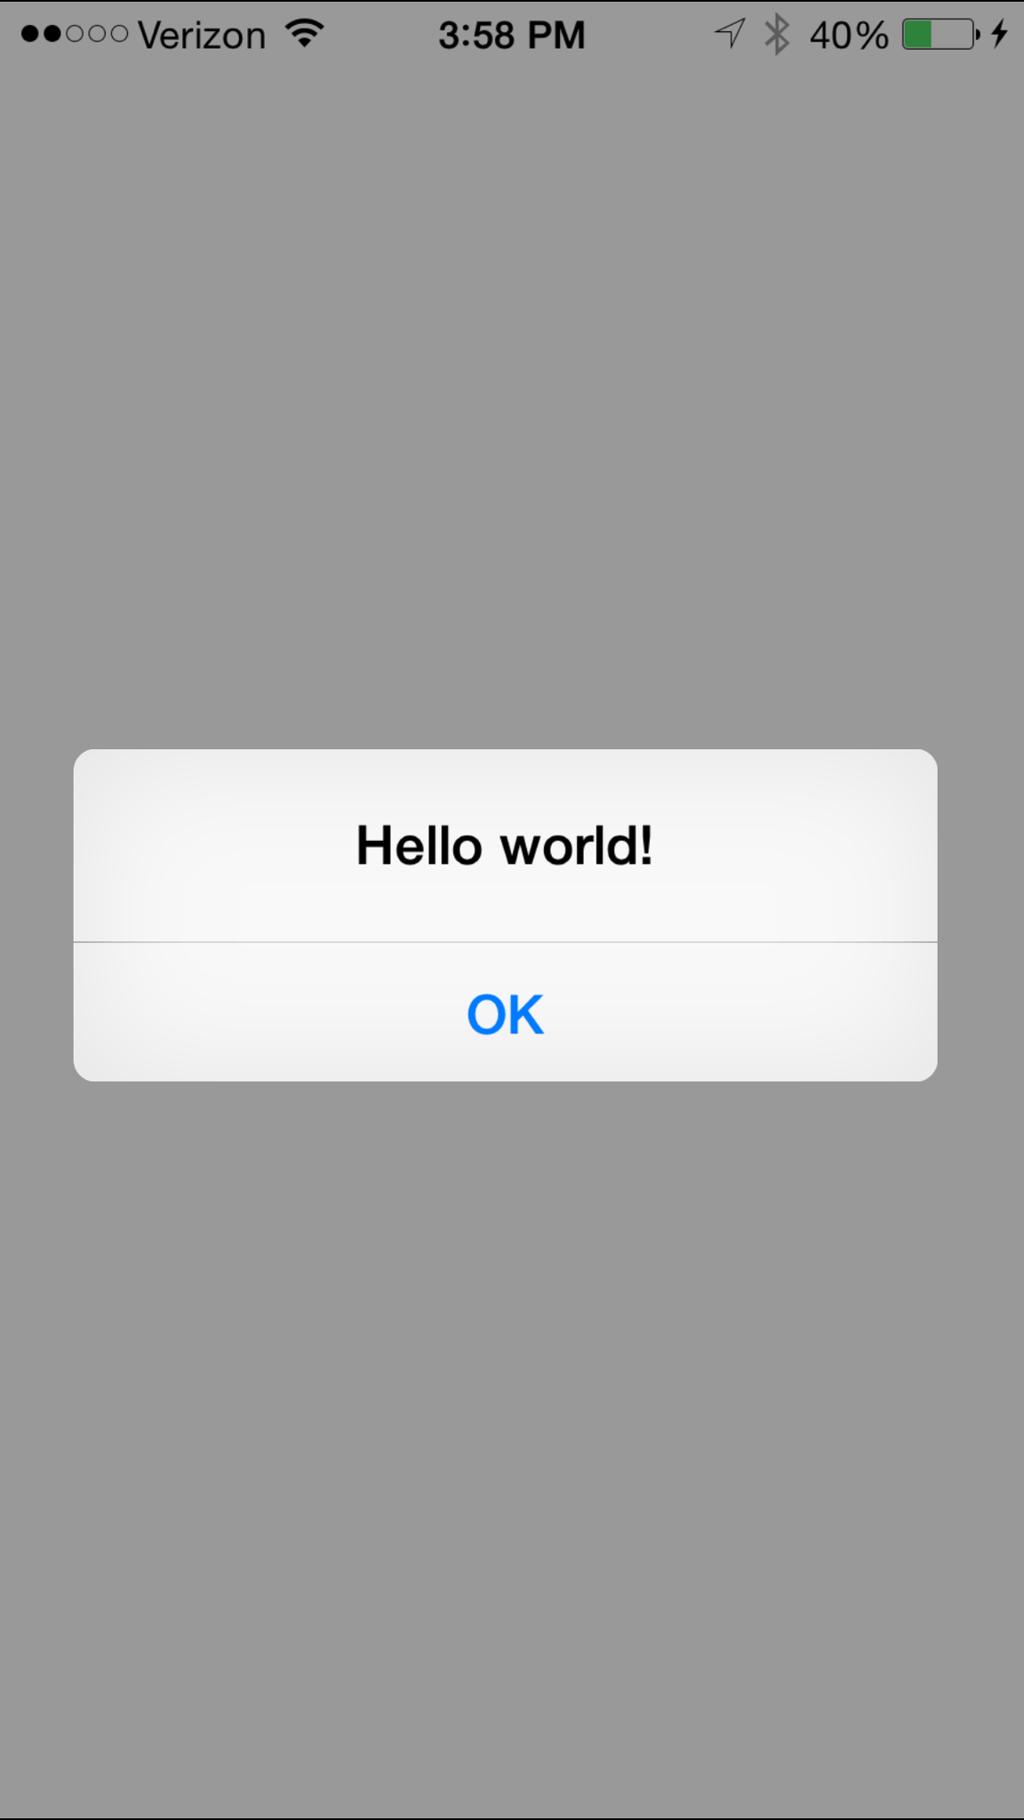
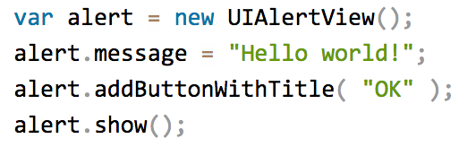
NativeScript iOS example
Notes:
This JavaScript code instantiates an Objective-C UIAlertView class, sets its message property, and then calls its addButtonWithTitle() and show() methods. When you run a NativeScript iOS app with this code you'll see the alert below:

Slide 17
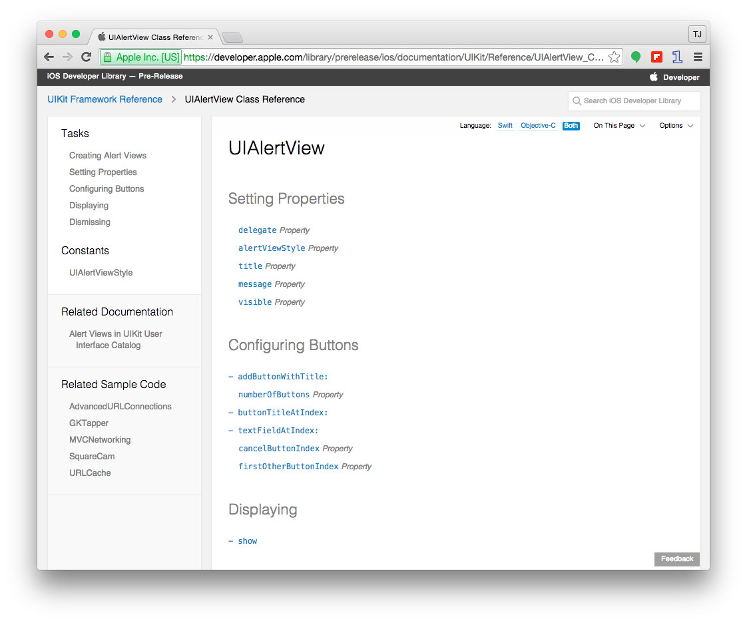

Slide 18

How does this work?

Slide 19
NativeScript and JS VMs
NativeScript runs JavaScript on a JavaScript VM
JavaScriptCore on iOS
V8 on Android
JavaScriptCore on Windows (subject to change)

Slide 20
Runs on V8
Runs on JavaScriptCore

Slide 21
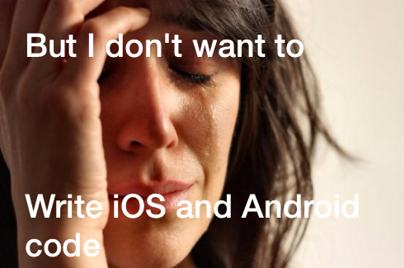

Slide 22
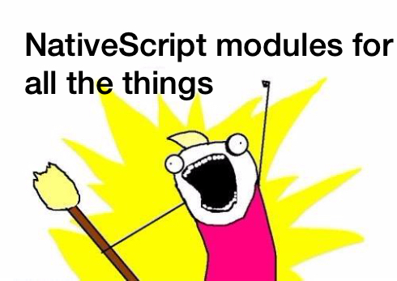

Slide 23
NativeScript modules
NativeScript-provided modules that provide cross-platform functionality.
There are dozens of them and they’re easy to write yourself.
NativeScript modules follow Node module’s conventions (CommonJS).

Slide 24



NativeScript file module

Slide 25
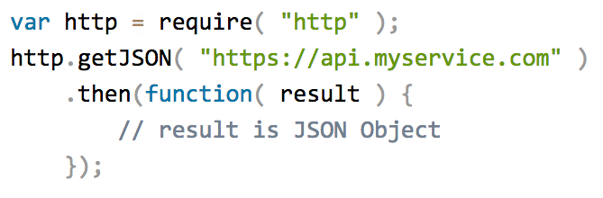
HTTP module example

Slide 26
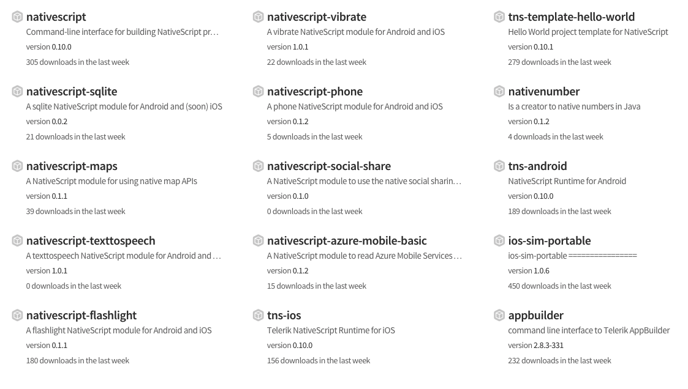
Community modules

Slide 27

But how do I turn this into an app?

Slide 28


Two ways to use NativeScript
1)
2)

Slide 29
http://telerik.com/platform
Backend-as-a-service
Push notifications, cloud data, file storage, and more
Analytics
AppBuilder
Cloud builds (build iOS apps on Windows, Windows Phone apps on a Mac)
NativeScript debugging and tooling
Automated app testing
And more!

Slide 30
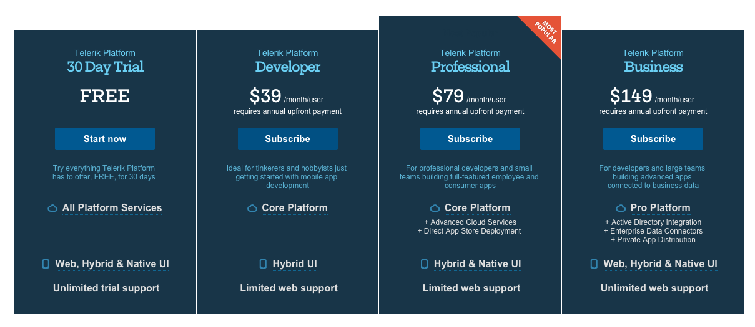
https://www.telerik.com/purchase/platform

Slide 31
Telerik AppBuilder IDE Options
In-Browser Client
Visual Studio Extension
Sublime Text Package
Command-Line Interface

Slide 32
NativeScript CLI
Free and open source
https://github.com/nativescript/nativescript-cli

Slide 33
NativeScript CLI requirements
https://github.com/nativescript/nativescript-cli#system-requirements
JDK, Apache Ant, Android SDK
Xcode, Xcode CLI tools, iOS SDK

Slide 34


Slide 35
NativeScript versions
0.10
The version we’re using
1.0
Newly released
Available on the CLI, not AppBuilder quite yet
Changelog
http://docs.nativescript.org/Changelogs/Cross-Platform%20Modules
Future
https://www.nativescript.org/roadmap

Slide 36


Slide 37

Lab 1
https://github.com/NativeScript/NativeScript-NEXT-Workshop
labs/Lab-1

