Slide 1
NativeScript.org
Diving Deep
Summer of NativeScript
TJ VanToll, Clark Sell

Slide 2
So far you’ve learned
What NativeScript is
How to build apps with NativeScript
How to use UI controls, use NativeScript modules, and add application logic

Slide 3
Today
Accessing native code
Debugging
Using npm modules
NativeScript plugins

Slide 4
Today
Accessing native code
Debugging
Using npm modules
NativeScript plugins

Slide 5
Accessing native code
All iOS and Android APIs are available to your NativeScript app in JavaScript directly.

Slide 6
Example
Suppose you want to add a flashlight to your NativeScript-written iOS app.

Slide 7
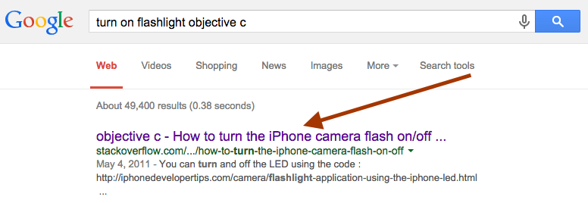

Slide 8
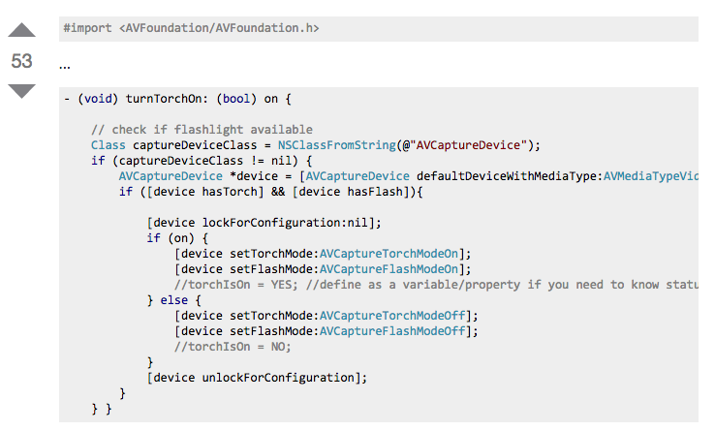

Slide 9
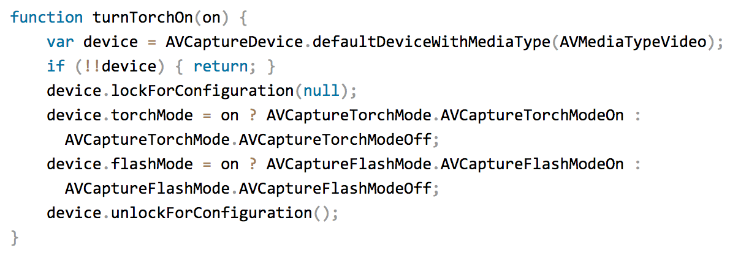
The same function in NativeScript

Slide 10
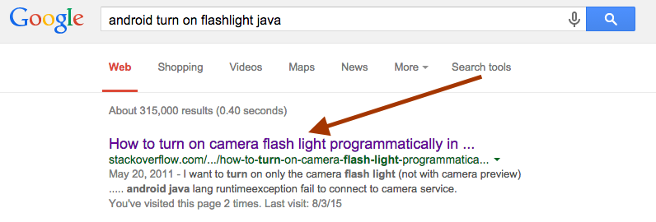

Slide 11
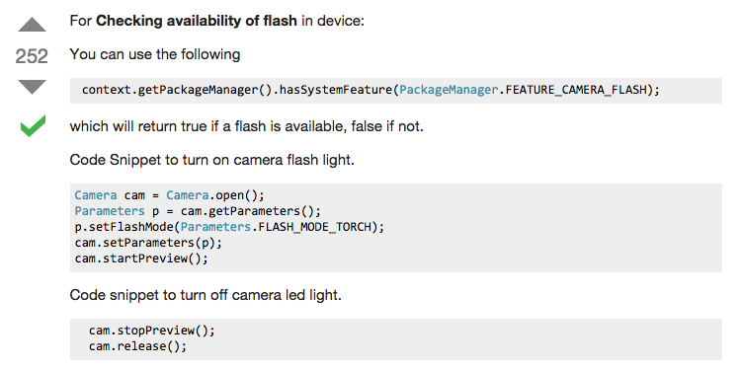

Slide 12
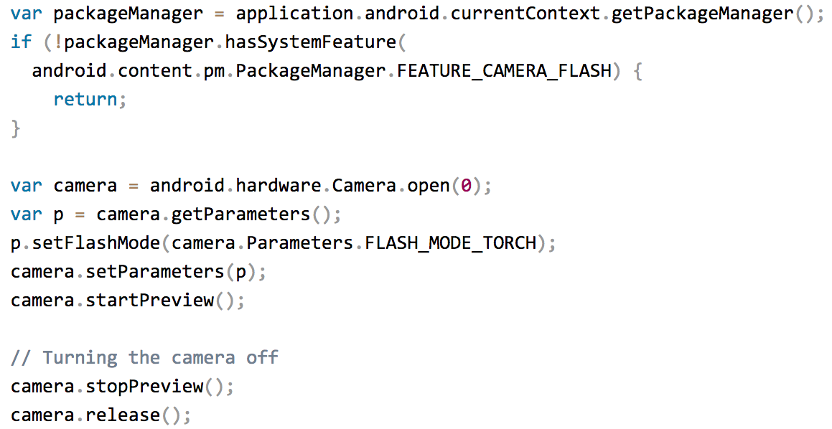
The same code in NativeScript

Slide 13
Converting native to JS, a few tips
Check the docs when you hit an advanced scenario
Android:
http://docs.nativescript.org/runtimes/android/overview
iOS:
http://docs.nativescript.org/runtimes/ios/Overview

Slide 14
Use NativeScript’s TypeScript definition files as a reference for native APIs
Android
https://raw.githubusercontent.com/NativeScript/NativeScript/master/android17.d.ts
iOS
https://raw.githubusercontent.com/NativeScript/NativeScript/master/ios.d.ts
Try running native APIs with the debug tooling.

Slide 15
Today
Accessing native code
Debugging
Using npm modules
NativeScript plugins

Slide 16
Console logging
The NativeScript CLI automatically sends the result of all console.log calls to the terminal.

Slide 17
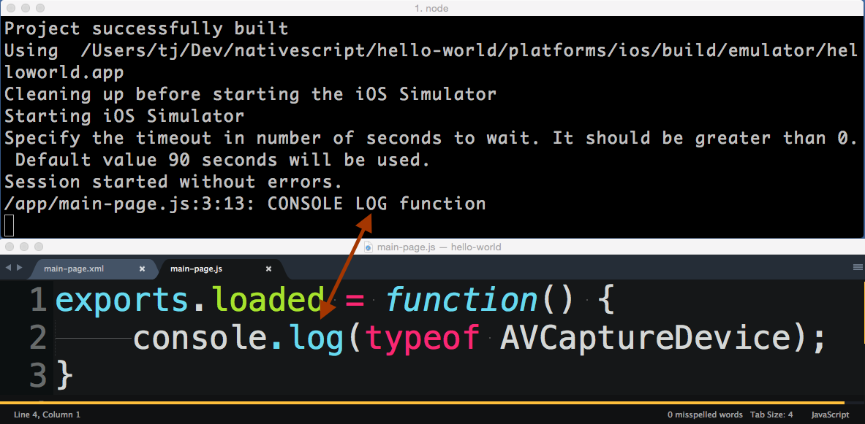

Slide 18
Stack traces
The NativeScript CLI also sends stack traces to the terminal when things go wrong.

Slide 19
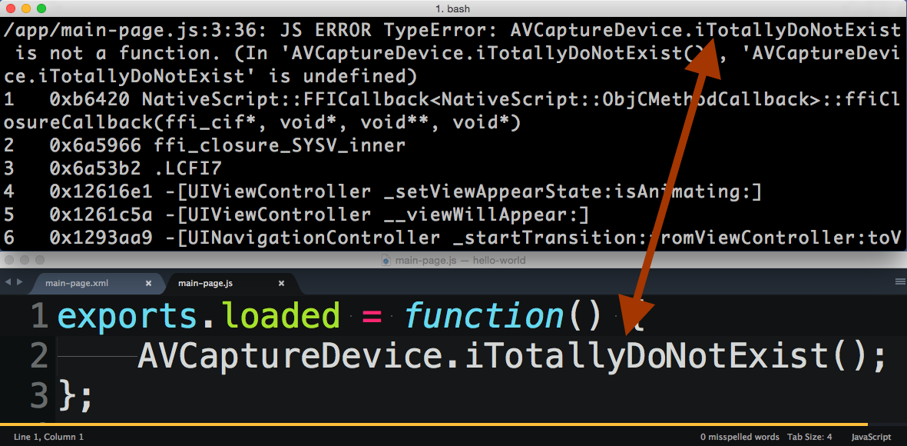

Slide 20
Web inspector
Use the tns debug command to launch.
Allows for step debugging, an interactive console and more.
Visual tree debugging and performance benchmarking is coming soon.

Slide 21
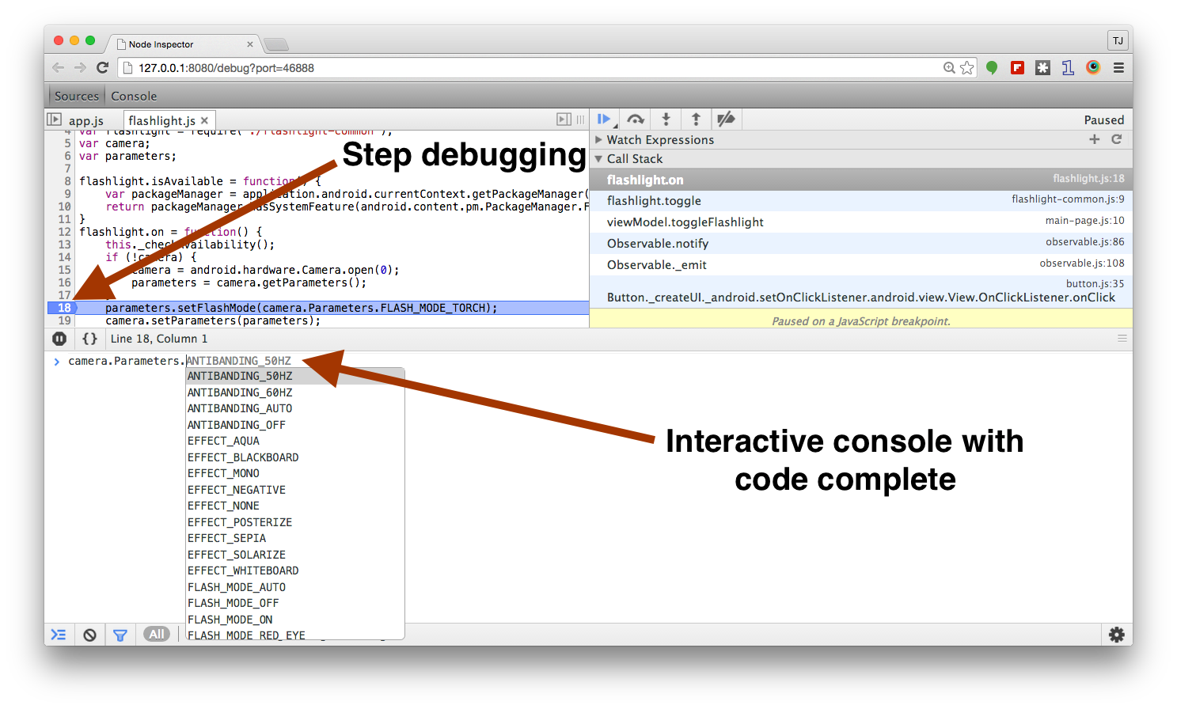

Slide 22
Today
Accessing native code
Debugging
Using npm modules
NativeScript plugins

Slide 23
Using npm modules
NativeScript modules adhere to the same CommonJS spec Node modules do.
Installing modules from npm works just like it does in Node apps.

Slide 24
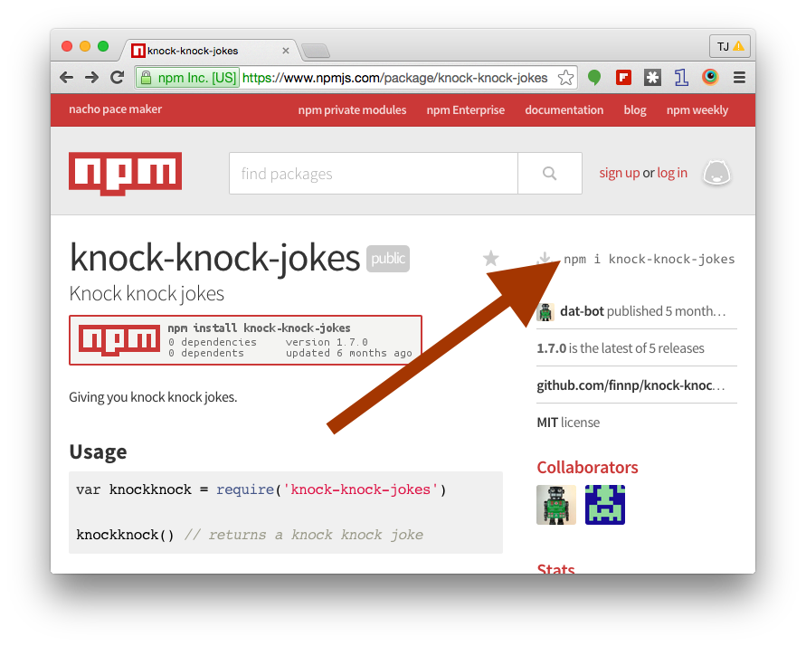
Example: Knock knock jokes

Slide 25
Notes
Make sure to run the install in the root of the app.
The --save flag tells npm to save the dependency in your app’s package.json file.
At build time the NativeScript CLI copies the appropriate files from node_modules into the app itself.

Slide 26

Using knock knock jokes
It’s that easy!
Let’s look a slightly more practical example.

Slide 27

Using Moment.js

Slide 28
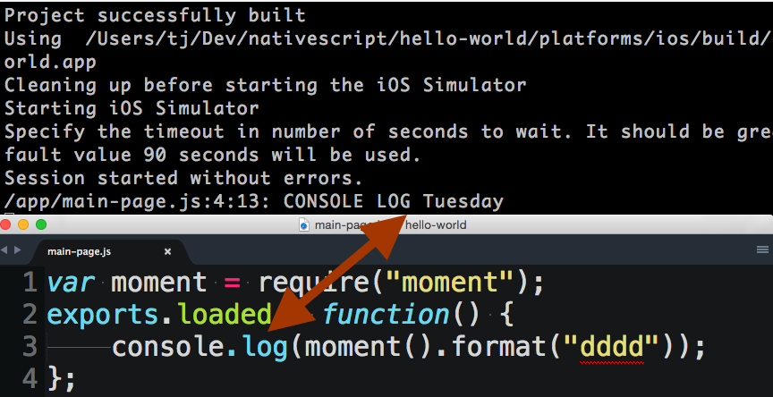

Slide 29
Supported npm modules
Most npm modules will work in {N} apps.
Notable ones that won’t are…
Modules that depend on browser APIs such as the DOM (e.g. jQuery)
Modules that depend on Node.js APIs not present in NativeScript

Slide 30
Today
Accessing native code
Debugging
Using npm modules
NativeScript plugins

Slide 31
NativeScript plugins
{N} plugins are also npm modules.
However, {N} plugins have the added ability to run native code, as well as use native iOS and Android SDKs.

Slide 32
Installing plugins
The following installs the NativeScript flashlight plugin:

Slide 33
Plugins
tns plugin add does the following
Installs the plugin from npm (including saving dependency in your package.json)
Manages Android and iOS configuration files.
Installs any necessary iOS and Android SDKs that the plugin needs.

Slide 34
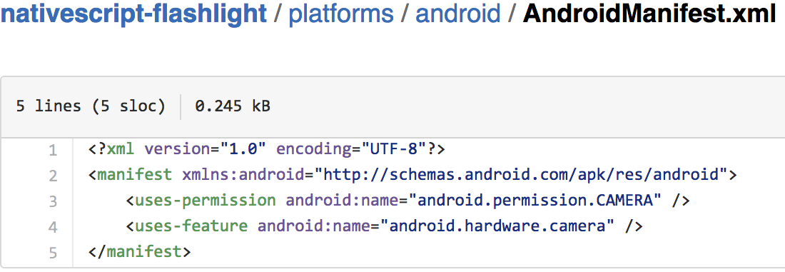
For example, using the camera on Android requires camera permissions, but the plugin install takes care of that.

Slide 35
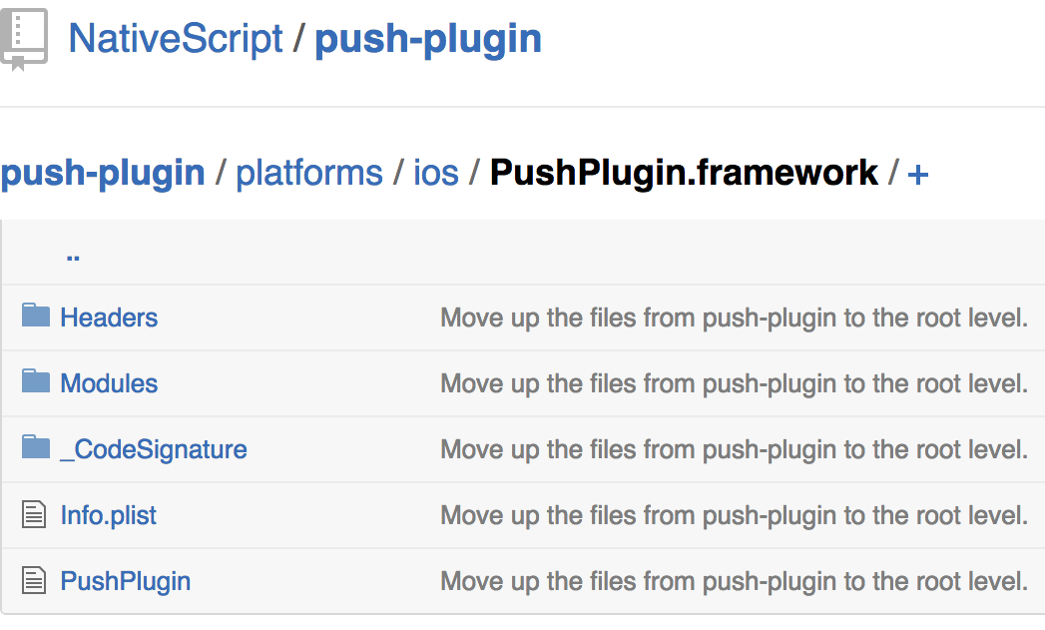
The NativeScript push plugin uses iOS .framework files, but again, the plugin install takes care of that.

Slide 36

After installing, using {N} plugins is just like using an npm module.

Slide 37
Where to find NativeScript plugins?
npm
https://www.npmjs.com/search?q=nativescript

Slide 38
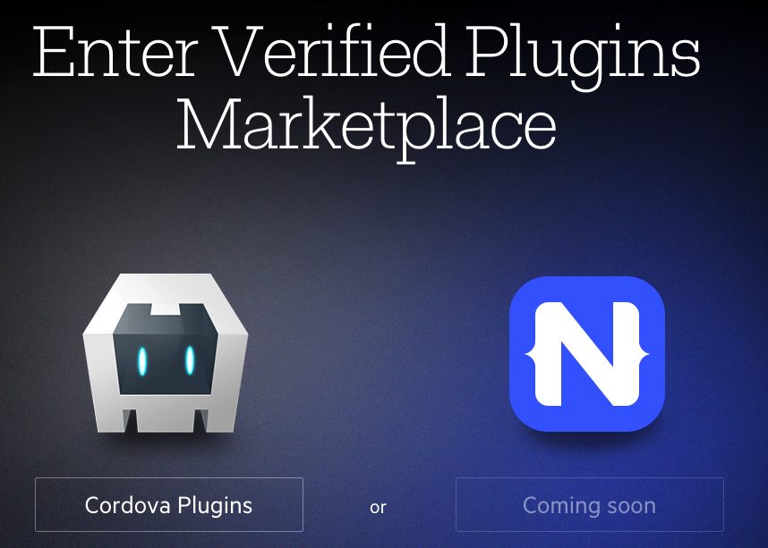
Verified Plugin Marketplace
http://plugins.telerik.com/

Slide 39
Questions?
https://groups.google.com/forum/#!forum/nativescript
https://twitter.com/nativescript

Slide 40
NativeScript.org
Thanks!

