Slide 1
Summer of NativeScript
July 2015

Slide 2


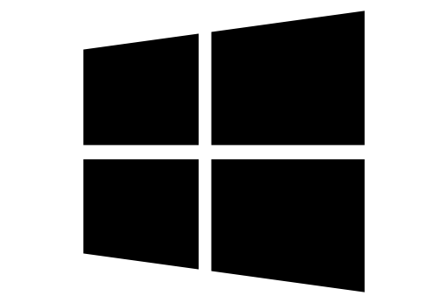
What is NativeScript?
A runtime for building and running native iOS, Android, and (soon) Windows Phone apps with a single, JavaScript code base

Slide 3
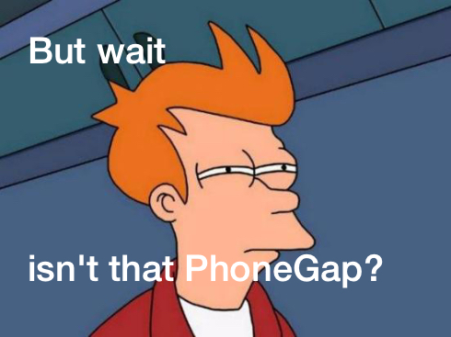

Slide 4
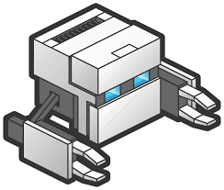
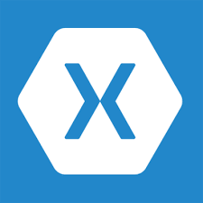


!=
No DOM
!=
No cross compilation
!=
Direct access to native APIs in JS

Slide 5
Why NativeScript?
Skills reuse
Standards-based JavaScript, CSS, optionally TypeScript
Code reuse
npm modules, 3rd-party iOS and Android libraries
Easily use native APIs
No wrappers to access native APIs
Use native UI elements
Open source!

Slide 6
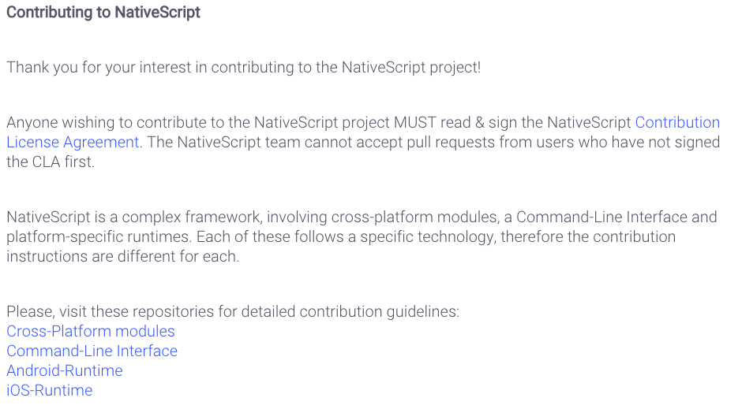
Contribute! (nativescript.org/contribute)

Slide 7





Bridge

Slide 8
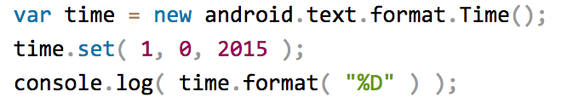

NativeScript Android example
Output:
Notes:
I'll give your brain a minute or two to parse this, because yes, this JavaScript code instantiates a Java android.text.format.Time() object, calls its set() method, then logs the return value of its format() method, which is the string "01/01/15".

Slide 9
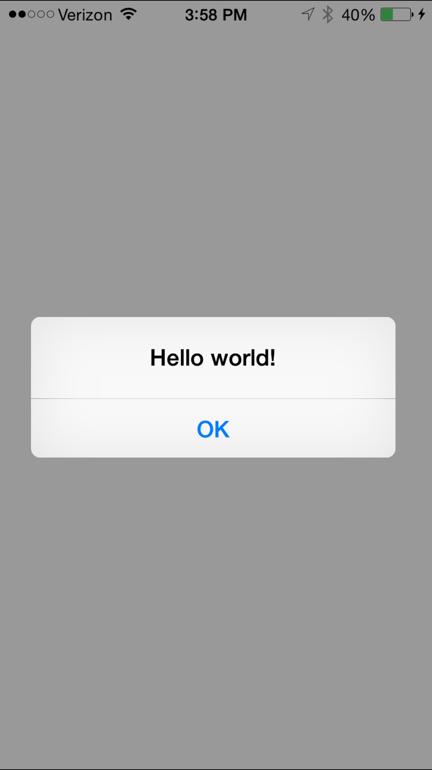
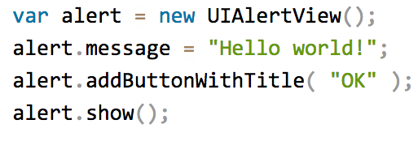
NativeScript iOS example
Notes:
This JavaScript code instantiates an Objective-C UIAlertView class, sets its message property, and then calls its addButtonWithTitle() and show() methods. When you run a NativeScript iOS app with this code you'll see the alert below:

Slide 10
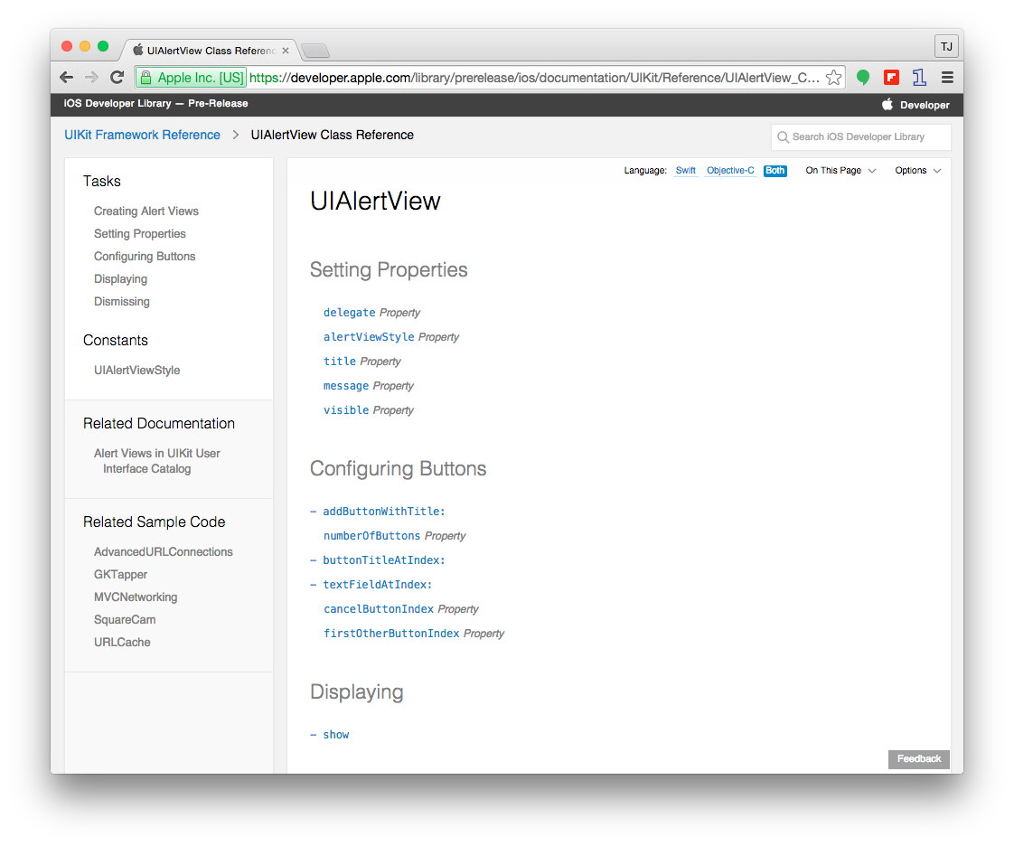

Slide 11

How does this work?

Slide 12
NativeScript and JS VMs
NativeScript runs JavaScript on a JavaScript VM
JavaScriptCore on iOS
V8 on Android

Slide 13
Runs on V8
Runs on JavaScriptCore

Slide 14
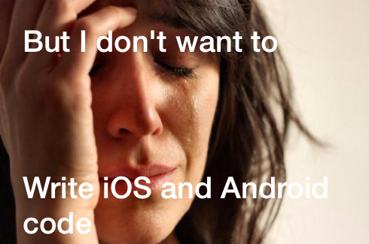

Slide 15
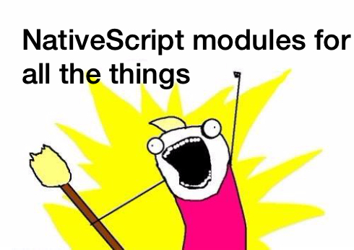

Slide 16
NativeScript modules
NativeScript-provided modules that provide cross-platform functionality.
There are dozens of them and they’re easy to write yourself.
NativeScript modules follow Node module’s conventions (CommonJS).

Slide 17



NativeScript file module

Slide 18
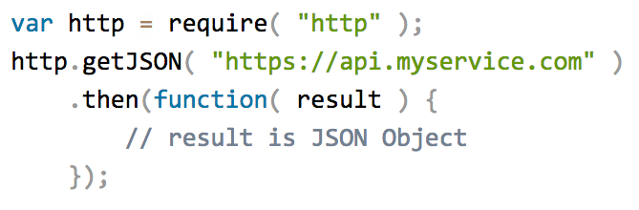
HTTP module example

Slide 19
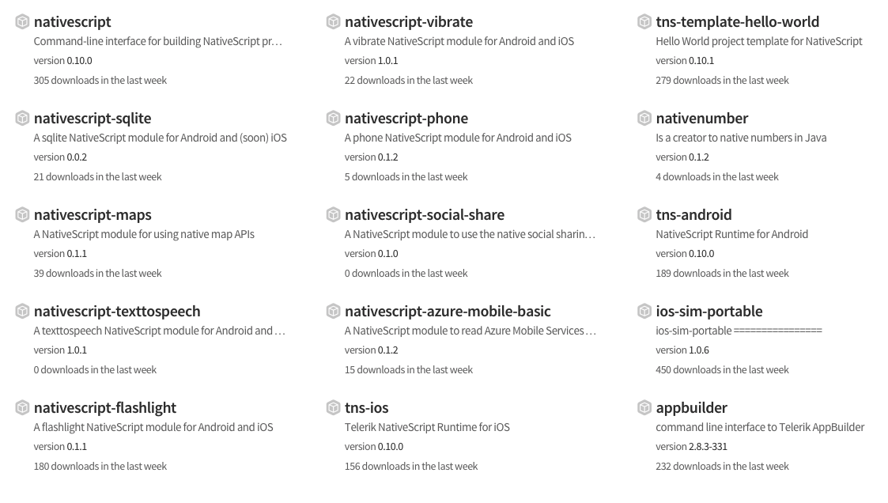
Community modules
https://www.npmjs.com/search?q=nativescript

Slide 20

But how do I turn this into an app?

Slide 21


Two ways to use NativeScript
1)
2)

Slide 22
http://telerik.com/platform
Backend-as-a-service
Push notifications, cloud data, file storage, and more
Analytics
AppBuilder
Cloud builds (build iOS apps on Windows, Windows Phone apps on a Mac)
NativeScript debugging and tooling
Automated app testing
And more!

Slide 23
Telerik AppBuilder IDE Options
In-Browser Client
Visual Studio Extension
Sublime Text Package
Command-Line Interface

Slide 24
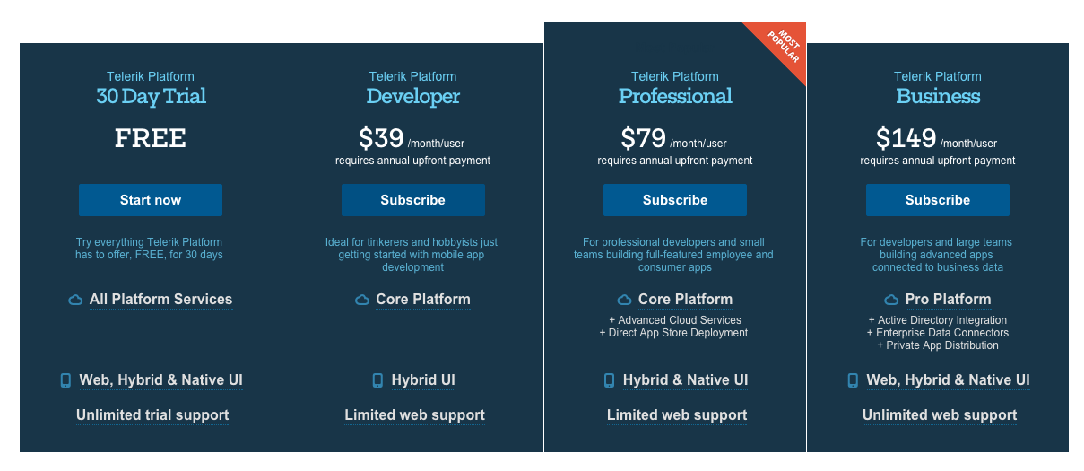
https://www.telerik.com/purchase/platform

Slide 25
NativeScript CLI
Free and open source
https://github.com/nativescript/nativescript-cli

Slide 26
NativeScript CLI requirements
https://github.com/nativescript/nativescript-cli#system-requirements
JDK, Apache Ant, Android SDK
Xcode, Xcode CLI tools, iOS SDK

Slide 27
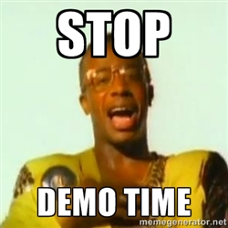

Slide 28
Hands-on Lab

Slide 29
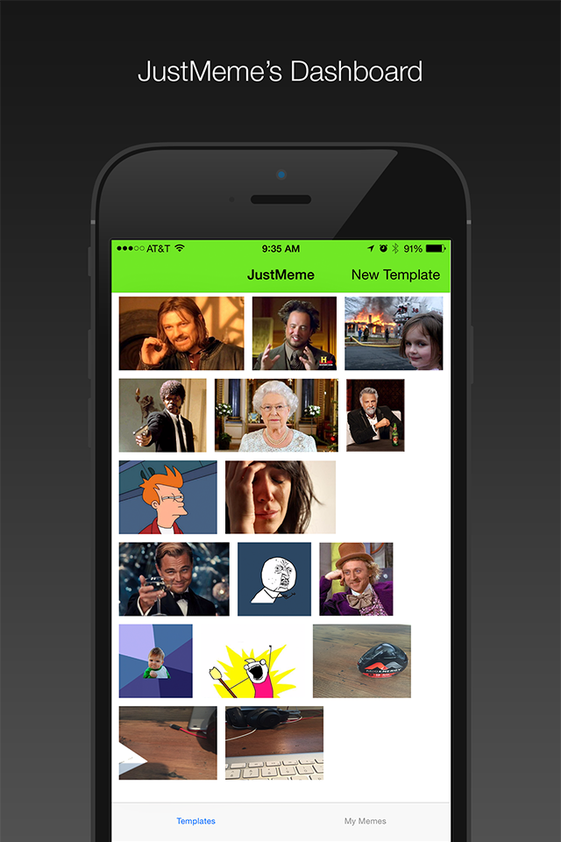

JustMeme

Slide 30
Follow NativeScript
nativescript.org
@nativescript
nativescript.org/blog

