Slide 1
± 15V Linear Power Supply Design
Natnael Teklu | ENES 205 |
Spring 2026 | Howard Community College

Slide 2
Introduction
Objective: Design a ±15V linear DC power supply
Converts standard 120V AC (60 Hz) to regulated DC output
Application: powering sensitive analog and electronic systems
Focus on low ripple, stability, and accuracy

Slide 3
Requirements and Constraints
Convert 120V 60hz to +-15v
Output accuracy +-1%
Supply minimum 250mA
Ripple less than 0.1%
Stable =-0.001% for over an hour

Slide 4
LM317 Voltage Regulator
Resistors
01
04
LM7915 Voltage Regulator
02
Transformer
03
Design Requirements Evaluation
For the positive Rail to provide +15v Regulated output
R1 = 240Ω
R2 = 2700Ω
Provides -15v Regulated output
05
Load Current
I = 15V/60Ω = 250mA
Output voltage
For low electromagnetic noise coupling
06
VO = 1.25(1+2700/240) = 15.3V

Slide 5
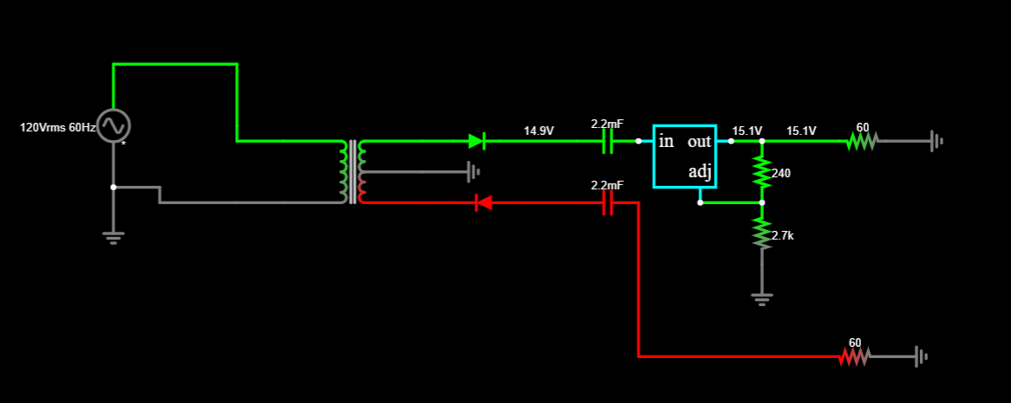
Resistors
AC 120V ↓ Transformer ↓ Rectifier ↓ Filter Capacitors ↓ LM317 / LM7915 ↓ ±15V DC Output
Drawings & Diagrams

Slide 6
Conclusion
The design satisfies all specified requirements using standard, readily available components. The combination of a transformer, full-wave rectifier, filtering stage, and linear regulators ensures a stable, low-ripple ±15V output. This design is suitable for sensitive analog and electronic applications requiring high reliability and precision.

