Slide 1
GoCo Transit
By: Zach Brown & Nathan Gray

Slide 2
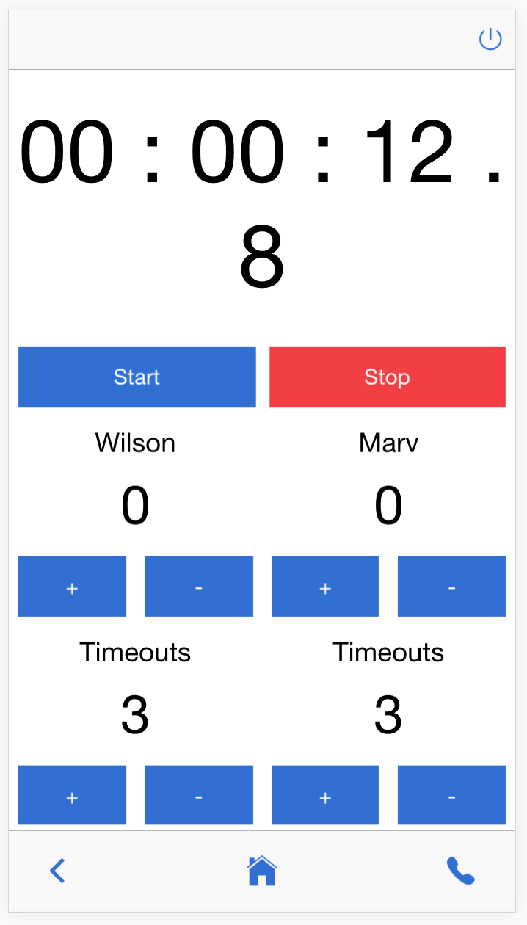
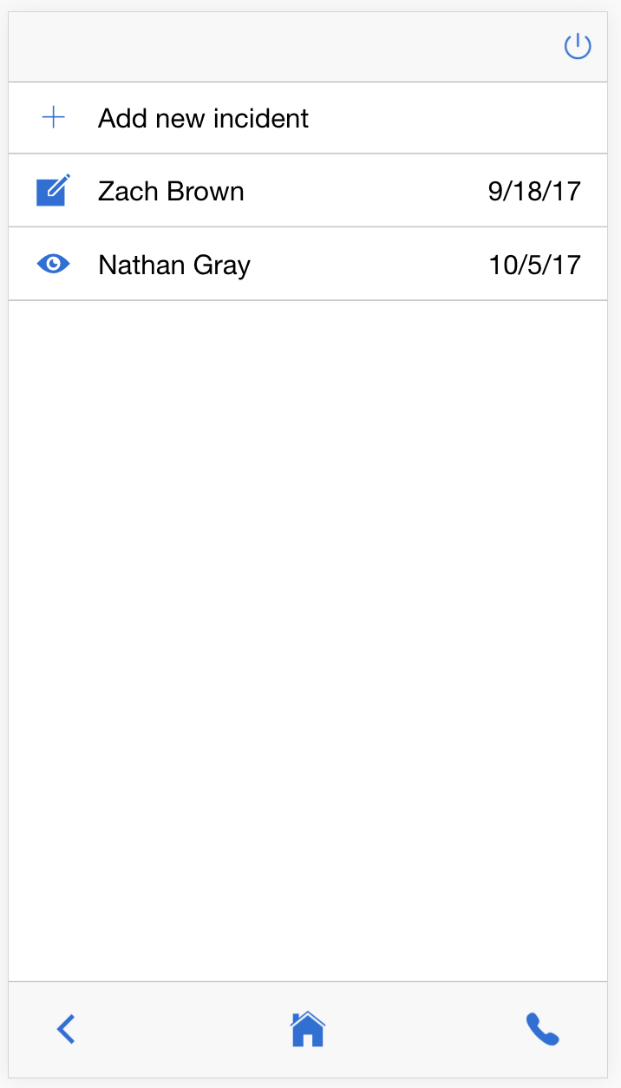
Rec-IM Mobile (Our first project…)

Slide 3
Overview
Problem
Student ride sharing and carpooling is haphazard and disorganized
Solution
Ride sharing web app
Talked with Chris Jones and the Highland Express
Not an Uber service but a carpooling app

