Slide 1

Lending club: case study by Nataraj naikar

Slide 2

Lending club case study – Business Problem
Largest online loan marketplace, facilitating various types of loans
Study the LC provided data repository
Identify the risky loan applicants
Understand the driving factors behind the default loans

Slide 3
Lending club case study – why?
Identify the risky applicants in the early stage of the process
Minimize the credit loss to the company
Provide the method to identify the risky applicants

Slide 4
Lending club case study –EDA to analyze the data set
Cleaned the data – removed not required and redundant columns
Meaningful column names
Analyzed the outliers
Applied EDA to produce graphical output

Slide 5
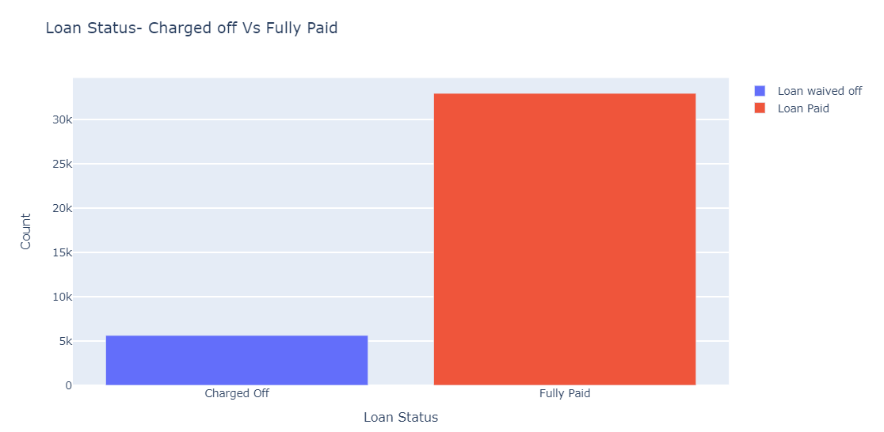
Lending club case study – Over all Loan status
Number of loans: 38578
Number of Fully paid loans
Number of Charged off loans

Slide 6
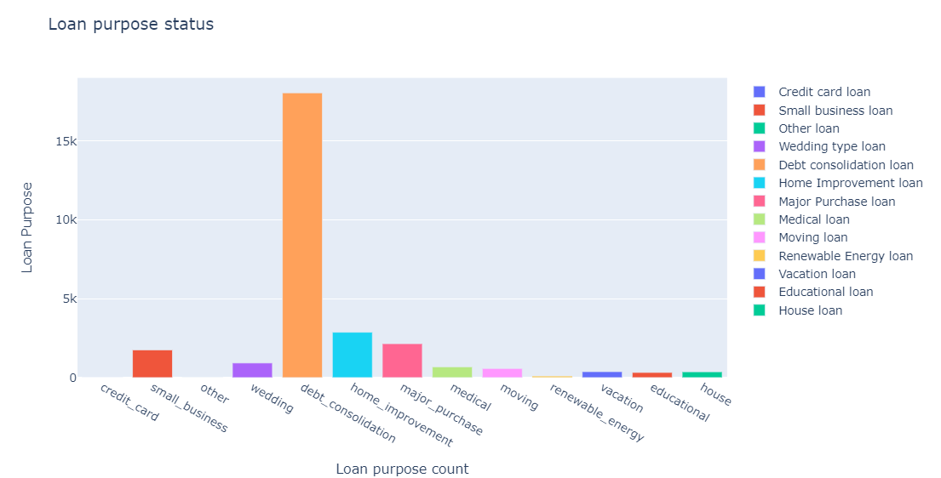
Lending club case study – Barrowers Loan Purpose ranks
Debt Consolidation – 1st rank
Home improvement – 2nd rank
Major purchase – 3rd rank

Slide 7
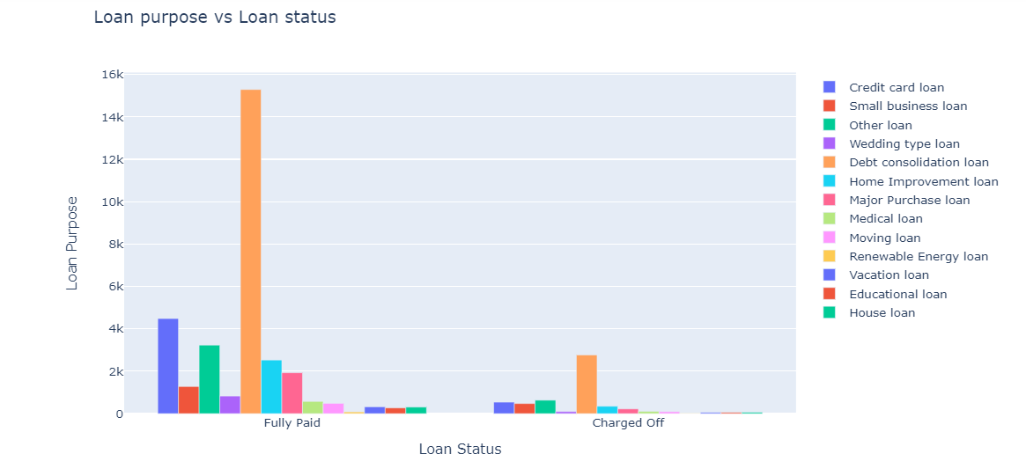
Lending club case study – Purpose and Status
Charged off loans
Debt Consolidation loan – 1st rank
Other loan – 2nd rank
Credit card loan – 3rd rank

Slide 8
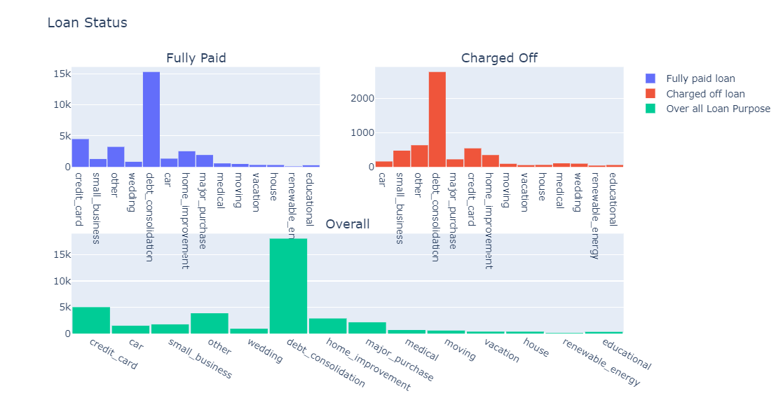
Lending club case study – Purpose and Status-Detail
Charged off loans
Debt Consolidation loan – 1st rank
Other loan – 2nd rank
Credit card loan – 3rd rank

Slide 9
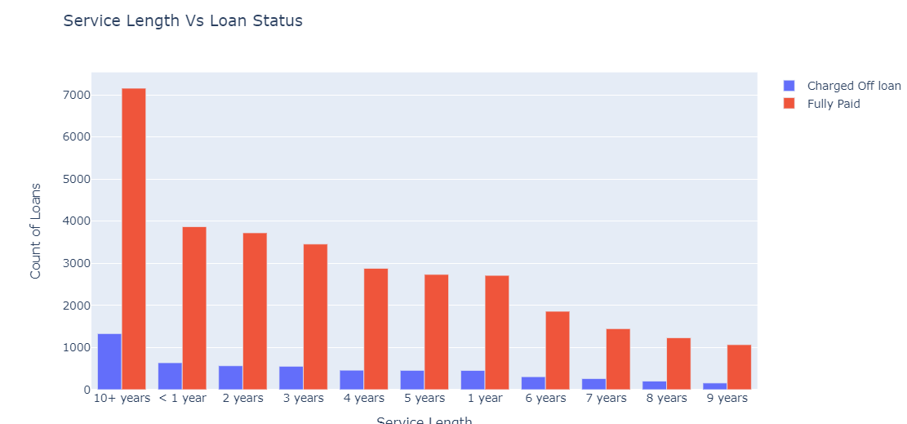
Lending club case study – Service Length and Status
Charged off loans
Contribution from experience:>10 years
Early stage in the carrier: <5 years

Slide 10
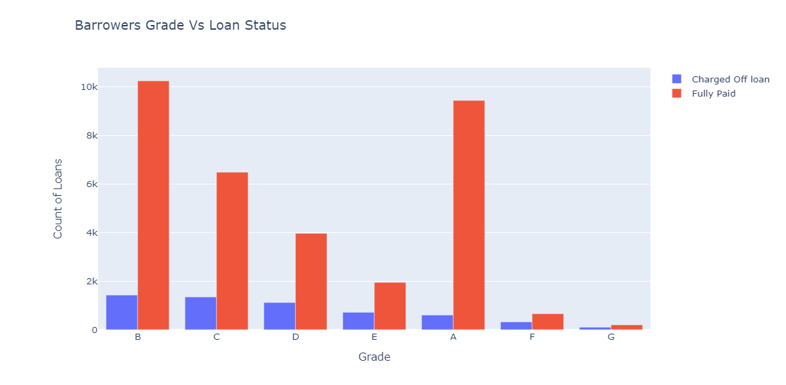
Lending club case study – Grade and Status
Charged off loans
Major contribution from Grade:
B
C
D

Slide 11
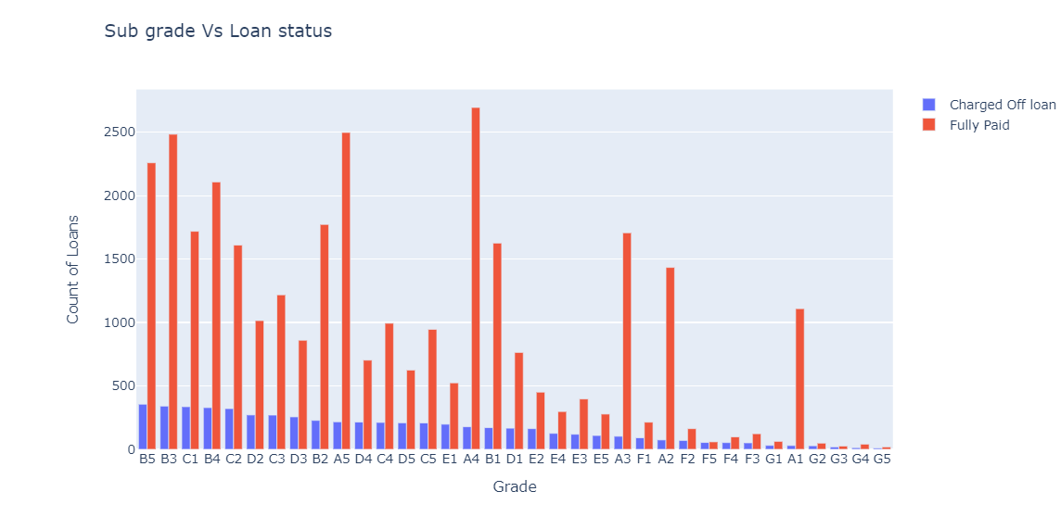
Lending club case study – Sub grade and Status
Charged off loans
Major contribution from Grade:
B-B2,B3,B4,B5
C-C1,C2,C3,C4,C5
D-D2,D3,D4,D5

Slide 12
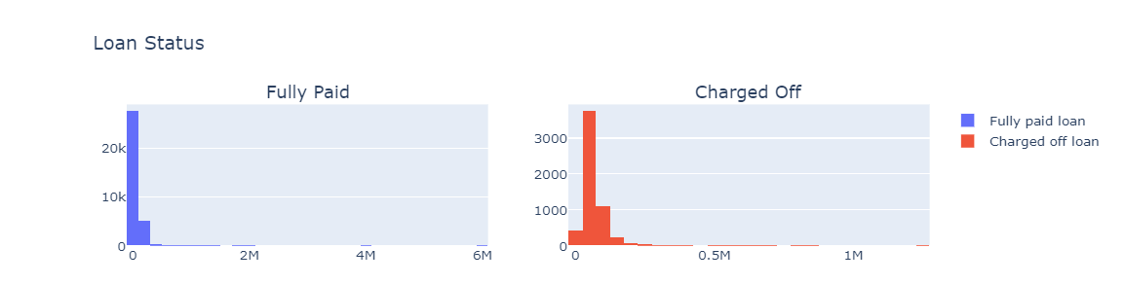
Lending club case study – CTC and Status
Charged off loans-??
Major contribution from Grade:
B-B2,B3,B4,B5
C-C1,C2,C3,C4,C5
D-D2,D3,D4,D5

Slide 13
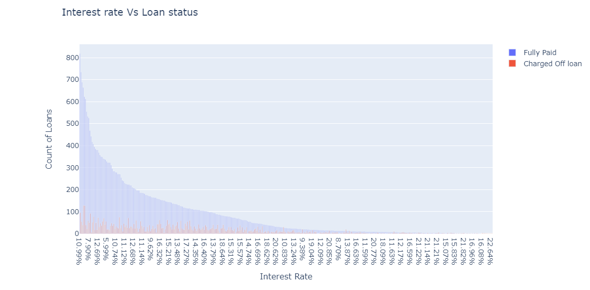
Lending club case study – Interest rate and Status
Charged off loans-??
Major contribution from Grade:
B-B2,B3,B4,B5
C-C1,C2,C3,C4,C5
D-D2,D3,D4,D5

Slide 14
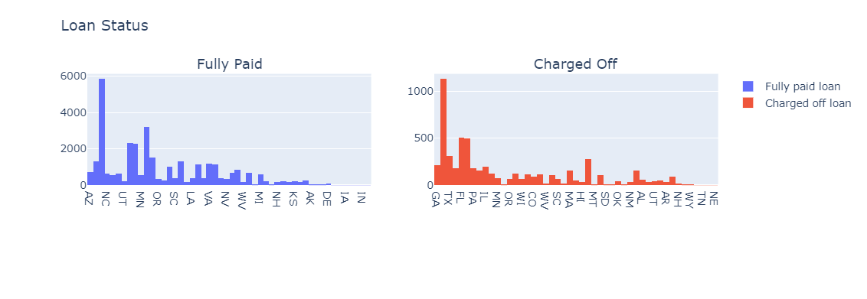
Lending club case study – State and Status
Charged off loans-??
Major contribution from State:
CA - California
FL - Florida
NY- Newyork

Slide 15
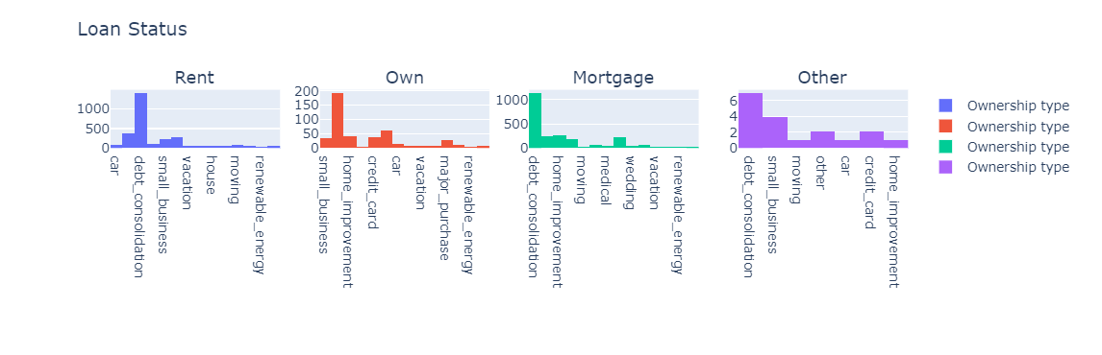
Lending club case study – Ownership type and Status
Charged off loans-??
Ownership type:
Rent
Mortgage
Own

Slide 16
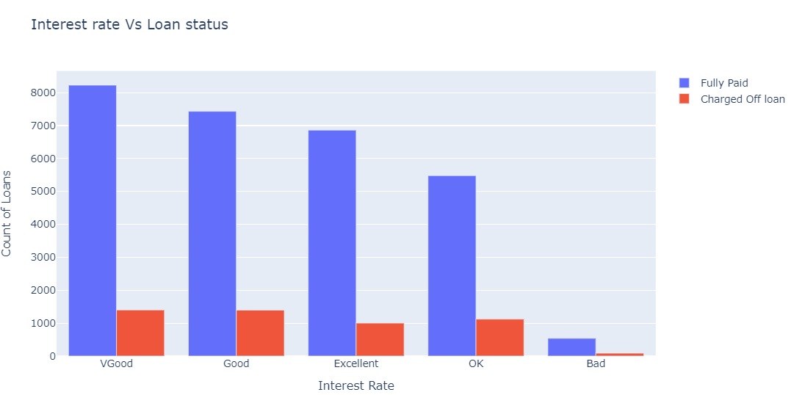
Lending club case study – Monthly payment debt ratio and Status
Charged off loans-??
Debt ration:
VGood
Good
OK

Slide 17
Lending club case study –Recommendation

Slide 18
Lending club case study – Observations and recommendations
Applicants in the good cities are more likely to default the loan
Service range 0-5years and 10+years of experiences applicants are likely to default
Applicant who seeks loan for Debt consolidations, small business, house improvements and for other reasons are likely to default
Applicants who’s monthly debt payment ration in 0-20 are likely default the loan
Application with Grade: B,C and D are likely to default
So above mentioned variables/points to be verified closely before sanction

