Slide 1
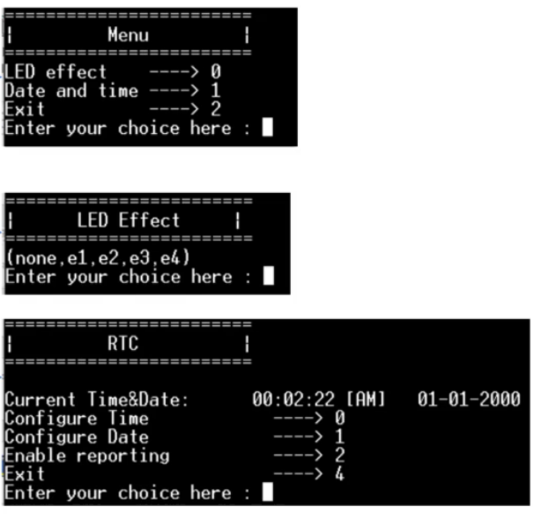
Menu Task
LED Task
RTC Task

Slide 2
Input from serial terminal
Enqueue
Print Queue (size: 10 bytes)
I/O Tasks
UART
Print Task
Serial terminal
Dequeue

Slide 3
UART
ISR
Enqueue
Input Data Queue (size: 10 bytes)
Serial terminal
input
Notification
Dequeue
Notifies the relevant task
Process received message
Command Handling Task

Slide 4
Initially, displays menu and enters BLOCKED STATE Waits for
notification from
Command Handling
Task to unblock
End of menu task – enters BLOCKED STATE
Input from
serial terminal
Menu Task ready
Initially current_state
= state_MainMenu
Command
Handling Task ready
Processes
message
Notifies menu task handler
BLOCKED STATE
Waits for notification from UART ISR to unblock
Case 1 Notify RTC Task
Case 0 Notify LED Task
Case 2
End of LED Task
LED Task ready
current_state =
state_LedEffect
RTC Task ready
current_state =
state_RtcMenu
End of RTC
Task
Exit Application
BLOCKED STATE Waits for notification Menu Task to unblock
BLOCKED STATE Waits for notification Menu Task to unblock
End of Menu Task – enters BLOCKED STATE

