Slide 1
MUST Graduate Application Forum
Group members: Lu Jie, He Xinyi, Cao Yulong, Chen Rui

Slide 2
Contents
01 | Problem Definition and Goal
02 | Market Analysis
03 | Methods
04 | Programming Language, Frameworks and Tools
05 | Process
06 | Project risk management
07 | Project schedule

Slide 3
01 | Problem Definition and Goal
What is MUST Graduate Application Forum
Why do we need to design this website
Our Target

Slide 4
What is MUST Graduate Application Forum
MUST Graduate Application Forum is a website
The target group is MUST students
Provide MUST students with cases of successful applications of previous MUST students
Build the communication between students who want to apply and students who have applied successfully

Slide 5
The Application Status of MUST Students

Slide 6
The Application Status of MUST Students

Slide 7
The Data Obtained by MUST Students
MUST students belong to special overseas undergraduate students
It is difficult to determine whether MUST students belong to 985, 211, or ordinary colleges
Intermediaries and related websites do not have large data about the application of MUST students
The reference value of the data from intermediaries and related website is not high

Slide 8
The Target of MUST Graduate Application Forum
Let MUST students get the application information of seniors
Let MUST students have opportunity to leave messages about their doubts
Seniors will reply these doubts
Let MUST students be more clear about the application matters

Slide 9
02 | Market Analysis
Market Trend
SWOT Analysis

Slide 10
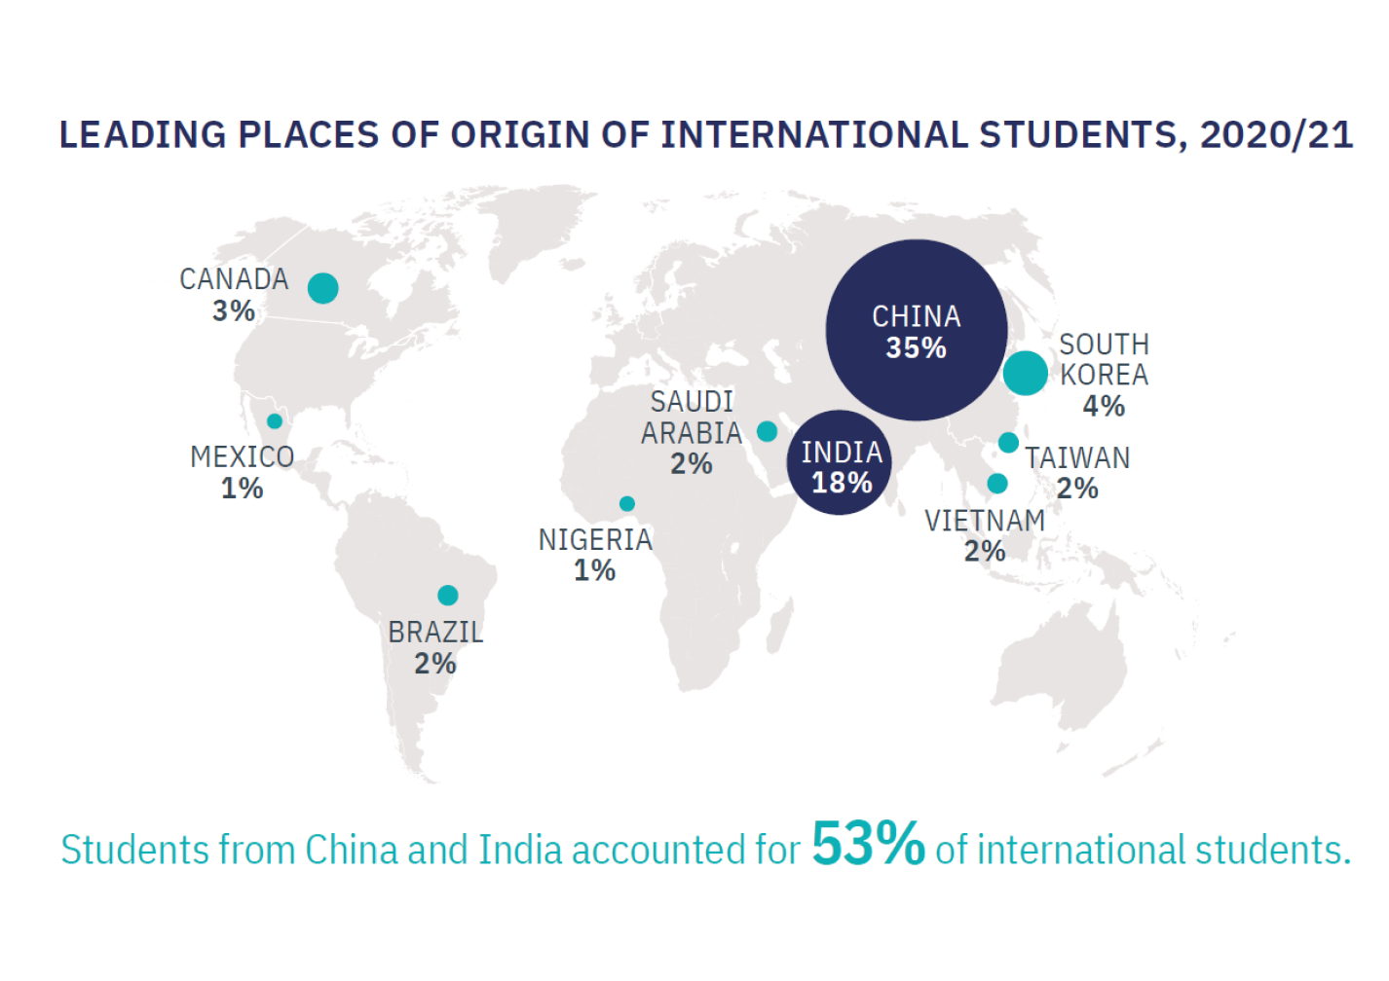
Market Trend
China - Largest source of international students in the world[1]
Maintains an increase in the number of students studying abroad[2]
Notes:
as the largest source of international students in the world, China has always maintained an increase in the number of students studying abroad. According to the Ministry of Education of China, the total number of Chinese students studying abroad in 2019 was 703,500, an increase of 41,400 or 6.25% over 2018, which is far ahead in the world[2].
Pressman, R. S. (1987). Software engineering: A practitioner's approach. New York: McGraw-Hill.

Slide 11

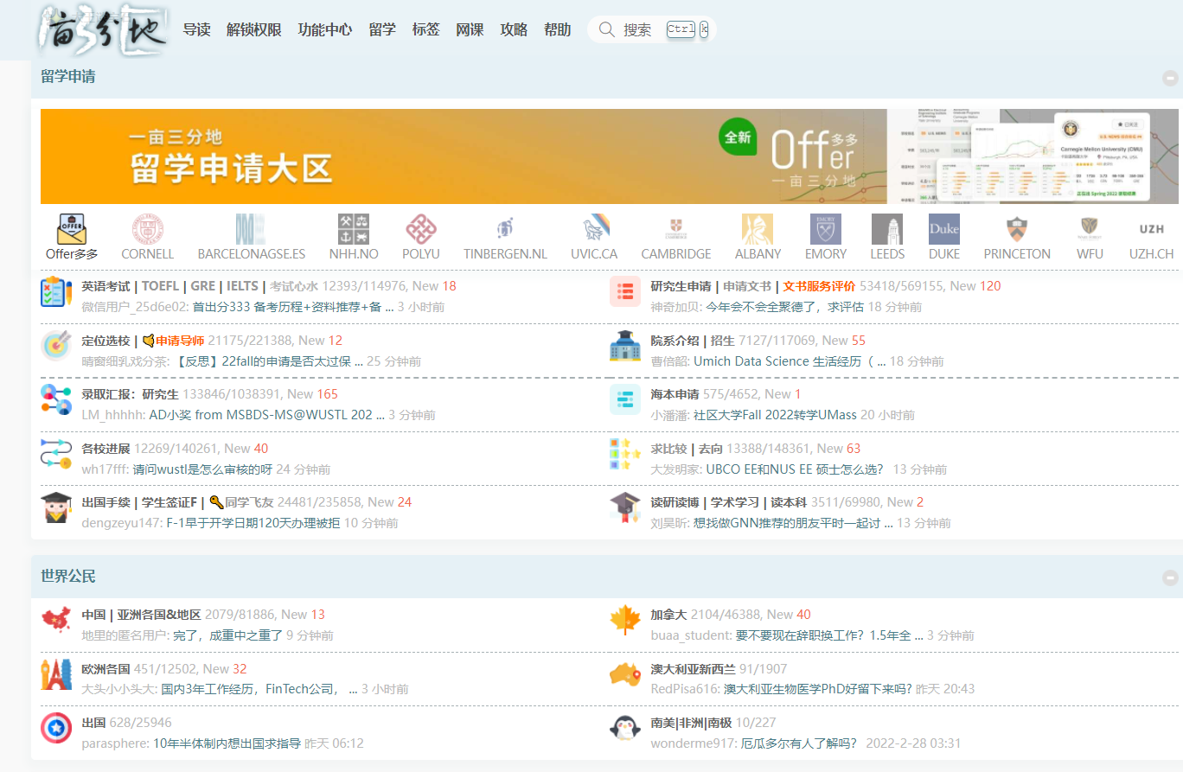
Market Trend
Past: Application consultants or agencies
The portion of DIY applicants increases
DIY applicants account for more than 50% of the market share[3]
More internet platforms with application information:
The GradCafe Forums[4]
1point3acres[5]

Slide 12
SWOT Analysis
Strengths
Weaknesses
Accuracy
Transparency
Nonprofit
Lack of Visibility
S
W
Opportunities
T
Threat
O
Free of Charge
Increasing DIY Applicants
High Demand
Existing Website
Regulatory Impact

Slide 13
03 | Methods

Slide 14
Methods
Two uncoupled modules of frontend and backend code
Transfer data by json
Instantiated with its own database
Exchange data using pre-defined interfaces using json

Slide 15
04 | Programming Language, Frameworks and Tools

Slide 16
Programming Language, Frameworks and Tools
Frontend: HTML5 + CSS + JavaScript and vue.js.
Backend: Python3.7.9 (Flask library as web server)
Database: MySQL
Testing: Unittest library

Slide 17
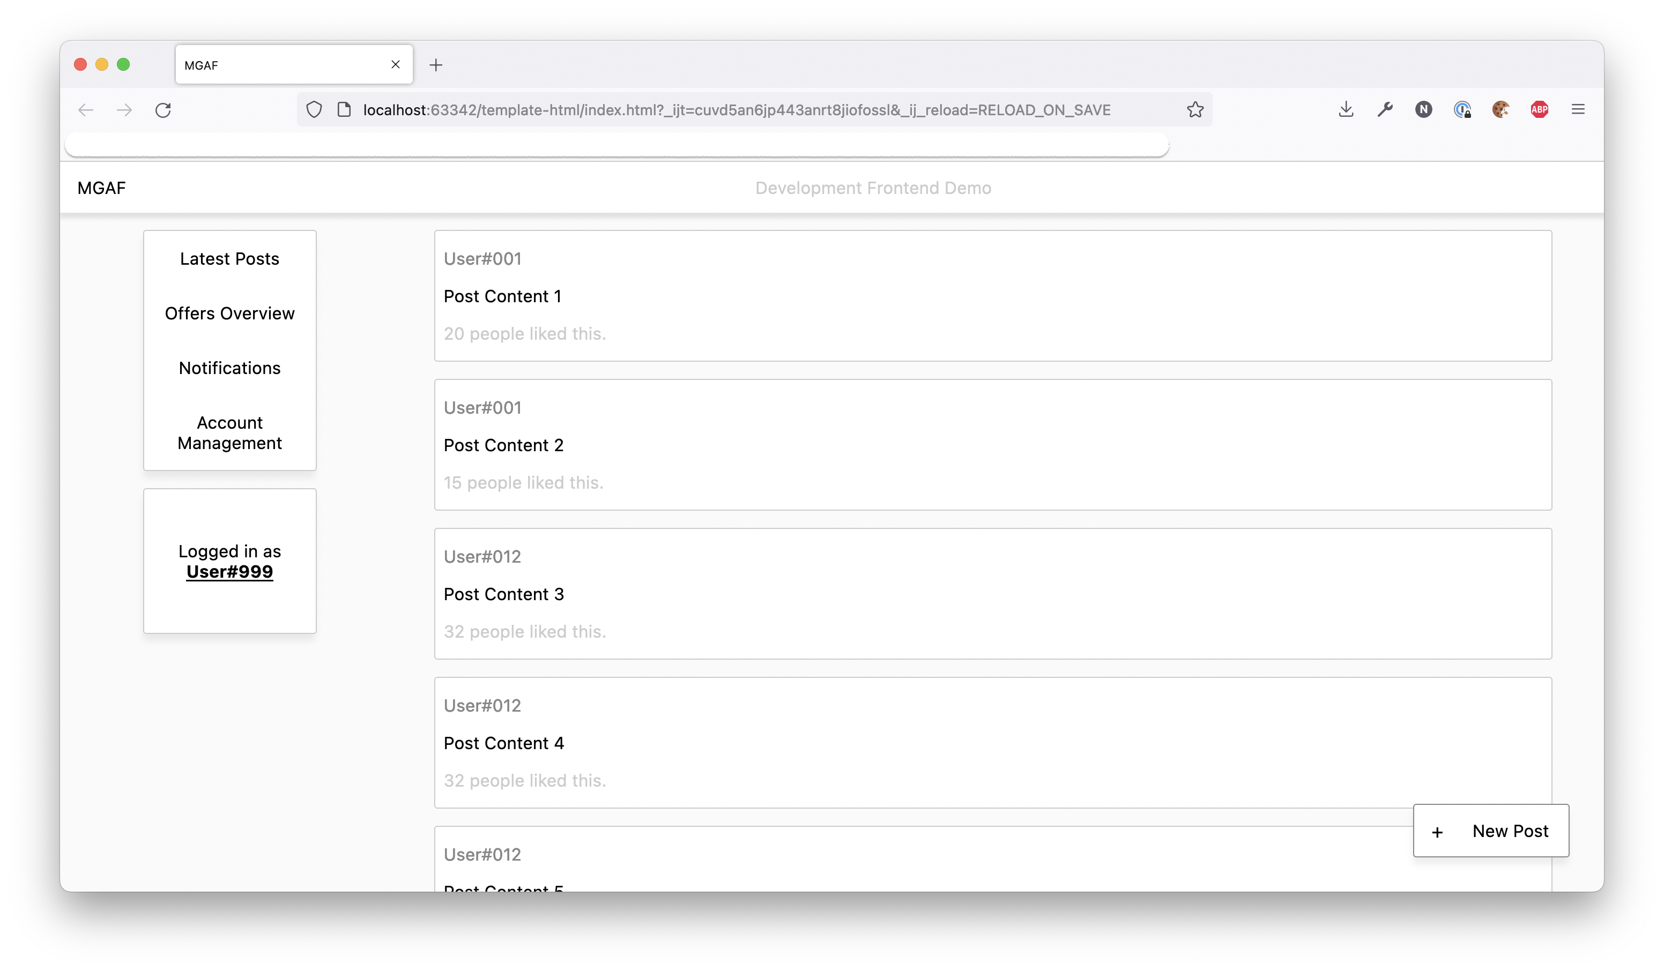
Demonstration of Frontend Interface Design

Slide 18
05 | Function modules

Slide 19
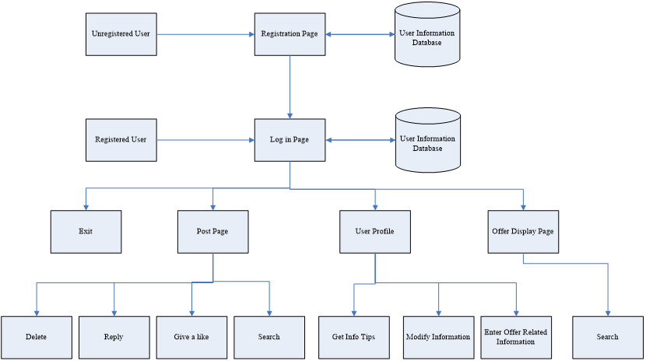
Function modules
Register function module
Login function module
Information sharing function module
User personal home page function module
Offer display function module
System Structure Chart

Slide 20
06 | Problem Definition and Goal
Risk
Risk management plan

Slide 21
Project Risk Management
Risk
Late delivery
Changes in requirements
Lack of Development Experience
Deviation from software engineering standards
The product user scale is different from the actual one
Technology does not meet specifications
Risk Management Plan
Risk Mitigation, Monitoring, and Management (RMMM) plan [6]

Slide 22
07 | Project Schedule
Project schedule table
Gantt chart.

Slide 23
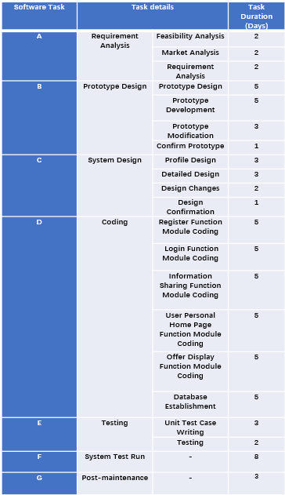
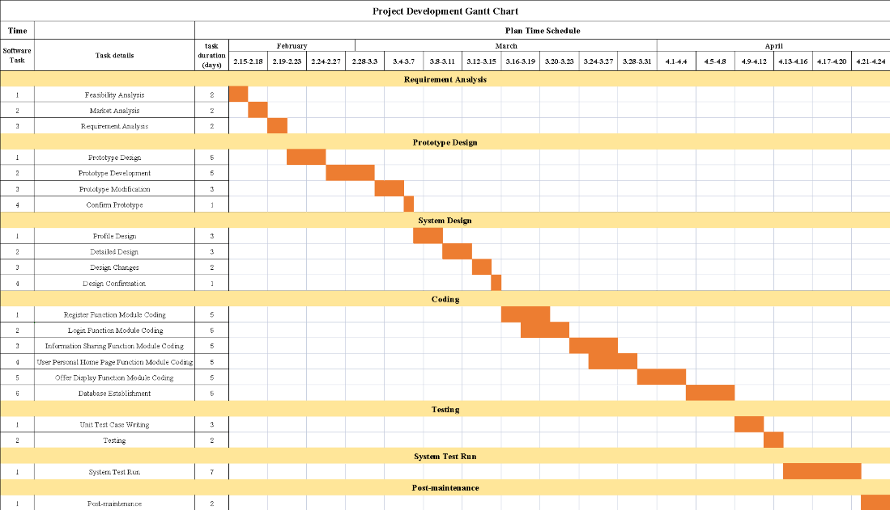
Project Schedule
Gantt Chart
Project Schedule Table

Slide 24
References
Global Flow of Tertiary-Level Students. (2022, February 27). UNESCO Institute of Statistics. http://uis.unesco.org/en/uis-student-flow
Leading Places of Origin of International Students, 2020/21. (n.d.). Institute of International Education, Inc. https://opendoorsdata.org/infographic/leading-places-of origin-of-international-students-2020-21/
Lu, Y. (2014, December 26). Studying Abroad under the Impact of the Internet: DIY Has Become the “New Normal.” People’s Political Consultative Conference Network. https://www.rmzxb.com.cn/zszq/tj/2014/12/26/424158.shtml
(2022, February 27). The GradCafe. https://forum.thegradcafe.com
(2022, February 27). 1point3acres. https://www.1point3acres.com/bbs/
Pressman, R. S. (1987). Software engineering: A practitioner's approach. New York: McGraw-Hill.

Slide 25
Thanks for listening!

