Slide 1
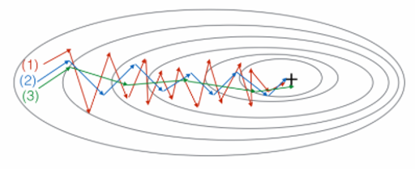
Questions
1. Does mini-batch gradient descent’s performance always lower than full-batch gradient descent?
2. What is exponential weighted average? What is bias correction of exponential weighted average?
3. Why should we decay the learning rate during training epochs?
4. What is “local optima” problem at high-dimensional inputs? What can be done to this problem?
5. Try to write down the Adam’s formulas.
6. These plots were generated with GD, GD with small momentum and GD with large momentum. Which curve corresponds to which algorithm?

Slide 2
Q1
Does mini-batch gradient descent’s performance always lower than full-batch gradient descent?

Slide 3
A1
No.
Full-batch gradient descent may fall into the saddle point or worse local minimal.
Mini-batch gradient descent can jump out these points because each iteration the training samples are different.
If the sample size is very small, the batch gradient descent algorithm is adopted, otherwise the small batch gradient descent algorithm should be used.
If sample comes by online manner, use the stochastic gradient descent algorithm(we have no other choices).

Slide 4
Q2
What is exponential weighted average? What is bias correction of exponential weighted average?

Slide 5
A2
Exponential weighted average use the actual value and the estimated value of the previous period to make a prediction for the next estimated value, which is calculated as:
is bias correction which is used to correct the results in initial phase of training and helps getting better estimation early.

Slide 6
Q3
Why should we decay the learning rate during training epochs?

Slide 7
A3
Setting the size of the learning rate is to find a balance between precision and speed.
If the learning rate is high, the training speed will be improved, but the accuracy of the result is not enough.
If the learning rate is small and the accuracy is improved, the training will consume too much time.
The degraded learning rate is also called the decay of learning rate. When the training starts, the high learning rate is used to accelerate the speed, and the small learning rate is used to improve the accuracy after the training reaches a certain level.

Slide 8
Q4
What is “local optima” problem at high-dimensional inputs? What can be done to this problem?

Slide 9
A4
It is unlikely that there will be in local optimality in a high-dimensional space, because that means the gradient of all dimensions be zero, which is almost impossible.
The real problem of “local optima” is the stagnation region near the saddle point. The saddle point is not the best point, but the standard gradient descent algorithm will cost lots of time to across this point.
Momentum, Adam, RMSprop can be adopted to jump out the “local optima” and speed up training.

Slide 10
Q5
Try to write down the Adam’s formulas.

Slide 11
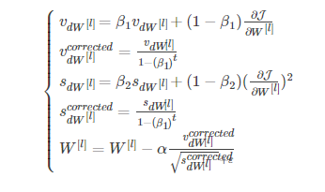
A5
ADAM:
L is the number of layers
β1 and β2 are hyperparameters that control the two exponentially weighted averages. In general,β1=0.9 β2 =0.999
α is the learning rate
ε is a very small number to avoid dividing by zero ,usually set 10^−8

Slide 12
Q6
Consider this figure:
These plots were generated with GD, GD with small momentum and GD with large momentum. Which curve corresponds to which algorithm?

Slide 13
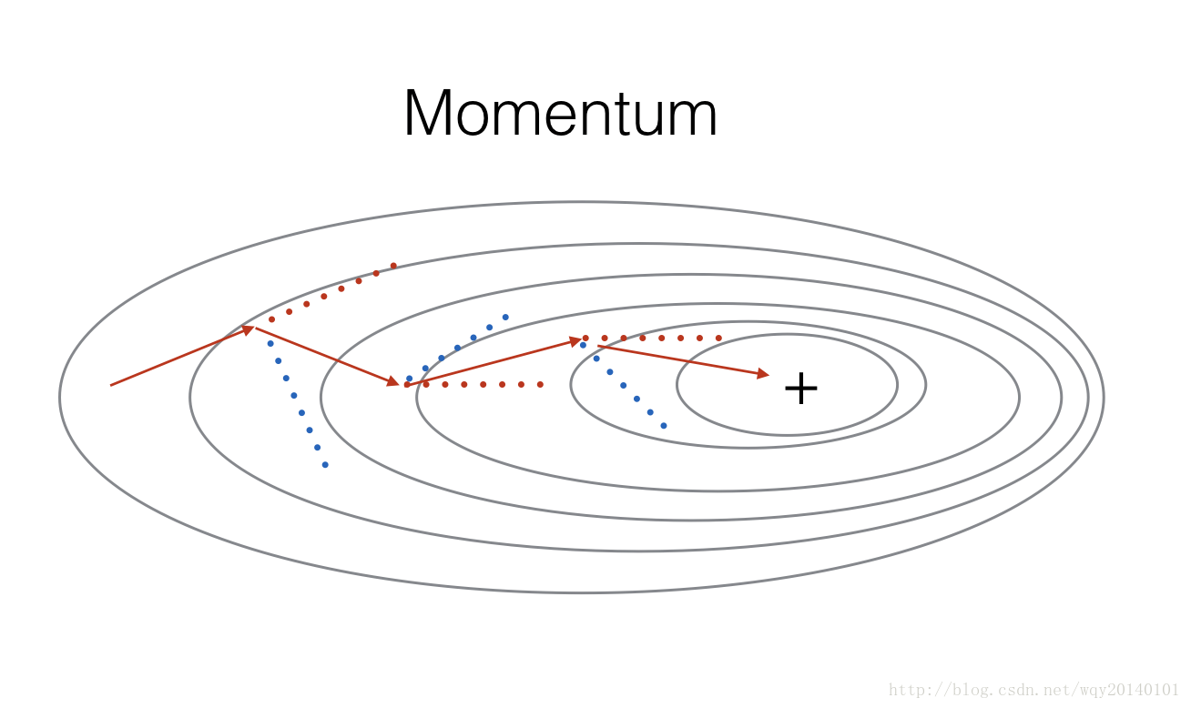
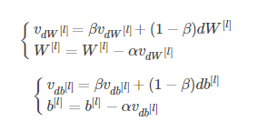
A6
GD with momentum:
(1) is gradient descent.
(2) is gradient descent with small momentum.
(3) is gradient descent with large momentum.

