Slide 1
Experiment Course
would be held in:
Time: 2018-11-24 Sat. 9:00 AM 2:30 PM
Location: B7-238
http://222.201.187.50:7001/homeworks
Experiment 1、2、4 and 5

Slide 2
Questions
1. Why should we use convolutional layer in large images computer vision task?
2. A 97*97 RGB image is feed into a CONVOLUTIONAL layer (3*3 kernel size, 16 filters, padding 1, strike 2), what is the layer’s output dimension? What is the number of the layer’s parameters?
3. Why should we use pooling layer in computer vision task?
4. A 96*96 RGB image is feed into a POLLING layer (2*2 kernel size, stride 2), what is the layer’s output dimension? What is the number of the layer’s parameters?
5. How to compute the gradient of max/average pooling layer?

Slide 3
Q1
Why should we use convolutional layer in large images computer vision task?

Slide 4
A1
If we use fully connect layer in a large images, the number of parameters would be too large and cause time consuming and overfitting.
The convolutional layer avoid these problem by using parameter sharing (Small feature filters are used in all parts of the image) and sparsity of connections (each output value is only depends on small number of inputs).

Slide 5
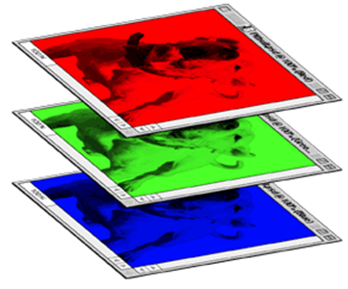
Q2
A 97*97 RGB image is feed into a CONVOLUTIONAL layer (3*3 kernel size, 16 filters, padding 1, strike 2), what is the layer’s output dimension? What is the number of the layer’s parameters?
Conv. Layer
3*3 kernel
16 filters, padding 1, strike 2
output dimension？
Layer’s parameters?

Slide 6
A2
After convolution the length/width of feature maps change to :
(input size+2*padding-kernel size)/stride +1
= (97+2*1-3)/2 + 1 = 49
so the output dimensions are 49*49*16.
Last dimension 16 is depends on filters number.
The number of layer parameters are:
((kernel size^2)*(input channel) + 1)*(filters number)
= (3*3*3+1)*16 = 448

Slide 7
Q3
Why should we use pooling layer in computer vision task?

Slide 8
A3
Pooling layer is used to further reduce parameters and maintain invariance of images (like rotation, translation, expansion). The pooling layer also can reduce the mean shift caused by convolution layers.
There are generally two methods:
Max pooling: take the maximum value in pooled visual field
Average pooling: take the Average of the pooled visual field

Slide 9
Q4
A 96*96 RGB image is feed into a POLLING layer (2*2 kernel size, stride 2, no padding), what is the layer’s output dimension? What is the number of the layer’s parameters?
Polling layer, strike 2
No padding
output dimension？
Layer’s parameters?

Slide 10
A4
After pooling the length/width of feature maps change to :
(input dim +2*padding - kernel size)/stride +1
In this problem, padding = 0 , stride = kernel size = 2
Thus (96-2)/2 +1 = 47, the output dim is 47*47*3.
Last dimension 3 is depends on input channels (RGB=3).
Pooling layer don’t have trainable parameters.

Slide 11
Q5
How to compute the back propagation of max/average pooling layer?

Slide 12
A5
For max pooling, the position of the maximum value in the input data is recorded in forward propagation and transmit the gradient value to the corresponding position of the maximum value in back propagation.
For average pooling, we don’t need to save the position like max pooling. The gradient value would evenly transmit to all position in back propagation.

