Slide 1
Questions
1. What’s the different between object classification, object localization and object detection?
2. In object detection task , how to define the target label y as a supervised learning task?
2-2:While we define the target label y as a supervised learning task, what does output the bounding box’s bx, by, bh and bw stand for?
3. What’s the Intersection Over Union(IoU) function?
4. Since some sliding windows (bounding boxes) may point out a same object because sliding stride is small, how to make sure the algorithm detects each object only once?
4-2. Try to write down a pseudo code to implement NMS algorithm.
5. Why should we use anchor boxes in object detection task?
6. YOLO algorithm is faster than Faster-RCNN algorithm but lower performance. Why?

Slide 2
Q1
What’s the different between object classification, object localization and object detection?

Slide 3
A1
Classification aims to find which the object showed in the image it is, while localization must further use a rectangle to point the object location. We use b_{x} , b_{y} , b_{h} and b_{w} to localize bounding box in video.
Object detection is a more challenging tasks where the image contains multiple objects and needed to be found simultaneously.

Slide 4
Q2
In object detection task , how to construct the target label y as a supervised learning task?

Slide 5
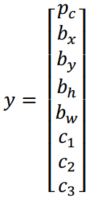
A2
p_{c} standing for the probability that there's an object.
For example, These are our four classes. So, if the object is, classes 1, 2 or 3, pc will be equal to 1. And if it's the background class or none of the objects you're trying to detect, then pc will be 0.
Next if there is an object, then you wanted to output the bounding box for the object you detected , there are b_{x}, b_{y}, b_{h} and b_{w}.
Finally if there is an object, so if pc is equal to 1, you wanted to also output c1, c2 and c3 which tells us is it the class 1, class 2 or class 3.

Slide 6
Q2-2
While we define the target label y as a supervised learning task, what does output the bounding box’s b_{x}, b_{y}, b_{h} and b_{w} stand for?

Slide 7
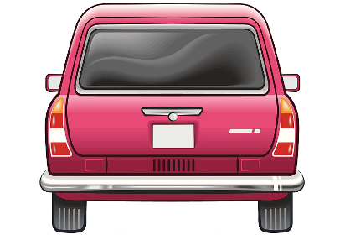



A2-2
First, set that the upper-left coordinate of the image is (0,0) and the lower-right coordinate is (1,1).
(0,0)
$$b_{w}$$
$$b_{h}$$
($b_{x},b_{y}$)
(1,1)
To determine the location of the bounding box, specify the center point of the red box, which is (bx,by), the height of the bounding box bh, and the width bw.

Slide 8
Q3
What’s the Intersection Over Union(IoU) function?

Slide 9
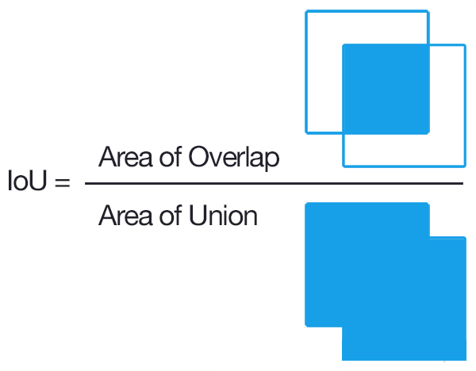
A3
Intersection-over-Union (IoU), a concept used in target detection, is the Intersection rate of candidate bound and ground truth bound——the ratio of their Intersection to Union set.
Usually if IoU score > 0.5 , that would be considered a good result.

Slide 10
Q4
Since some sliding windows (bounding boxes) may point out a same object because sliding stride is small, how to make sure the algorithm detects each object only once?

Slide 11
A4
Non-max suppression algorithm is used to choose the best bounding box of each object.
Firstly it choose the highest probability bounding box for an object, then it suppressed bounding boxes which have high IoU score with the chosen box.
The algorithm would repeat several times until all bounding boxes are chosen or suppressed.

Slide 12
Q4-2
Try to write down a pseudo code to implement NMS algorithm.

Slide 13
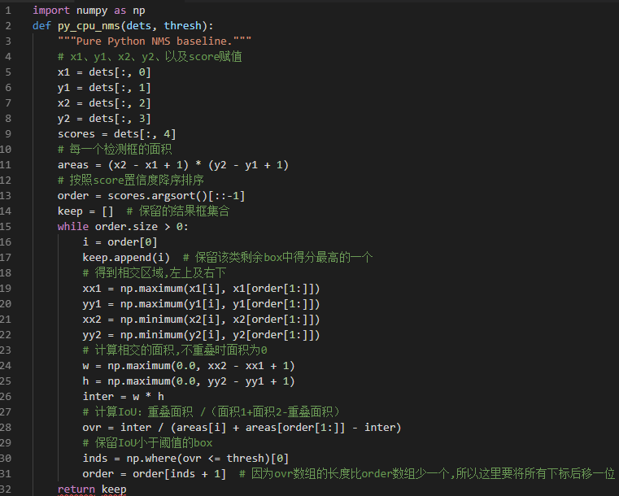
A4-2
Python implement

Slide 14
Q5
Why should we use anchor boxes in object detection task?

Slide 15
A5
Anchor boxes algorithm can avoid the problem that each grid cell can only detect one object.
Using anchor boxes, each object in training image is assigned to grid cell that contains object’s midpoint and anchor box for the grid cell with highest IoU. Thus each grid cell can detect multiple (number of anchor boxes) objects.
Anchor boxes also help achieve better result by specializing some outputs to special object. Such as person(tall and narrow object) and car(short and wide object).

Slide 16
Q6
YOLO algorithm is faster than Faster-RCNN algorithm but lower performance. Why?

Slide 17
A6
YOLO makes predictions based on global information about the image.
Compared with Faster-RCNN, YOLO can reduce the error rate of false detection (the detection of background as an object) by more than half , but it’s performance like poor positional accuracy , poor detection of small objects and dense objects.
Faster-RCNN is a two steps method, where it firstly propose some regions that have an object with high probability and then classify it.
It reduce the class imbalance problem (the number of windows with not object is much larger than the number of windows with object.) but leads to higher computation cost.

