Slide 1
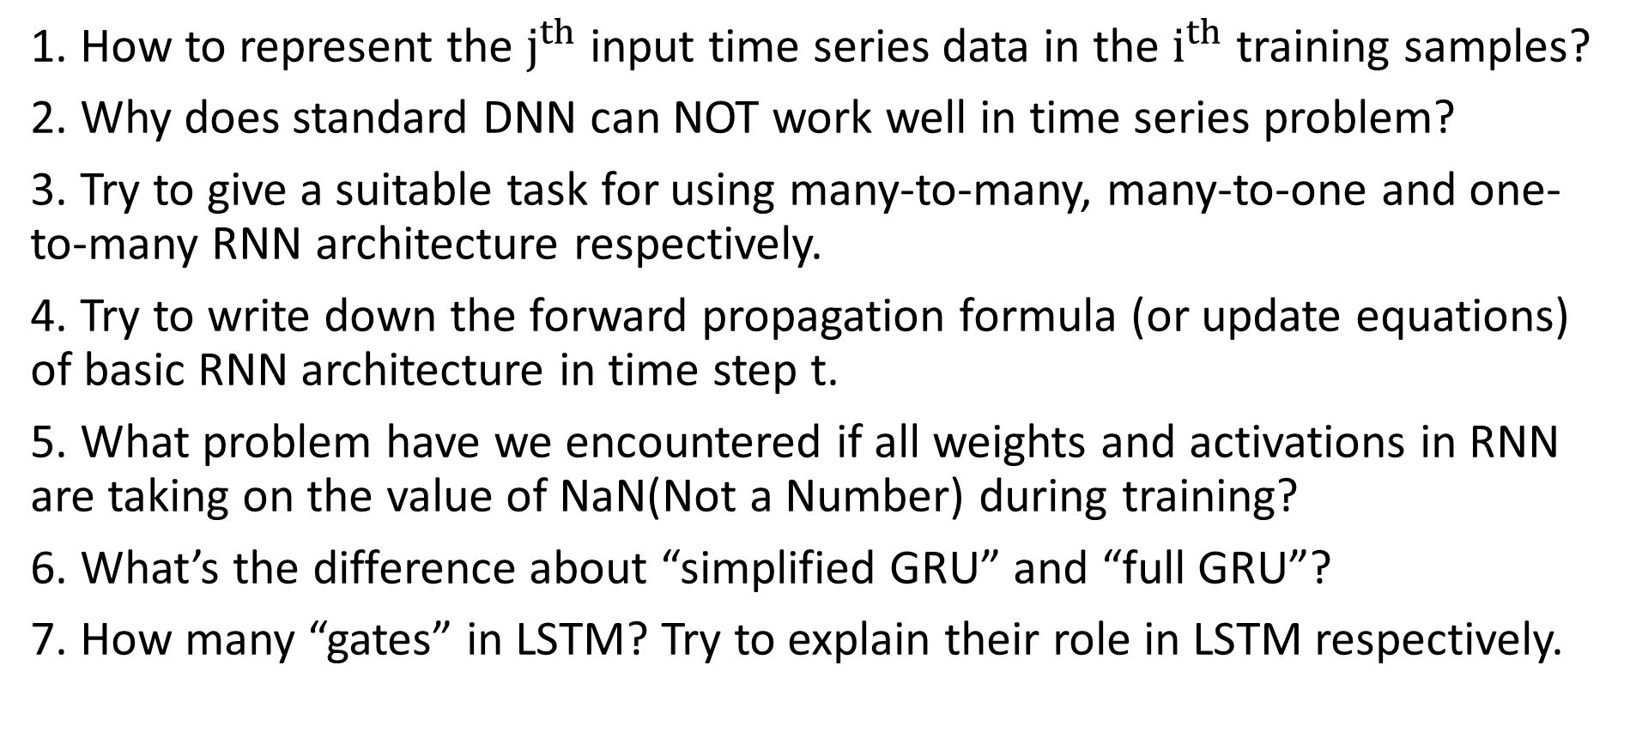
Questions
1. How to represent the $j^{th}$ input time series data in the $i^{th}$ training samples?
2. Why does standard DNN can NOT work well in time series problem?
3. Try to give a suitable task for using many-to-many, many-to-one and one-to-many RNN architecture respectively.
4. Try to write down the forward propagation formula (or update equations) of basic RNN architecture in time step t.
5. What problem have we encountered if all weights and activations in RNN are taking on the value of NaN(Not a Number) during training?
6. What’s the difference about “simplified GRU” and “full GRU”?
7. How many “gates” in LSTM? Try to explain their role in LSTM respectively.

Slide 2

Q1
Assume that the training examples are sentences of words.
How to represent the $j^{th}$ input word of the $i^{th}$ training sequence?

Slide 3

A1
$x^{\left(i\right)<j>}$
We index into the $i^{th}$ row first to get the $i^{th}$ training example (represented by parentheses) , then the $j^{th}$ column to get the word (represented by the brackets)

Slide 4
Q2
Why does standard DNN can NOT work well in time series problem?

Slide 5
A2
Different from general tasks, sequence problem’s inputs and outputs can be different lengths in different examples, for example language translation, each sequence may have different number of words.
The same word in different positions of sequence may express the same meaning, but a standard DNN can NOT learns that because it does NOT share features learned across different positions of sequence.
If each word in sequence is presented as a one-hot vector, using whole sequence as the DNN’s input would also lead to huge number of parameters.

Slide 6
Q3
Try to give a suitable task for using many-to-many, many-to-one and one-to-many RNN architecture respectively.

Slide 7
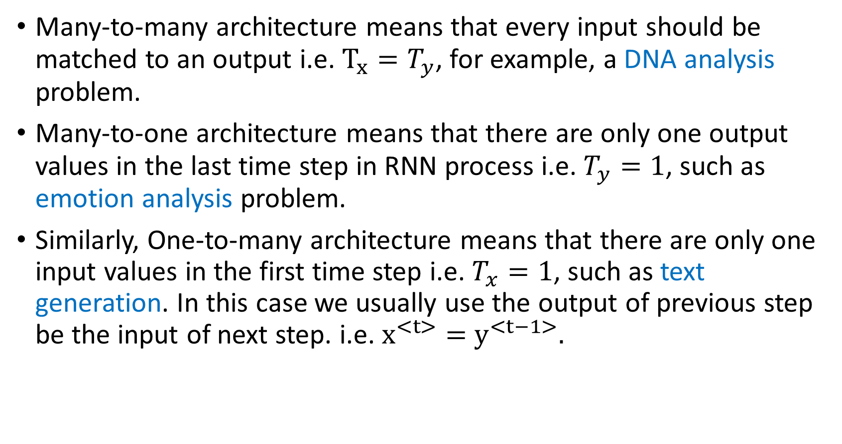
A3
Many-to-many architecture means that every input should be matched to an output i.e. $T_{x}=T_{y}$, for example, a DNA analysis problem.
Many-to-one architecture means that there are only one output values in the last time step in RNN process i.e. $T_{y}=1$, such as emotion analysis problem.
Similarly, One-to-many architecture means that there are only one input values in the first time step i.e. $T_{x}=1$, such as text generation. In this case we usually use the output of previous step be the input of next step. i.e. $x^{<t>}=$ $y^{<t−1>}.$

Slide 8
Q4
Try to write down the forward propagation formula (or update equations) of basic RNN architecture in time step t.

Slide 9
A4
At time step t, the RNN receive inputs and hidden layer output from previous step , and calculate the outputs and
RNN

Slide 10
Q5
What problem have we encountered if all weights and activations in RNN are taking on the value of NaN(Not a Number) during training?

Slide 11
A5
It’s a gradient explosion problem.
Because of the long-term dependence of back propagation, The gradient will be expressed as the product of multiple weights and the derivative of activation functions. In extreme cases, the value of the weight becomes so large that the result overflows (NaN value).
If the sample sequence is very long, it is easy to encounter the gradient explosion(or gradient vanish) problem in a standard RNN. As a solution, GRU and LSTM can solves this problem through the “Gate mechanism”.

Slide 12
Q6
What’s the difference about “simplified GRU” and “full GRU”?

Slide 13
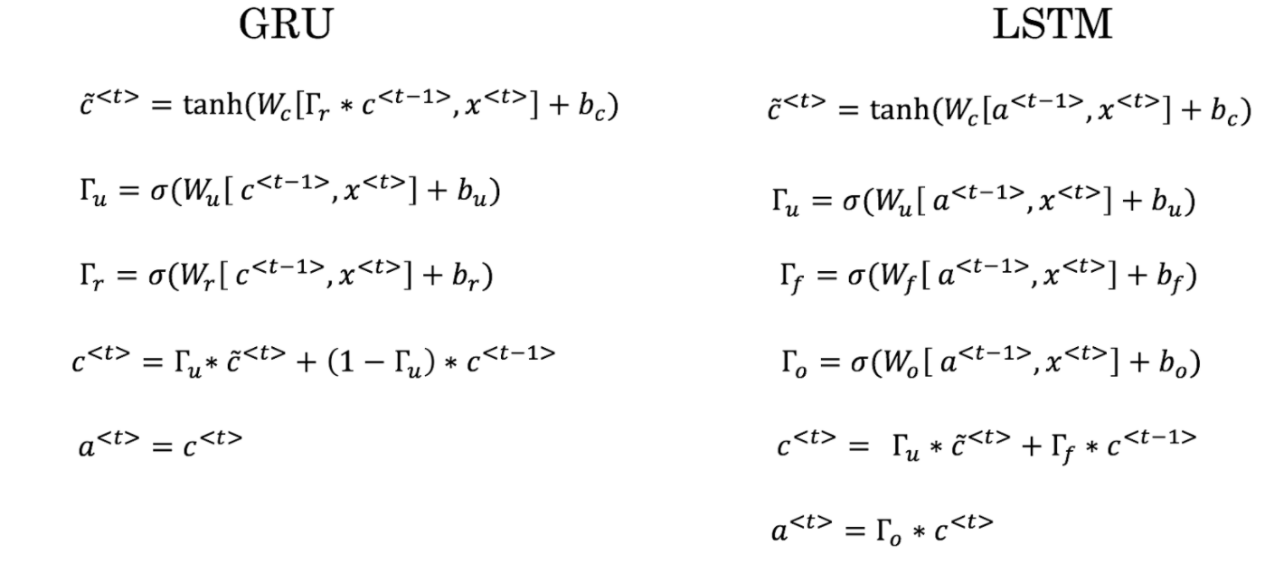
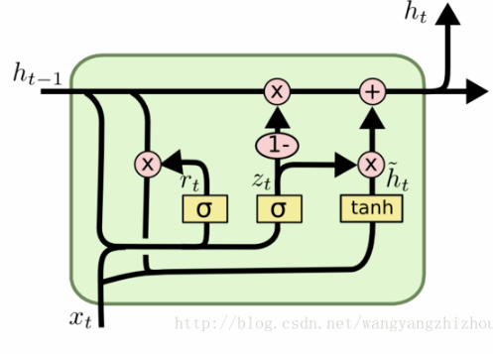
A6
Here is the update equations for “full GRU”.
For “Simplified GRU”, Andrew remove the Γr term(and set Γr = 1 to calculate ).
Γr can be seen as a “relevance gate”, which determines how much information was forgotten in the past hidden layer outputs.
It helps capture short-term dependencies in time series data.

Slide 14
Q7
How many “gates” in LSTM? Try to explain their role in LSTM respectively.

Slide 15
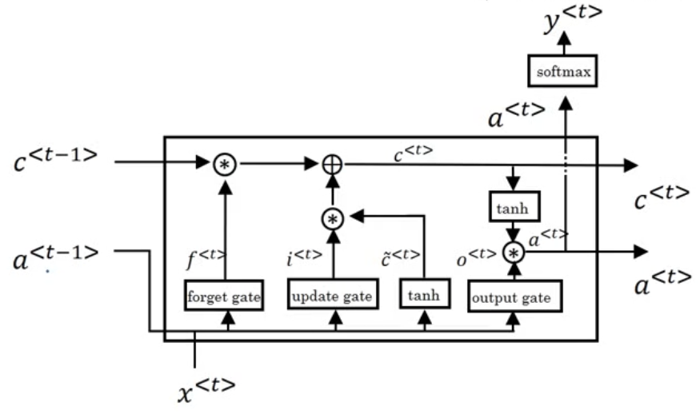
A7
Here is the update equations for LSTM. There are three “gates” in LSTM.
“Forget gate” Γf determines how much information was forgotten in the past hidden layer outputs.
“Update gate” Γu controls the degree of update of the hidden state .
“Output gate” Γo determines what hidden layer value to output.
and should both be output at a time step.

