Slide 1
Examination
9 Jan, 2019 19:00 – 21:00
A1 307，A1 308
You can only take one piece of A4 paper.
You can write anything you want on this A4 paper, and bring it into the examination classroom.

Slide 2
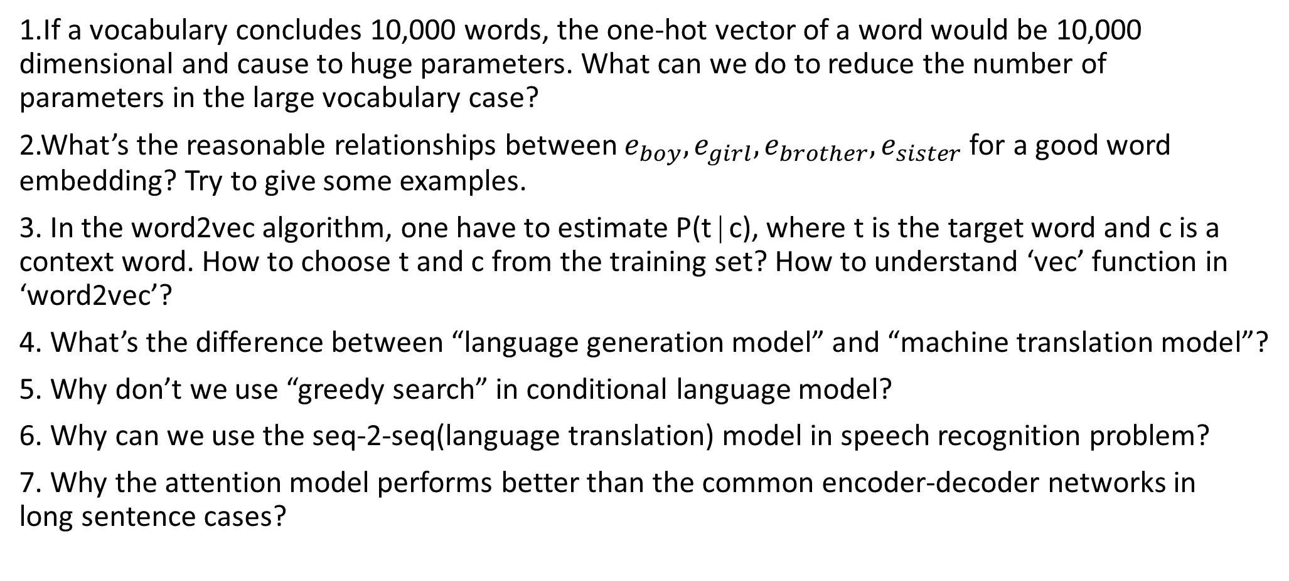
Questions
1.If a vocabulary concludes 10,000 words, the one-hot vector of a word would be 10,000 dimensional and cause to huge parameters. What can we do to reduce the number of parameters in the large vocabulary case?
2.What’s the reasonable relationships between $e_{boy},e_{girl},e_{brother},e_{sister}$ for a good word embedding? Try to give some examples.
3. In the word2vec algorithm, one have to estimate P(t∣c), where t is the target word and c is a context word. How to choose t and c from the training set? How to understand ‘vec’ function in ‘word2vec’?
4. What’s the difference between “language generation model” and “machine translation model”?
5. Why don’t we use “greedy search” in conditional language model?
6. Why can we use the seq-2-seq(language translation) model in speech recognition problem?
7. Why the attention model performs better than the common encoder-decoder networks in long sentence cases?

Slide 3
Q1
If a vocabulary concludes 10,000 words, the one-hot vector of a word would be 10,000 dimensional and cause to huge parameters. What can we do to reduce the number of parameters in the large vocabulary case?

Slide 4
A1
We can use word embedding.
By using word embedding, the dimension of word vectors would be much smaller than the size of the vocabulary. Most of the common sizes for word vectors are ranges between 50 to 400.
Word embedding can also capture the relationship between two word and the semantic information.

Slide 5

Q2
What’s the reasonable relationships between $e_{boy},e_{girl},e_{brother},e_{sister}$ for a good word embedding? Try to give some examples.

Slide 6
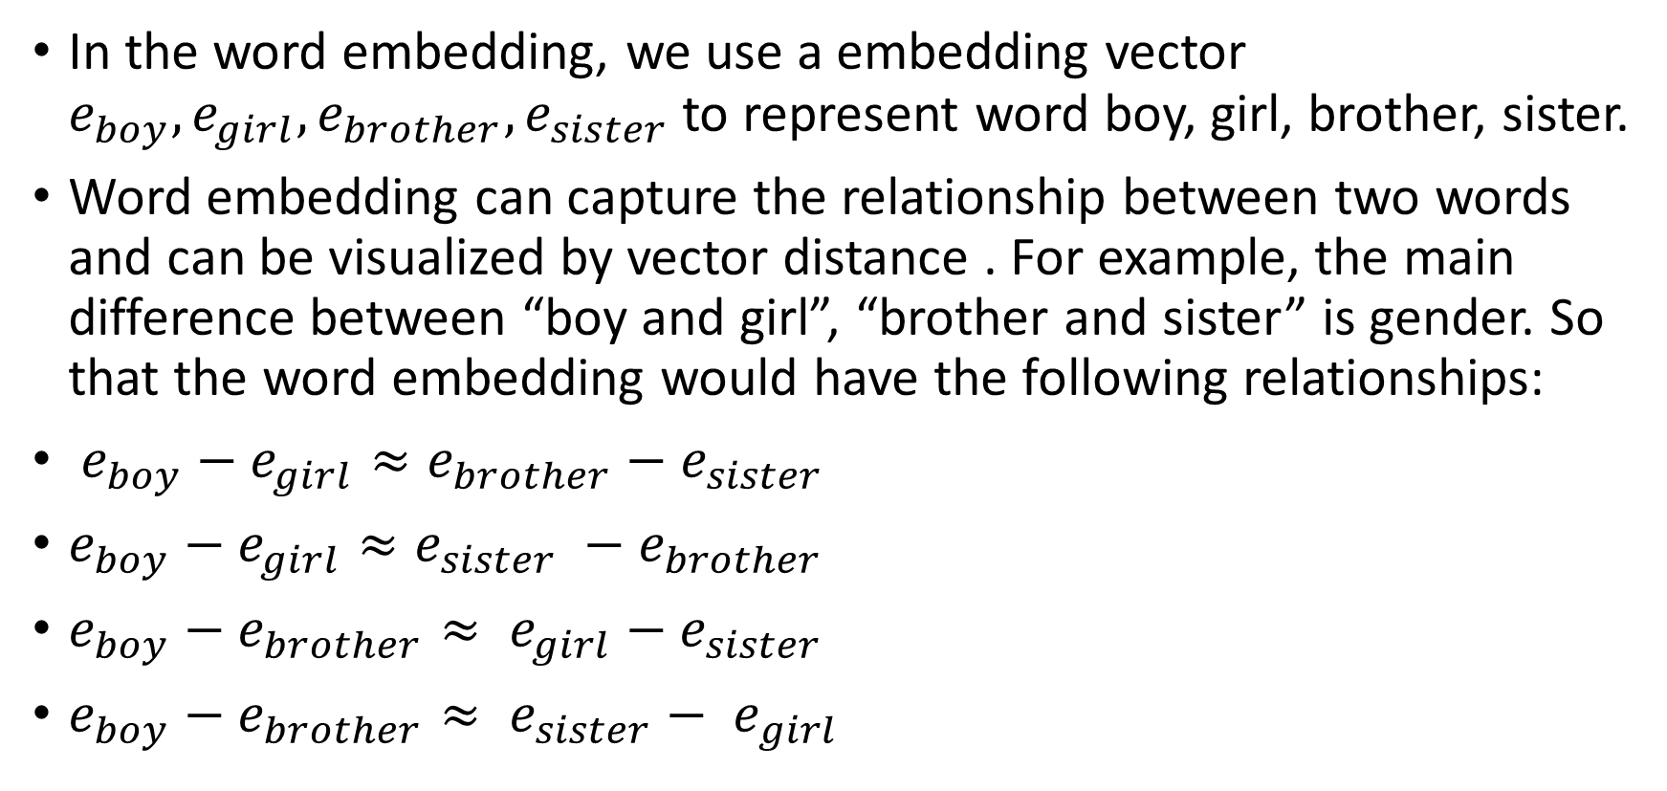
A2
In the word embedding, we use a embedding vector $e_{boy},e_{girl},e_{brother},e_{sister}$ to represent word boy, girl, brother, sister.
Word embedding can capture the relationship between two words and can be visualized by vector distance . For example, the main difference between “boy and girl”, “brother and sister” is gender. So that the word embedding would have the following relationships:
$e_{boy}−e_{girl}≈e_{brother}−e_{sister}$
$e_{boy}−e_{girl}≈e_{sister} −e_{brother}$
$e_{boy}−e_{brother}≈ e_{girl}−e_{sister}$
$e_{boy}−e_{brother}≈ {e_{sister}− e}_{girl}$
More info: https://blog.csdn.net/scythe666/article/details/79203239

Slide 7
Q3
In the word2vec algorithm, one have to estimate P(t∣c), where t is the target word and c is a context word. How to choose t and c from the training set? How to understand ‘vec’ function in ‘word2vec’?

Slide 8
A3
In P(t∣c), c and t are chosen to be nearby words.
Word2vec is an efficient algorithm model to represent words as real value vectors.
By using the idea of deep learning, the processing of text content is simplified to the vector operation in k-dimensional vector space, and the similarity in vector space can be used to express the semantic similarity of text.
More info: https://www.cnblogs.com/maybe2030/p/5427148.html

Slide 9
Q4
What’s the difference between “language generation model” and “machine translation model”?

Slide 10
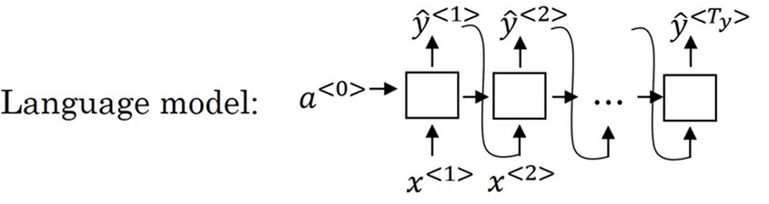
A4
For a language generation model, it can be use to estimate the probability of the given words are a sentence, and it can be use to generate a new sentence.

Slide 11
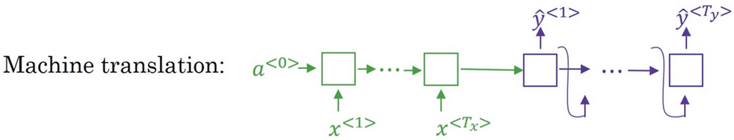
A4
In this figure, we represent the encoder network in green and the decoder network in purple.
The decoder and the language generation model are almost the same. In the ordinary language model, the input vector a<0> is zero, but in machine translation model the input of decoder is the output of encoder.
The decoder in machine translation is also called a conditional language model, the models will tells the corresponding possibilities of various translations through models.

Slide 12
Q5
Why don’t we use “greedy search” in conditional language model?

Slide 13
A5
Greedy search is an algorithm from computer science, which says to generate the first word just pick whatever is the most likely first word according to your conditional language model.
In a word, going to machine translation model task. Greedy search would picked the previous word which has most likely, and then pick the next word that seems most likely, I.e. one-by-one fashion.
But what the truly need is that to pick the most the most possible sentence(entire sequence of words). The maximizes the joint probability of whole sentence is not equals to maximizes probability of each word of sentence.

Slide 14
Q6
Why can we use the seq-2-seq(language translation) model in speech recognition problem?

Slide 15
A6
Speech recognition is also a sequence problem.
An audio can split into many small voice clip, after process them to different frequencies and generate a spectrogram,.
So that audio can also be represented as a series of features, which is similar to text problem.

Slide 16
Q7
Why the attention model performs better than the common encoder-decoder networks in long sentence cases?

Slide 17
A7
A common encoder-decoder network is NOT performs well because it trys to store all messages of the whole sentence and translate it at the beginning.
Attention model could simulate human behavior and do well in long sentence cases.
For human, many people would pay more attention to a corresponding part of the sentence when they generate a few translation words. So you cannot read the whole sentence and translate it all at once without special training.

