Slide 1
Experiment Course

Slide 2
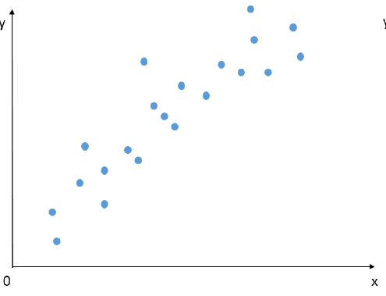
Linear Regression
Linear regression is a simple regression model.

Slide 3
Matrix Presentation
It use least square error as the loss function:

Slide 4
Regularized Least Square Regression
is called Regularizer, and is called trade-off parameter

Slide 5
Close Form Solution
Let the above formula be zero, we get the optimal parameters:

Slide 6
Stochastic Gradient Descent
Choose ONE training example randomly
Compute gradient of loss with this example
Update parameters with a learning rate

Slide 7
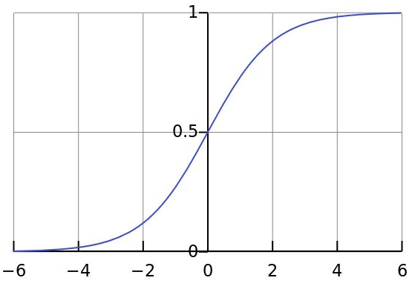
Logistic Regression
Using sigmoid function, we can limit the output of the linear model between 0 and 1.
With help of cross-entropy loss, we can solve classification problem with logistic regression.

Slide 8
Formulation of Logistic Regression
Assume that it’s a binary classification problem:
And the logistic loss(cross-entropy loss):

Slide 9
Gradient of Logistic Regression

Slide 10
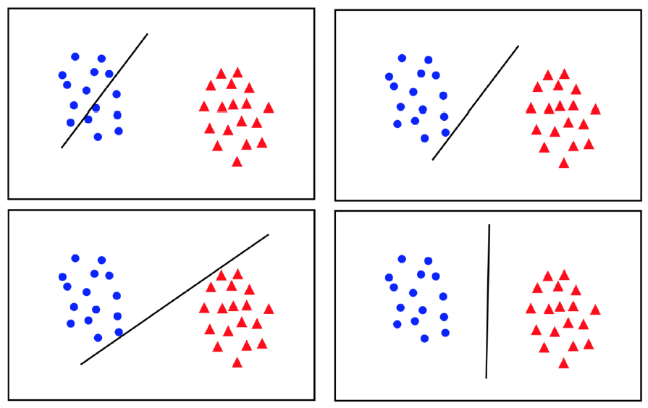
Support Vector Machine
The best solution is to let the distance between two classes as large as possible.

Slide 11
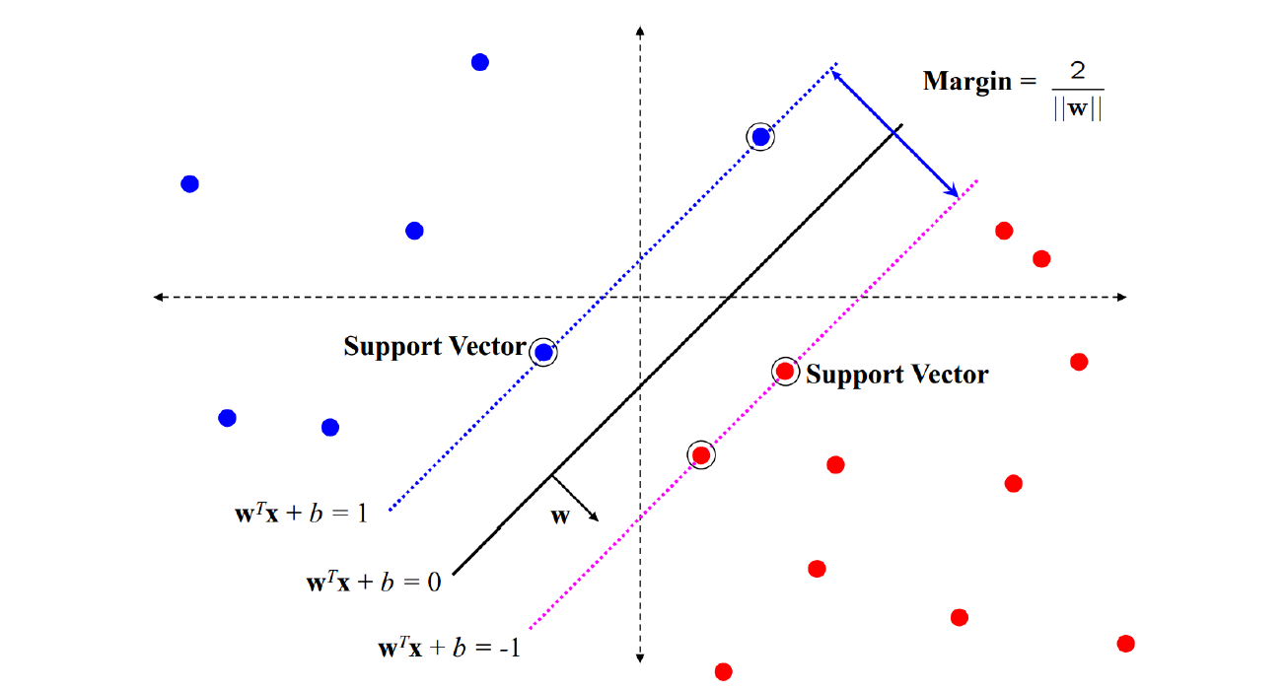
Maximum margin solution
Choose the most stable hyper-planes under perturbations of the inputs

Slide 12
Hard Margin Formulation
or

Slide 13
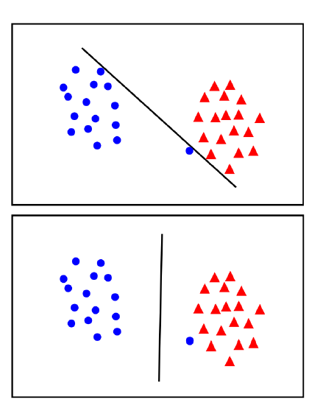
Which margin is better?
The second one may be better though one constraint is violated.
In general we should add a trade off between the margin and the number of mistakes on the training data.

Slide 14
Soft Margin Formulation
or

Slide 15
Gradient of soft margin SVM
Where:

