Slide 1
PARTNER BRIEFING · NOVEMBER 2026
Ambient Cyber Companion
The calendar assistant that knows when to stay quiet, and never touches your calendar without your say-so.
A browser extension for Chrome, Edge and Firefox
Notes:
Open by naming the one-line idea: an assistant that reads the room. Most calendar tools optimise your schedule; this one first asks whether it should be speaking at all. This briefing covers what it does, why it is different, an honest account of where it stands, and the decisions I need from this group.

Slide 2
THE PROBLEM
Assistants got good at doing things. Few know when not to.
Bad timing
Talking over you
It chimes in during a lecture, a client call, or an exam.
It speaks while you are sharing your screen to a room full of people.
Surprise changes
Retyping, and mistyping
It reschedules things on its own, and you find out afterwards.
Getting an event off a flyer or a whiteboard means typing it in, and it is easy to get the date wrong.
And to do any of it, these tools want broad access to your data while saying little about what happens to it.
Notes:
Frame the pain in everyday terms. Ask the room whether they have had a notification go off in the wrong moment. The last line is the trust gap: the more automatic a tool is, the more access it asks for and the less it explains.

Slide 3
OUR IDEA
Be present when you want it, silent when you don't, and never act without a clear yes.
1
2
3
Context before action
Nothing without your yes
Honest about uncertainty
Before it speaks, it checks what you are doing: in class, in a meeting, in an exam, sharing your screen, on a call.
Every event it suggests waits for your tap. Nothing is added, moved or deleted on its own, and the database enforces it.
If it is not sure of a date or time, it leaves it blank and asks you, instead of showing a confident wrong answer.
Notes:
These three ideas run through every feature. If a partner remembers only one slide, it should be this one. Note that the second and third are not marketing language: each is enforced by something in the system, which the trust slide covers.

Slide 4
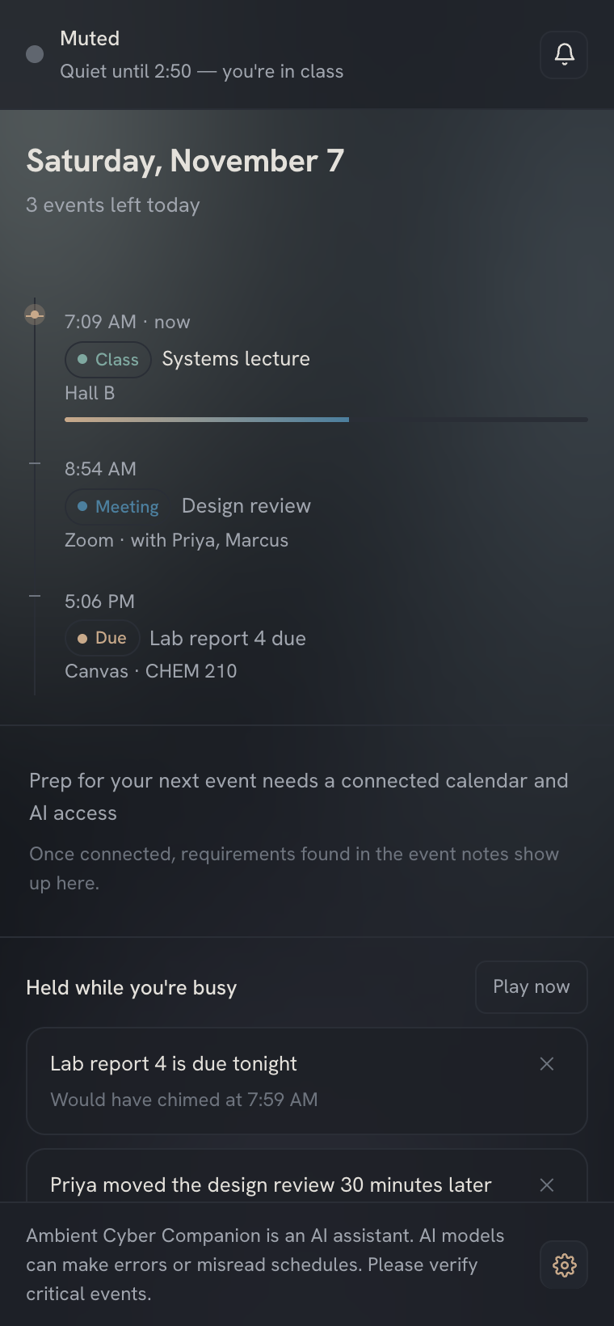
THE PRODUCT
The panel, at a glance.
1
It tells you why it is quiet
The header shows its state and the reason. Here a lecture is in progress, so it stays muted until it ends.
2
Your day, with what is happening now
A plain timeline of today, with a progress line on the event in progress.
3
Nothing is lost while you are busy
Alerts that would have interrupted you wait in a held list. Play them when you are free, or dismiss them.
Sample day, from the panel's built-in demo data
Notes:
This is the real panel, rendered from the built extension, not a mock-up. The data is the panel's own sample day, so the lecture and the held alerts are illustrative. Point at the header first: the product's whole premise is that it can say why it is quiet. The footer reminder that AI can make mistakes is permanent by design.

Slide 5
HOW IT WORKS
It reads the room before it speaks.
What it watches
What you see
Your calendar: a class, meeting or exam in progress
Screen sharing and microphone use
Quiet hours you set, and one-tap mute or snooze
Your computer's Focus / Do Not Disturb (optional helper)
Fullscreen and idle state
Listening
Free: it may speak
Idle
Visual cues only
Muted
Silent: it holds what it has
Exams stay exams
When in doubt, quiet
If an exam and a meeting overlap, the exam rules win.
If it cannot see your calendar, it assumes you might be busy.
Notes:
Held alerts wait in the panel and play when you ask or when you are free. Two details worth saying out loud: exams take priority over meetings because exam content is locked down, and offline it fails quiet, never loud. Screen-share and mic detection was verified in a real browser; the Focus helper is optional and not yet packaged.

Slide 6
CAPTURE
From a photo to a calendar event, with you in charge.
1
2
3
4
Select
It reads
You review
You tap Add
Highlight text, or right-click an image, and choose Add to my calendar.
It extracts the event and flags anything it is unsure of, with its assumptions listed.
Fill in any missing time yourself. Pick which calendar if you have two.
One event, exactly once. Double-taps cannot make a duplicate.
Blank beats a guess. It never invents an end time. Card and ID numbers are redacted before storage, instructions hidden inside an image are ignored, and a photo of a whole syllabus becomes many events.
Notes:
The motivating failure: a flyer says 'Friday the 3rd, 7pm' with no year, zone or end time. A naive tool emits a confident timestamp and someone misses the recital. This one emits the ambiguity. Be clear that the AI step is the part not yet proven against the live service; the review-and-confirm mechanics around it are tested.

Slide 7
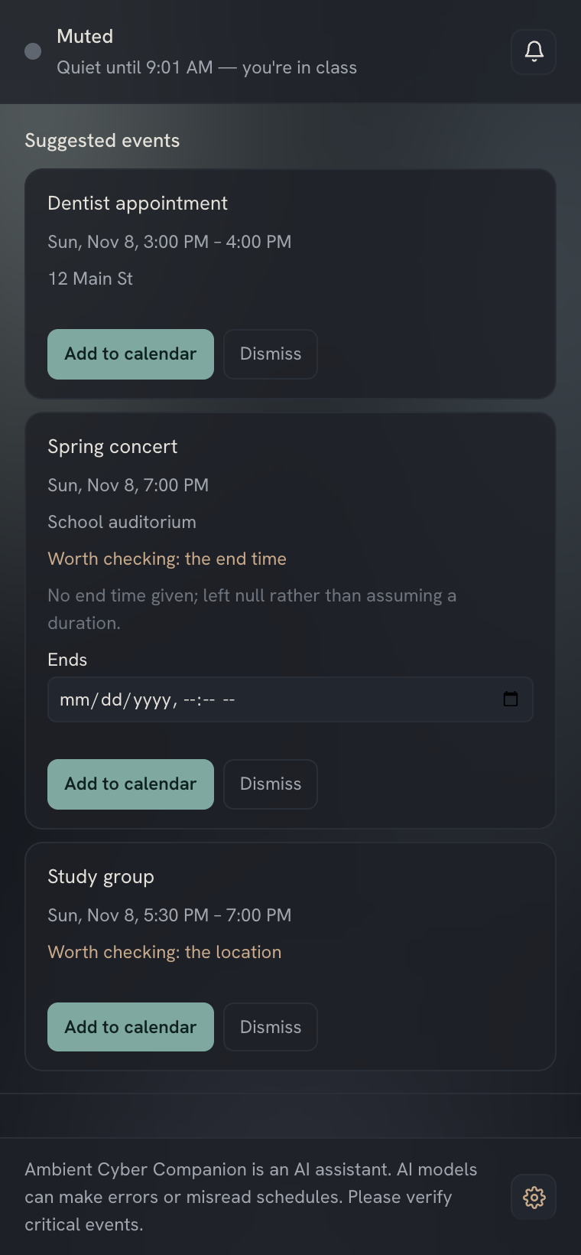
REVIEW
You approve every event before it lands.
1
It shows what it found, and what it is unsure of
Each suggestion lists the time and place it read, flags anything worth checking, and states its assumptions.
2
A missing time stays blank, and asks you
The concert had no end time on the flyer. It leaves the field empty and you fill it in. It never invents a duration.
3
You decide: Add or Dismiss
Nothing is on your calendar until you tap Add to calendar, and a double tap cannot create a duplicate.
Sample suggestions
Notes:
The middle suggestion is the point of the slide. A flyer said 7pm and nothing about an end time. Most tools would guess; this one asks. The suggestions here are sample content fed to the real panel. If you have two calendars connected, the card also asks which one to use.

Slide 8
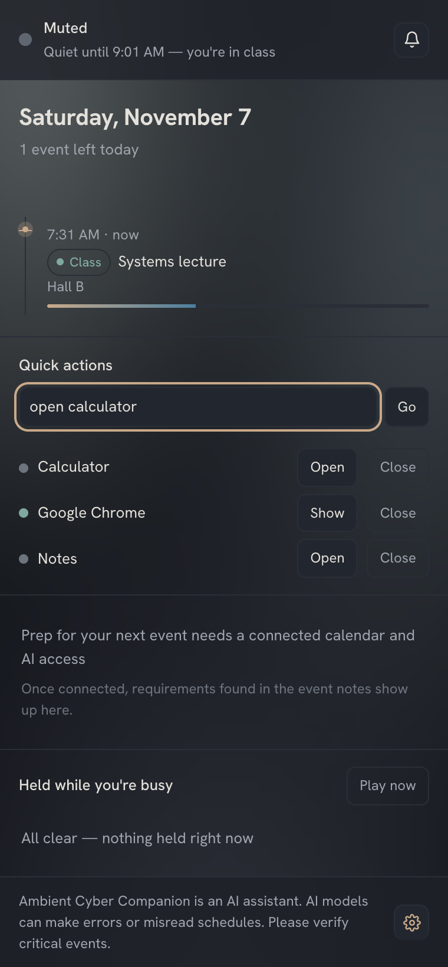
NEW: APPS
Open and close your apps, only when you ask.
1
Off until you turn it on
It only touches the apps you tick in Settings, and the list of your apps never leaves your computer.
2
Open is instant. Close asks first.
Closing is a polite request, never a force-quit, so an app can still ask you to save.
3
Some apps can never be closed
Your browser, Finder and system apps can be opened but never closed from here, which is why Chrome's Close button is greyed out.
macOS only today. Opening is verified with a real app. A real close needs a one-time macOS permission and has not been run yet.
Quick actions, listing apps on this Mac
Notes:
Typed commands like 'open Zoom' are read by plain matching, with no AI involved, and only you can trigger them from the panel. A web page, a calendar entry or a photo cannot. Be honest about status: opening was tested with a real app; a real close was not run, because macOS shows a one-time permission prompt. It needs a small helper installed on the Mac, kept separate so it can be added or removed on its own.

Slide 9
TRUST
Built in, not promised.
AI is opt-in
Delete everything
Learning is off by default
Captured text and images go to Anthropic only if you turn it on. Off takes effect on the next request.
One step removes your data from the server and the device, and revokes Google access.
If on, it learns timing only, never titles or people. Switching off destroys it.
Writes need a tap
Secrets stay off the device
Sensitive messages first
The database rejects an event record that was never confirmed.
Sign-in uses a standard secure flow. Calendar tokens are encrypted at rest on the server.
Crisis language is intercepted before any AI sees it, and logged without its content.
The rules are enforced by the database and the code, not by good intentions.
Notes:
Be precise here. Tokens are encrypted at rest on our server; that is NOT end-to-end encryption and we should never describe it that way. Captured content does go to Anthropic if the user opts in, so we cannot claim nothing leaves the device. The crisis handling is a safety net, not a mental-health product. All of these controls are covered by automated tests.

Slide 10
WHO IT IS FOR
People whose attention is the scarce thing.
Students
Presenters and call-heavy roles
Quiet in lectures and exams. Photos of syllabi, whiteboards and flyers become events they review first.
Teachers, trainers, streamers. It will not speak over you while you share your screen.
Busy professionals
Parents and organizers
A day of back-to-back meetings, with quiet where it counts and a held queue for later.
The school flyer or event photo becomes a calendar entry in a couple of taps, with doubts flagged.
Notes:
Students are the sharpest wedge: exam awareness and syllabus capture are things generic schedulers do not do, and the privacy posture suits them. Professionals are a larger market but more crowded. I would like the group's view on which to lead with.

Slide 11
THE LANDSCAPE
A different job from the tools around us.
 | Auto-schedulers (e.g. Motion, Reclaim) | Photo-to-calendar apps | Ambient Cyber Companion
Core job | Plan tasks and protect time automatically | Read an image into an event | Know when to speak, and capture events safely
Who decides when it acts | The tool | You | You, after it reads your context
Knows you are in a meeting, exam, or sharing | Not its focus | No | Yes, and goes quiet
Writes to your calendar | Adjusts and reschedules automatically | Often saves directly, usually with a review step | Only after your explicit tap
Admits when unsure | Not its focus | Varies | Per-field confidence; blank beats a guess
Competitor descriptions come from public comparison articles, several by competing vendors. Verify before using externally.
Notes:
The point is not that the others are bad. Auto-schedulers optimise your plan; photo apps extract events. Neither is built around 'should I be speaking right now' or around a never-without-a-tap rule. One caution: these descriptions come from comparison articles, many written by competing vendors, so we should check each vendor's own pages before putting a comparison in public. Also note that Clockwise, a known tool in this space, was reported to have shut down in March 2026.

Slide 12
WHAT SETS US APART
Five ideas the others are not built around.
1
Context before action
Most assistants optimise your schedule. This one first asks whether it should be speaking at all.
2
Consent as a mechanism
The tap rule, the learning toggle and the AI switch are enforced by the system itself.
3
Honest about uncertainty
A blank field instead of a confident wrong answer.
4
Safe with sensitive input
Crisis messages intercepted first, secrets redacted, hidden instructions ignored.
5
Private and deletable
Learned patterns are timing only, and users can erase everything themselves.
Notes:
These are design positions, not features a competitor could not copy. The defensible part is the combination and the discipline of enforcing it in the system, which is also what makes the product easier to trust. None of this has yet been proven with real users, which the next slide is straight about.

Slide 13
WHERE WE ARE TODAY
An honest account of what is real.
Built and tested
Not yet proven live
Designed, not switched on
Quiet mode, mute and snooze
Screen-share and mic detection (real browser)
Suggested events: review and add
Add-once logic, sync, reconnecting
Privacy rules enforced by the database
Opening apps from the panel (macOS)
Google and Microsoft sign-in and event creation
The AI prompts on the live service
A hosted database (tested on an in-process one)
Closing an app for real (macOS asks for permission first)
Real users and real load
Adaptive learning (toggle and privacy rules are done)
Prep cards for upcoming events
Canvas and Blackboard calendar feeds
OS Focus helper packaging
Enterprise admin screen
230+ automated tests · 3 browser suites · 0 known vulnerabilities
Works against fakes. Real-world run is the next step.
Not to be advertised as working.
Notes:
I would rather say this plainly than have a partner find out later. The left column is verified by tests and browser checks. The middle column is code that is written and exercised against fakes, but has not touched Google, Microsoft, the live AI service or a hosted database. The right column exists in design or partly in code but is not operating end to end, so it must not appear in any marketing. One new item: the extension can now open and close apps you allow, on macOS, only when you ask. Opening has been tried with a real app. Closing asks for confirmation and is a polite quit, never a force-quit, but a real close has not been run because macOS shows a one-time permission prompt, so do not promise it yet.

Slide 14
THE PATH TO LAUNCH
Four steps from here to a product people can buy.
1 Verify
2 Closed beta
3 Launch
4 Expand
Run against real Google, Microsoft, the live AI service and a hosted database. Fix what breaks.
Students and presenters use it for real. Measure whether the quiet mode earns its place.
Store listings, privacy policy, pricing live, Google's review for calendar access.
Switch on learning and prep cards, add Canvas and Blackboard feeds, then organizations.
Things that could slow us down
Google's verification process for apps that read calendars: timing is outside our control, and the exact requirements need confirming.
Cost per use: each capture is a paid AI call, so pricing has to cover it.
A crowded category: we win on trust and context, not on features alone.
Notes:
I have deliberately not put dates or numbers on these steps because I do not yet have a basis for them; step one will tell us. Google's review is a known gate for calendar access and I want to confirm its requirements before promising a timeline. The per-capture AI cost is the main driver of the pricing decision on the next slide.

Slide 15
BUSINESS MODEL
Three ways to charge, and what each would mean.
 | Subscription | One-time purchase | Organization licence
Why it could work | Matches an ongoing cost: every capture is a paid AI call | Simple, and easy to say yes to | Schools and teams buy for many people at once
Main risk | Needs a reason to keep paying; students are price-sensitive | AI cost continues after the sale, so heavy users erode the margin | Longer sales, and it needs an admin screen and security review we do not have yet
Best suited to | Individuals and students | People who dislike subscriptions | Schools and companies
What it needs first | A clear monthly value, plus a usage limit | A usage cap, or a way to cover the AI cost | Admin controls and an audit view
No prices yet, on purpose. The verification phase measures the real cost per capture, and we price against that.
Notes:
I have not put numbers on this because I do not have a basis for them yet. The cost that matters is each capture being a paid AI call: that cost never stops, which is why a one-time price is the riskiest option and a subscription with a usage limit is the most natural fit. Organization licences are attractive but need an admin screen that does not exist yet; the controls are in the database, but there is no screen for them. This feeds directly into decision two on the next slide.

Slide 16
WHAT I NEED FROM YOU
Four decisions to move forward.
Lead audience
Students first (sharpest wedge, privacy suits them) or professionals first (bigger, more crowded)?
1
Business model
Subscription, one-time purchase, or organization licences? Per-use AI cost favours a subscription or a usage cap.
2
Browsers first
Chrome and Edge are the tested path. Firefox and Safari can follow. Agree?
3
Go and resourcing
Approve the verification phase and agree who owns accounts for Google, Microsoft, hosting and the AI service.
4
An assistant that earns your attention by knowing when to stay quiet.
Notes:
Close by asking for the decisions, not applause. The first two shape everything downstream: who we build for and how we charge. I have left pricing numbers out on purpose; I would rather decide the model with you and then size the number against real AI cost from the verification phase.

