Slide 1
Techniques for Fault Detection and Visualization of Telemetry Dependence Relationships for Root Cause Fault Analysis in Complex Systems
Nathaniel Guy
natguy@uw.edu
March 16, 2016
University of Washington
Seattle, WA
??, 2015

Slide 2
Fault Detection
“Fault” is any sort of problem with a system
One specific type of what’s called an “anomaly” in aerospace
Many types of faults:
Off-nominal sensor readings
Off-nominal metrics calculated from various sensors
Hardware failures
Faults can be symptoms of larger root causes
Example: high current draw on wheel motor -> physical obstruction preventing wheel from turning

Slide 3
Fault Detection, Isolation, and Recovery (FDIR)
Automated fault detection system detects a fault
Sends commands/transitions vehicle state if necessary
Fault is isolated to specific part of vehicle
Triggers an alarm for human operator
Human operator evaluates alarm for root cause diagnosis
After root cause is determined (or sometimes even not), recovery steps are taken to restore operation
Much of FDIR is automated
Only complex issues require operator intervention

Slide 4
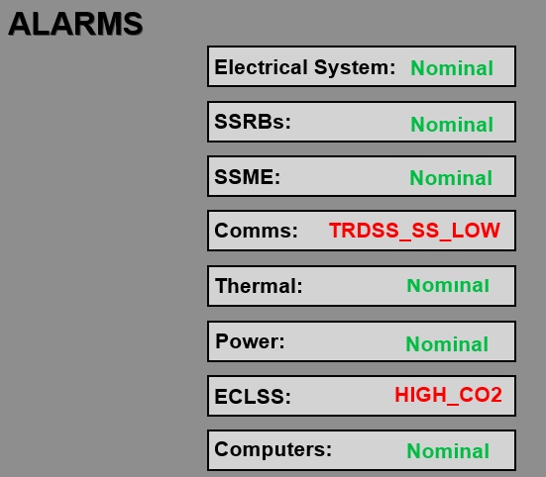
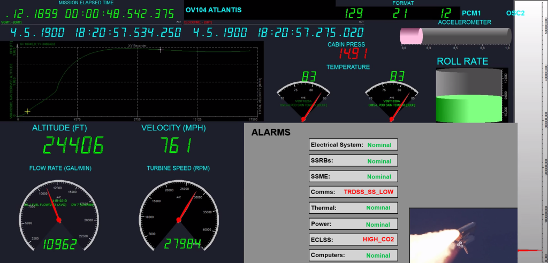
Fault Detection, Isolation, and Recovery (FDIR)

Slide 5
Model-Based Fault Detection
Build a model of normal system operation
Associate rules with particular faults
Automated recovery steps may also be associated with these faults
Example:
if (motor.current > 20A) { trigger(OvercurrentFault); }
Observer-based models and estimation models can generate new data channels that can be used
Other systems include probabilistic models, signal-processing-based models, and neural networks

Slide 6
Fault Diagnosis Difficulties
Faults are often very complex
Many faults are correlated with each other
A single fault may be caused by many possible root causes
Must discard noise and “red herrings”
Much expert knowledge is never formalized to assist with automated fault recovery
Often relies on non-captured “tribal knowledge”
Human operators often do most of the work for root cause diagnosis of in-flight anomalies in the post-mortem (slow)
SpaceX CRS-4 examples
SIGI unit
Mousetronauts

Slide 7
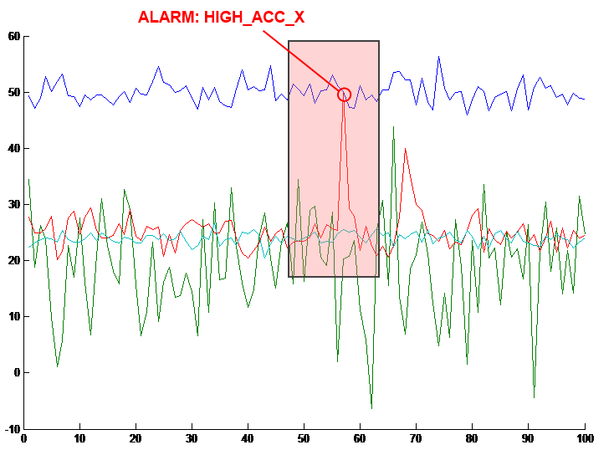
Data Navigation: Annotated Plot Events

