Slide 1
Flocking
Nat Guy (Some slides borrowed from John See at Multimedia University, Malaysia)

Slide 2
Flocking
Moving together in coordinated groups
Birds in flocks, fish in schools, land animals in herds
Murmuration of starlings:
https://www.youtube.com/watch?v=eakKfY5aHmY

Slide 3
Applications to Games
NPCs can move in cohesive groups
Meadow of grazing sheep
Hunting flock of birds
Ants, bees, fish
Other types of computer-controlled NPCs
Humans, orcs, catapults
Squadrons of aircraft
Friendly soldier squads
Crowds of people loitering

Slide 4

Behavioral Modeling of Flocking
Craig Reynolds developed flocking model in 1986
“Boids” model
Presented at SIGGRAPH 1987: “Flocks, Herds, and Schools: A Distributed Behavioral Model”
Later went on to do flocking animation for DreamWorks and Sony

Slide 5
Examples in Media
First used for bats and penguins in Batman Returns (1992)
https://www.youtube.com/watch?v=Mo_1rAaj7FE#t=5
https://youtu.be/jCVwdeAobYc?t=15
Jurassic Park (1993)
https://www.youtube.com/watch?v=nM-RPO10aPY
Assassin’s Creed (various)
https://www.youtube.com/watch?v=ACWIRMePpxk#t=597
Countless other films and games
Autonomous robotics:
GRASP Lab at UPenn:
https://www.youtube.com/watch?v=UQzuL60V9ng#t=27

Slide 6
Simple Rules of Flocking
Leaderless flock of agents
Each agent calculates its movements independently
Agents can only see a few agents around them, their “neighborhood”
3 simple rules:
Cohesion
Alignment
Separation

Slide 7
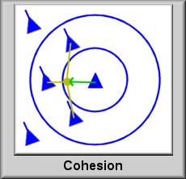
Cohesion
Each unit steers towards the average position of its neighbors
Units are attracted to one another as long as they are within range

Slide 8
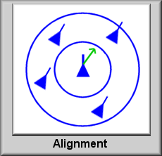
Alignment
Each unit steers so as to align itself to the average heading of its neighbors
Matches direction of units around it that it can detect

Slide 9
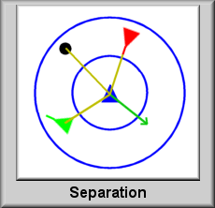
Separation
Each unit steers to avoid hitting its neighbors
Units are repelled by non-member units or obstacles. Repel effect can be inversely proportional to distance from unit

Slide 10
Mackerel “Baitball” Video
https://www.youtube.com/watch?v=r1m6IKiO26c#t=82

Slide 11

Neighborhood
Range in which units can detect other units

Slide 12
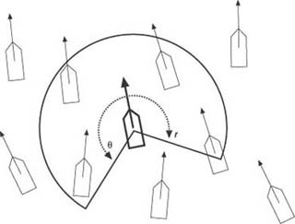
Visibility
Visibility constrained by field of view
Also can be constrained by limited number of influencing neighbors
Each unit is aware of its local surroundings
Each unit does not necessarily know what the entire group is doing at any given time

Slide 13
Other Extensions
Avoiding obstacles
Avoiding predators
Following leaders
Making specific formations (circle, “flying V,” etc.)

Slide 14
Implementation
In each game loop
Cycle through all units in the flock to acquire data (direction, speed, etc.) from unit’s neighbors
For each unit, update with net steering force from the three rules
Each unit must update its list of current neighbors each game loop

Slide 15
Cohesion Implementation
Calculate average position – vector sum of neighbors’ respective positions divided by total number of neighbors
Determine direction to turn and angle to steer towards
Steering force = (direction) * (steering force) * (angle of steering)

Slide 16
Alignment Implementation
Calculate average heading – vector sum of neighbors’ respective alignments divided by total number of neighbors
Determine direction to turn and angle to steer towards
Steering force = (direction) * (steering force) * (angle of steering)

Slide 17
Separation Implementation
Steer away from any neighbor that is within view AND within prescribed minimum separation distance (i.e., too close)
Because this steering force is corrective, direction multiplier goes the opposite way
Separation factor can be used to increase force with smaller separations
Steering force = (direction) * (steering force) * (separation factor)

Slide 18
2D Flocking Demo (written by Nat in Python)
https://youtu.be/ipgdxQoVXWA
Note how the flocking pink agents respond to the presence of the single green agent, once it appears.
(Sorry about the video capture quality!)

Slide 19
Further Resources
Craig Reynolds’s Boids page
http://www.red3d.com/cwr/boids/

