Slide 1
Stephen King & the Language of Fear
Done by: Ahmad Tomeh, Aryan Dhiman, Yassin ElGazzar

Slide 2
The Language of Fear
King turns ordinary words into psychological triggers
Repetition of dark, blood, dead, scream, shadow creates dread
Fear emerges through sensory detail + psychological tension
Our computational analysis reveals the patterns behind this fear

Slide 3
Research Purpose
How King constructs fear through word choice
Compare fear-language between Pet Semetary and The Shining
Identify patterns in fear word frequency
Visualize fear intensity across each narrative
Use clustering + TF-IDF to analyze dominant themes

Slide 4
Method Summary
Cleaned, normalized, and tokenized both novels
Loaded a custom fear lexicon
Counted fear-word occurrences
Split each book into 40 narrative segments
Calculated fear intensity per segment
Used TF-IDF + k-means clustering on text samples
Visualized top words, clusters, and narrative fear patterns

Slide 5
The Foundations: Cleaning & Counting Words
Cleaned and tokenized the full novels
Counted total tokens and extracted frequent words
Identified early patterns in fear-related vocabulary
Established the baseline for deeper analysis

Slide 6
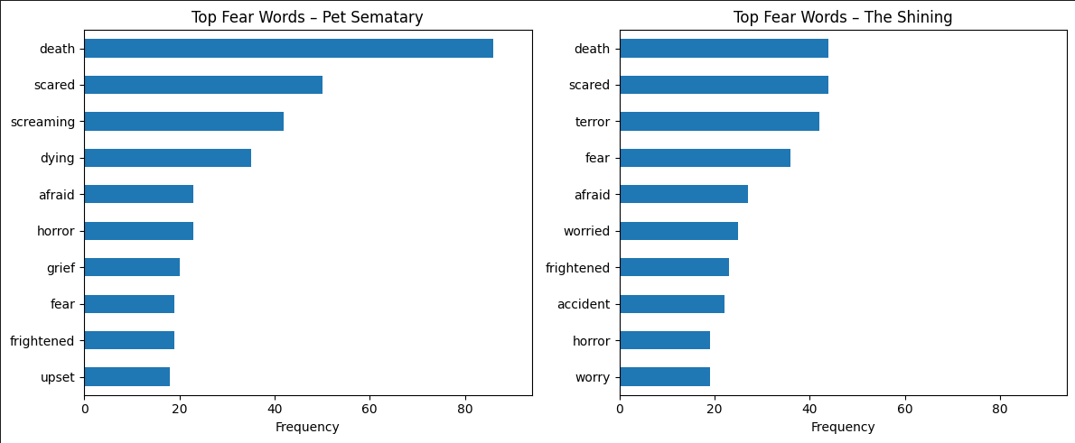
Key Findings
Common fear-adjacent words: dark, fear, blood, dead
Pet Semetary: stronger focus on death, burial, grief
The Shining: more sensory and psychological language
Early data already hints that the novels use fear differently

Slide 7

Fear Over Time: The Intensity Curve
Loaded a custom fear lexicon
Split each book into 40 equal narrative segments
Counted fear-word frequency per segment
Normalized results to compare books fairly

Slide 8
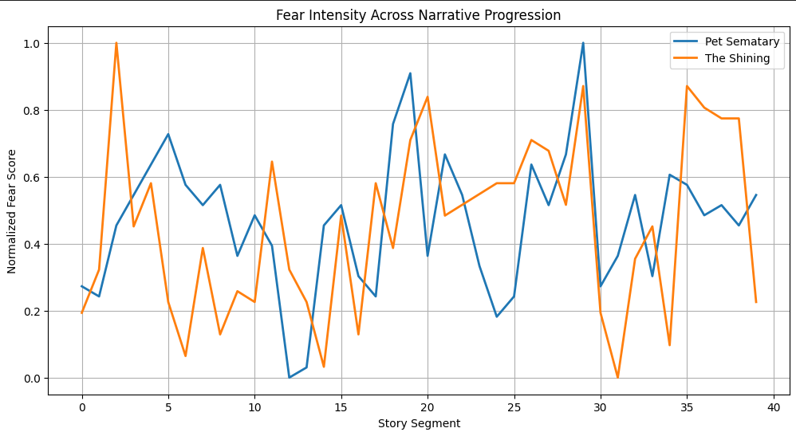
Key Findings
Pet Semetary: sudden spikes in fear intensity → moments of dread
The Shining: smoother but longer-lasting tension → psychological horror
Both books peak near major story climaxes
King clearly “paces” fear strategically

Slide 9
Fear’s Vocabulary: What Words Drive the Horror?
Expanded fear lexicon comparisons
Counted most-used fear terms per novel
Measured relative frequency differences
Revealed dominant themes in each book

Slide 10
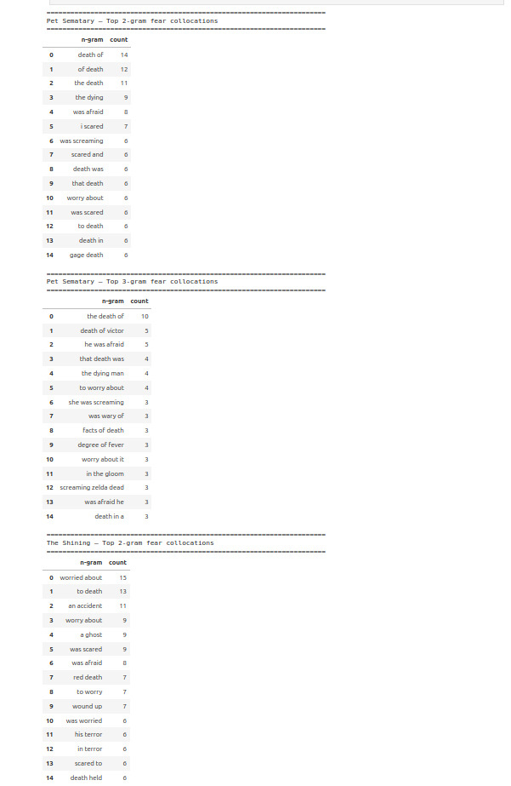
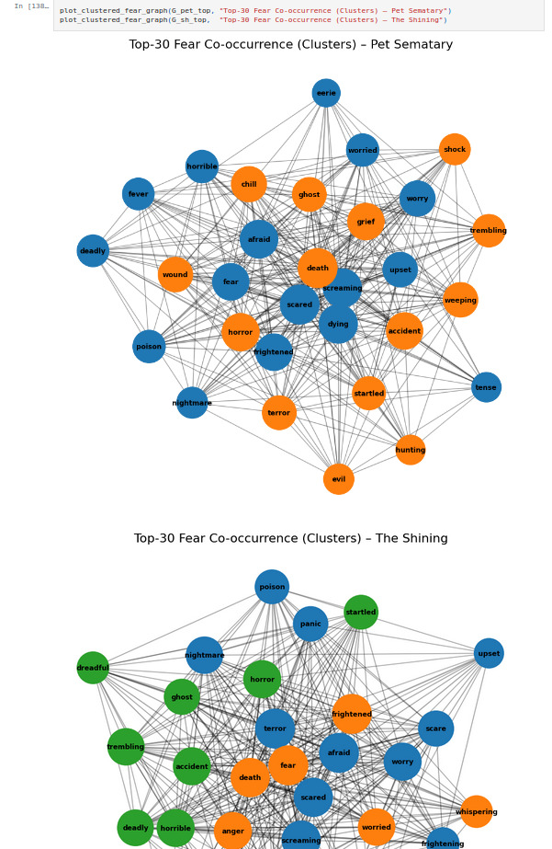
Key Findings
Pet Semetary: most frequent fear words include dead, dark, ground
The Shining: dark, scream, blood, voice more prominent
Pet Semetary fear = rooted in death + grief
The Shining fear = rooted in madness + supernatural tension

Slide 11
Preparing the Text: Advanced Cleaning & Consistency Checks
Identified words linked to the 5 senses
Visual (dark, shadow, light)
Auditory (scream, whisper, silence)
Tactile (cold, touch, frozen)
Olfactory (smell, rot, scent)
Gustatory (taste, blood, bitter)
Counted how often each sensory category appears
Compared sensory profiles between Pet Sematary and The Shining
Revealed how King creates “immersive fear” through physical sensations

Slide 12
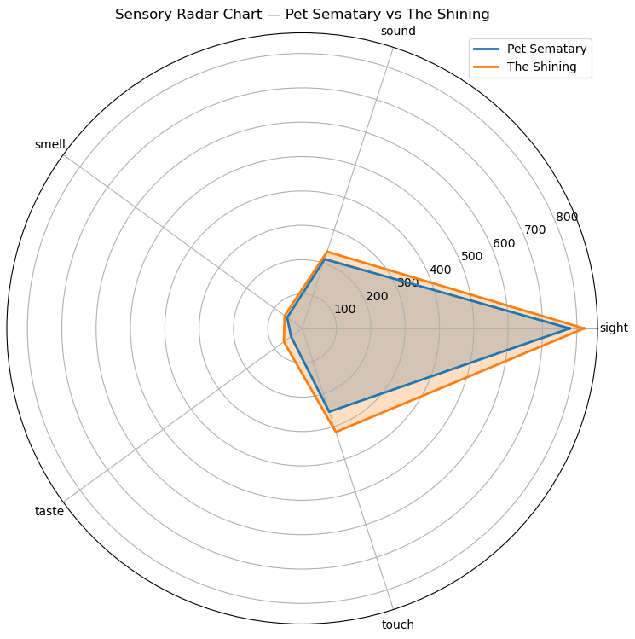
Key Findings
Visual words dominate both novels — King relies heavily on imagery
The Shining uses more auditory and tactile words, matching its psychological horror tone
Pet Semetary uses more olfactory and gustatory words, reinforcing themes of death, decay, and the physicality of loss
Sensory language shapes each book’s emotional atmosphere:
The Shining → fear through sounds + environment
Pet Semetary → fear through the body + decay

Slide 13
Hidden Themes: Clustering King’s Language
Converted text into 5,000-dimensional TF-IDF vectors
Applied K-Means to detect natural language themes
Identified 5 major fear-related clusters
Generated word clouds for visual representation

Slide 14
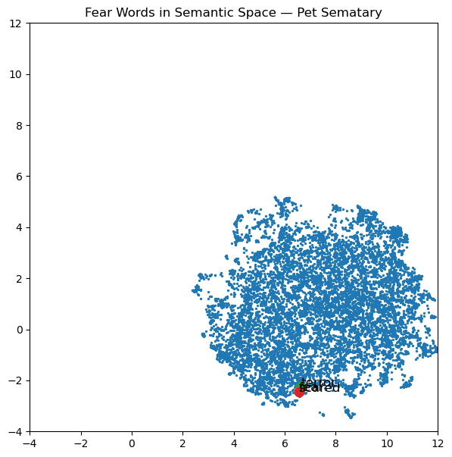
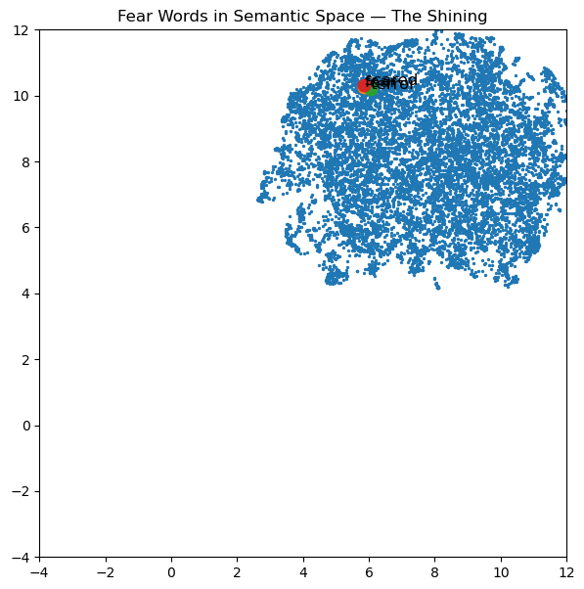
Key Findings
Clusters revealed distinct types of fear patterns:
  Violence / blood imagery
  Darkness & isolation
  Supernatural cues
  Mental breakdown vocabulary
  Setting-driven tension
Shows King blends internal and external fear sources

Slide 15
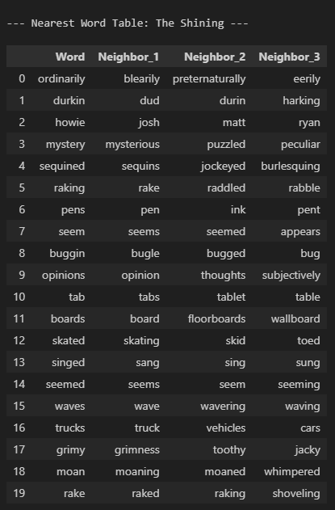
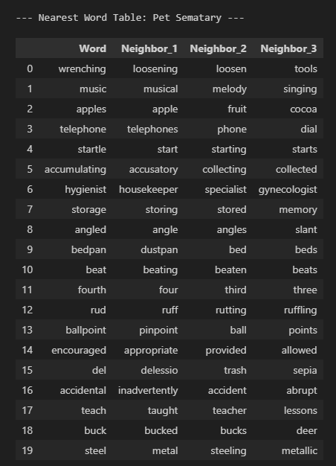
Sensory Word Examples
Top 10 sensory words from each novel
Frequency chart of senses (Sight / Sound / Touch / Smell / Taste)
Example sentences showing sensory vividness

Slide 16
Pet Sematary vs The Shining
Pet Sematary
Fear of death, loss, and inevitability
Sudden fear spikes
Heavy emotional weight
The Shining
Fear of madness, isolation,possession
Sustained psychological tension
More supernatural-driven vocabulary

Slide 17
What This Shows About King
Repetition of emotionally charged words
Uses sensory detail to keep readers on edge
Fear vocabulary intensifies at plot peaks
Language creates atmosphere as much as events do
NLP confirms King’s control of pacing + emotional impact

Slide 18
Our Contact Information
Ahmad Tomeh: ahmadtomeh06@gmail.com
Aryan Dhiman: aryanger725@gmail.com
Yassin ElGazzar: yassinehab323@gmail.com

