Slide 1
TOPICS
MAP
Helproutine
On Error

Slide 2
MAP
MAP is used to access the online screens.
When creating a new map module, a profile is used to control the default map settings for such things as:
number of lines and columns
identifying different classes of fields
assigning intensity
upper/lower case
filler character for input/modifiable fields

Slide 3
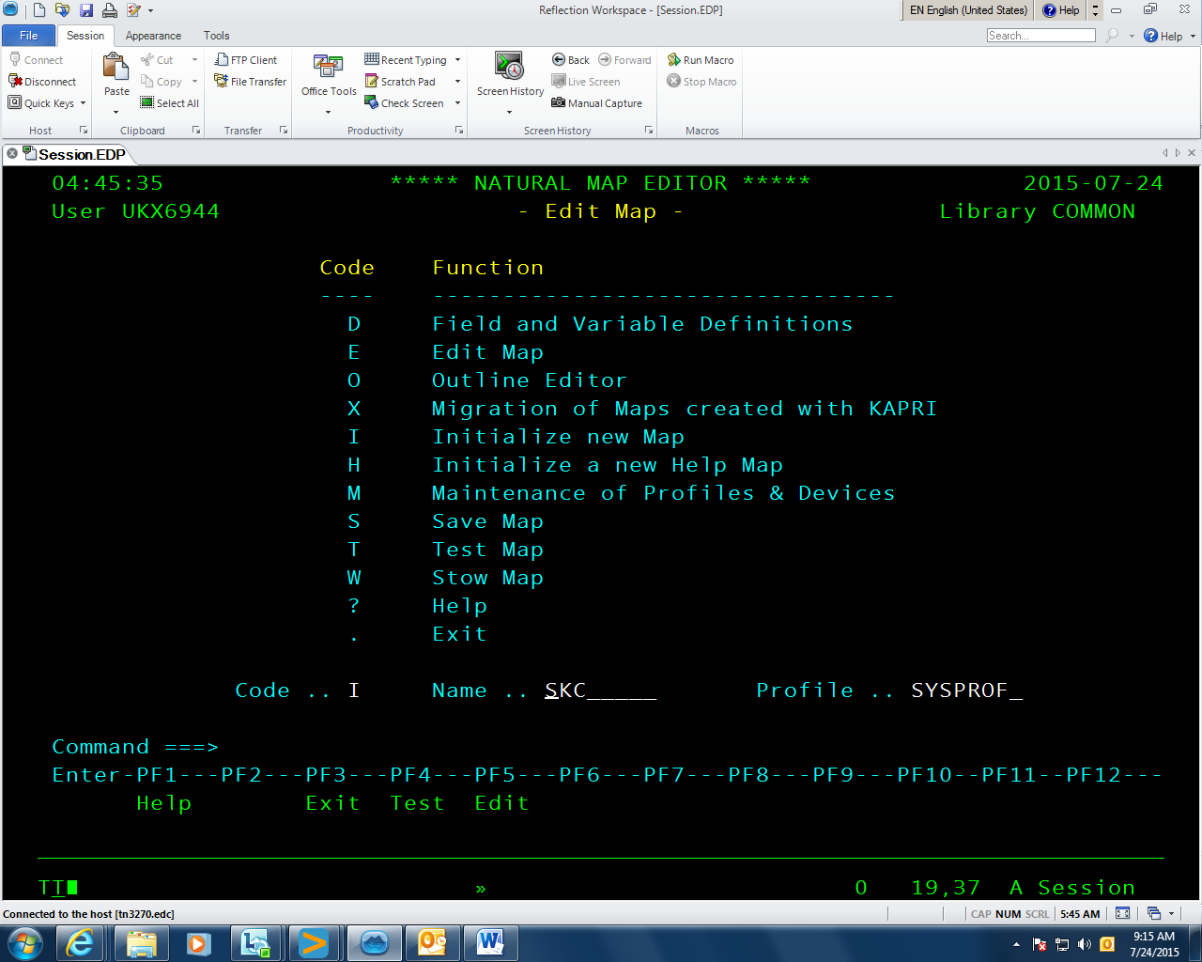
We can edit the profile or change current map settings at any time, by entering a code of M (maintenance of profiles & devices) on the above menu.

Slide 4
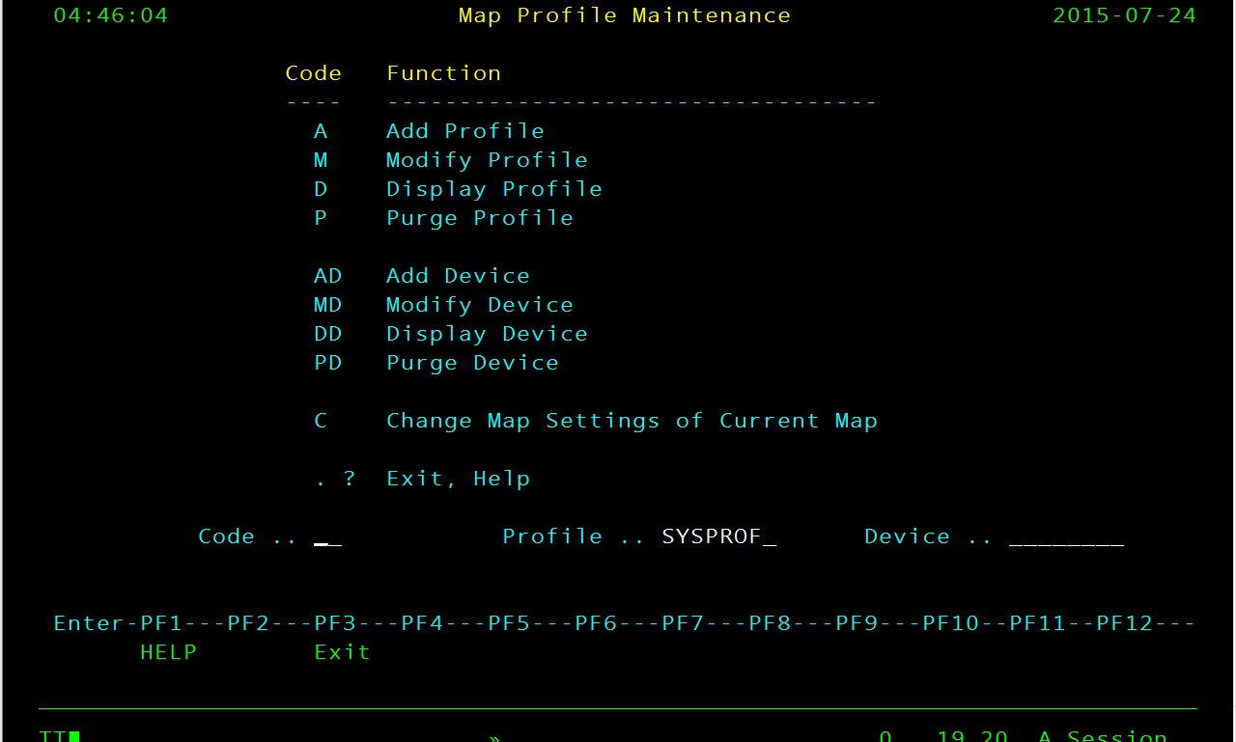
This screen allows us to create and maintain profiles. It also allows us to change the current map settings.

Slide 5
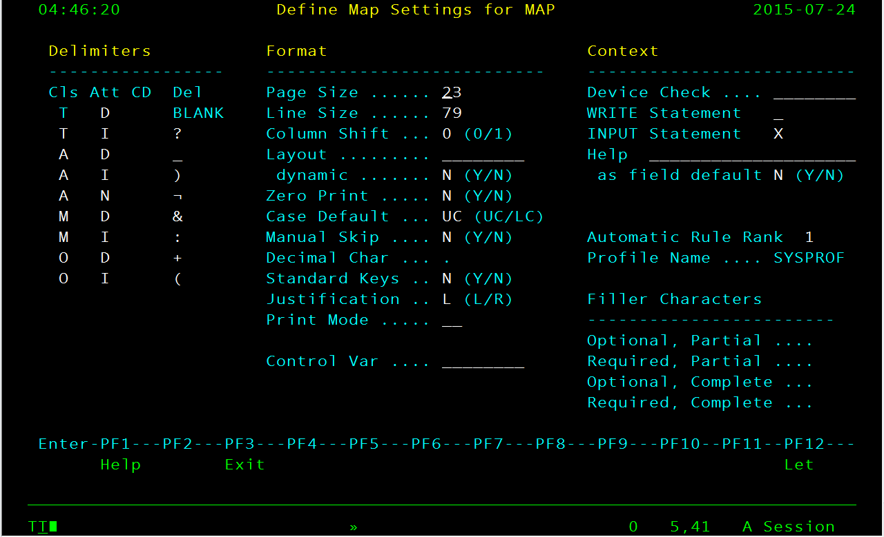
When you enter a code of C (change map settings of current map), a screen similar to the following is returned:

Slide 6
The essential map settings are:
Delimiters (explained below)
Page Size (number of rows)
Line Size (number of columns)
Case Default (whether input data is converted to upper case)
Control Var (name of map level control variable)
WRITE Statement (whether map is used in conjunction with WRITE, as opposed to INPUT)
INPUT Statement (whether map is used in conjunction with INPUT, as opposed to WRITE)
Filler Characters (to indicate location and length of input/modifiable fields)

Slide 7
MAP FIELDS
A map consists of a series of fields. Usually this is a mixture of text fields (e.g. headings and prompts), output fields (displayed to the user, but not changeable), modifiable fields (changeable) and input fields. Non-text fields are attached to data items within the “calling” module.

Slide 8
How to create a map module
Step 1 - Initialize new map

Slide 9
Step 2 - Adjust map settings

Slide 10
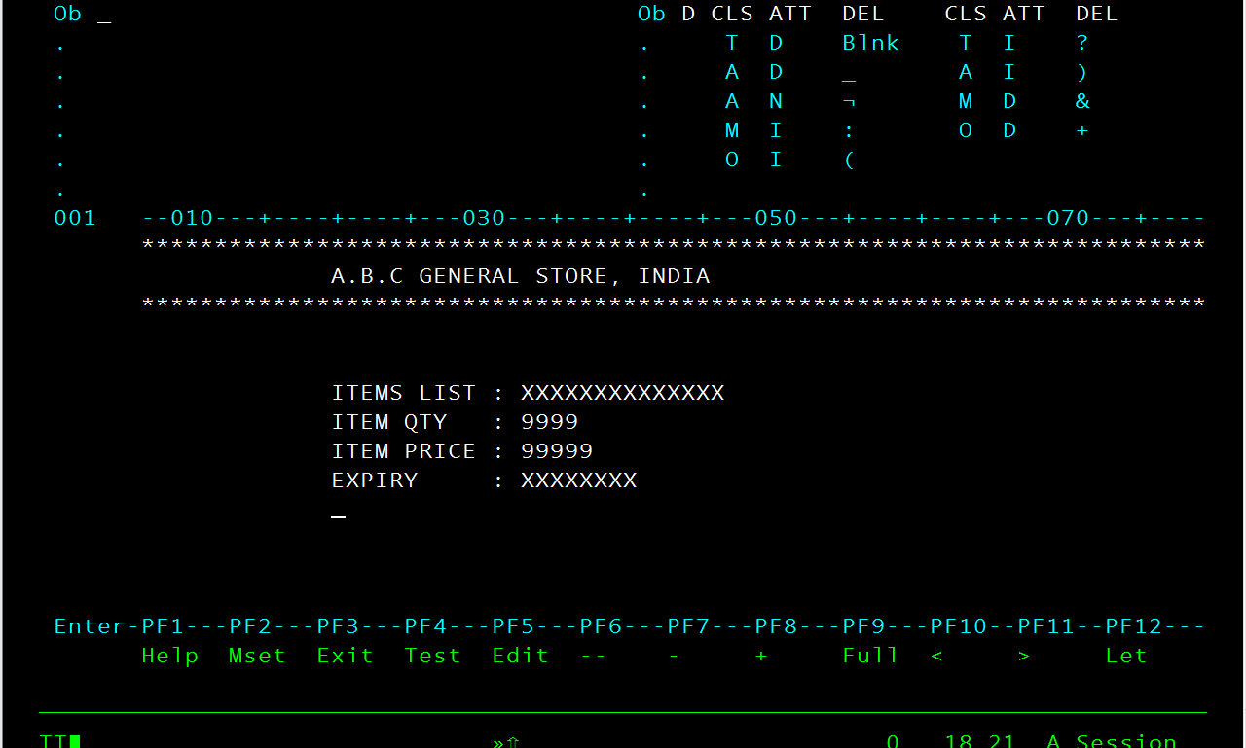
Step 3- Create text fields

Slide 11
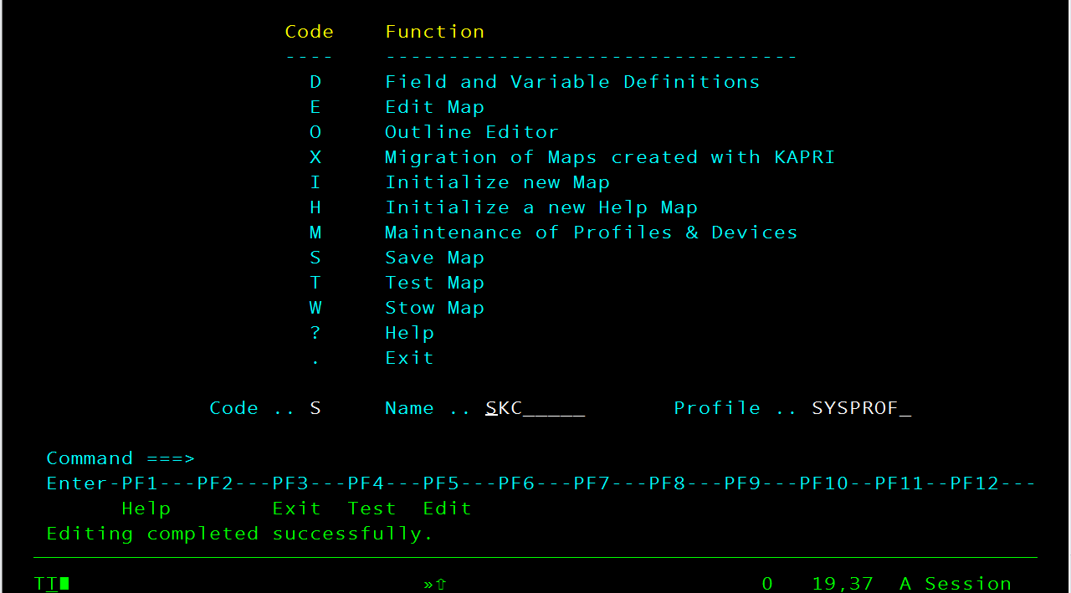
Step 4 - Save your work (optional)
Press PF3 to return to the Map Editor menu and save your work.

Slide 12

Step 5 – Press W to Stow the MAP

Slide 13
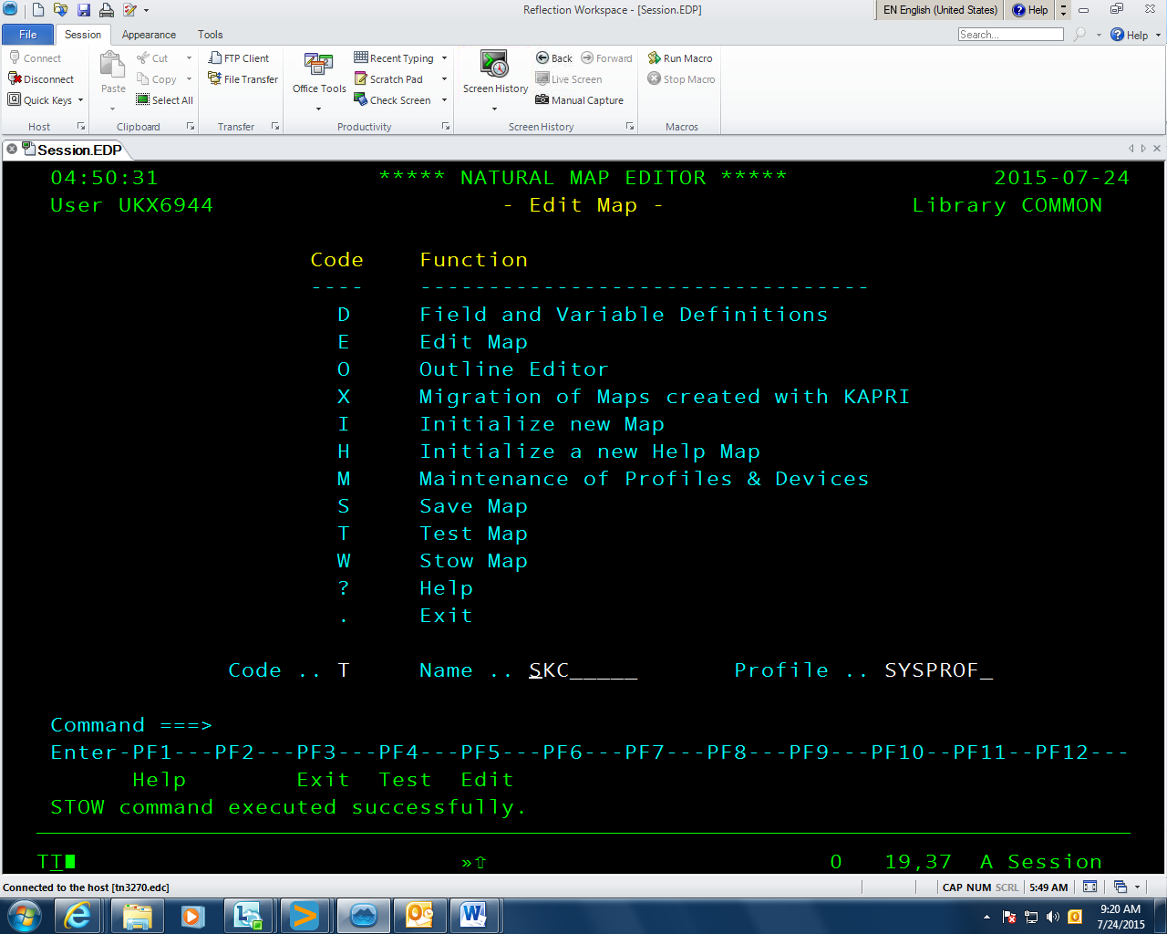
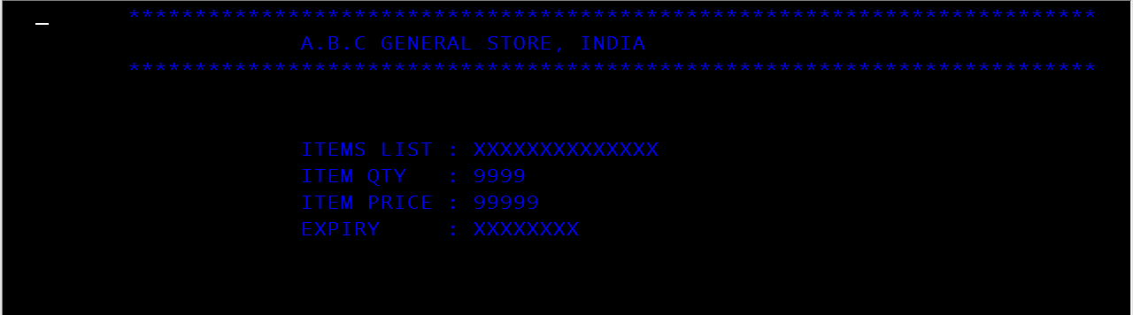
Step 5 – Press T to TEST the Stowed map

Slide 14
Few important codes:
D - Field and Variable Definitions
E - Edit Map
I - Initialize new Map
H - Initialize a new Help Map
M - Maintenance of Profiles & Devices
S - Save Map
T - Test Map
W - Stow Map
? – Help
. - Exit

Slide 15
HELPROUTINE
A help routine may take the form of a map module or a special kind of executable module, similar to a subprogram. Help routines are used only in on-line applications and are only executed if invoked by the user.
Invocation occurs when the user enters a help character (“?” by default) into the first character position of a map field or presses the help key (PF1 by convention).
The HE parameter allows you to specify the name of a field-level help routine. This could be a map module or an executable help routine module. The specified help routine will be executed if the user enters a help character (“?” by default) in the first character position of the field or positions the cursor anywhere on the field and presses the help key (PF1 by convention).
The name of the help routine module must be specified in quotes.

Slide 16
***************************************************
A.B.C GENERAL STORE, INDIA
***************************************************
ITEM QTY PRICE
RICE 5KG 550
SUGAR 2KG 100
BISCUIT 5 50
Confirm : (Y/N) __

Slide 17
ON ERROR
When an error occurs, Natural will automatically trace back the subroutine structure and select the first ON ERROR statement encountered in a subroutine for execution.
An ON ERROR block may be excited by using a FETCH, STOP, TERMINATE, RETRY or ESCAPE ROUTINE statement. If the block is not exited using one of these statements, standard error message processing is performed and program execution is terminated.

Slide 18
ON ERROR
WRITE '=' #THIS-ITEM-LIST-INDEX
WRITE '=' #RULES-T
WRITE '=' #THIS-ITEM-QTY-INDEX
WRITE '=' #THIS-ITEM-EXPIRY
WRITE '=' #LIST
END-ERROR
END

Slide 19
THANK YOU

