Slide 1

Ashford University Application
By Brandie Briggsivey
July 2021

Slide 2
Definition Statement
The Ashford University Mobile Application is an integral part of the education.
This university application keeps the student notified about the ever-changing situation around campus
It keeps the student aware of educational assignments and also allows in-house communication between students and instructors.

Slide 3

Intended Usage
This application’s main objective is the facilitation of students especially those with special needs, i.e., visually impaired and auditorily impaired individuals.
The application enhances and simplifies communication between peers and instructors.
Furthermore, the app helps schedule assignments and notifies about deadlines.

Slide 4
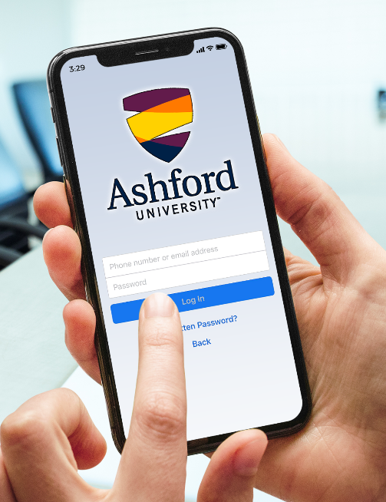
Main Page: Login Page
The main page activity of my app contains the login page.
There is a form that takes the user’s credentials and verifies it with the credentials in the database.
The password is encrypted and can be restored in case the user forgets.

Slide 5
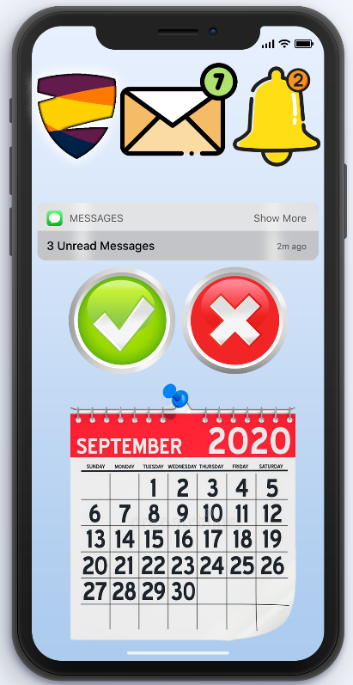
User Dashboard
The user dashboard contains an overall view of the new things happening across campus and contains three activities, i.e.,
It gives an overview of the messages and notifications.
A calendar is also presented so that the student knows about the days when an assignment is due.

Slide 6
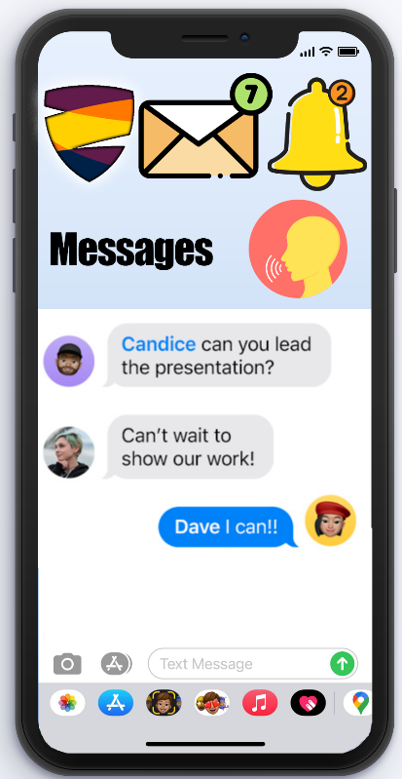
Messages Activity
The messages button takes the user to the messages activity. It contains two fragments, i.e., upper and lower parts.
The messaging activity allows communication between peers and instructors.
It also hosts a voice-narration feature and is visually attractive and enlarged so that its easy to read.
Colors have been chosen to maximize visibility.

Slide 7
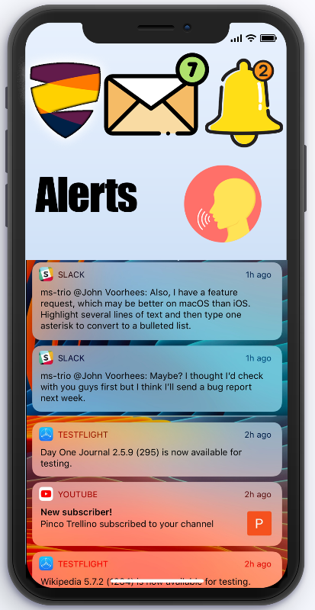
Alerts Activity
The alerts activity keeps track of changes across campus.
This activity also contains two fragments. One fragment contains the buttons on the top and the other fragment contains the detailed alerts.
The alerts can also be read using the narrator button on the top.

Slide 8
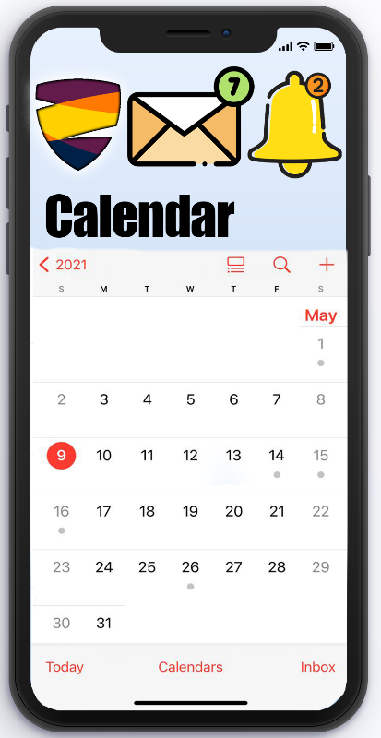
Calendar Page
The calendar activity helps keep track of assignments and social events across campus.
Certain events on the calendar trigger notification alerts in the alert activity.
The calendar feature is a much needed functionality and saves the hassle of going to a PC for active scheduling.

Slide 9

Tests Performed: Unit Tests
Unit tests were performed on the mobile application throughout the phase of development.
Each feature was tested individually before integration with the other functionalities.
Minor interface bugs were observed and resolved in due time.

Slide 10

Tests Performed: Load Testing
The application was tested with loaded traffic to ensure that it operates under immense user pressure.
The application was made robust to make sure that it does not fail when many users simultaneously access the university portal through it.

Slide 11
THANK YOU!

