Slide 1

AGRITECH INNOVATION
AgriShield
Offline-First Agricultural Decision-Support Platform for Zimbabwean Smallholder Farmers
TRACK 4
AGRITECH
Innovate. Build. Transform.
IoT Storage Sensors
AI Plant Screening
TEAM MEMBERS:
SHALLIN T. TAIRO
MARK CHINDUDZI
CHRISTOPHER GOCHERO
Satellite Climate Intelligence
Africa University, Zimbabwe
Notes:
Introduce the team in one breath, then go straight to Tendai — no tech yet.

Slide 2
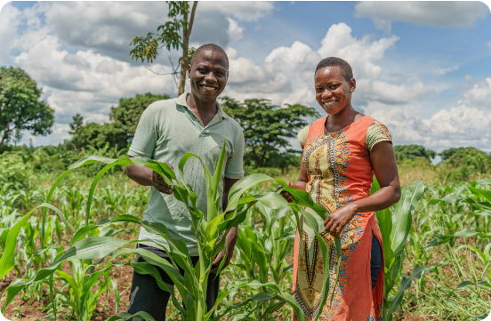
THE FARMER
Meet Tendai
1
She grew a good maize harvest.
Good rains, hard work, a full store.
2
Then it spoiled, out of sight.
Warm, damp air inside the store. Mold starts before anyone can see it.
3
Nobody warned her in time.
No sensor, no signal, no extension officer nearby.
Tendai is an illustrative farmer.
AgriShield is built so the next harvest ends differently.
Notes:
Open on the farmer, not the tech. Say it slowly:
"A smallholder farmer can grow a good harvest and still lose it — not to drought, not to disease, but to a grain bin they can't see inside. That's the whole problem in one sentence. Everything we've built is the fix."
Tendai is an illustrative farmer — say so if asked. Her story is what the numbers on the next slide describe.

Slide 3

MACRO CONTEXT & VULNERABILITY
The Zimbabwean Smallholder Challenge
$126M Annual Agricultural Risk Losses
Drought exposure and rainfall deficits devastate rain-fed production cycles.
16.5% Post-Harvest Loss Rate
Lack of storage monitoring and cold infrastructure spoils harvested grains and produce.
75% Smallholders Under 2 Hectares
Requires low-cost, shared-service digital tools over high-cost machinery.
Notes:
Now the numbers behind Tendai's story. Have the source for each figure ready if a judge asks.

Slide 4




INTEGRATED PLATFORM
Whole-Season Decision Intelligence
Crop Disease Check
Solar Storage Sensors
Climate Intelligence
Market Visibility
Offline TFLite leaf diagnostics with extension referral.
Real-time temperature and humidity spoilage alerts.
Sentinel-2 district view; local weather alerts coming next.
AMA vegetable prices from Mbare and more — coming next.
Notes:
One loop through the whole season. Be plain about what is live and what is next: market prices and weather alerts are coming next.

Slide 5
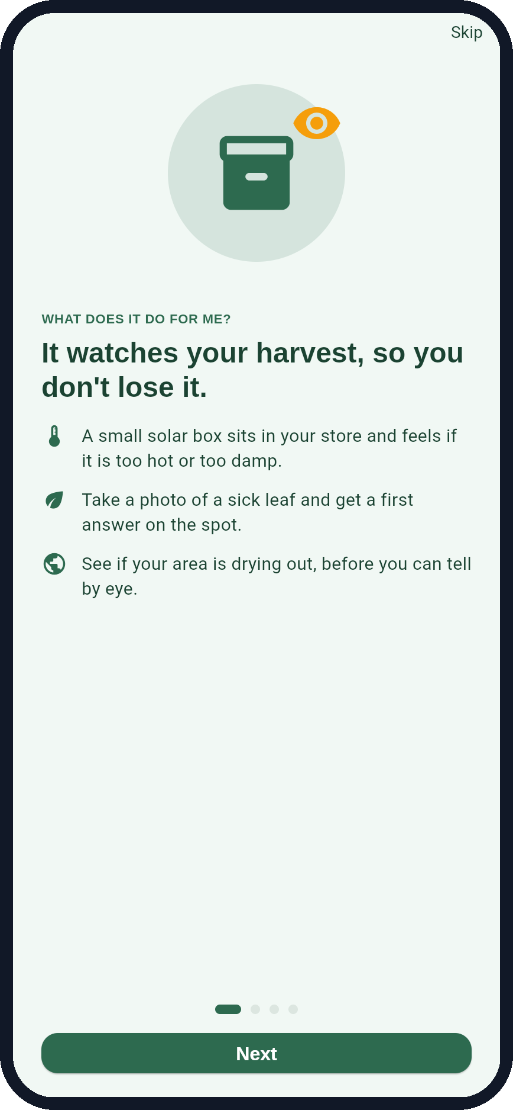
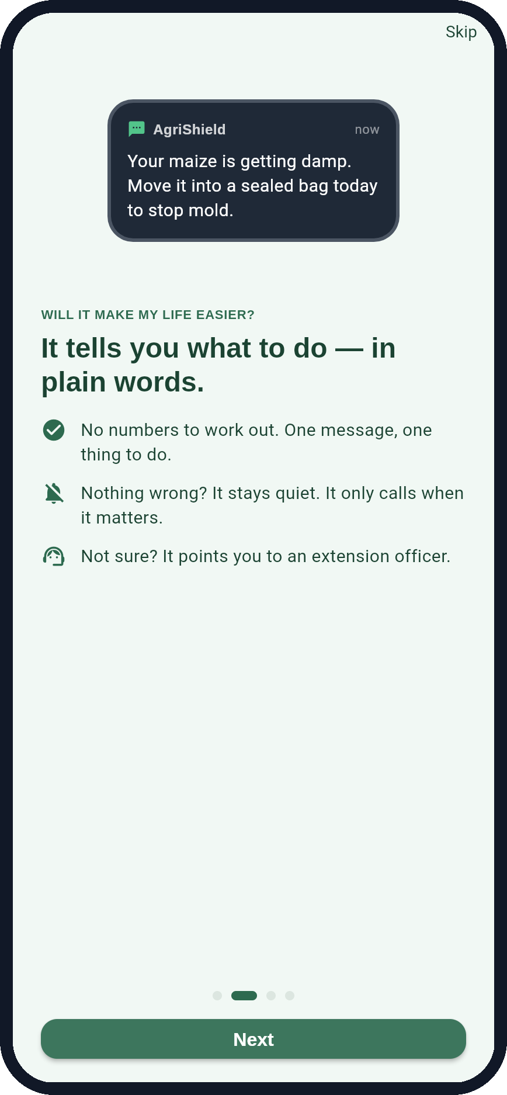
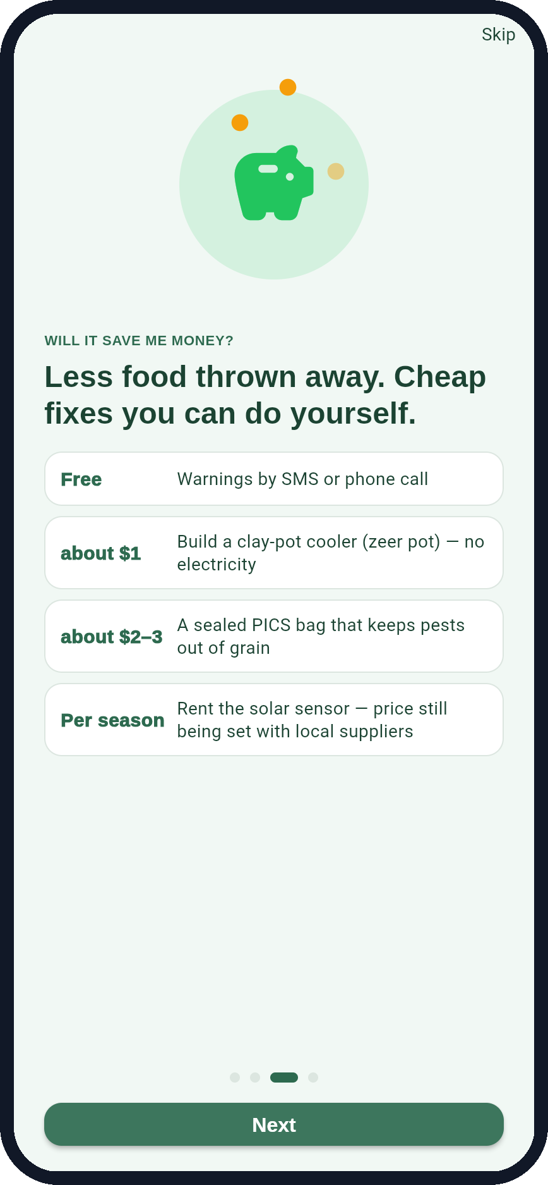
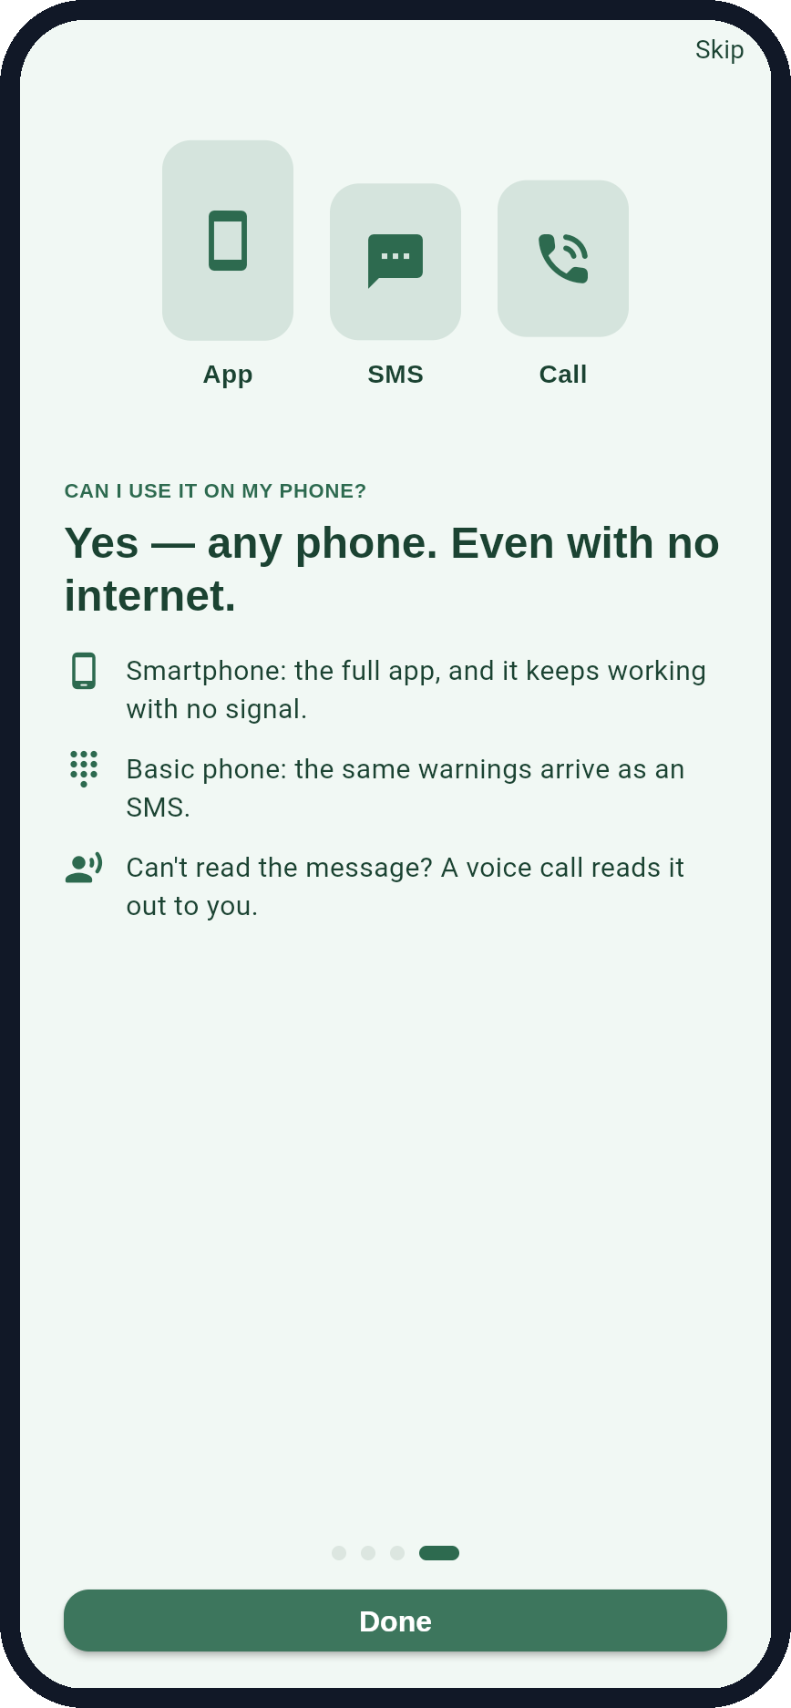
THE FARMER'S QUESTIONS
Four questions every farmer asks us
What does it do for me?
Will it make life easier?
Will it save me money?
Can I use my phone?
It watches your harvest
It says what to do
Free alerts, $1 fixes
Any phone, no internet
Notes:
This is how a farmer judges us — not by the tech. Four questions, four screens from the working app:
1. What does it do for me? It watches your harvest.
2. Is it easier? It tells you what to do, in plain words.
3. Is it cheaper? Free warnings, a $1 cooler, a $2–3 bag.
4. Can I use my phone? Any phone — app, SMS or a voice call.
These are real screens from the prototype's 'How AgriShield helps you' story.

Slide 6
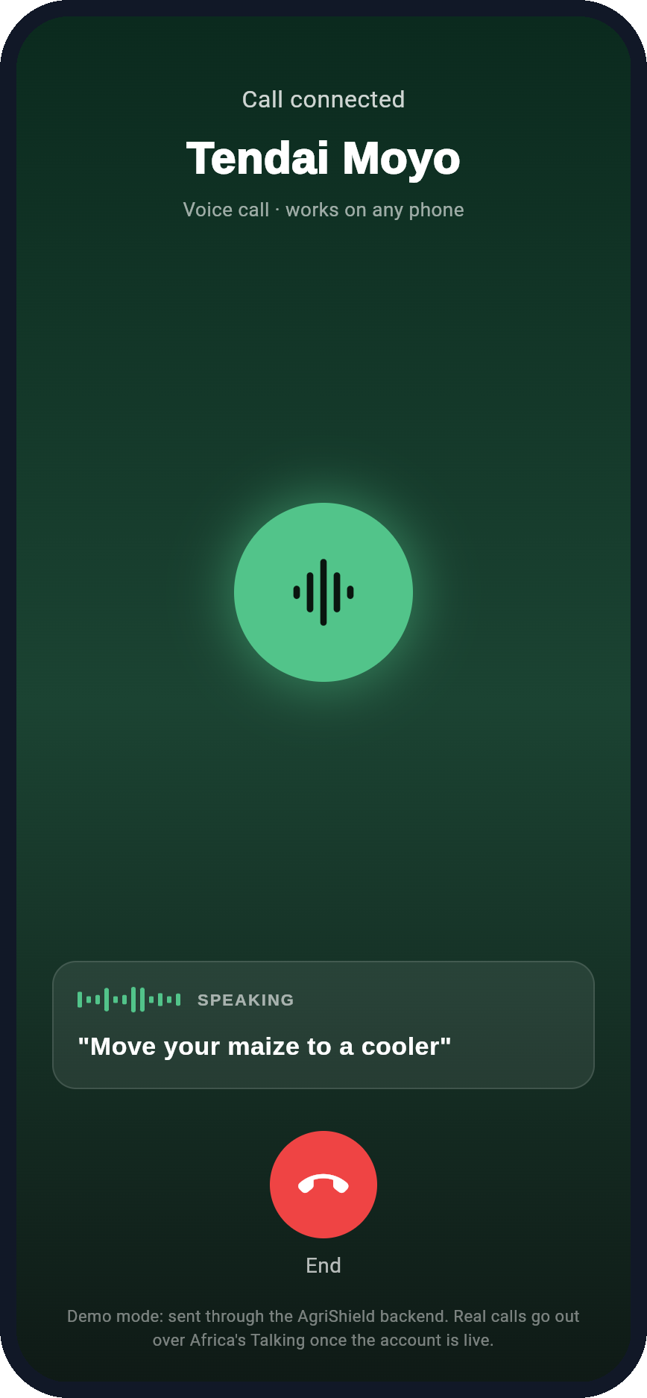
ACCESS
Any phone. Even with no internet.
1
Smartphone
The full app — and it keeps working with no signal.
2
Basic phone
The same warning arrives as an SMS.
3
Voice call
Can't read the message? A call reads it out to you.
One message. One thing to do. In words a farmer already uses.
Notes:
Most judges — and every farmer — care how it reaches them, not what it's built with. Smartphone: the full app, working with no signal. Basic phone: the same warning as an SMS. Can't read? A voice call reads it out. All three go through one channel, Africa's Talking.
On screen is the prototype's call screen. Be plain: the live call needs the Africa's Talking account switched on; in the demo it runs through our backend in demo mode.
(The technical architecture is in the appendix if a judge asks.)

Slide 7
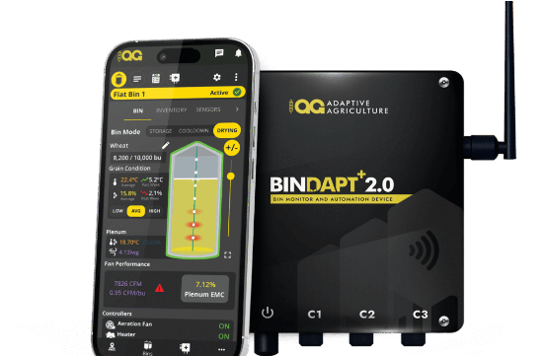
MODULE SPOTLIGHT 01
See it live
Solar Storage Monitoring
Low-Cost IoT Hardware
Solar panel, rechargeable battery, and high-accuracy DHT sensors.
Early Spoilage Threshold Alerts
Converts temperature and relative humidity into actionable SMS warnings.
Evidence-Before-Infrastructure
Uses sensor data to validate actual demand before building $30k solar cold rooms.
Notes:
This is the part to show live: the two thermometers, then the phone ringing. Keep the backup video ready.

Slide 8
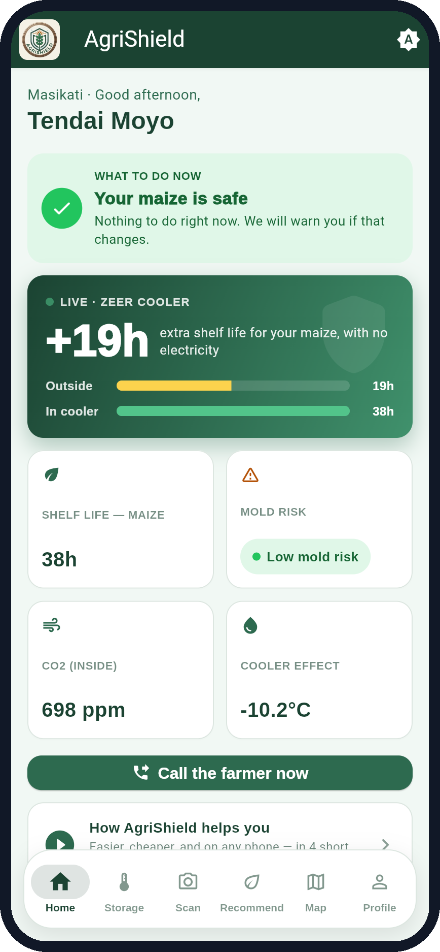
THE MOMENT TO REMEMBER
A $1 clay pot, no electricity
+19 hours
of extra shelf life for maize inside a zeer pot-in-pot cooler, compared with the same maize outside it.
How we know: two sensors, one inside the cooler and one outside. The app turns the temperature gap into hours using the rule that spoilage roughly doubles for every 10°C.
Demo reading, sensor simulated; per-crop rate still to be checked.
Notes:
Give the room one number to remember. In the live demo the gap grows as the cooler keeps working — about +17 to +19 hours after 30–40 seconds.
Be exact about what it is: a live reading from the prototype (sensor simulated until the hardware is connected), using the food-science rule that spoilage roughly doubles every 10°C. The exact rate differs per crop and still needs checking against a food-storage reference.
The zeer pot-in-pot cooler: Mohammed Bah Abba, Rolex Award 2001, about $1 to build.

Slide 9
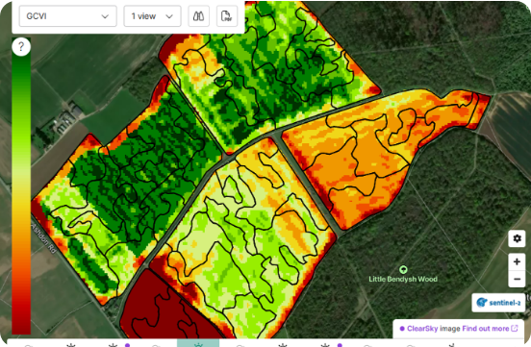
MODULE SPOTLIGHT 02
Geospatial & AI Plant Screening
10-Meter Sentinel-2 Satellite Index
Detects district-level vegetation stress and drought anomalies early.
Cautious AI Screening
Provides first-level leaf symptom checks with explicit confidence scoring.
Human AGRITEX Escalation
Refers uncertain disease classifications directly to local extension officers.

Slide 10

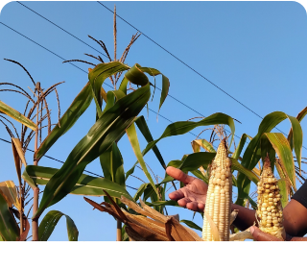
MARKET ACCESS · PHASE 02
Market Pricing & Net-Return Calculator
Priority: Mbare
352M kg
6 Markets
Smallholder Volume Potential
AMA Price Feed Tracking
Delivered by smallholders across tobacco and staple grains in peak seasons.
Piloting first in Mbare, then Sakubva, Chipadze, Renkini, Chiredzi.

Slide 11
WHAT IT COSTS A FARMER
Cheap enough to say yes today
Free
~$1
~$2–3
Per season
Warnings
Zeer cooler
PICS bag
Solar sensor
SMS and voice-call alerts for smallholders.
Two clay pots and wet sand — built at home, no electricity.
A sealed bag that stops pests and mold in stored grain.
Rented, not bought. Price being set with local suppliers.
No new machine to buy. No data plan needed.
Notes:
Farmers ask 'what will this cost me?' before anything else. Answer it plainly: the warnings are free; the fixes are things they can afford today — a clay-pot cooler for about a dollar, a PICS bag for about two to three dollars. The sensor is rented by the season.
Don't give a sensor price until we have three local supplier quotes (playbook §02). PICS bag price is the commonly quoted figure — not reconfirmed from a live source.

Slide 12
COMMERCIAL VIABILITY
Multi-Stream Sustainability Model
Start here
Hardware-as-a-Service
Co-op Subscriptions
Freemium Alerts
NGO Data Analytics
Seasonal leasing of solar IoT storage sensor units to farmers and traders.
Bulk storage tracking and group management dashboards for aggregation hubs.
Core USSD/SMS weather and crop alerts provided free to smallholders.
Anonymized regional risk analytics and yield trends for development partners.

Slide 13
EXECUTION PLAN
Strategic Phased Roadmap
Prototype live
Planned
Planned
Planned
PHASE 01
PHASE 02
PHASE 03
PHASE 04
Core MVP
Intelligence
Local Field Testing
Ecosystem
Offline app, solar storage sensor prototype, basic TFLite leaf diagnostics.
Sentinel-2 maps, Open-Meteo integration, and AMA price engine.
AGRITEX human workflow, dataset collection, and outcome metrics.
Kuwana price engine, buyer-matching, and transport logistics.

Slide 14
LONG-TERM VISION
AgriShield Innovate Expansion
Agri-Rover Scouting
BSF Waste-to-Feed
Kuwana Input Engine
Solar Drip Automation
Autonomous row-tracking robot adapted from Campus Compass capstone.
Black soldier fly larvae automation turning crop residues into livestock feed.
Compute-first BCI scoring comparing fertilizer and seed quality versus cost.
Closed-loop soil moisture sensors controlling solar irrigation pumps directly.

Slide 15
The Future
One Morning in 2030
Before sunrise, last night’s storage reading has already synced quietly to the network — no alert needed, because nothing crossed the line.
A solar-charged Agri-Rover has already walked the maize rows at dawn, its camera flagging two stressed plants that a satellite pass first noticed three days earlier. By the time the farmer reaches the field, a diagnosis is already waiting on their phone.
Overnight, soil-moisture sensors opened the drip line on their own — no app, no phone, just water where the roots needed it. Nearby, the Kuwana input engine has already compared three suppliers’ fertiliser prices against this season’s forecast, waiting only for a tap to confirm.
Sensor + threshold logic
working prototype
TFLite disease screening
prototype · demo model
Sentinel-2 + Open-Meteo pulls
designed · demo data today
Agri-Rover, Kuwana engine, solar drip
roadmap, not yet built
None of this is invention. Every piece is a working prototype today or already proven elsewhere — this is only what happens when they keep running together.
Notes:
Read it like a story. Then point at the labels on the right: what is a working prototype today, and what is roadmap.

Slide 16
MEASURABLE IMPACT
Target Operational Metrics
60%
< 3s
100%
Storage Loss Target
Diagnostic Speed
Offline Availability
Zimbabwe's national post-harvest-loss target for 2030 — AgriShield's contribution toward it.
On-device leaf symptom response time without network.
Core functions operate without cellular connection.

Slide 17
JOIN THE MOVEMENT
Partner With AgriShield
Building scalable climate resilience and food security for African smallholder farming communities.
Core Track
Target Deployment
AgriTech & Climate Resilience
Zimbabwe Rural Pilot Hubs
Live demo → github.com/NatureAiia/AgriShield_Super_App

Slide 18
APPENDIX · TECHNICAL FOUNDATION
Resilient Offline-First Architecture
Edge & On-Device Layer
Cloud & Gateway Layer
Flutter Mobile App: Single codebase for Android-first deployment.
FastAPI Backend: Python REST API with PostgreSQL database.
TensorFlow Lite: On-device crop illness screening without internet.
Africa's Talking: Multi-channel SMS, USSD, and Voice dispatch.
Solar IoT Nodes: Microcontroller-based temperature/humidity sensors.
Google Earth Engine: Scheduled Sentinel-2 satellite analysis.
Local Cache Sync: Delayed data upload when connectivity resumes.
Open-Meteo Integration: Automated local weather forecast feeds.
Notes:
Appendix — only if a judge asks how it's built.

Slide 19




Image Sources
Source: www.hrnstiftung.org
Source: adaptiveagriculture.ca
Source: www.agrii.co.uk
Source: www.mastercard.com
App screenshots: AgriShield working prototype — github.com/NatureAiia/AgriShield_Super_App. Farmer "Tendai" is illustrative.

