Slide 1
HawkOS
A Lightweight x86 Operating System, Built from Scratch
PROJECT REVIEW – I
Submitted by
Priyanshu Ghosh — 24BDE0138
Guide: [ Faculty Name ]
[ University / School ]
Leya Susan Vargheese — 24BDE0134

Slide 2
OVERVIEW
Agenda
▸ Objectives and scope for this review
▸ Toolchain and system architecture
▸ Work completed: boot, interrupts, drivers, shell, memory management
▸ Work completed: storage (FAT32), graphics, and a GUI preview
▸ Live demo screenshots
▸ Current results and known limitations
▸ Future scope: Review 2 and Review 3, ending in a working web browser
HawkOS — Project Review I
2

Slide 3
INTRODUCTION
Why Build an OS From Scratch?
Modern operating systems hide enormous complexity behind system calls and standard libraries. HawkOS rebuilds that complexity from nothing — starting at the CPU reset vector — to genuinely understand booting, interrupts, memory virtualization, and eventually a full desktop and browser.
Architecture
x86, 32-bit protected mode
Booted via GRUB
Multiboot 1 specification
Development
QEMU (qemu-system-i386)
Primary test environment
Real hardware: future work
End Goal
Graphical desktop environment
Centerpiece: a working browser
Budget: 128 MB RAM
HawkOS — Project Review I
3

Slide 4
OBJECTIVES
Long-Term Goal vs. This Review's Scope
Long-term objective
Review – I scope
A lightweight OS with a functioning graphical desktop and a working web browser as its centerpiece application — engineered to run entirely within a 128 MB RAM budget.
▸ Bootstrap a protected-mode kernel via GRUB
▸ Interrupts: IDT, CPU exceptions, PIC, PIT
▸ Core drivers: keyboard, VGA/framebuffer console, serial
▸ Memory management: physical allocator, paging, kernel heap
▸ A usable interactive shell with live diagnostics
▸ Read-only FAT32 storage and a first GUI preview
HawkOS — Project Review I
4

Slide 5
SYSTEM DESIGN
Toolchain and Boot-Time Architecture
Toolchain
NASM — assembler (ELF32)
GCC — freestanding 32-bit build
GNU ld — custom linker script
GRUB — Multiboot 1 bootloader
grub-mkrescue — BIOS + UEFI ISO
QEMU — qemu-system-i386
GitHub Actions — CI build on every push
Boot-time layers (in order)
GRUB (Multiboot) loads the kernel ELF
boot.s: captures Multiboot info, loads GDT
GDT: flat ring-0 code/data segments
IDT/ISRs: CPU exceptions + hardware IRQs
Drivers: PIC, PIT, keyboard, mouse, serial, ATA
Memory management: PMM, paging, kernel heap
Shell: line editor + command interpreter
HawkOS — Project Review I
5

Slide 6
WORK COMPLETED
What's Working, End to End
▸ Boot & protected mode: multiboot handshake, flat GDT, kernel entry
▸ Interrupts & exceptions: 256-entry IDT, all 32 CPU exceptions decoded and reported by name
▸ Drivers: PS/2 keyboard, serial UART, PS/2 mouse, ATA (PIO)
▸ Memory management: physical frame allocator, paging (identity-mapped), kernel heap (kmalloc/kfree)
▸ Interactive shell: line editor, plus live diagnostics (meminfo, cpuinfo, date, crash)
▸ Storage: read-only FAT32 filesystem — ls / cd / cat on a real disk image
▸ Graphics: linear framebuffer, bitmap font console, and a first GUI preview with a live mouse cursor
HawkOS — Project Review I
6

Slide 7
SECTION 5.1 – 5.2
Boot Sequence and Interrupt Handling
Boot & Protected Mode
Multiboot 1 header requests a framebuffer
boot.s captures EAX/EBX (magic + info ptr)
load_gdt installs a flat ring-0 GDT
Kernel stack set up, kernel_main() called
Interrupts & Exceptions
256-entry IDT, default handler on every gate
All 32 CPU exceptions decoded + reported by name
PIC remapped off conflicting BIOS vectors
PIT programmed to a 100 Hz tick
Proven live via the shell's crash command
HawkOS — Project Review I
7

Slide 8
SECTION 5.3 – 5.4
Device Drivers and Debug Output
Input
PS/2 keyboard: scancode → ASCII
Shift / caps-lock tracking
Ring-buffer input queue
PS/2 mouse (IRQ12), 3-byte packets
Output
Framebuffer console (replaces VGA text)
Hand-authored 5×7 bitmap font
Serial (UART) — independent debug channel
kprintf: mirrors to console + serial
Why serial matters
Works even before graphics is ready
Full scrollback in a terminal/log file
make run-log captures it to serial.log
Primary tool used throughout development
HawkOS — Project Review I
8

Slide 9
SECTION 5.5, 5.8
Interactive Shell and Live Diagnostics
Shell core
tty_readline(): blocking line editor
Backspace, enter, printable-range handling
help / echo <text> / uptime
Simple, readable command dispatch
New: live introspection
meminfo — live PMM + kheap usage
cpuinfo — CPUID vendor/brand string
date / time — CMOS RTC driver
clear
crash — triggers a live divide-by-zero to prove exception handling works
HawkOS — Project Review I
9

Slide 10
SECTION 5.6
Memory Management — The Foundation
Every later subsystem — multitasking, storage, graphics, networking, the browser — depends directly on this.
Multiboot Memory Map
Parses the real BIOS memory map
Fallback: mem_lower / mem_upper
Last resort: guessed 16 MB
Physical Allocator (PMM)
Bitmap allocator, one bit / 4 KB frame
Reserves first 1 MB + kernel image
kernel_start/kernel_end from the linker
Paging + Kernel Heap
Full identity map, CR3/CR0.PG enabled
paging_map(): reusable mapping primitive
kmalloc/kfree: first-fit, coalescing
HawkOS — Project Review I
10

Slide 11
SECTION 5.9
Storage: ATA Driver + Read-Only FAT32
ATA PIO Driver
LBA28, primary bus, master drive
Polls BSY/DRQ status, 16-bit PIO reads
First disk access the kernel has ever had
FAT32 (read-only)
BPB parsing + FAT cluster-chain walking
Root directory = a cluster chain, like any dir
VFAT long-filename entries safely skipped
ls / cd <dir> / cat <file> in the shell
Write support: a controlled Review 2 follow-up
HawkOS — Project Review I
11

Slide 12
SECTION 5.10
Graphics: Framebuffer, Font, and a GUI Preview
Framebuffer + Console
Multiboot video-mode request; GRUB negotiates it
gfx.c: pixel / rect / char / string primitives
Hand-authored 5×7 bitmap font (upper + lower case)
console.c backend rewritten — same public API
kprintf/shell/exceptions needed zero changes
GUI Preview (gui command)
Static desktop scene: taskbar + 2 window panels
Live PS/2 mouse cursor, accurately tracked
Save/restore-under-cursor redraw (no corruption)
ESC returns cleanly to the text shell
Foundation for Review 2/3's window manager
HawkOS — Project Review I
12

Slide 13
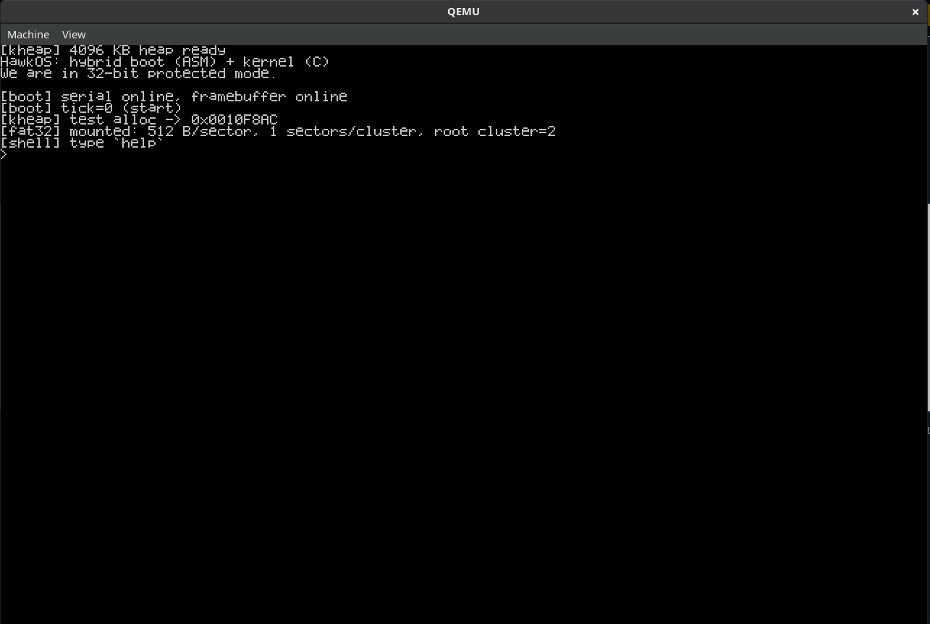
DEMO
Screenshots — Boot, Shell, Diagnostics
[ Paste screenshot here ]
Fig. 3 — Shell session (help, echo, uptime)
Fig. 1 — Boot: banner + memory-manager log
HawkOS — Project Review I
13

Slide 14
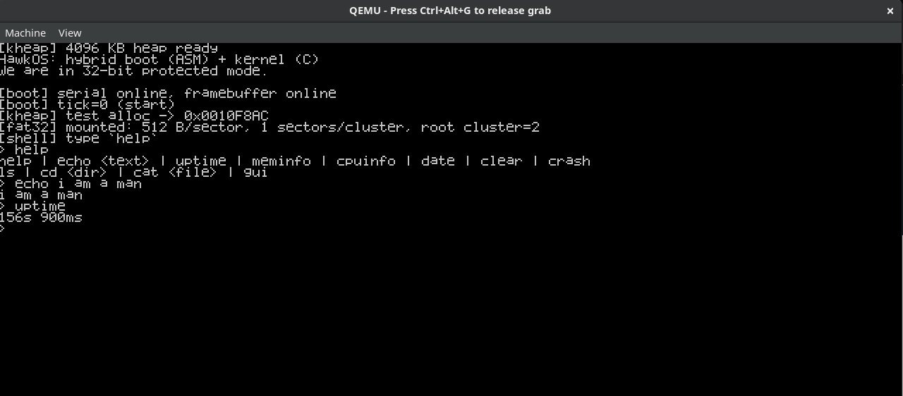
DEMO
Fig. 2 — Shell session (help, echo, uptime)

Slide 15
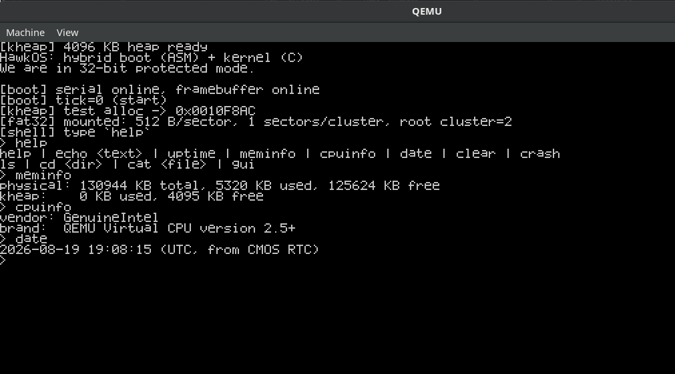
DEMO
Fig. 3 — meminfo / cpuinfo / date output

Slide 16
DEMO
Fig. 4 — ls / cat on the FAT32 disk image

Slide 17
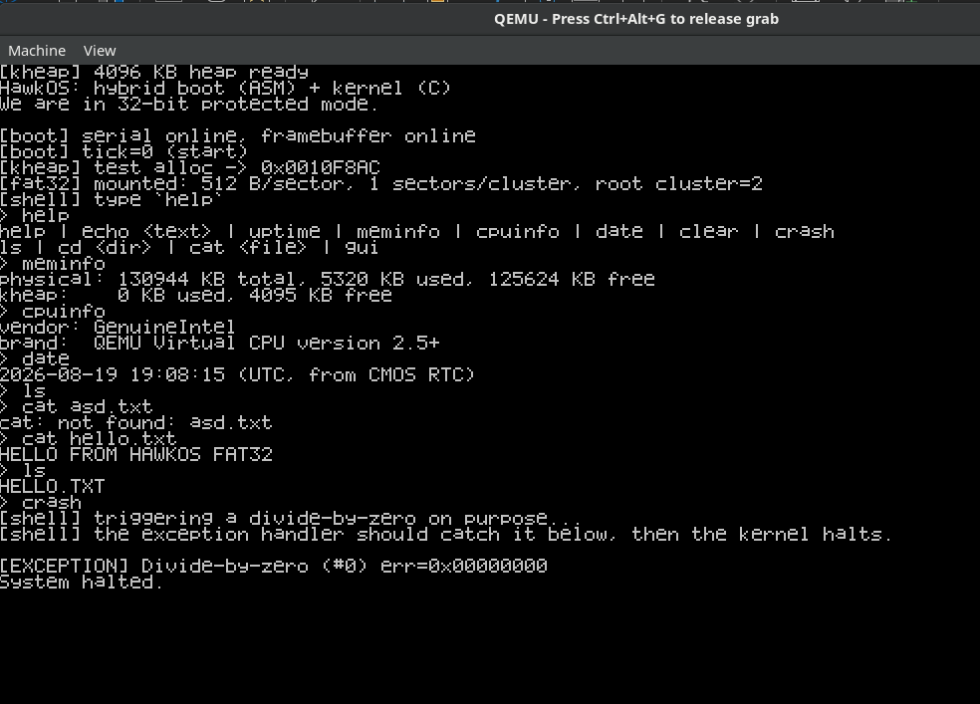
DEMO
Fig. 5 — crash: exception handler live

Slide 18
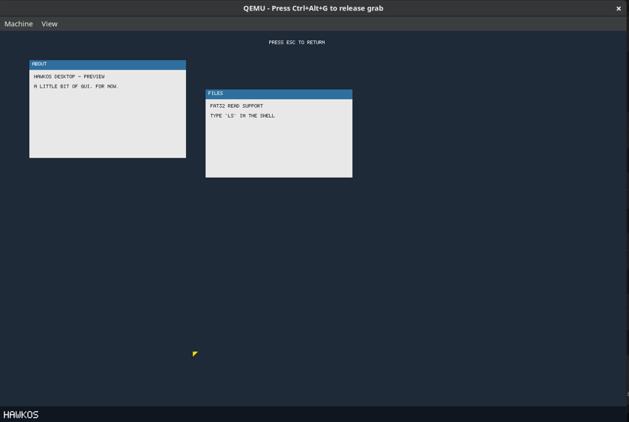
DEMO
Fig. 6 — gui: desktop preview + cursor

Slide 19
STATUS
Results and Known Limitations
Working end-to-end
Known limitations
▸ Boots via GRUB (BIOS + UEFI) in QEMU
▸ Exceptions caught and reported, not triple faults
▸ Keyboard, mouse, serial, framebuffer console all live
▸ Shell responds in real time, incl. diagnostics
▸ FAT32 read of real files off a real disk image
▸ GUI preview renders + tracks the mouse correctly
▸ Single flat address space, no user mode yet
▸ No process/thread model or scheduler
▸ FAT32 is read-only for now
▸ GUI is static — no window dragging/clicking yet
▸ No networking stack yet
HawkOS — Project Review I
15

Slide 20
DESIGN CONSTRAINT
128 MB RAM — Enforced at the Software Level
HawkOS is not limited by 128 MB of physical hardware — it's a deliberate design budget the kernel is engineered to respect regardless of how much RAM is actually available. The physical memory manager already tracks and reports usage precisely for this reason, verified live with the meminfo command.
▸ Kernel heap, FAT32 buffers, and the framebuffer are all sized deliberately, not left unbounded
▸ The network stack and browser (Review 3) will be held to the same budget
▸ This rules out existing browser engines (Chromium/WebKit/Gecko need hundreds of MB+) by design
HawkOS — Project Review I
16

Slide 21
FUTURE SCOPE
Review 2 — Multitasking, Storage, and a Real Desktop
▸ Multitasking — process/thread model, context switching, round-robin scheduler
▸ User mode + syscalls — ring-3 execution and a minimal ELF loader
▸ FAT32 write support — cluster allocation, FAT/FSInfo updates, done carefully
▸ A real window manager — z-ordering, dirty-rect redraw, a minimal widget set, built directly on this review's framebuffer/font/mouse driver
▸ Start the network stack early if there's schedule slack — Review 3's biggest risk item
HawkOS — Project Review I
17

Slide 22
FUTURE SCOPE
Review 3 — Networking and the Web Browser
▸ Network stack: one well-emulated NIC (virtio-net / RTL8139) — our own Ethernet→ARP→IP→ICMP→UDP→TCP + sockets
▸ HTTP client built on that TCP stack
▸ HTML/CSS via reused libraries: Gumbo (HTML5) + NetSurf's libcss/libparserutils/libwapcaplet — purpose-built for low-memory, non-POSIX targets
▸ Our code: OS integration, TCP/HTTP layer, and painting layout onto the framebuffer inside a real window
▸ To confirm early: check with the faculty guide that reused parsing libraries are acceptable for grading
Deliverable: a browser window inside the HawkOS desktop, fetching and rendering a real page over a real network connection.
HawkOS — Project Review I
18

Slide 23
Thank You
A working protected-mode kernel with interrupts, drivers, memory management, storage, and a first GUI preview — the foundation for Review 2 and 3, ending in a browser running inside HawkOS's own desktop.
Questions?

