Slide 1
Zero-shot & few-shot learning and when they meets scalability
DTM2 CHEN PENG
KYOTO UNIVERSITY

Slide 2
Research Background
In anomaly detection and activity recognition, having few labeled data is very often. In such cases, supervised model tends to have degraded performances.
Zero-shot learning
Few-shot learning
Data distribution
Notes:
Problem: Annotating large number of object categories is challenging and expensive and needs updating over time to include new objects.
Zero-shot learning: The ability to correctly annotate images of previously unseen object categories.

Slide 3
Our activities on zero- and few-shot learning
Research for top-tier conferences
Zero-shot learning with GAN, accepted by AAAI 18, DTM3 Martin and Kong
Zero-shot learning with disentangled representation, CVPR 19, DTM3 Martin
Few-shot learning with data distribution adaptation, ICML 19, DTM1 Ohashi and Huang
Build a library for zero-shot and few-shot learning, including state-of-the-arts and our proposals.
Make this library handles big data, and supports distributed training and inference with scalable data.

Slide 4
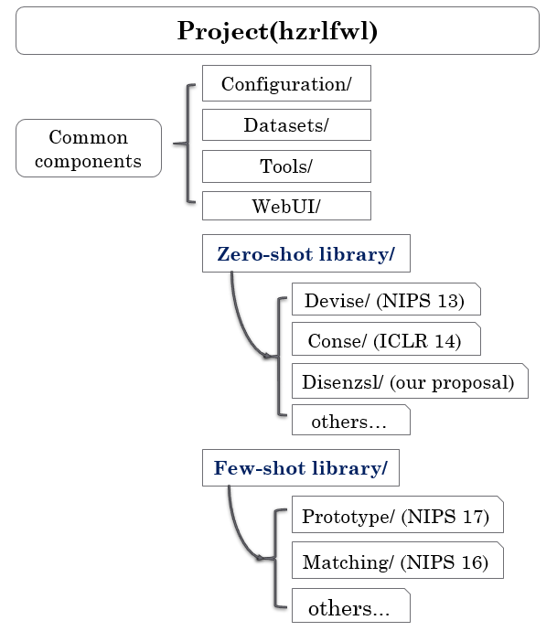
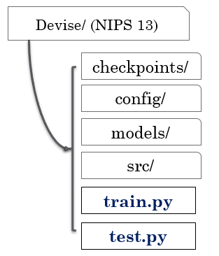
Structure of our library

Slide 5
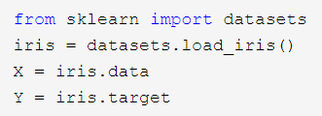

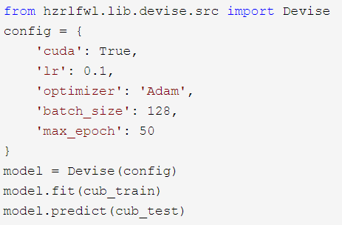


How to use this library
Sklearn
load datasets (e.g. iris)
load models (e.g. SVM)
training and test
Our library
load datasets (e.g. CUB)
load models & training & test (e.g. devise)

Slide 6
Problems with scalable data
Generally, most of trainings and inferences work on single GPU on
single node.
Better case: work on multiple GPUs on single node.
Our proposals: Distributed framework
Distributed training
Distributed inference
Speed up the PoCs

Slide 7
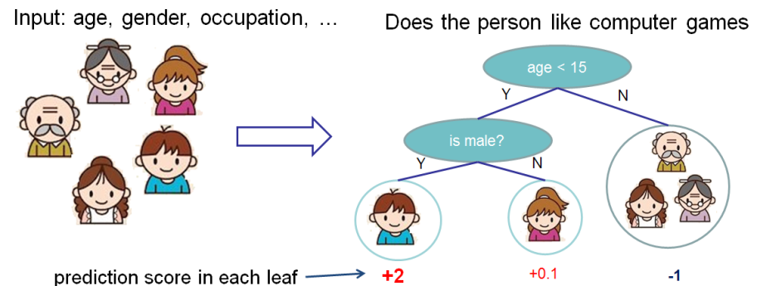
Distributed training with multiple GPUs/nodes
How to be distributed ?
Which attributed to select?
Two kinds of distributed training
Model distributed training
Data distributed training
Example of model distributed training
XGBoost distributed training
attr1
attr2
attr3
attrN
Distributed calculate losses
node1
node2
node3
Select the best attribute
age
Notes:
How to be distributed ?
Consider when we are constructing decision tree….

Slide 8
Distributed training with multiple GPUs/nodes
Two kinds of distributed training
Model distributed training
Data distributed training
Commonly used: Data distributed training
Process(model) replicas on nodes
Data partition
Gradient averaging
Dataset
Data partition
Node1
(data part1)
Node2
(data part2)
Node3
(data part3)
Calculate gradients
G1
G2
G3
Averaging
mean(G)
Back-propagation & Updating

Slide 9
Distributed training benefits
Experiment1: data distributed training of Devise (NIPS 13)
Our environment: node-1 (2 GPUs), node-2 (2 GPUs)
Training time comparison
Single GPU: 7.0 seconds / epoch
2 GPUs + 2 GPUs: 4.3 seconds / epoch
Knowhow about distributed training
Computation cost
GPU computation
Switching between GPU(s) and CPU
Communication between nodes
Experiment2: model distributed training of XGBoost
Our environment: node-1 (12 CPU cores), node-2 (12 CPU cores), node-3 (40 CPU cores)
Training time comparison
Single CPU (12 cores): > 2 hour / epoch
Three nodes (12+12+40): 42 minutes / epoch
Knowhow about distributed training
Computation cost
CPU computation
Communication between nodes

Slide 10
Inference with scalability
Our use case: after training, we want to handle concurrent data
Use trained model to do inference
Streaming data, continuous and massive
High concurrency. E.g. 200 queries per second
Distributed inference framework
Docker
Packages up applications and run them by using containers.
The container also package up OS environment, libraries, and other dependencies it needs.
Kubernetes
A system for scaling and management of containerized applications
Kafka
A data queue structure as a streaming data source.
Spark
A engine for large-scale and distributed data processing.
Notes:
The container also package up OS environment, libraries, and other dependencies it needs.

Slide 11
How they collaborate together
Kubernetes cluster is based on Docker
Spark cluster is deployed on Kubernetes cluster
Results
query
stream
Spark cluster (Logical)
Data
(Queries)
Kafka
Executor1
Executor2
Driver
Executor3
Kubernetes cluster (Physical)
Master
Node1
Node2
Docker Containerization

Slide 12
Work flow of the framework
Kubernetes Cluster
HTML
Javascript
Message Processing Cluster
②Create
executor request
Spark Driver
Web UI
Flask
Communicate
POST
message topics
APIserver
①Create driver
Spark
Executor
Upload
Kafka
Scheduler
Spark
Executor
Spark
submit
③Create executors
Spark
Executor
images
Docker Repository
container
A
container
Container
spark-driver
image
Few-shot/
Zero-shot Library
spark-executor
image
container
B
Spark Library
Cuda Library

Slide 13
Demo show

Slide 14
Another use case of distributed framework
Problem: 130M asset management data can not be trained on one node.
What we can do:
Distributed train our classifier
XGBoost distributed training
Based on a spark cluster
Pytorch distributed training
Deep learning based classifier
Multiple GPUs and multiple nodes
Based on distributed package supported by Pytorch
Inverted Indexing on a spark cluster
Do map-reduce on a spark cluster

Slide 15
Problems with scalable data

Slide 16
Thank you.
Questions please!

Slide 17
Appendix

Slide 18
Project(hzrlfwl)
Configuration/
Devise/ (NIPS 13)
Common components
Datasets/
checkpoints/
Tools/
config/
WebUI/
models/
Zero-shot library/
src/
Devise/ (NIPS 13)
train.py
Conse/ (ICLR 14)
Disenzsl/ (our proposal)
test.py
others…
Few-shot library/
Prototype/ (NIPS 17)
Matching/ (NIPS 16)
others...

Slide 19
Results
Spark cluster (Logical)
Data stream
Kafka
Executor1
Executor2
Driver
Executor3
Support
Kubernetes cluster (Physical)
Master
Node1
Node2
Support
Docker Containerization

