Slide 1

Sprocket Central Pty Ltd
Data analytics approach

Slide 2
Agenda
The approach will be implemented in three stages :
Data Exploration
Model Development
Interpretation

Slide 3
Data Understanding
Approach for New Customer Data analysis :
Age distribution
Bike purchase
Job industry
Number of cars owned

Slide 4
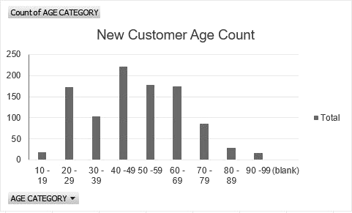
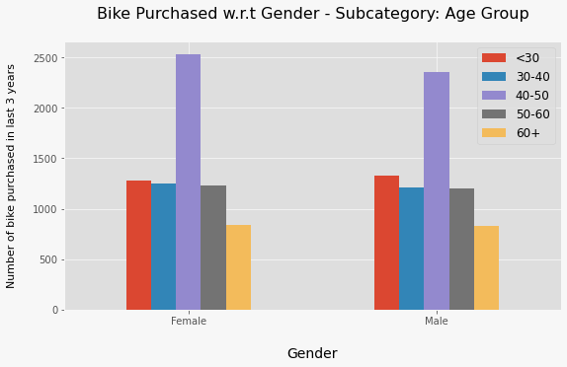
Data Exploration : Age Distribution & Bike Purchases
The majority of new customers fall within the 40-49 age range, with the 50-59 and 60-69 groups following closely behind
Fewer customers are in the 10-19 and 90-99 age groups, which is understandable
The data indicates that the 40-50 age group has the highest number of bike purchases in the last 3 years, with a slightly higher proportion of females
When planning our marketing and advertising efforts, it's advisable to place more emphasis on targeting females over males in this age range

Slide 5
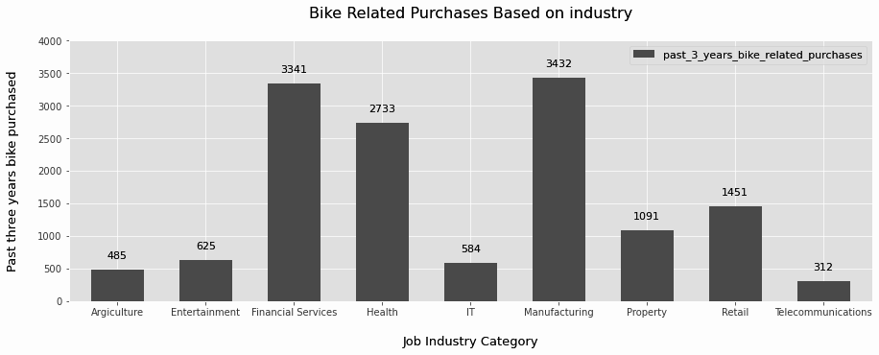
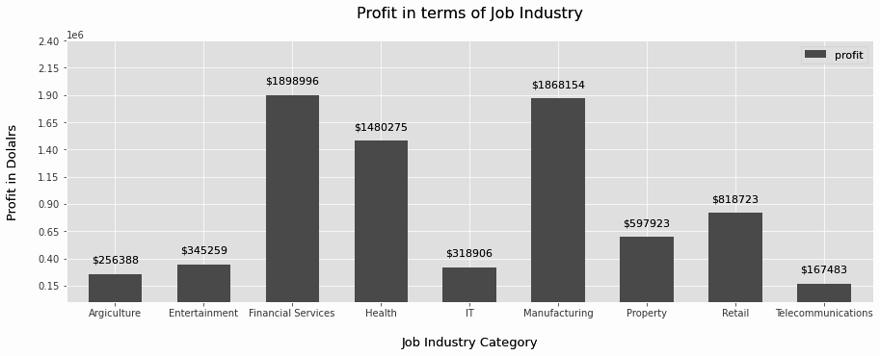
Data Exploration : Job Industry Purchase Analysis
The leading industries in generating profits are Financial Services, Manufacturing, and Health, with Retail and Property following closely behind.
Similarly, the second chart reflects that the most significant profits are derived from Financial Services, Manufacturing, and Health.

Slide 6
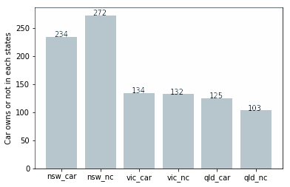
Data Exploration : Count of owned cars
Out of three states, New South Wales, could be potential market opportunities for the company
New South Wales has the biggest potential since the number of people who own vehicles is nearly equal to the number of individuals who do not own cars, indicating that there is room for value customers there
VIC and QLD has more customers that own car that who don’t but we can try to have something so that those owns car will buy bikes

Slide 7
Model Development
CUSTOMER CLASSIFICATION – Targeting High Value Customers
The following are the high-value clients to target from the new list :
In the age range of 40 to 50
A higher number of high-value customers are female rather than male
They are employed in the Financial Services, Manufacturing, and Health sectors
And they currently reside in New South Wales and Victoria

Slide 8
Interpretation
HIGH-VALUE CUSTOMER SUMMARY TABLE
Analysis of the provided table reveals:
The top job categories for recent bike-related purchases (within the last three years) are Financial Services, Manufacturing, and Health sectors
These purchases are predominantly associated with customers in the Mass Customer segment
The geographical focus of these purchases is primarily in New South Wales and a portion of Victoria
This data highlights the need for targeted marketing and sales strategies in these regions to capitalize on this trend and enhance market performance

Slide 9
Note: The data and information in this document is reflective of a hypothetical situation and client. This document is to be used for KPMG Virtual Internship purposes only.
THANK YOU
Presented By: Natwar Upadhyay
Junior Data Analytics Consultant

