Slide 1

POE Final PROG6212 PowerPoint
St10258513 Clifford Naude Group 1

Slide 2
Update from part 2 to part 3 Based on lecturer comments
Added document column in the table with view and download buttons for the managers to view the documents from the lectureres based on the lecturer feedback.
Used more descriptive comments in my github comment submission as asked by the lecturer Created SQL database and adpated the project to use the database and migrate to it.

Slide 3
Detail design and key features for part 3
Used SSMS for local database while I worked on the application.
Added 2 viewmodels to help with the flow of data within the project.
Added HR controller Added Hr views with CRUD implimented
Added View and functions for ClaimsReport to generate pdf based on the data from the database per lecturers claim that has been approved.
Using SQL Database so store the information

Slide 4
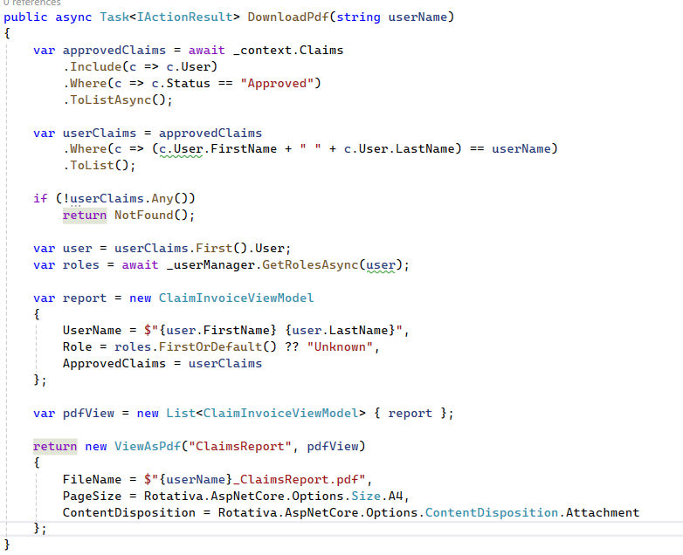
HR Controller
This is the download PDF method that will generate
the PDF of the query based on each lecturer’s claim
That has been approved. It checks the username of the
Lecturer and checks if the claim is approved.
It then collects all the data into the claimInvoiceViewModel
And uses Rotativa to generate the pdf from the result
Of the ViewAsPdf.

Slide 5
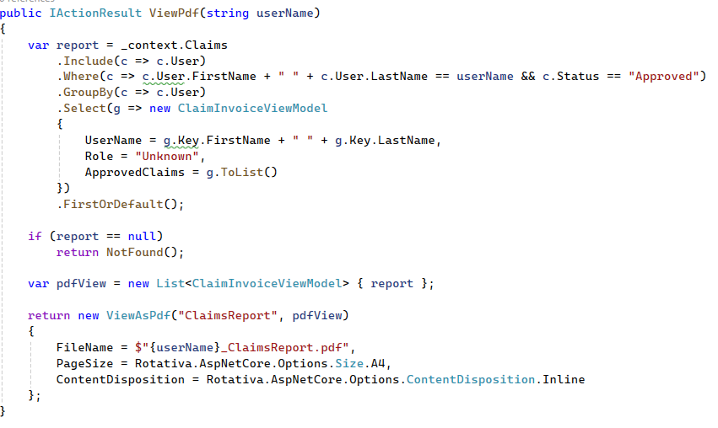
View PDF Method Of HR controller
This is method used by a button in the razor
View that allows us to view the query report in
The browser allowing for more easier viewing for
The hr.

Slide 6
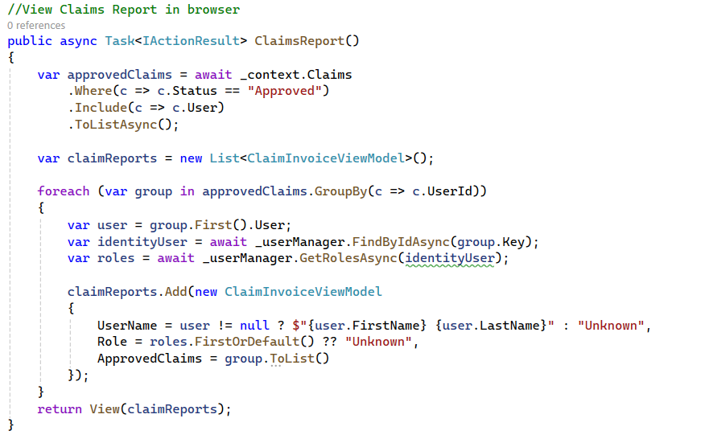
Method for the razor view in the Hr Folded
This method displays the report to the HR
And links the navigation link in the header to
The razor page.

Slide 7
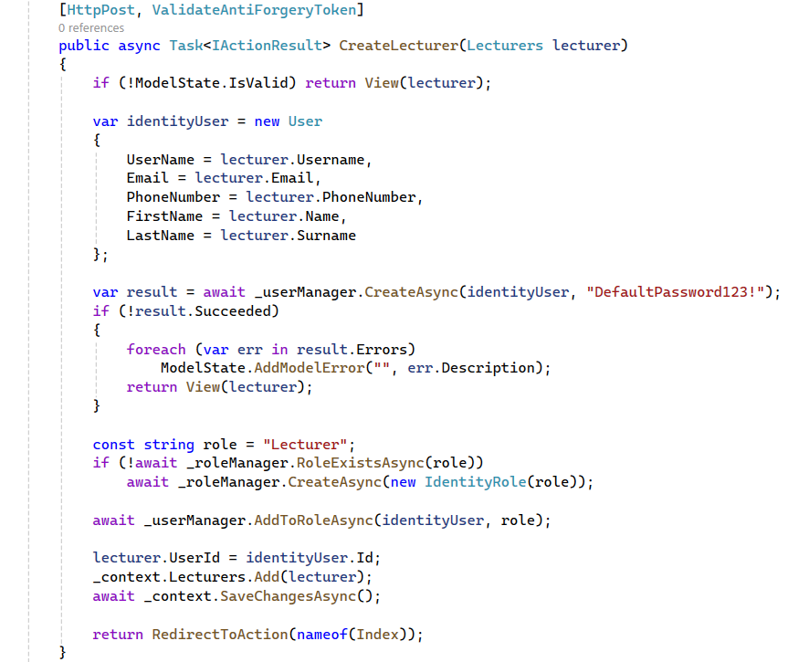
Create Lecturer
This method allows the HR to create a
Lecturer user and save the information
To the database.

Slide 8
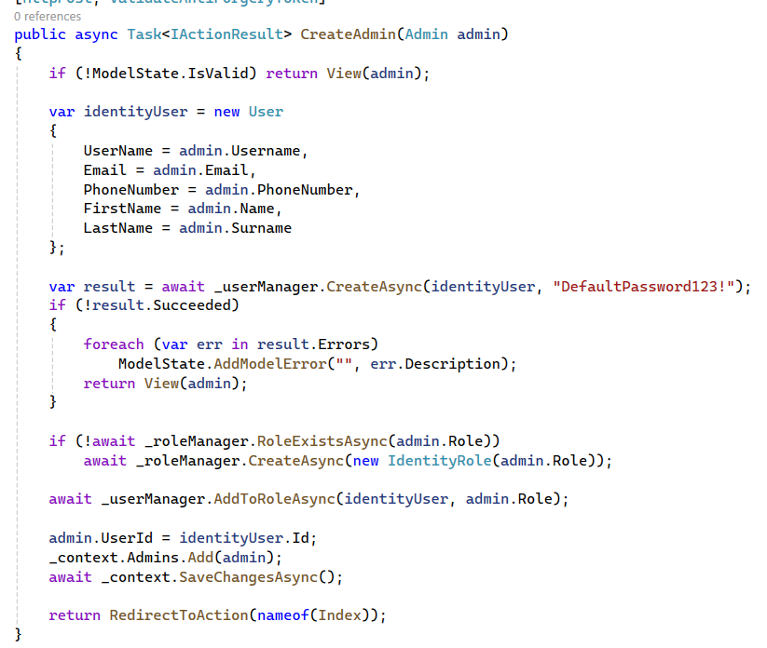
Create Admin
This allows the HR to create the admin user
And save the information to the database.

Slide 9
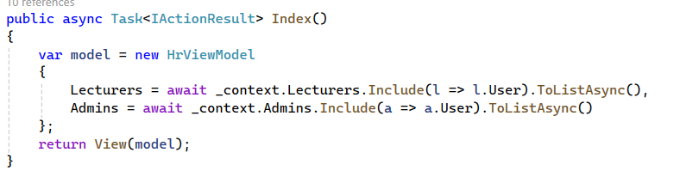
Index for Hr Controller
This method allows
Hr to view all the claims
Approved by sending
The users through the
Model.

Slide 10
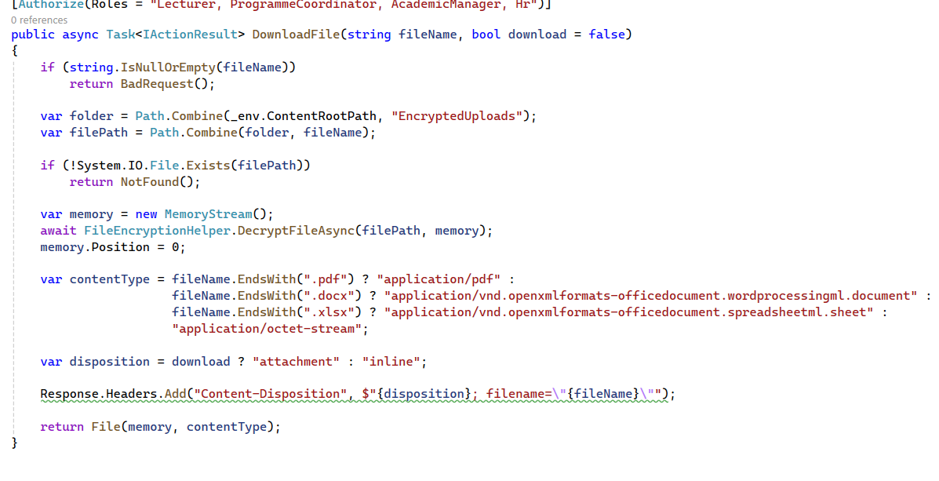
Admin Controller
This method allows
The admins to view/
Download the document
From the lecturers claims
As request by the
Lecturer in the comments
Of part 2

Slide 11
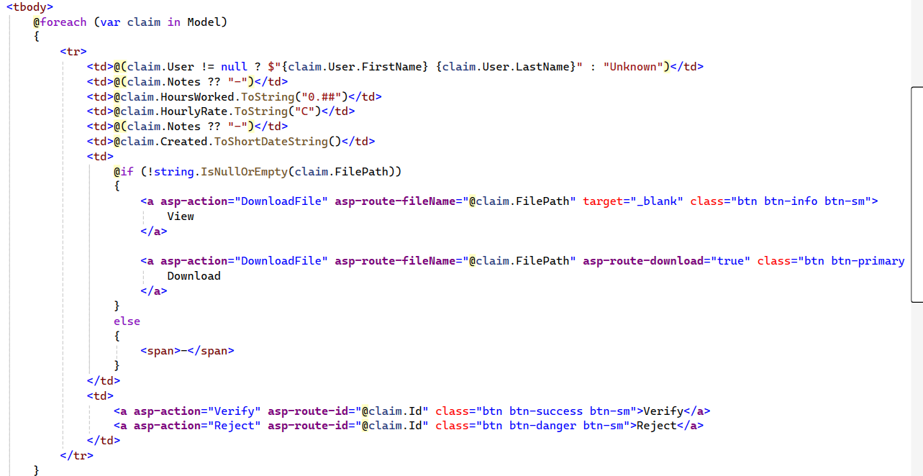
Razor view of one of the admins
This shows that I had
Included the document
Column for the admins to
View lecturers document as
Requested by the lecturer
In part 2 comments.

Slide 12
Thank You for Viewing my project for Contract Monthly Claims System
From Clifford Naude

