Slide 1
Meeting 18/02/2020
Naudé Conradie
19673418

Slide 2
Theoretical Work
Model in NX 12
Quarter model/Whole model
Mesh
Convert for Marc Mentat
.dat
Run simulation in Marc Mentat
Settings
Results
py_mentat and py_post not working
Keeping record of all selections and settings

Slide 3
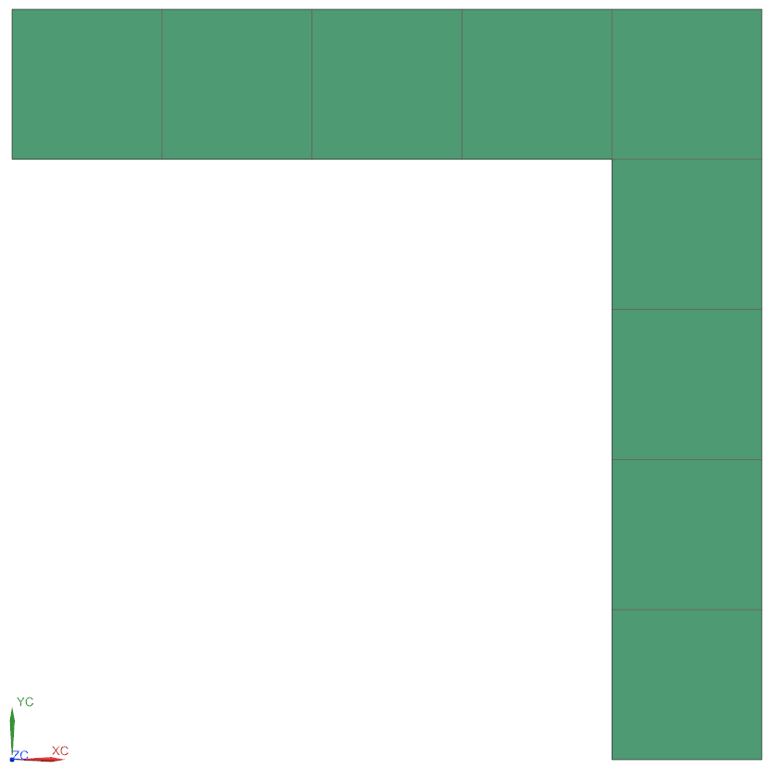
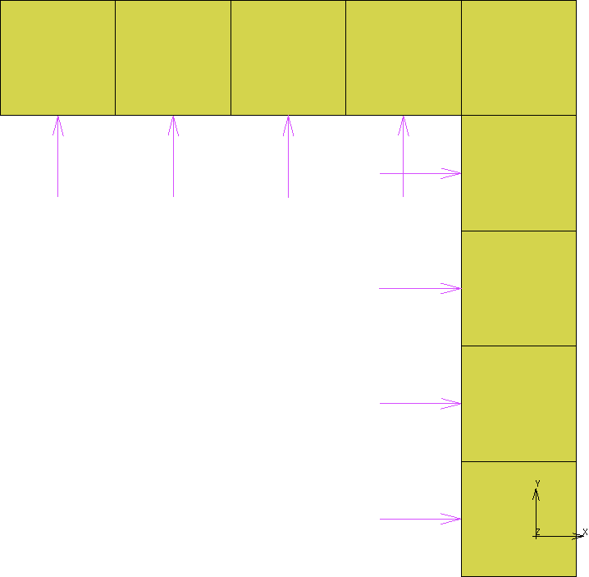
NX to Marc Mentat

Slide 4
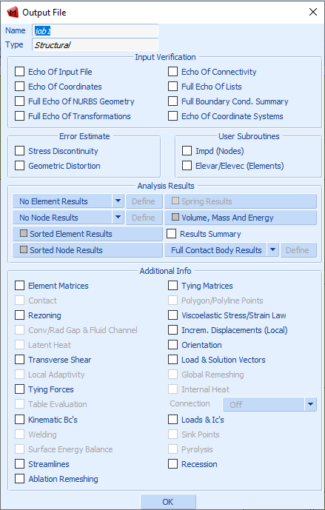
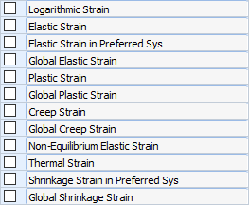
Results

Slide 5
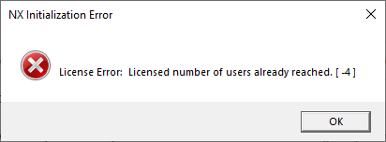
Error

Slide 6
Lab Work
Added to Instron calendar
Instron not recommended for loads less than 20 kN
Add appendix to safety report
Created specimens
Engineering Lunch Hour
DIC

