Slide 1
Meeting 27/04/2020
Naudé Conradie
19673418

Slide 2
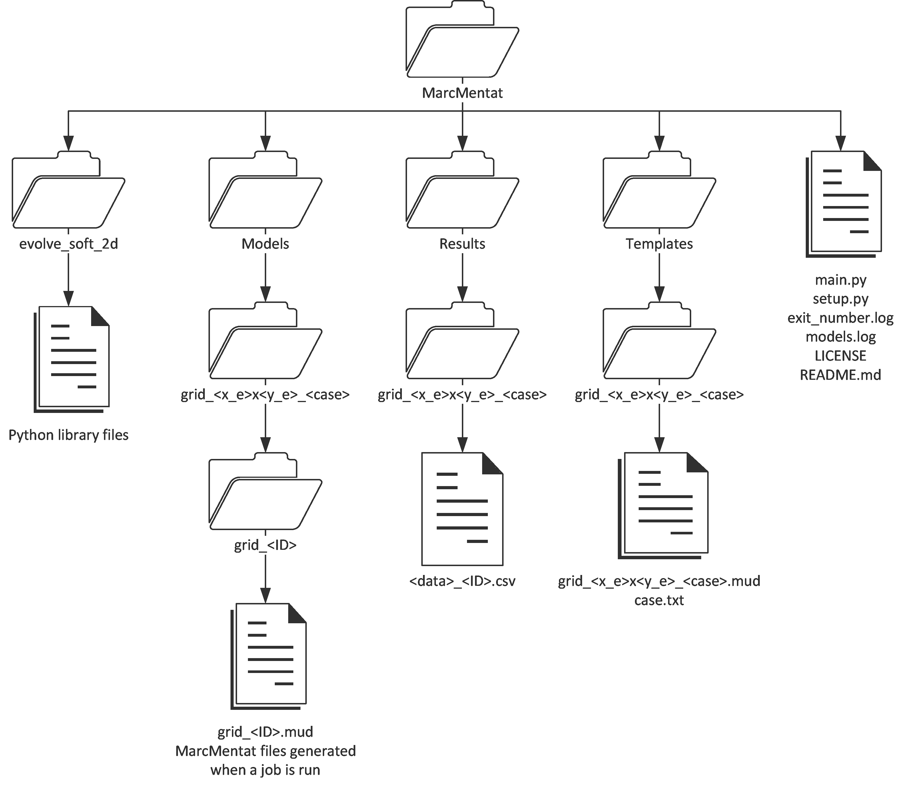
File Hierarchy
x_e | The number of elements in the x-direction | 5
y_e | The number of elements in the y-direction | 5
case | The case identifier | 1
ID | The unique model ID | 2a853a7cdfd80d15c74683cfa4136769
data | The type of data stored | Displacement

Slide 3

Code
Python library setup
License?
Reopen MarcMentat to register changes
Boundary energy
$E_{Boundary}=\sum_{i=1}^{n_{n}}{d_{i}∙F_{i}} if i is a boundary node$
Where
$n_{n}$ is the total number of nodes
$d$ is the absolute displacement of a node
$F$ is the absolute reaction force experienced by a node

Slide 4
Cases
Elongate in one direction while maintaining breadth in the other
Elongate along one edge
Circular shape
Wedge shape
Rhombus shape (pure strain)

Slide 5
Code
Random deletion of internal elements
Remove free floating elements left afterwards
Does a single node connection count?
Multiple generations?
Evolve
Add/remove neighbouring elements
Cross-breed grids
Keep overlapping elements and spaces
50/50 on differences
Weight of metric
Maximum node stress
Boundary energy

Slide 6
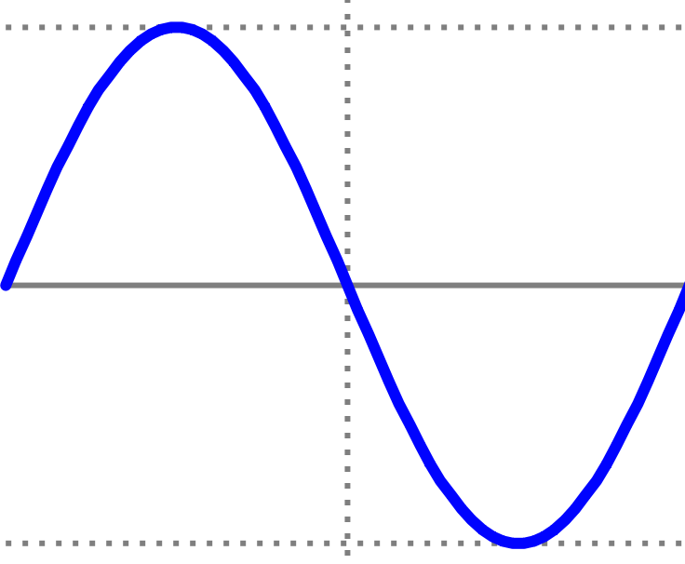
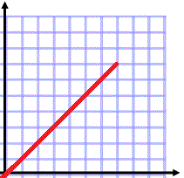
Loadcase
Evaluate sinusoidal wave at peaks and neutral
Evaluate ramp

