Slide 1
Meeting 27/04/2020
Naudé Conradie
19673418

Slide 2
Theoretical Work
Code
Python library setup
License?

Slide 3
File Hierarchy
MarcMentat
.csv result files
Python code files
Base_Models
Models
Results
grid_5x5.mud
e.g. grid_5x5
e.g. 5x5
grid_470b1add31d0e27a125b5047a7c9a88f
.mud and all Marc
generated files

Slide 4
Boundary Energy
Boundary energy = Reaction force * Displacement

Slide 5
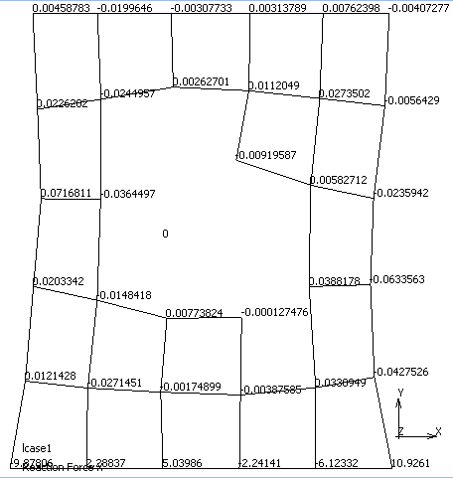
Boundary Energy

