Slide 1
Meeting 03/30/2020
Naudé Conradie
19673418

Slide 2
Theoretical Work
Code
Define network of elements
Each element sharing 2 nodes with another element
No free elements
Delete if free
Closed loop
Github
https://github.com/NaudeConradie/Masters-Project
Models > MarcMentat
Issues
Wait for .t16 file generation
.t16 opened too soon – all zeros

Slide 3
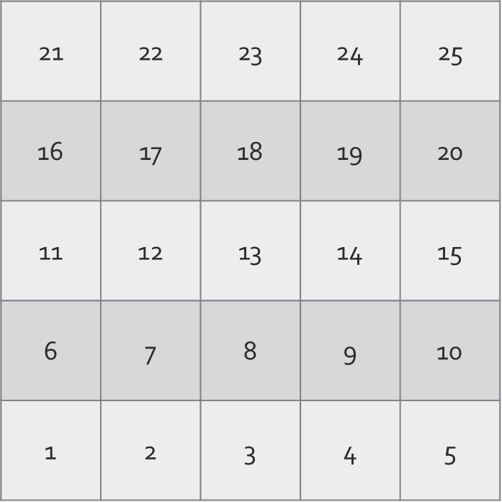

Slide 11
General Admin
Retrieved monitor
Adapter doesn’t work
Extra monitor
Occasional license server connection failure
Turned off office PC
No remote desktop access

