Slide 1

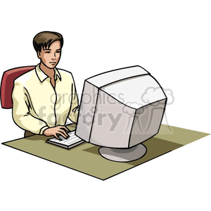
GRaphic DesigN
Is my Passion
M. O. D

