Slide 1

ARDE Website
Presentation
Created by: Wishal, Naufal, Clarence & Xinyang
01

Slide 2
01
Introduction
What the project is about
OVERVIEW
Agenda
02
Planning Phase
How we got started
What we'll cover today
03
Development Phase
Creating the product
04
Testing Phase
Ready to Launch
02

Slide 3
CHAPTER
01
Introduction
What the project is about
03

Slide 4
By The Numbers
01
120+
35
18
4.9
Member Hotels
Countries
Years Running
Guest Rating
08

Slide 5
CHAPTER
02
Planning Phase
How we got started
03

Slide 6
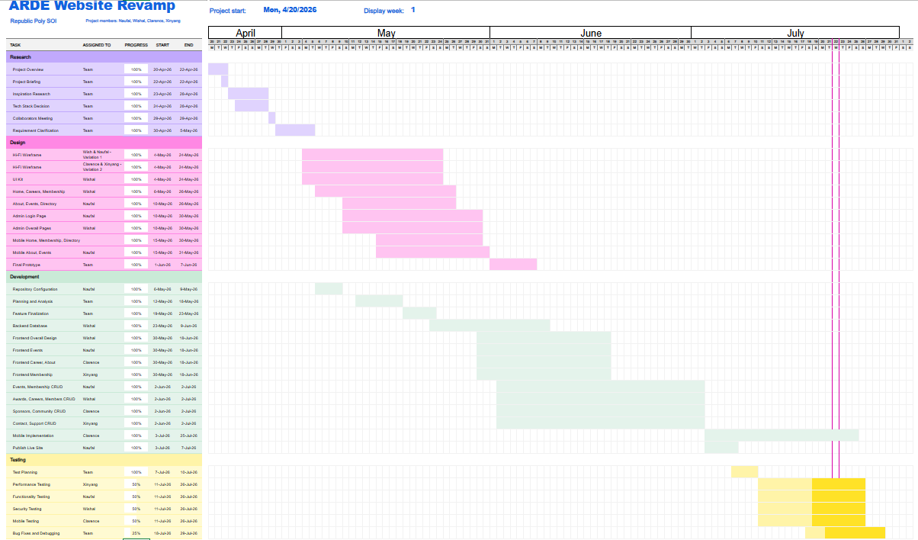
Gantt Chart: Full Project Schedule
02
LIVE DOCUMENT
View Gantt Chart

Slide 7
A Content Slide With Bullets
Clear Point One
Short supporting description goes here for context.
Clear Point Two
Keep each line tight — one idea per row reads best.
Clear Point Three
Swap the icon colour to match the section's tone.
Clear Point Four
Duplicate this row to add as many points as needed.
04

Slide 8
Comparing Two Options
Option A
Option B
Feature or benefit one
Feature or benefit one
Feature or benefit two
Feature or benefit two
Feature or benefit three
Feature or benefit three
Feature or benefit four
Feature or benefit four
05

Slide 9
SECTION 03
Development Phase
Creating the product
10

Slide 10
Image Plus Supporting Text
A supporting headline
Use this space for a short paragraph that explains the image, a program, or a milestone. Two to three sentences reads best.
Supporting detail one
Supporting detail two
Supporting detail three
Replace this placeholder with your image
06

Slide 11
“
Great hospitality is remembered
long after the stay is over.
— Name Surname, Title / Organisation
07

Slide 12
Our Process
1
2
3
4
Apply
Review
Onboard
Celebrate
09

Slide 13
SECTION 04
Security Testing
A full audit of the ARDE Admin & Public platforms.
What was tested, what was found, and what it means.
10

Slide 14
Security Testing Methodology
04
1
2
3
4
Recon
Static & Dep. Scan
Dynamic Testing
Report & Fix
11

Slide 15
Audit at a Glance
04
4
60+
121
0
CVEs Flagged (npm audit)
Routes Reviewed
DB Queries Checked
Confirmed SQL Injections
12

Slide 16
Key Findings
04
Secrets Committed to Git
CRITICAL
.env with live DB, session & Cloudinary credentials is tracked in git history, in both repos, with no .gitignore.
Password Hash Exposed Client-Side
HIGH
cookie-session stores the full admin record — including the bcrypt hash — inside a signed but unencrypted cookie.
Vulnerable Dependencies
HIGH
npm audit flags 4 CVEs: a Cloudinary SDK argument-injection bug and two Multer DoS issues, in both repos.
No Login Rate Limiting
MEDIUM
/login accepts unlimited attempts with no lockout, throttling, or CAPTCHA — brute-forceable.
13

Slide 17
Git History Audit
04
VERIFICATION
$ git log --all --oneline -- .env
→ 3 commits found (exposed)
$ git filter-repo --path .env --invert-paths
→ 60 commits parsed, history rewritten
$ git push origin --force --all
→ cleaned history pushed to GitHub
$ git log origin/main --oneline -- .env
→ (empty) — verified clean
Secrets Committed to Git
A .env file with live database, session, and Cloudinary credentials was tracked in git history across 3 commits, in both repos, with no .gitignore in place. Rated Critical Severity.
Database credentials — full read/write DB access (Critical)
Session secret — could forge valid admin login cookies (Critical)
Cloudinary API key & secret — full media account access (Critical)
The Fix
Rotated all credentials, purged .env from git history via git-filter-repo, and force-pushed the cleaned history. Verified Working.
14

Slide 18
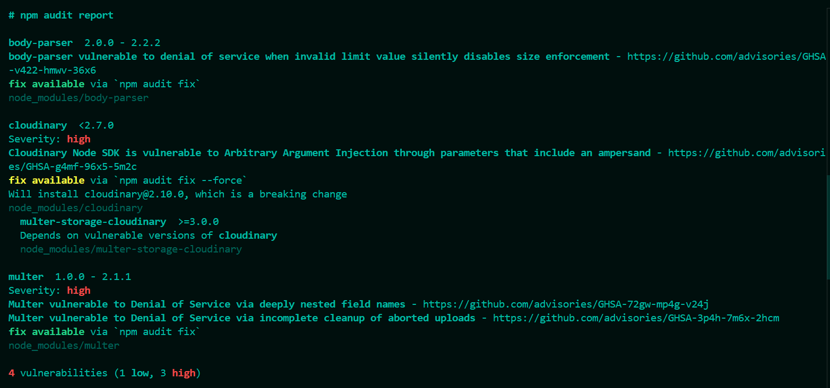
Dependency Scan
04
Vulnerable Dependencies
A dependency scan of the codebase surfaced 4 known vulnerabilities across 3 packages, all with public advisories and fixes already available. 3 of which are rated High Severity.
Multer – 2 denial-of-service issues (High Severity)
Cloudinary – Argument injection through unsanitized uploads (High Severity)
Body-parser – Denial-of-service issue (Low)
The Fix
Used “npm audit fix --force”. Verified Working
06

Slide 19
SECTION 03
Functionality Testing
10

Slide 20
Image Plus Supporting Text
04
A supporting headline
Use this space for a short paragraph that explains the image, a program, or a milestone. Two to three sentences reads best.
Supporting detail one
Supporting detail two
Supporting detail three
Replace this placeholder with your image
06

Slide 21
SECTION 04
Mobile Implementation Testing
10

Slide 22
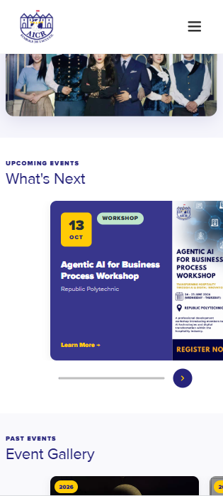
Mobile Implementation Testing
04
Findings
The mobile implementation revealed layout inconsistencies where certain UI elements were not properly aligned. The event cards and page content appeared shifted, resulting in uneven spacing and a less polished user interface..
Event cards were not horizontally centered on smaller screen sizes.
Inconsistent margins and padding caused elements to appear misaligned.
The overall layout reduced visual consistency and user experience on mobile devices.
The Fix
Updated the responsive CSS media queries by adjusting margins, padding, and element widths to improve the alignment of the mobile layout. The website was then retested across multiple mobile screen sizes to ensure that all components were consistently aligned and displayed correctly.
06

Slide 23
SECTION 04
Performance Testing
10

Slide 24
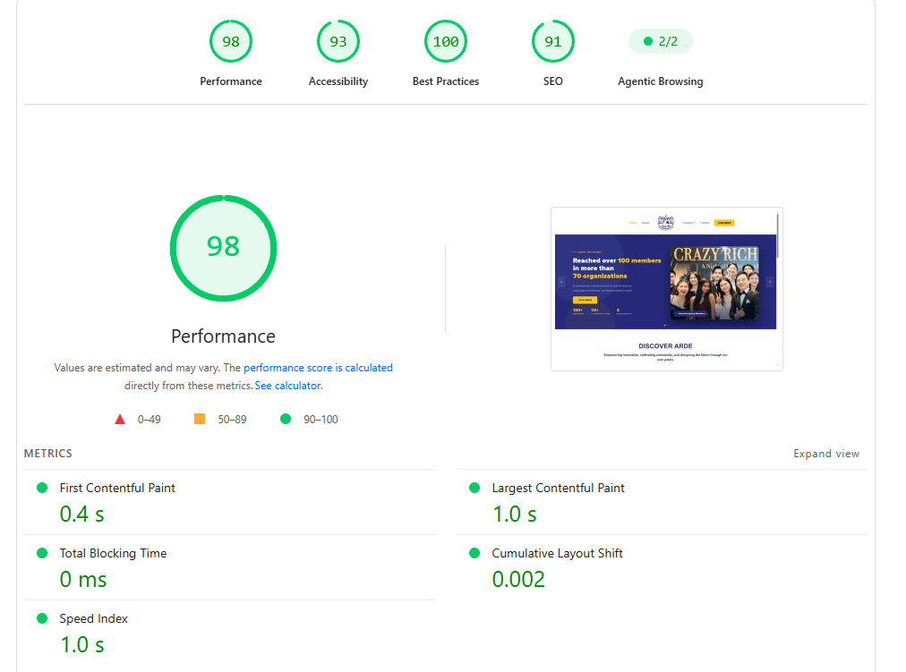
Performance Testing (Desktop)
04
Findings
Google Lighthouse was used to evaluate the desktop performance of the ARDE website. The website achieved a performance score of 98/100, demonstrating excellent loading speed and responsiveness. The accessibility score was 93/100, the best practices score was 100/100, and the SEO score was 91/100, indicating that the website follows recommended web development standards. Core performance metrics also showed excellent results, including a First Contentful Paint of 0.4 seconds, a Largest Contentful Paint of 1.0 second, a Total Blocking Time of 0 milliseconds, and a Cumulative Layout Shift of 0.002, providing users with a fast and stable browsing experience.
The Google Lighthouse performance test indicates that the ARDE website delivers excellent desktop performance. Pages load quickly, user interactions are not delayed, and the layout remains visually stable during loading. These results demonstrate that the website has been optimized to provide a smooth and efficient user experience on desktop devices.
06

Slide 25
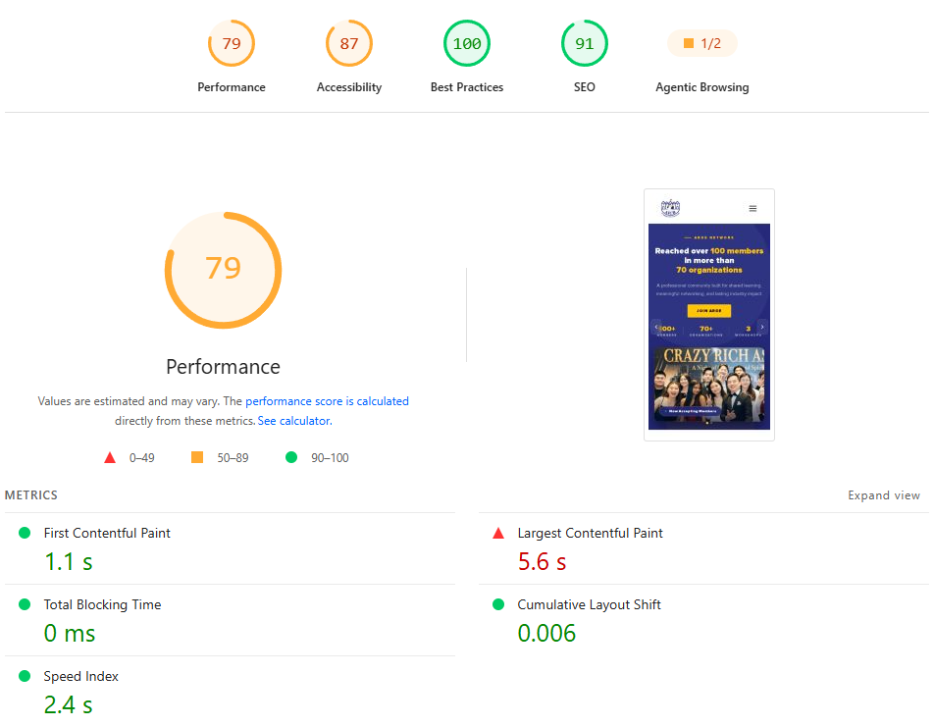
Performance Testing (Mobile)
04
Findings
The Google Lighthouse test shows that the mobile version of the ARDE website achieved a Performance score of 79/100. While the website loads smoothly and remains visually stable, the Largest Contentful Paint (LCP) of 5.6 seconds indicates that the largest visible content on the page takes longer than recommended to load. This affects the overall performance score. The website achieved 100/100 for Best Practices and 91/100 for SEO, showing that it follows modern web development standards.
The Fix
The mobile performance can be improved by reducing the size of images and loading only the resources that are needed when the page first loads. Additional optimizations, such as minimizing CSS and JavaScript files, can also help improve loading speed and increase the overall performance score.
06

Slide 26
SECTION 04
Usability Testing
A full audit of the ARDE Admin & Public platforms.
What was tested, what was found, and what it means.
10

Slide 27
Usability Testing
04
06

Slide 28
Thank You
10

