Slide 1
Building a Small Language Model
Kyle Remmenga
May 5th 2025

Slide 2
Goals of this Class
Learn how are generative text models are designed and built
Develop a deep learning testing environment
Create a small language model using minimal resources
What key components exist are core to a predictive text model?
How does a deep learning model learn language?
How are these elements implemented in modern code?
To what extent could we create a language model sandbox that could be used to further the learning of others?
What considerations should we make to help future students understand what we created?
Using the resources I have, how feasible is it to develop and train a deep learning model?
How much data is necessary to create an adequate model?

Slide 3
Foundations of Neural Networks
Loss functions
Activation Functions
Optimization Algorithms

Slide 4
Loss Functions
How do you measure how accurate a prediction is?
Expected Outcome - Actual Outcome = Loss
How do we calculate this for a word?
Cross Entropy:

Slide 5
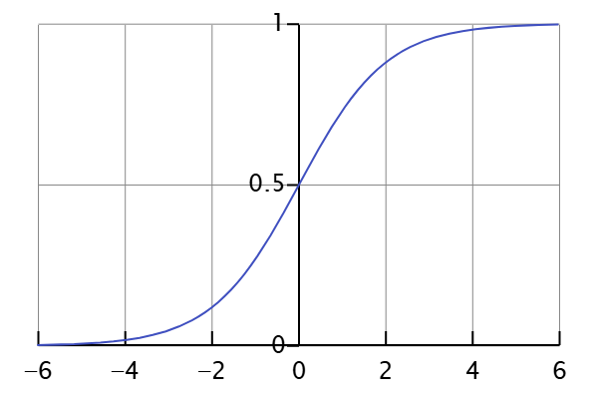
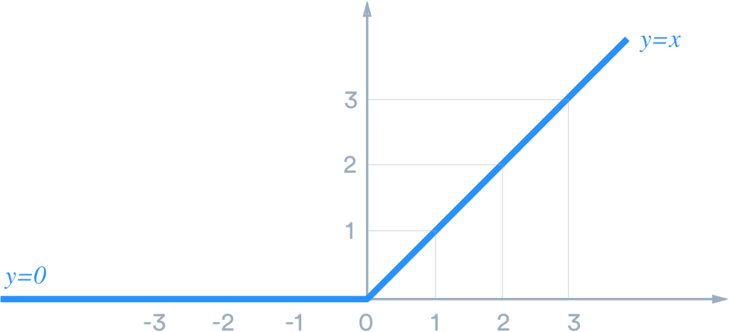
Activation Functions
Add non-linearity allowing models to make non-linear predictions
Sigmoid function:
ReLu Function:

Slide 6
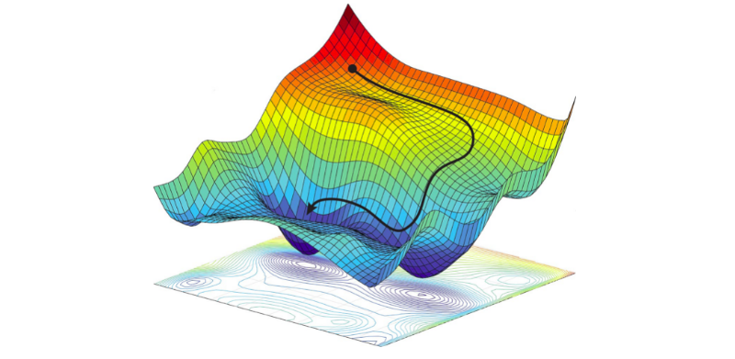
Optimization Algorithms - Gradient Descent
To train the model we calculate the derivative of the loss with respect to the weights in the model
Then we calculate the gradient, allowing us to see how to adjust the weights to reduce loss

Slide 7
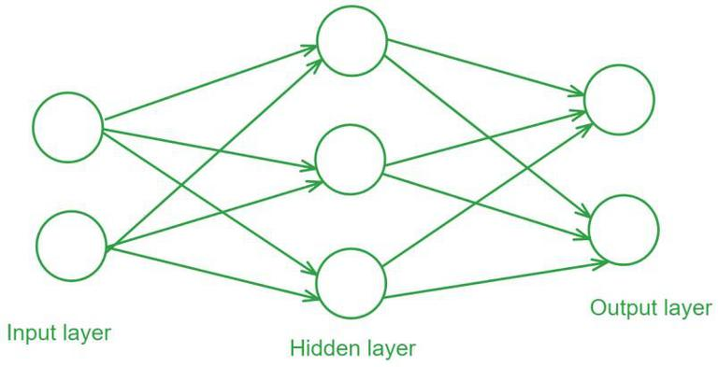
Feedforward Neural Network
Each edge, has a trainable weight
Sum inputs
Activation function
Allows a non-linear prediction

Slide 8
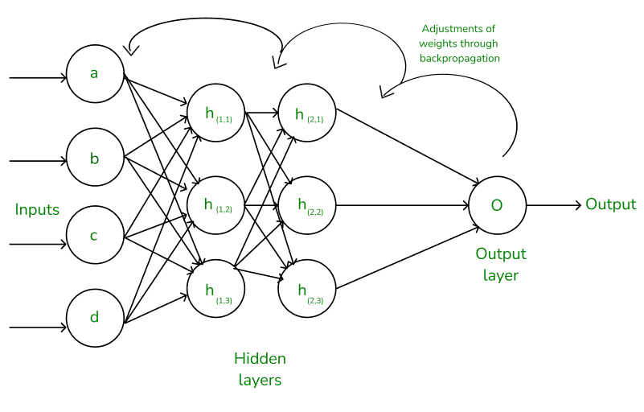
Backpropagation Neural Network
Calculate loss at the end, then traverse backwards
We can use the chain rule to walk back through the model calculating the derivative of the loss
Gradient can be calculated for each trainable weight
Adjust weights all the way back to the input

Slide 9
Our GPT
Attention
Vocabulary and Embedding
Grants the model the ability to learn context
What words we will allow into the model and how they are represented
Gathering Data
Training the Model
How we were able to get enough data to train our model
How we trained our transformer

Slide 10
Vocabulary/Token Considerations
Define a vocabulary, small but usable
How will we tokenize?
How do we decide what gets into our vocabulary?
As the vocabulary size grows, so does our model
Modern LLMs tokenize small pieces of words, such as suffixes
How do we decide what words should be in the vocabulary?
Balancing having a small vocabulary that could be expressive was a concern
This would greatly complicate our model so we avoided this
We knew that we were going to need data that stayed inside our working space

Slide 11
Pidgin English
To solve our tokenization, we created a simpler language.
No caps
No conjugating
Reduce punctuation
Reduce vocabulary
“they like cat”
“ball ing roll”
“bird ed fly up”
“ha you ing leave?”

Slide 12

Data Acquisition
We knew getting enough data was going to be a challenge
Since we created our own language, we couldn’t find training data
DeepSeek offered a cheap API that we could use to create our data
Despite many experiments with prompting, generating our specific stories was challenging
In total we spent $1.66 for all our data, 5570 stories total

Slide 13
Generating Our Data
Define our grammer
Define our Universe
Prompted using the API to gather only stories
Parse the data
We created a file containing the rules of pidgin English and a few examples
We defined the universe that these stories should take place in
Modern LLMs such as DeepSeek have a system prompt that can add extra text to these stories
We parsed our data checking for correct vocabulary, removing extra characters, adding our formatting and added it to a file

Slide 14
Embedding our Tokens
Tokens were embedded in two ways, specific token embedding and position
Each token had a unique embedding, converting each token into a unique 384 dimensional vector
Each position in a sequence of text, max 256, had a unique 384 dimensional vector
We sum these vectors to create a vector that encodes a specific token in a specific position within a sequence

Slide 15
What is attention?
How do words learn context?
Why is attention valuable?
Attention is what makes GPTs work
We want the model to use previous tokens to influence the current token
Attention helps distinguish synonym meaning
Incorporate adjectives into a noun
Allow a character’s history to influence their actions
The defining characteristic of a transformer is attention
The now infamous paper “Attention is All You Need” by Vaswani et al. from 2017 is responsible for the AI boom today

Slide 16
How is Attention Performed?
Attention occurs in what are called attention blocks that are layered throughout the model
Each attention block contains attention heads, which compute attention scores independently
Text Sequence
Attention Block
Attention Block
Prediction

Slide 17
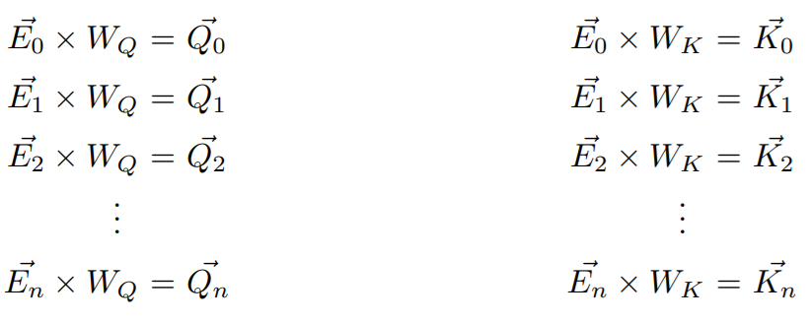
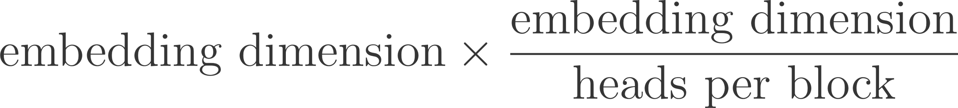
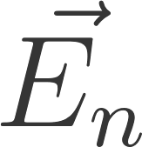


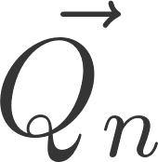
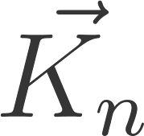
What goes on in each head?
Each head has 3 unique matrices: key, query and value of size:
For each embedding vector, we’ll multiply the embedding through the query and key matrices and
to get a two sequences of vectors:
and .
Now for each token in the sequence, we take the dot product of these two vectors

Slide 18
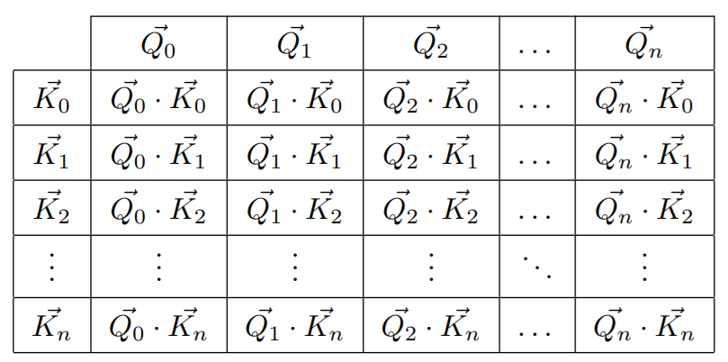

Slide 19
During training, it’s useful to split each sequence into subsequences, so we create many more training scenarios per sequence.
My
My favorite
My favorite flavor
My favorite flavor of
My favorite flavor of ice
My favorite flavor of ice cream
My favorite flavor of ice cream is
However, we during training we don’t want our model to learn context from a future token and use it to influence the current token
To solve this, we use a process called masking

Slide 20
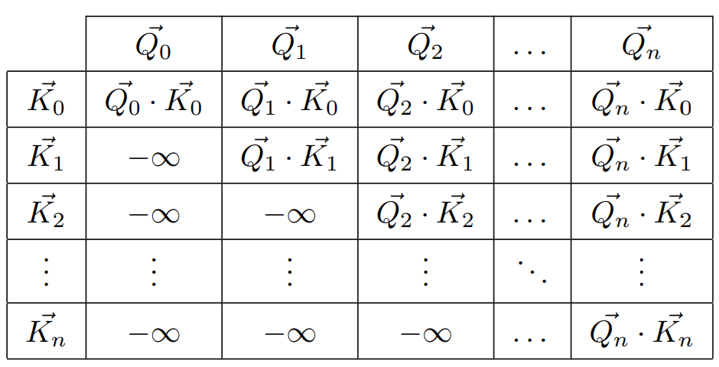

Slide 21

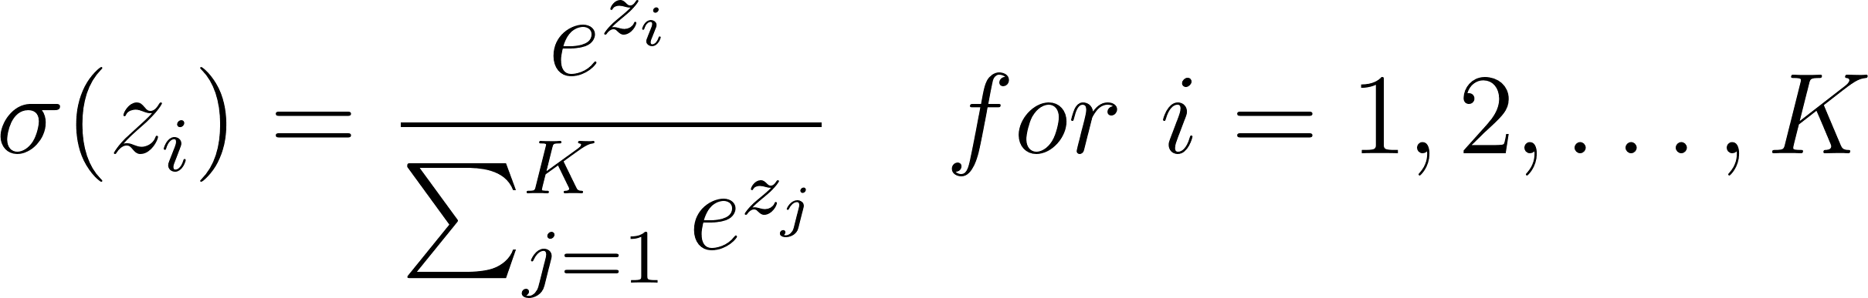
We now want to softmax our columns
Softmaxing is a process that normalizes a vector, so each dimension of the vector will sum to 1, like a probability distribution
After softmaxing, values at will be 0
We can think of this new table as showing how relevant each previous token is to the current one

Slide 22
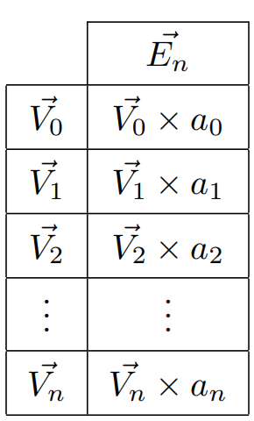

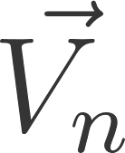
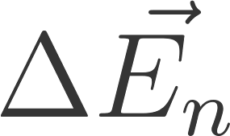
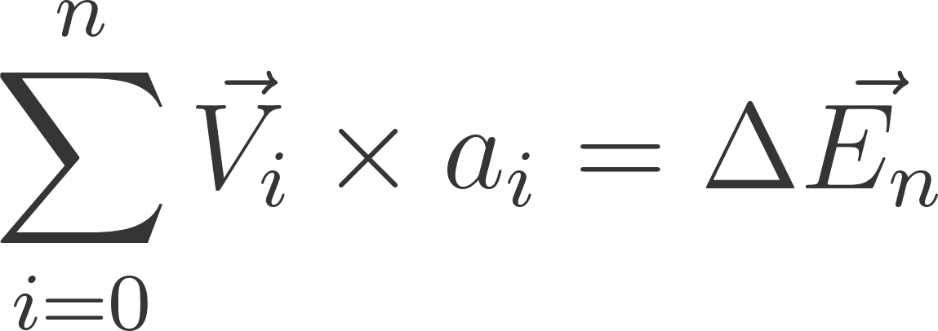
Now we will use our value matrix,
and multiply it by each embedding vector once again to obtain , for every token in the sequence
We will now multiply each tokens value vector the softmaxed column
Next we sum the column to produce the change that we want in that tokens embedding,
From each attention head in a block we produce an output vector

Slide 23

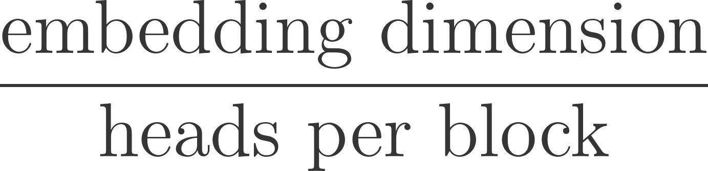
Our last step, is combining all of outputs from the attention heads
We do this by concatenating each vector output from each head
(each )
Since we compressed each embedding vector into a
space, when we concatenate these vectors, the vector they form is the same size as the embedding vectors
Since they are just concatenated, we need to scramble them
We define one last matrix which we call our projection matrix
We multiply the concatenated vector through which gives us the output to our attention mechanisms

Slide 24
Feed Forward Layer
Multiply expand matrix
Add non-linearity
Multiply compress matrix
Output from attention block
The expand matrix is has one dimension matching the embedding dimension and one side 4 times the embedding dimension
Multiply vector by activation function
The expand matrix is the opposite dimensions as the expand
This is the final output from our attention block

Slide 25
Training the Model
Split data into training and validation data
Randomly select sequences from data of 256 tokens
We divide the data: 90% training to 10% validation
Each training sample from the data was 256 tokens long
Train until we see overfitting occur
Create batches
We create a batch of 32 training sequences for 1 iteration of training
After experimenting with training the model too much, we saw that around 2250-2500 iterations is the best trained model with our set of data

Slide 26
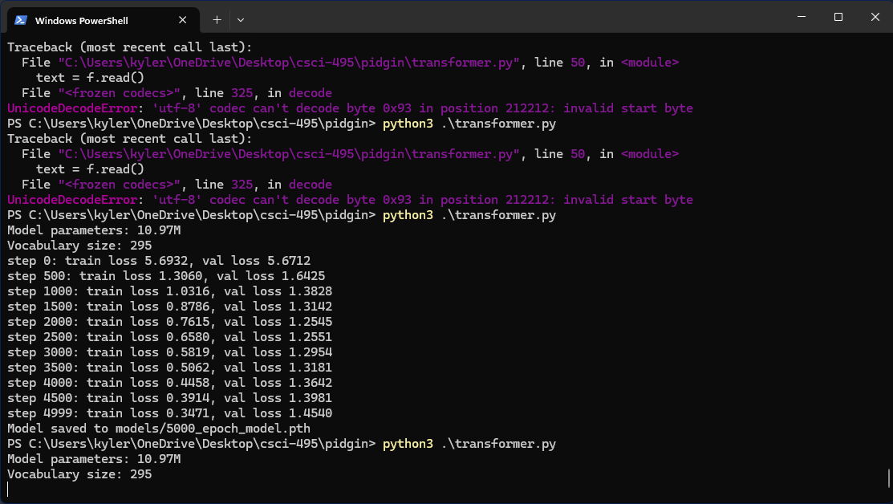

Slide 27
Model Demonstration

Slide 28
Conclusion
Learning about the architecture
Testing framework
Developing the model was cheap
I got the opportunity to learn about the architecture and algorithms that create a GPT
I was able to experiment with how PyTorch creates these models and the tools that are available for deep learning
We created a public repository that includes all my code from this semester and instructions for how to run and train the model
We were able to create a working GPT using $2
GPUs made for training can be rented for $2 an hour
Showed that gathering data, even niche data, is possible to train small models for specific tasks

