Slide 1



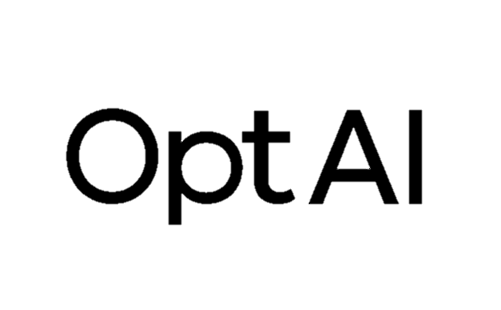
Personalized LLM Decoding via Contrasting Personal Preference
Hyungjune Bu*¹, Chanjoo Jung*¹, Minjae Kang², Jaehyung Kim¹
¹Yonsei University, ²Opt-AI Inc. *equal contribution

Slide 2

0
The Big Picture

Slide 3
Our work [CoPe] …
Is a new decoding-time personalization method
Stands for contrasting personal preference
Contrasts between what?
Between user model vs base model
Works without any external reward models
CoPe uses an implicit reward signal

Slide 4
1
Motivation

Slide 5


What is LLM Personalization?
Write a birthday message for my best friend.
Happy birthday! Wishing you a wonderful year full of happiness and success.
Non-personalized
Happy b-day, bro! Hope you crush it this year — more laughs, more chaos!
Personalized

Slide 6
Existing Methods
Prompt-based¹
RAG², PAG³
Weakness: superficial, prompt-dependent, and context-bound
Training-based⁴
Fine-tuning
Weakness: computational costs, catastrophic forgetting
Parameter-efficient fine-tuning (PEFT)⁴
Adapts a small subset of parameters
Weakness: incomplete
[1] Santurkar et al. (2023), Whose Opinions Do Language Models Reflect?, ICML.
[2] Lewis et al. (2021), Retrieval-Augmented Generation for Knowledge-Intensive NLP Tasks, arXiv:2005.11401. [3] Richardson et al. (2023), Integrating Summarization and Retrieval for Enhanced Personalization via Large Language Models, arXiv:2310.20081.
[4] Tan et al. (2024), Democratizing Large Language Models via Personalized Parameter-Efficient Fine-Tuning, EMNLP.

Slide 7
We propose a NEW paradigm which is…

Slide 8
2
CoPe
Contrasting Personal Preference
for Personalized LLM Decoding

Slide 9
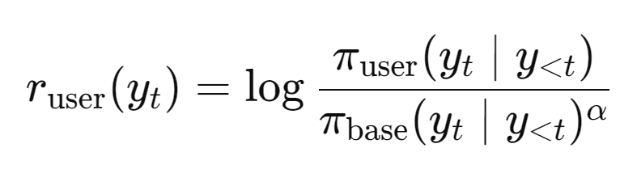
The core idea of CoPe
Decoding algorithm applied after PEFT
Uses implicit user reward signal for decoding :
Enhances PEFT to better capture this implicit user reward

Slide 10
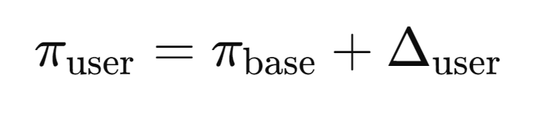
CoPe
Denote user model ,where represents PEFT parameters
We contrast the token-level likelihoods of and
I had a great cup of ______
{“coffee”, “tea”, “espresso”, “quantum,” “penguin”…}
Candidate tokens
We use our implicit reward model
to choose the best candidate!

Slide 11
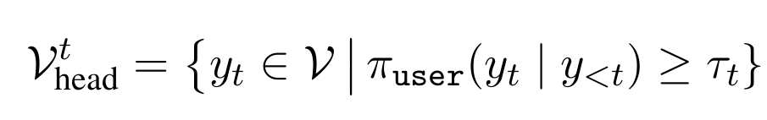
CoPe
Denote user model ,where represents PEFT parameters
We contrast the token-level likelihoods of and
But not all the tokens!
Following contrastive decoding¹, we restrict the candidates to tokens the user model considers plausible.
Under the following condition, we define the candidate token set:
Intuition:
Filtered set of plausible
next tokens at
decoding step t
[1]Li et al. (2023), Contrastive Decoding: Open-ended Text Generation as Optimization, ACL.

Slide 12
CoPe
Denote user model ,where represents PEFT parameters
We contrast the token-level likelihoods of and
I had a great cup of ______
We only consider these now!
{“coffee”, “tea”, “espresso”, “quantum,” “penguin”…}
0.35 0.25 0.2 0.00003 0.000001
We set τ = 0.1, so threshold is 0.1*0.35=0.105​
max

Slide 13

CoPe
Denote user model ,where represents PEFT parameters
We contrast the token-level likelihoods of and
Then for each candidate token ,
Intuition:
Reward favors tokens that are
1. user-preferred,
2. base-discouraged
where α is a contrastive weight hyperparameter (i.e The larger, the more penalty on base model favored tokens)

Slide 14
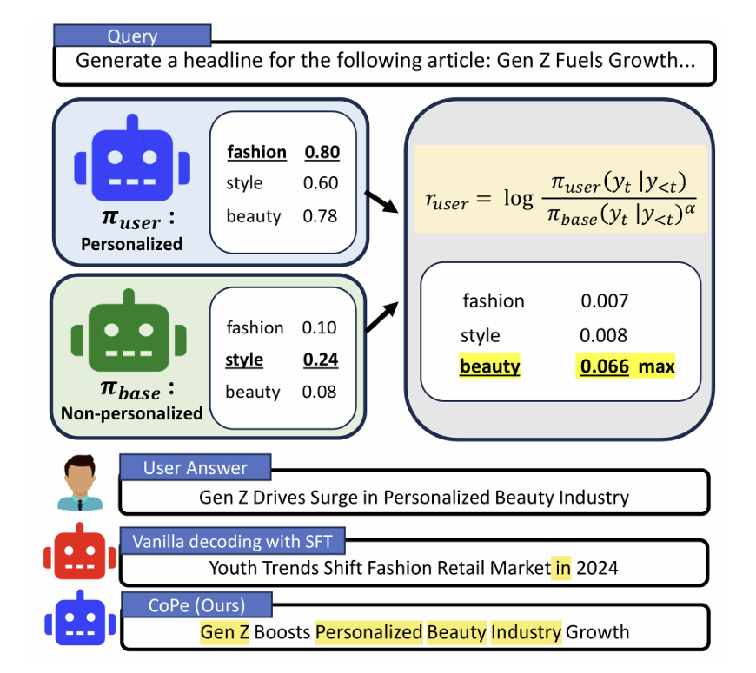
CoPe
Among the candidates,
the token with the
highest reward
is selected

Slide 15
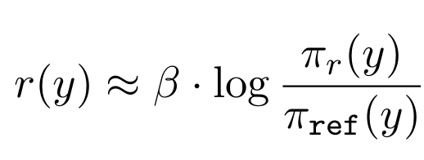
CoPe’s implicit rewards
RLHF¹ uses a trained reward model
But DPO² paper showed that an explicit reward model is not needed
Instead, the “reward” signal can be implicitly computed as the log-likelihood ratio between two models:
Intuition:
How much more does
the aligned model prefer this output compared to the base model?
aligned model
reference model
where β is a KL regularization strength
[1]Christiano et al., Deep Reinforcement Learning from Human Preferences, NeurIPS 2017 [2]Rafailov et al., Direct Preference Optimization: Your Language Model is Secretly a Reward Model, NeurIPS 2023

Slide 16
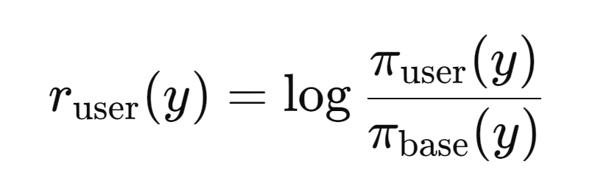




CoPe’s implicit rewards
This formulation appears in contrastive decoding¹
KL regularization keeps close to
PEFT keeps close to
Why?
Only a few parameters are updated
Majority of base model’s parameters are frozen
[1]Li et al. (2023), Contrastive Decoding: Open-ended Text Generation as Optimization, ACL.

Slide 17
CoPe
To further enhance the performance, we can apply DPO in training
This means we explicitly align with a user’s preferences during training
But DPO requires negative examples (for contrasting with positives).
Solution: synthesize negative examples!
We generate synthetic responses using the
And choose lowest implicit user reward
Thus, the one that is most unlikely from the user
This avoids privacy issues!

Slide 18
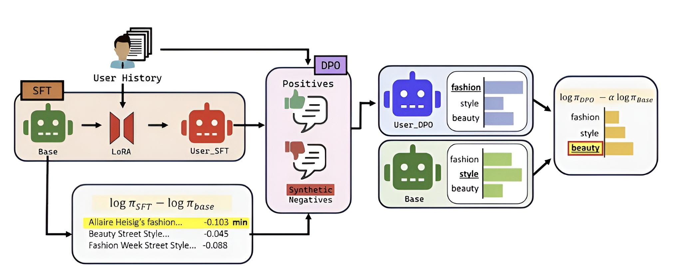
CoPe

Slide 19
3
Empirical Results

Slide 20
Experimental Setup
Tasks
LaMP: News headline generation, Scholarly title generation
LongLaMP: Abstract generation, Review writing, Topic Writing
Baseline
RAG, PAG, OPPU
Model: Mistral-7B-Instruct-v0.3
Metric: Rouge-1, Rouge-L

Slide 21
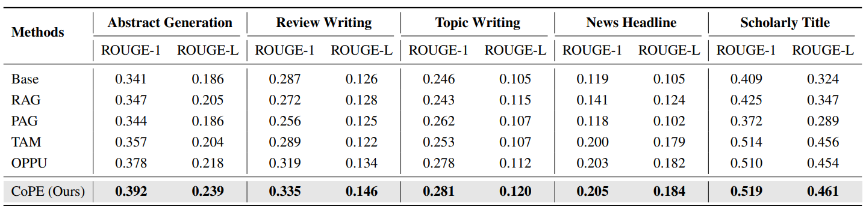
Main Results
vanilla
task-adapted
SFT user
CoPe wins all baselines 😊

Slide 22
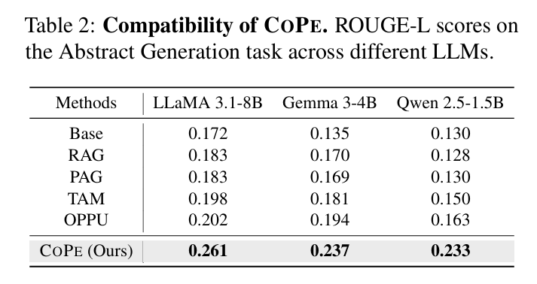
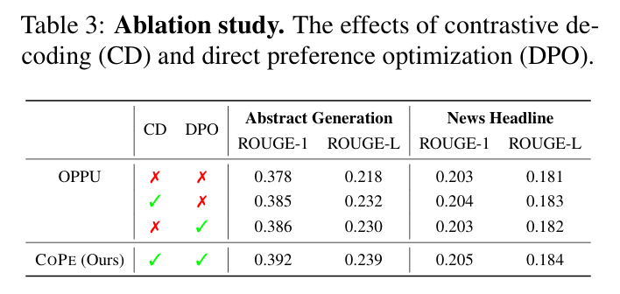
Additional Results
CoPe is flexible and generalizable across settings and model sizes.
CoPe works best when DPO and CD work synergistically to align model outputs with implicit user preferences
See more results in our paper!

Slide 23
4
Conclusion

Slide 24
Conclusion
CoPe: the first decoding-based framework for LLM personalization.
Our method maximizes an implicit user reward, eliminating the need for external reward models.
Comprehensive experiments show that CoPe consistently outperforms strong baselines.
We demonstrated that CoPe is generalizable across various LLM architectures and scales.

Slide 25

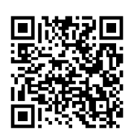

Thank you! 😀
contact: [cleverscent/chanjoo0427]@yonsei.ac.kr
Project Page
Github Code

