Slide 1



TiTok: Transfer Token-level Knowledge via Contrastive Excess To Transplant LoRA
Chanjoo Jung, Jaehyung Kim
Yonsei University

Slide 2

0
One Slide Summary

Slide 3
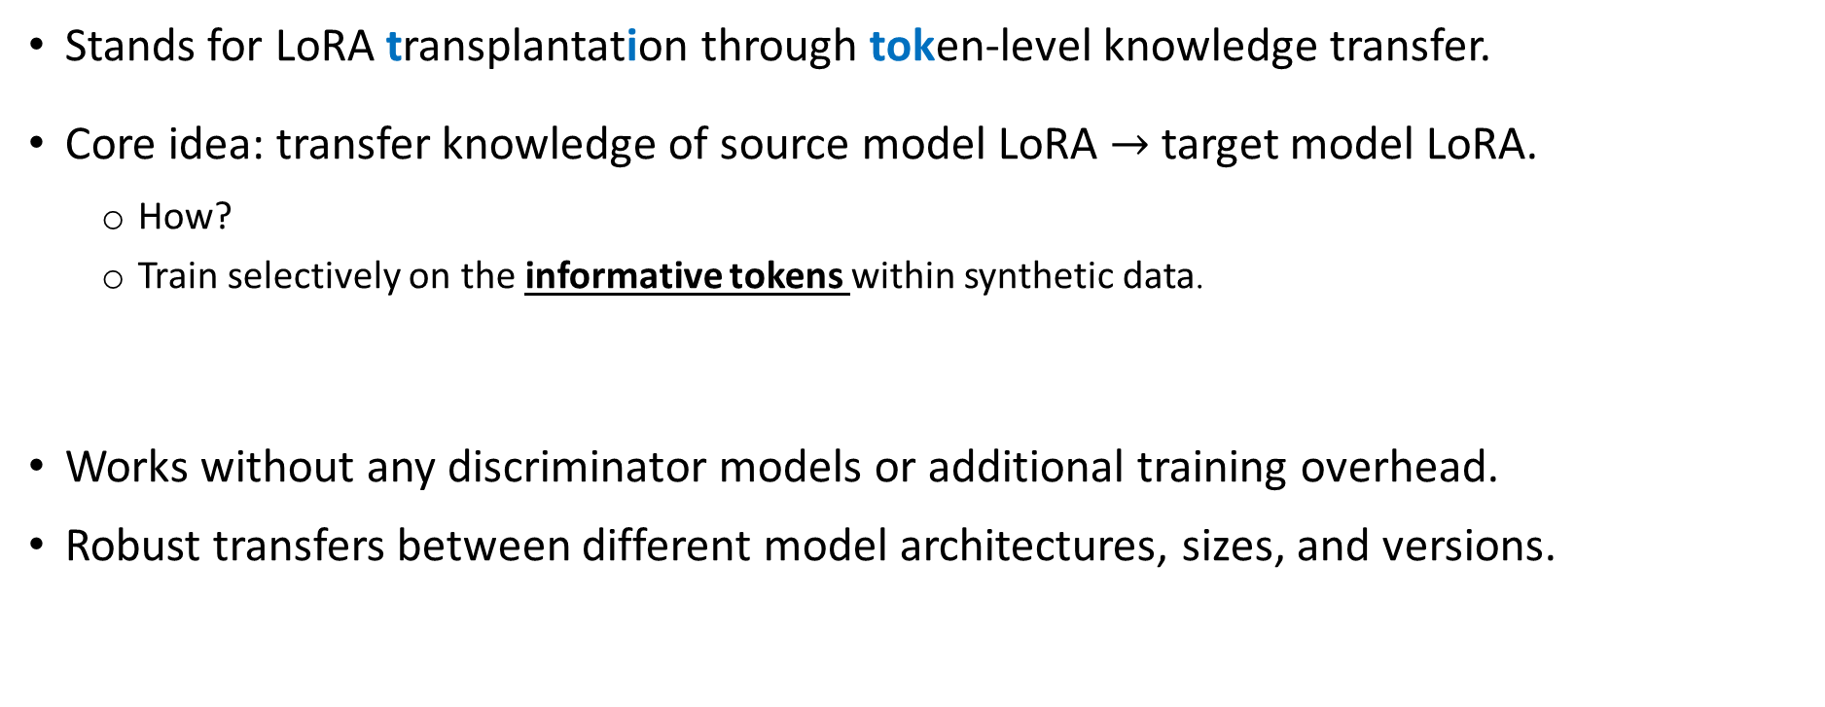
Our work [TiTok] …
Stands for LoRA transplantation through token-level knowledge transfer.
Core idea: transfer knowledge of source model LoRA $→$ target model LoRA.
How?
Train selectively on the informative tokens within synthetic data.
Works without any discriminator models or additional training overhead.
Robust transfers between different model architectures, sizes, and versions.
Identify by using the difference in predictions between the source model with and without its LoRA adapter.

Slide 4
1
Motivation

Slide 5
Motivation
LoRA¹ (Low-Rank Adaptation) is a highly popular technique used to train large language models efficiently.
“Shortcut to Fine-Tuning”
Freeze the base model and only train a tiny, separate set of new parameters.
[1] Hu, Edward J., et al. LoRA: Low-Rank Adaptation of Large Language Models. Proceedings of the International Conference on Learning Representations (ICLR), 2022.

Slide 6



Motivation
The Problem:
LoRA learns custom mathematical adjustments tied to its original base model.
This means that they cannot be directly transferred to different/new/upgraded models.
Wait, do I literally have to teach the new version everything all over again?
Model 2026 ver.
2026 ver. is out!
Model 2025 ver.

Slide 7
Existing Methods and Solutions
Knowledge Distillation¹
transferring the output distribution learned by a source model to a target model
Weakness: heavily dependent on access to task-specific training data
TransLoRA²
transfers LoRA knowledge via synthetic data filtered by a discriminator model
Weakness: 1) high computational cost due to the discriminator model 2) reliance on full synthetic sequences
[1] Hinton, Geoffrey, Oriol Vinyals, and Jeff Dean. Distilling the Knowledge in a Neural Network. arXiv preprint arXiv:1503.02531, 2015.
[2] Wang, Runqian, et al. Trans-LoRA: Towards Data-Free Transferable Parameter-Efficient Finetuning. Advances in Neural Information Processing Systems (NeurIPS), vol. 37, 2024, pp. 61217–61237.

Slide 8
In response, we propose…

Slide 9
2
TiTok
Transfer Token-level Knowledge via Contrastive Excess To Transplant LoRA

Slide 10
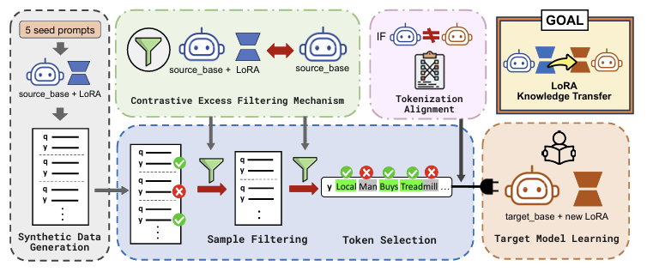
Overview of TiTok
Core idea: transfer knowledge of source model LoRA into target model LoRA by training selectively on the informative tokens within synthetic data.
(1) Synthetic data generation
(2) Excess score computation
(3) Target model training with filtering
①
②
③

Slide 11
TiTok: 1) Synthetic data generation
k seed prompts → source model generates queries & labels.
Diversity enforced via ROUGE-L < 0.7
ROUGE-L measures similarity by checking the longest sequence of matching words.

Slide 12
TiTok: 2) Excess score computation
Source model contains two roles: 1) "amateur" (base model only) 2) "expert" (base model + LoRA)
Compare expert vs amateur token probabilities on synthetic data → compute difference → identify informative tokens

Slide 13
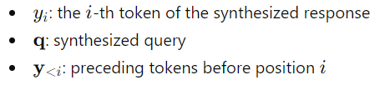




TiTok: 2) Excess score computation
Source model contains two roles: 1) "amateur" (base model only) 2) "expert" (base model + LoRA)
Compare expert vs amateur token probabilities on synthetic data → compute difference → identify informative tokens
Expert loss
Amateur loss
Excess score = Expert loss – Amateur Loss

Slide 14
TiTok: 2) Excess score computation
Source model contains two roles: 1) "amateur" (base model only) 2) "expert" (base model + LoRA)
Compare expert vs amateur token probabilities on synthetic data → compute difference → identify informative tokens
Intuition: token-level log-likelihood ratio (LLR) comparing the expert and amateur.
If the base is uncertain but LoRA is confident → high score.
Highlights tokens where LoRA injects decisive task knowledge (=informative tokens).
Excess score = Expert loss – Amateur Loss

Slide 15
TiTok: 3) Target model training with filtering
1. Filter Samples: Keep only the top synthetic data with the highest average contrastive excess scores.
2. Filter Tokens: Within each data sequence, select only the top k% of tokens with the highest individual contrastive excess scores.
3. Train the target model LoRA with the filtered tokens!
③
①
②

Slide 16
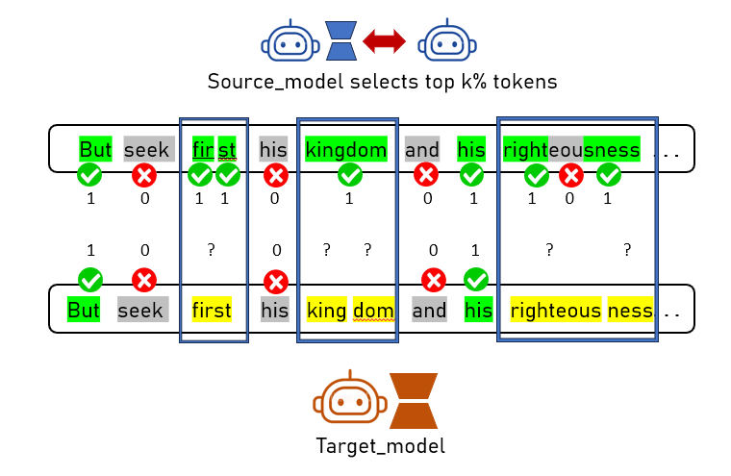
TiTok
Q) How about cases where source model and target model have different tokenizers?

Slide 17

TiTok
Q) How about cases where source model and target model have different tokenizers?
A) We formulated a tokenizer alignment algorithm!
1 0 1 1 0 1 0 0 1 0 1
But seek first his kingdom and his righteousness
Source model
But seek first his kingdom and his righteousness
Target model
one to one
many to one
one to many
many to many
1 / 1 = 1
(1+1)/ 2 = 1
1 / 1 = 1
2 / 3 = 0.667
Then, we choose top k% aligned tokens

Slide 18
3
Empirical Results

Slide 19
Experimental Setup
Tasks
Reasoning tasks: Big Bench Hard (BBH)¹, Massive Multitask Language Understanding (MMLU)²
Text generation tasks: LaMP³ (News headline generation, Scholarly title generation tasks)
Baselines
Knowledge distillation (+MinED tokenizer alignment algorithm)⁴
TransLoRA⁵
Metric:
BBH, MMLU : Average Accuracy
LaMP: Rouge-1, Rouge-L
[1] Suzgun, Mirac, et al. Challenging Big-Bench Tasks and Whether Chain-of-Thought Can Solve Them. Findings of the Association for Computational Linguistics: ACL 2023, 2023.
[2] Hendrycks, Dan, et al. Measuring Massive Multitask Language Understanding. arXiv preprint arXiv:2009.03300, 2020.
[3] Salemi, Alireza, et al. LaMP: When Large Language Models Meet Personalization. Proceedings of the 62nd Annual Meeting of the Association for Computational Linguistics (Volume 1: Long Papers), 2024.
[4] Wan, Fanqi, et al. Knowledge Fusion of Large Language Models. arXiv preprint arXiv:2401.10491, 2024.
[5] Wang, Runqian, et al. Trans-LoRA: Towards Data-Free Transferable Parameter-Efficient Finetuning. Advances in Neural Information Processing Systems (NeurIPS), vol. 37, 2024, pp. 61217–61237.

Slide 20
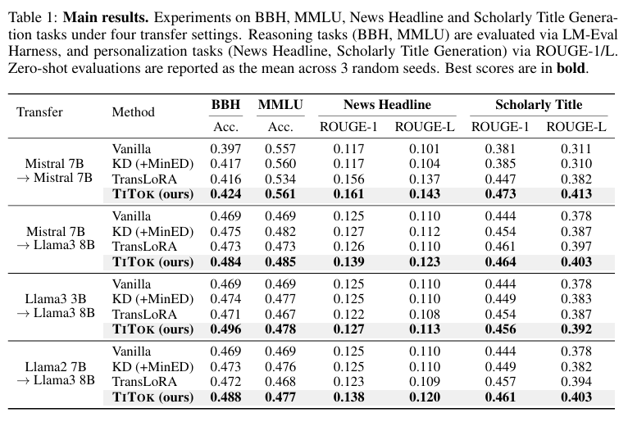
Main Results
Same model transfer
Different model architecture transfer
Different model size transfer
Different model version transfer
TiTok wins all baselines in diverse transfer settings 😊

Slide 21
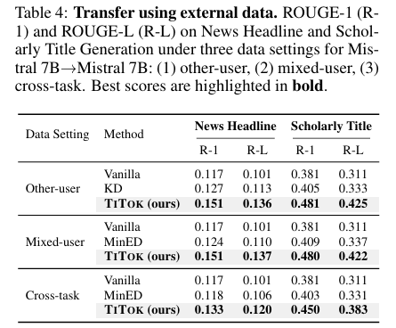
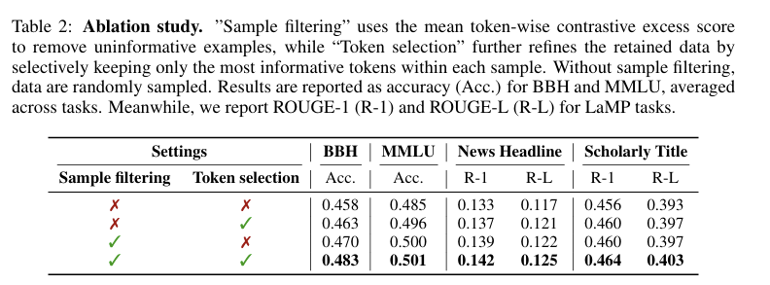
Additional Results
TiTok works best when doing both sample and token filtering.
TiTok is not limited to synthetic data. It well generalizes to external data too!
See more results in our paper!

Slide 22



Thank you! 😀
contact: chanjoo0427@yonsei.ac.kr
Project Page
Github Code

