Slide 1
Project 1_Progress_week4
_What I have implemented:
+ In the book page: I create the function to show the name of each book when users click on each book on the list view.
+In the menu page: I added two button to play or pause music to allow the user can listen to music during they read book if they don’t want just need click pause music button to stop music
+In the location page: I compiled the function to get the current location of the device when the user click on the get address button if the location is available the system will show the address under this button.
_Current Issue: I try to add the Google map to the app to show the map for my location to allow the users can come to my house to borrow if they want.
_What I have learned:
+In this week: I learnt Xamarin.Forms. I knew about the visual elements (What presented on the screen), the pages ( Screens, Activities, Layouts, Views, Cells), I learnt how to create and design the Xamarin.Forms to know what the xamarin form look like and how it running in the practical.
_Plan for next week: In next week I will find another way to add Google map component to my app to allow user can know exactly my location to they come to borrow book and I will compile the item click for my list view so when users click on the list view it will move to another page so they can read the contents of each book.

Slide 2
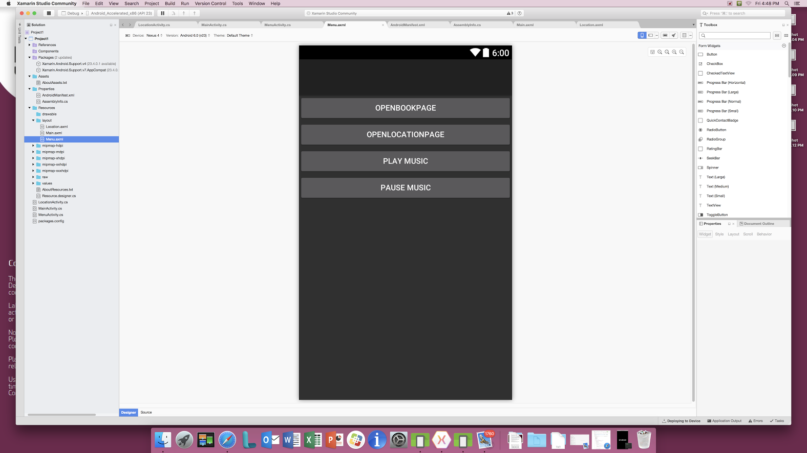
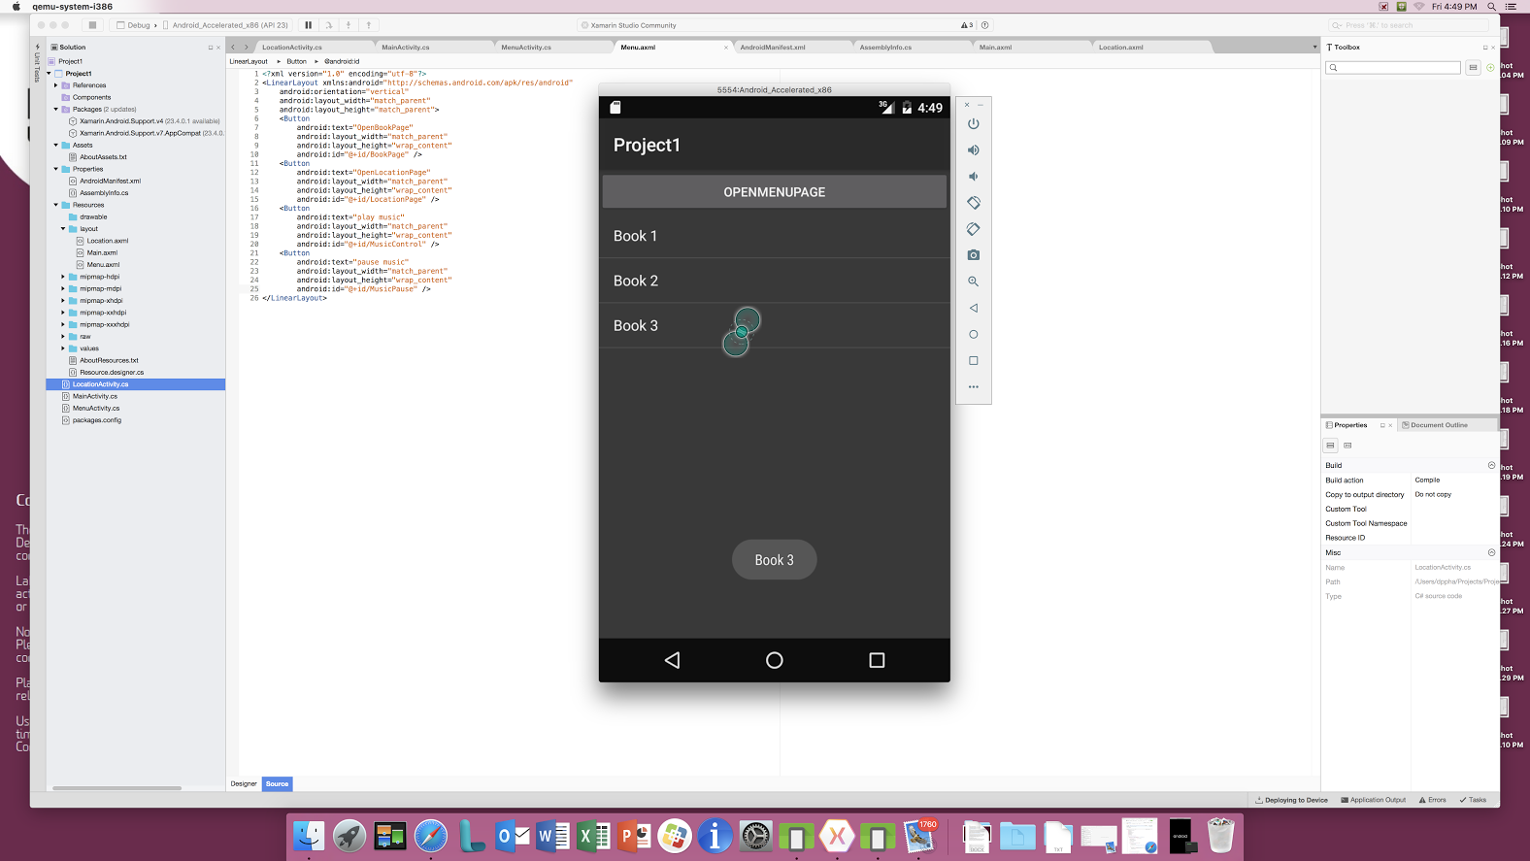

Slide 3
