Slide 1
Project#1 Progress
_What I have Implemented:
+ I designed wireframing for my app on fuildUI website.
+I collected the books I will post on my book app.
_What I have learned:
+In this week:
I learned about android app in Xamarin like: project structure, component of android app, screen, user interface and some widget such as: Text fields, Text View, ...
+In the practical:
I learn about display image in android app in different sizes: xhdpi, mdpi, layout-large.
I understand the Android Activity lifecycle.
I understand how to keep data of activity between events and in rotation.
I know how to create listview activity to display information in list and how to create a detail activity and link it with the listview so when user clicks on each item of a list view it will auto move to the detail activity.
_Plan for next week: In next week, I will write the code to create the menu page, audio playback and the table view and update books for my apps.

Slide 2
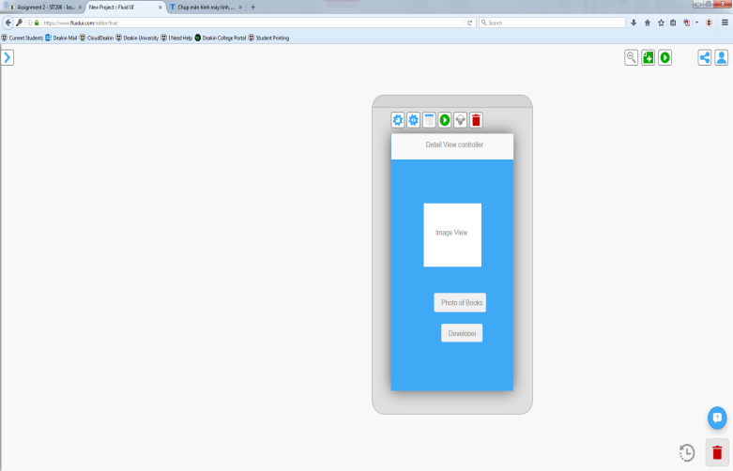
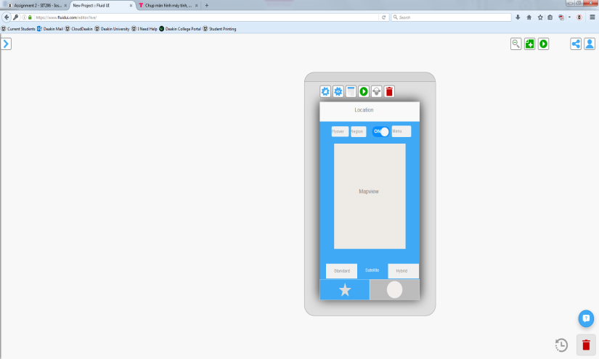
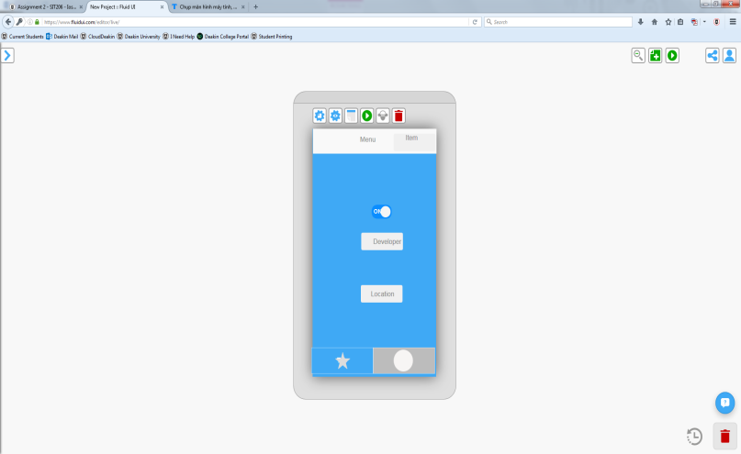
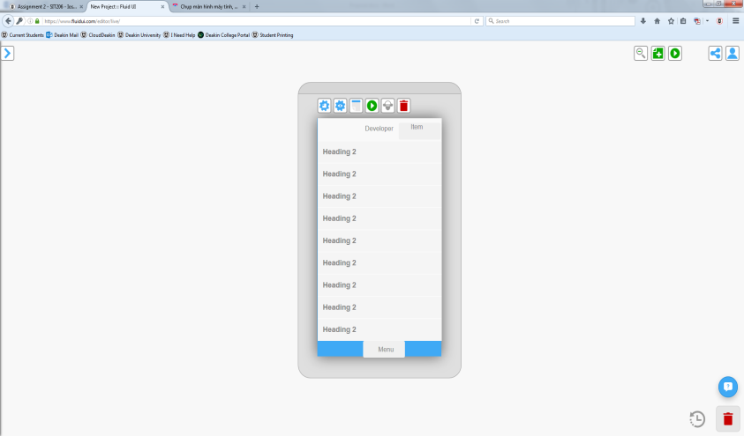
Wire Framing

Slide 3





Books

