Slide 1
Project#1 Progress_1
_What I have Implemented:
+ I compiled code for:
.Menu page: In this page there are 2 button link to book page and location page
Book page: In this page I already create list view to contain the list book
.Detail page: I already create 5 detail page, which will contain the content of 5 books I will upload on the app.
.Intent: Which connect menu page , book page, location page and detail page together by click the button
_What I have learned:
+In this week:
I learned about ios app in Xamarin like:
+ project structure,:
+story board,
+UIKit, UIView, and UIControl (UIButton, UISwitch, UISegment, UISlider, ...), +ViewController : life cycle (Appeared, Appearing, Disappeared, Dissappearing)
+In the practical:
I learn about auto lay out in ios app in different sizes of screen :
I learn how to create table view
I learn how to create activity contain data for each cell of table view
_Plan for next week: In next week, I will write the code to insert the book for list view, link each book with the detail page of each book and write music play back for the app .

Slide 2
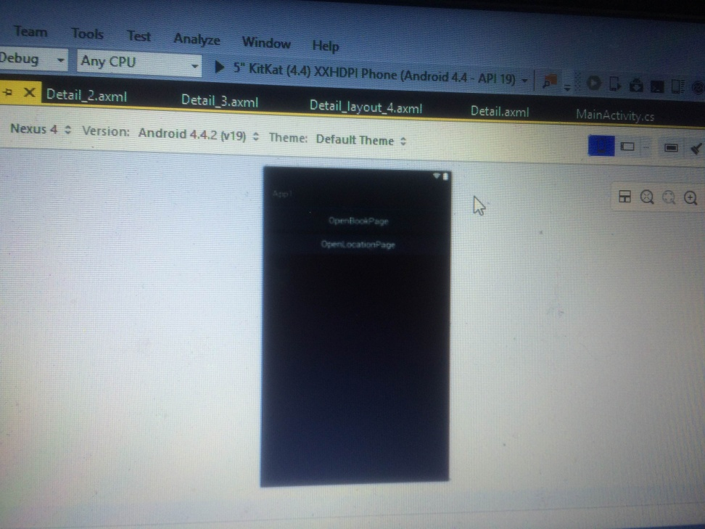
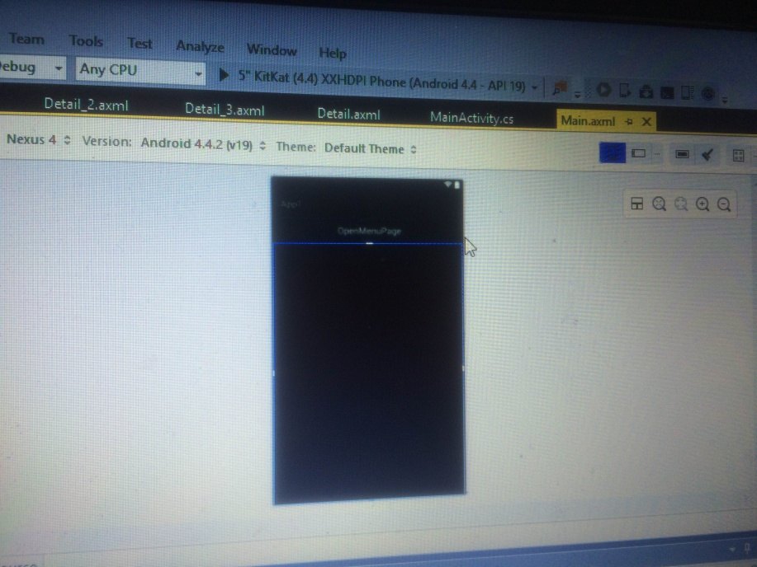
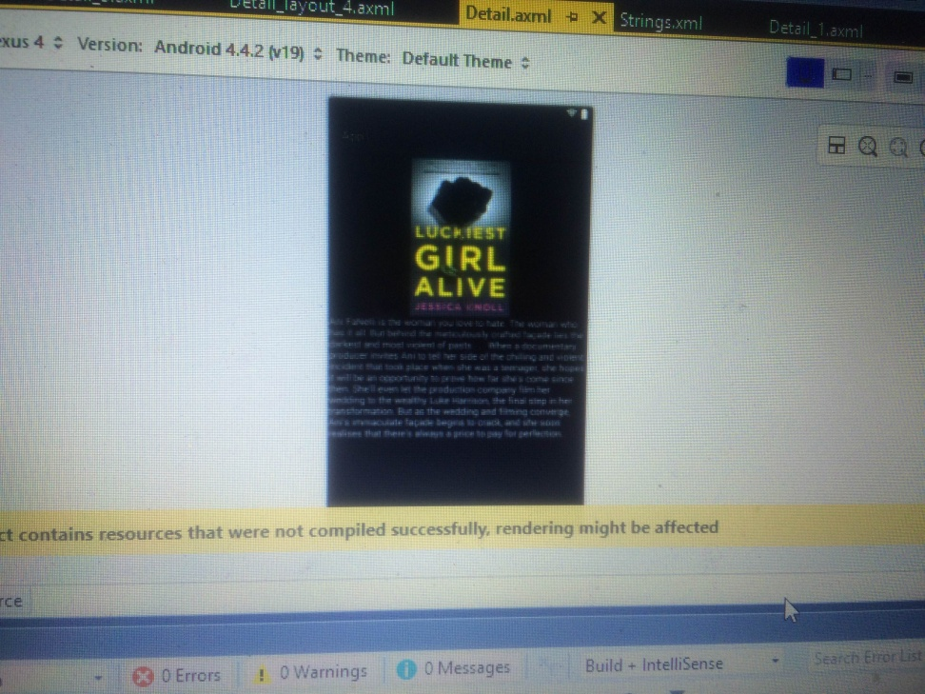
Prototype (Menu, Detail, Book page)

