Slide 1
Road surface analysis and classification using smartphones
Nauman Aslam
01-243172-024

Slide 2
Motivation
UK government payed 22million GBP in road ways compensations in 2018
400$ a year is spent on each car in US against the damages by road quality
11121 accidents in Pakistan in year 2017-18
Road accidents cause about 3,287 deaths every day worldwide
Manual inspection is costly and almost impossible
Efficient, reliable solution is needed

Slide 3
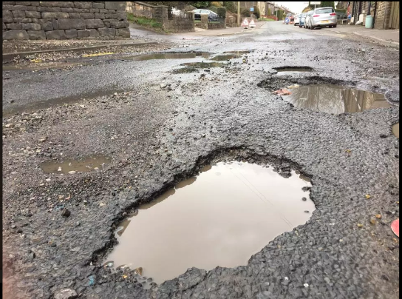
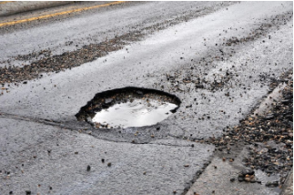
Why roads deteriorate?
Rain, flash flooding calamities
Over loading, in appropriate driving behaviors
UV rays bitumen in the road surfacing material to oxidize
Age, terrain response

Slide 4
Problem statement
Roads serve as the backbone of any city and without continuous monitoring and repairs, the roads deteriorate quickly. Physical inspection of roads is inefficient and can not guarantee timely repairs while the existing solutions require expensive infrastructure. An inexpensive crowd sourcing based solution is needed that enables the road commuters to report road quality information accurately, thus ensuring timely repair to avoid congestion and fatal accidents
Categorizing the road anomaly into 5 different categories based on their severity and discomfort caused.

Slide 5
Research questions
How can the smartphone's accelerometer and gyroscope sensors be used to gather sensible data about road surface anomalies and variations?
What are the prominent features in the sensory data that can be distinguished based on the discomfort/hazardous condition they cause
How efficiently a model can be formed based on this data that can correctly classify the road anomaly based on the features?

Slide 6
Scholarly solutions (Literature review)
Author | Year | Application | Classification | Sensors used | Limitations | Device used
Fredrico et al. | 2018 | Paved vs unpaved | SVM, HMM | Accelerometer, Gyro, GPS and compass | Limited information, data limitation | Samsung Galaxy S-8
El-Wakeel et al. | 2017 | Road anomalies | Decision tree | Accelerometer, GPS | 25 trips, 87% accuracy | Galaxy note tablet + external HW
Yazan et al. | 2017 | Road surface analyses | Algorithm only | Accelerometer, Gyroscope | 3.5km, device constrained | iPhone 5s
Prapulla et al. | 2017 | Road quality | Decision tree | Accelerometer, GPS | No model, SD card | Arduino UNO
Seraj et al. | 2015 | Road pavement monitoring | SVM | Accelerometer, Gyroscope, GPS | 2 categories, 88% accuracy | Samsung S2
Yoshiaki et al. | 2015 | Road anomalies | Algorithm only | Ultrasonic distance sensor | Physical hardware dependent | HC-SR04
Alessandroni et al. | 2014 | Road irregularities | Algorithm only | Accelerometer, GPS | No model | Moto G smartphone
Hoffmann et al. | 2013 | Road irregularities | KNN, Naïve Bayesian | Accelerometer, GPS | 3 categories, cycle, OS constraints | Nokia 5800
Astarita et al. | 2012 | Road quality | Algorithm only | Accelerometer-3 axis | 25km/h-40km/h | Android

Slide 7
Existing solutions
No dataset for Pakistan’s roads
No prominent work exists in Pakistan
No algorithm proposed for Pakistan’s roads

Slide 8
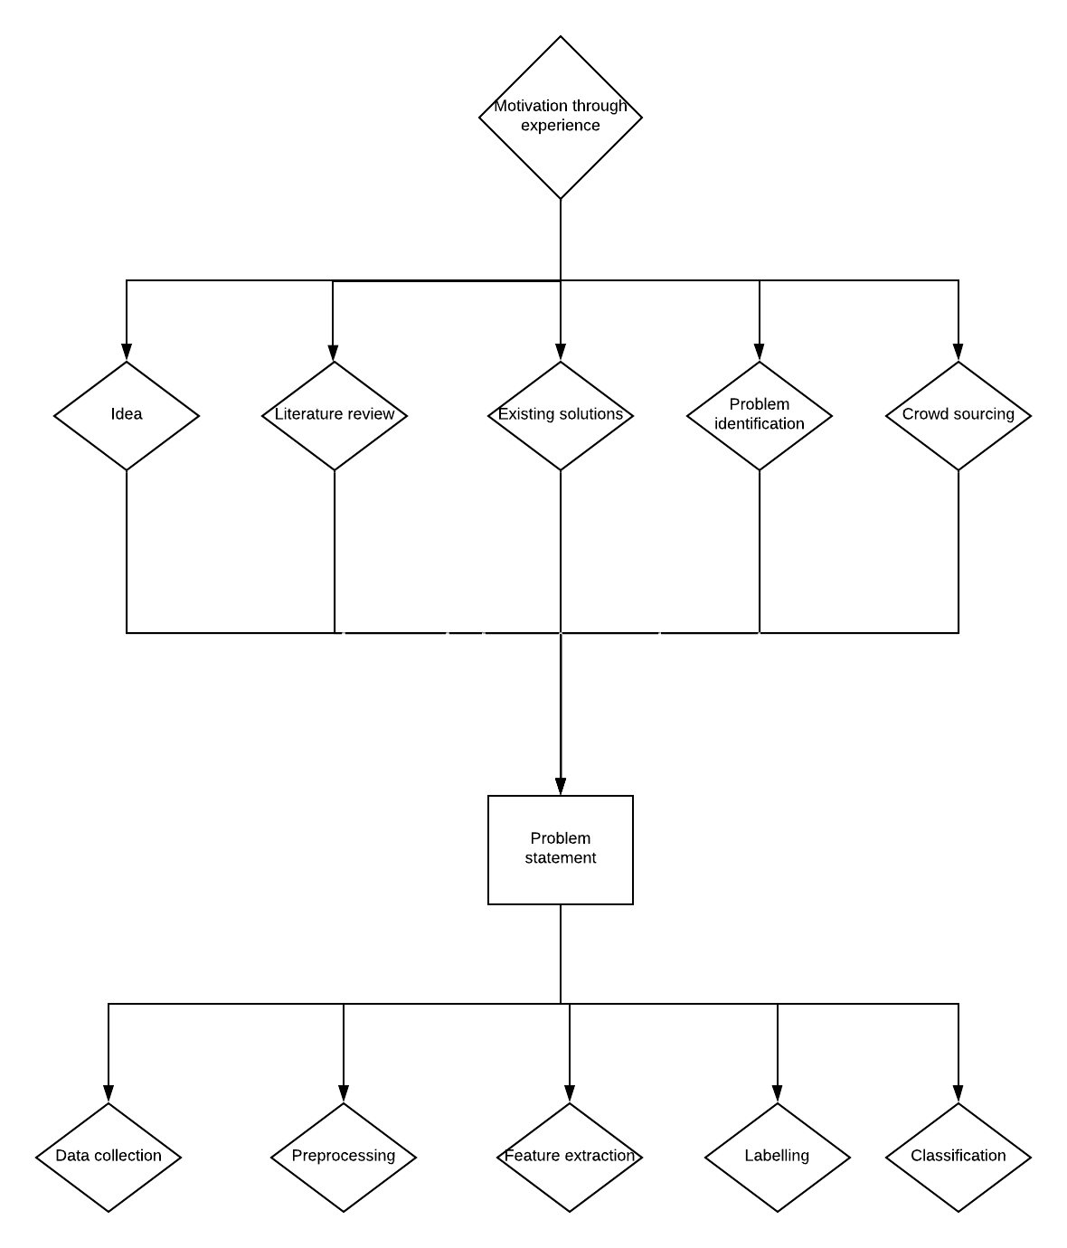

Slide 9
Methodology
Overview
Data collection
Pre processing
Feature extraction
Feature set for training

Slide 10
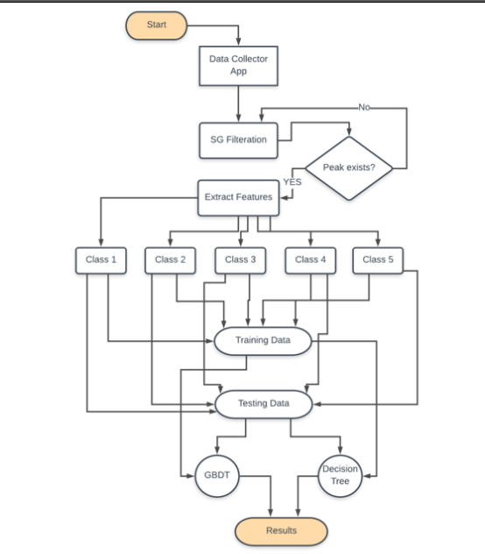
Overview
Android phone for data collection
Matlab for processing data
Decision tree and gradient boosting decision trees for classification

Slide 11
Overview
Introduction to Sensors
Mobile Application for data collection
Raw dataset
Preprocessing
Features extraction

Slide 12
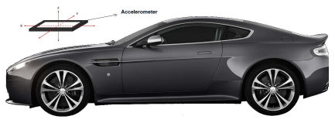
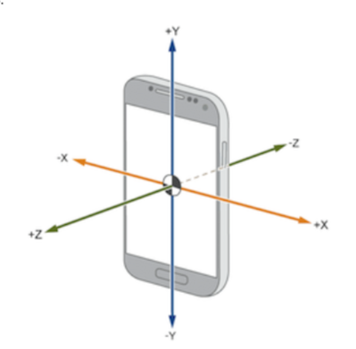
Overview
Introduction to sensors:
Accelerometer
Triaxial sensor i.e. x, y and z axis
Used to calculate acceleration, velocity & displacement
F = ma , a = Δv ÷ Δt
Collecting x, y and z values from device accelerometer

Slide 13
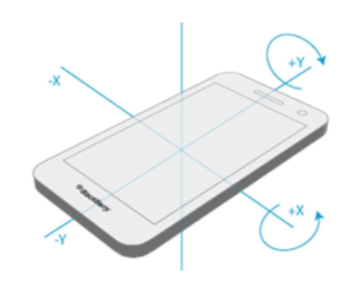
Overview
Gyroscope
Measures change in angular orientation
Uses earths gravity
Gyroscope will help find orientation and damp driving
behaviors

Slide 14
Data collector mobile app
The app collects the data as the driver drives
Accelerometer, Gyroscope, Timestamp and latitude, longitude are recorded
Both, calibrated as well as uncalibrated data is collected
Data collection is set to 50Hz while every 9-30ms produces new instance, GPS is set to once per second
Data is sent to Firebase database as well as CSV is generated

Slide 15
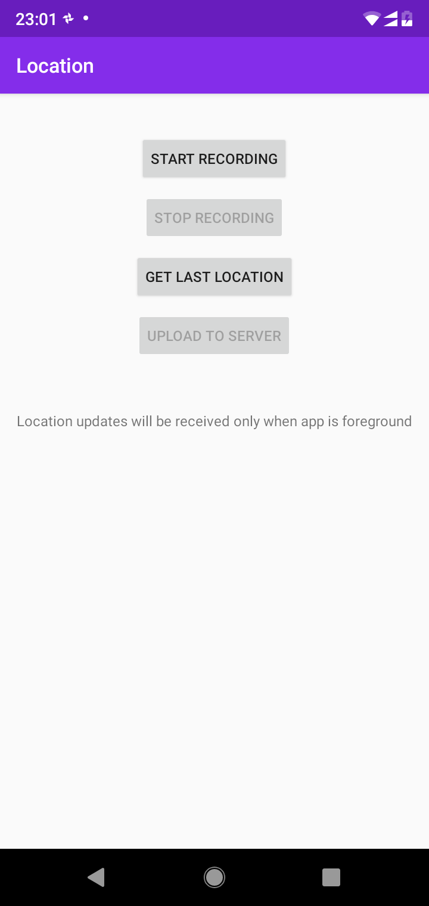
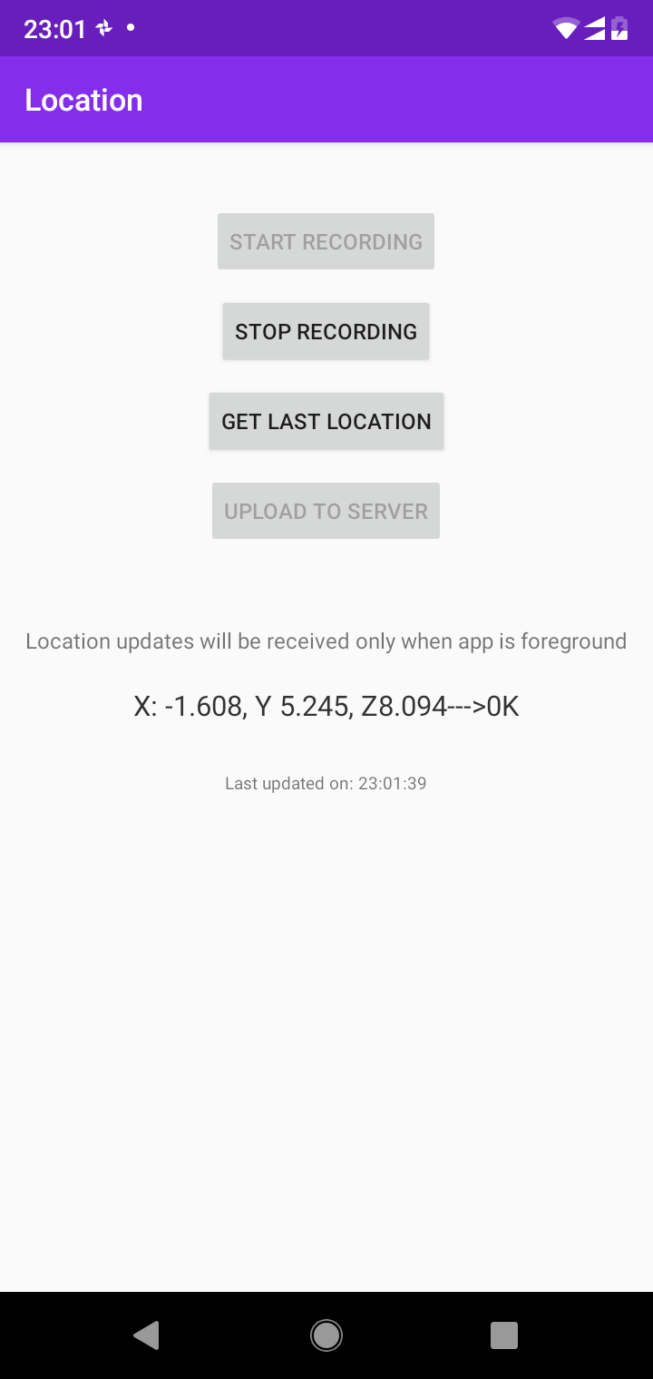
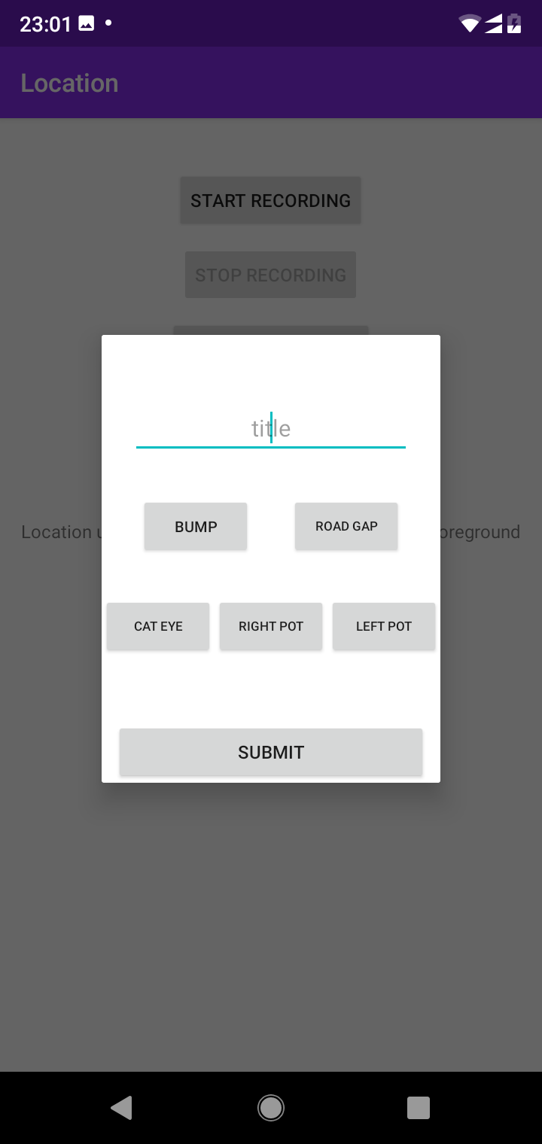

Slide 16
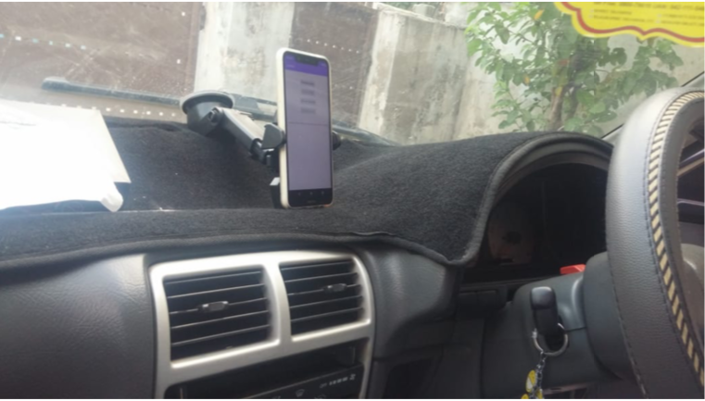
Raw dataset
Devices
Nokia 5.1 plus Android 9.0
Motorola Moto Turbo 1 Android 6.0
LG G3 running on Android 6.0
Vehicles
Suzuki Cultus, five door hatchback
Toyota Corolla, four door saloon
Honda City, four door saloon
Route
IJP Road, Islamabad
Kashmir Highway, NUST entrance gate no.1
Defence Road, Rawalpindi
Adyala Road, Rawalpindi
9th Avenue, Islamabad

Slide 17
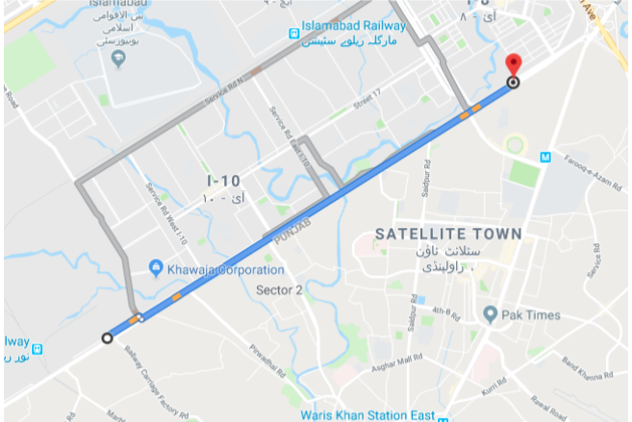
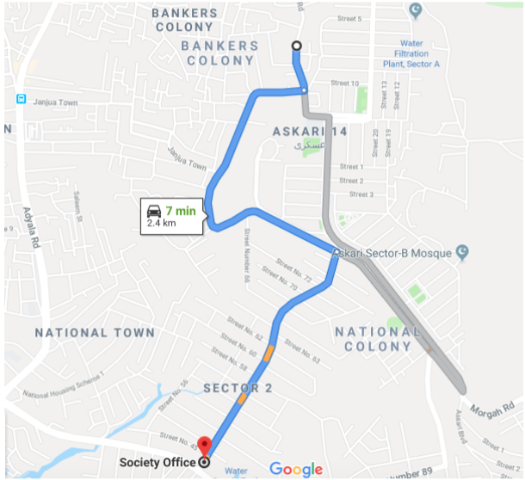
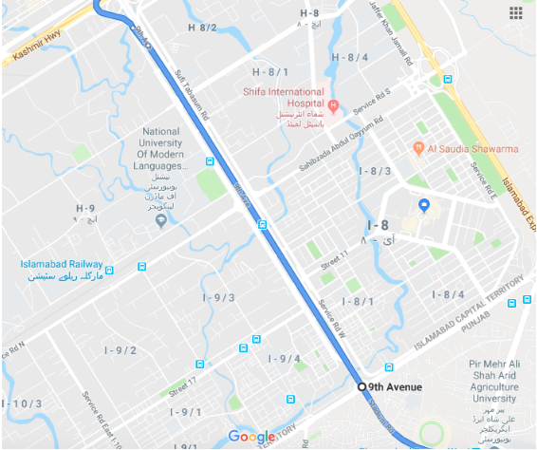

Slide 18
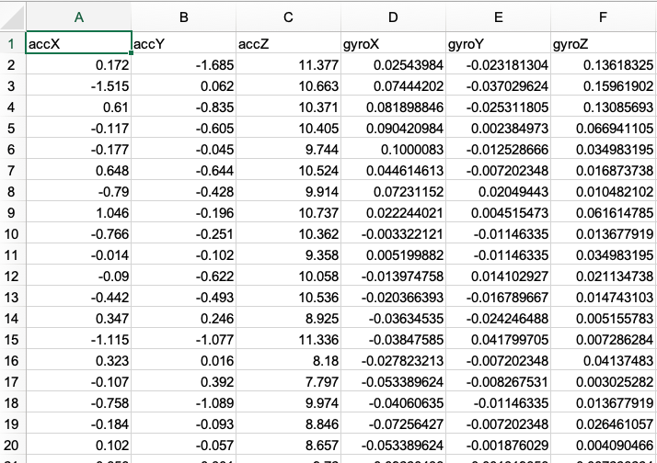
Raw Dataset (cont.)
2,20,000 rows, 9 columns
Accelerometer x,y,z
Gyroscope x,y,z
GPS coordinates
Date timestamp

Slide 19
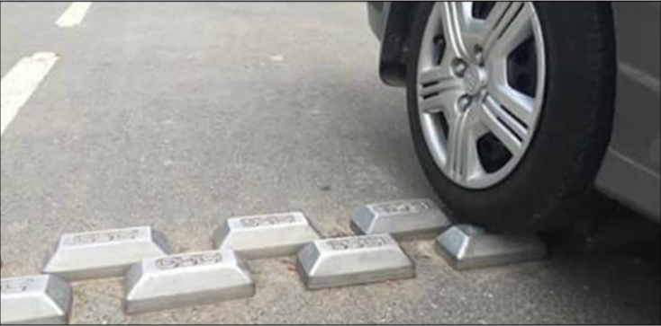
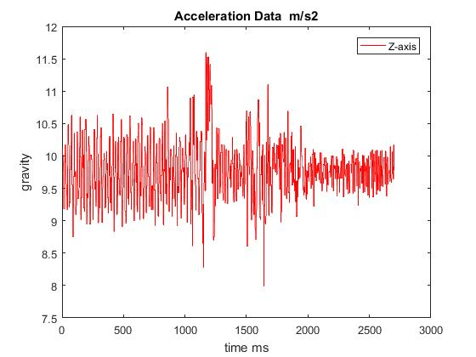
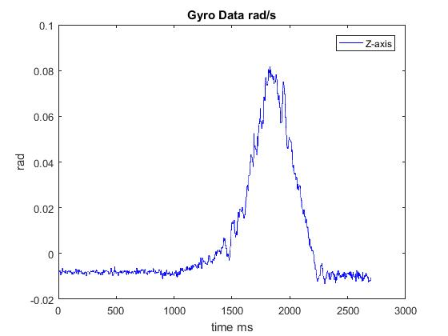
Preprocessing

Slide 20
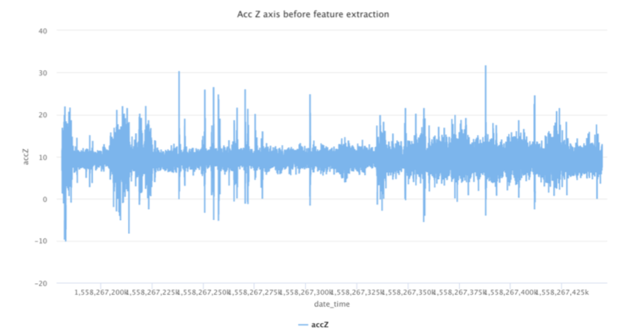
Preprocessing

Slide 21
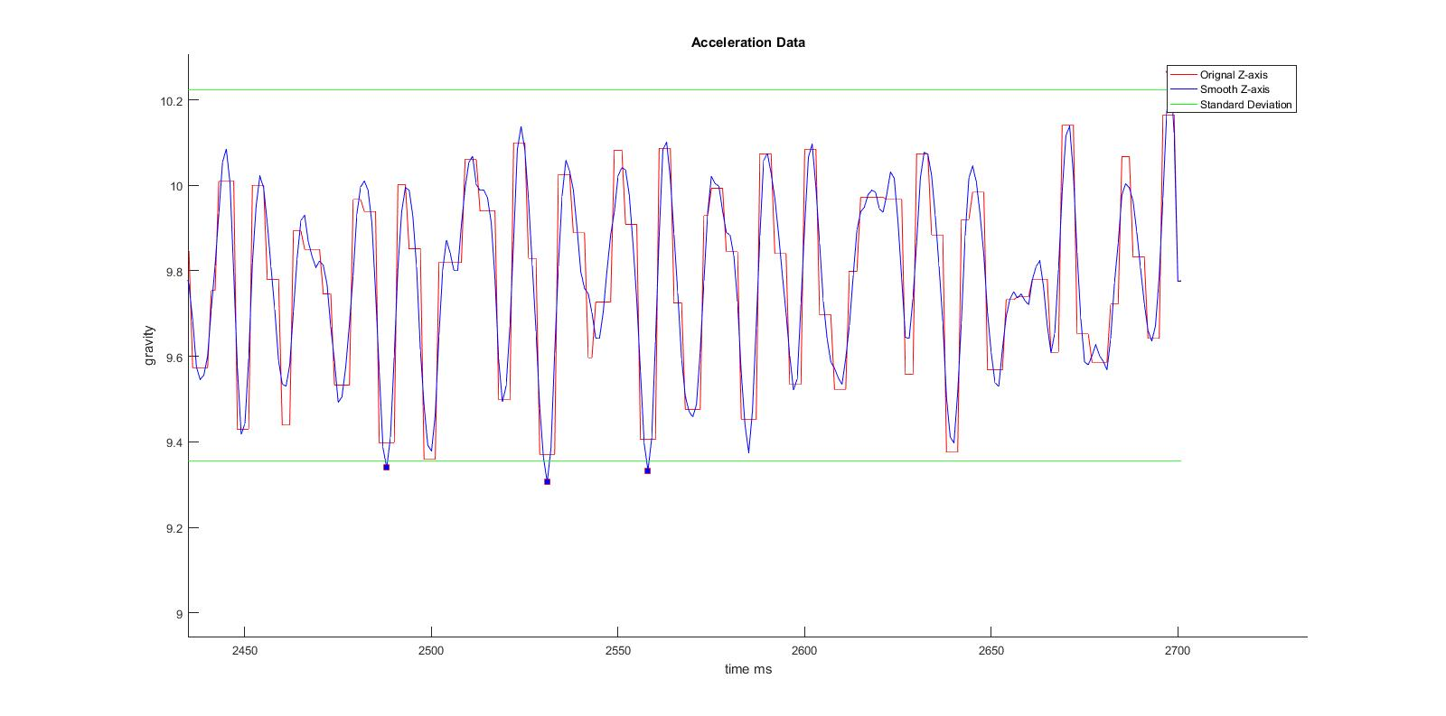
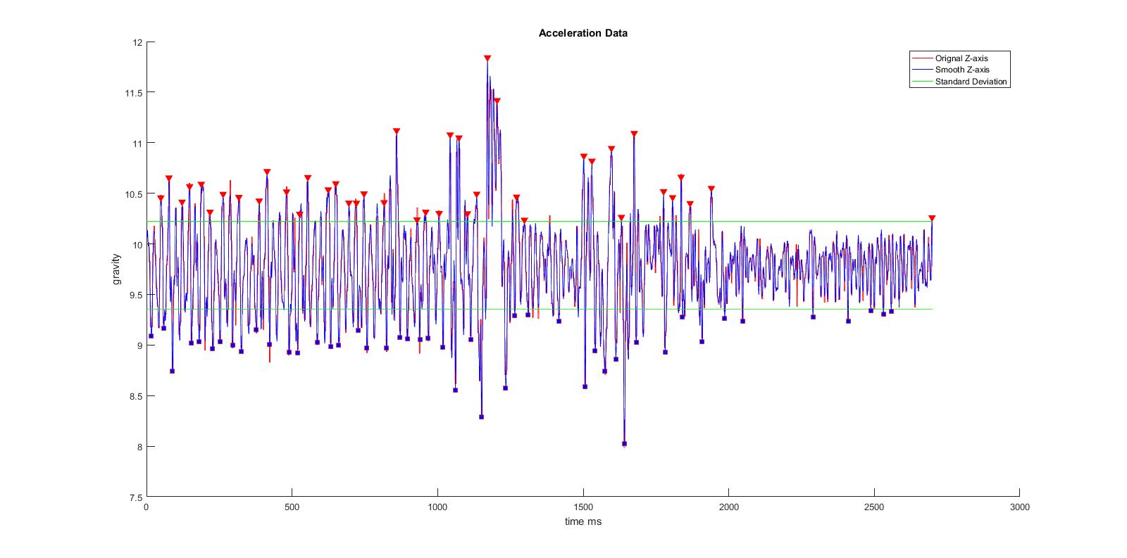
Preprocessing
Savitzky-Golay filter is used for the smoothing with order = 10 and framelen = 25

Slide 22
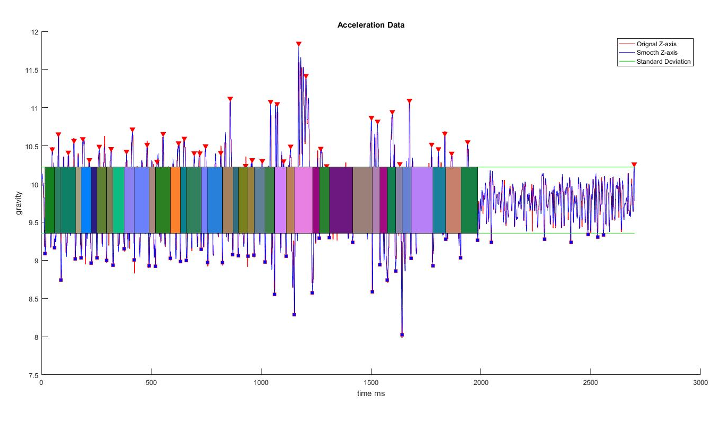
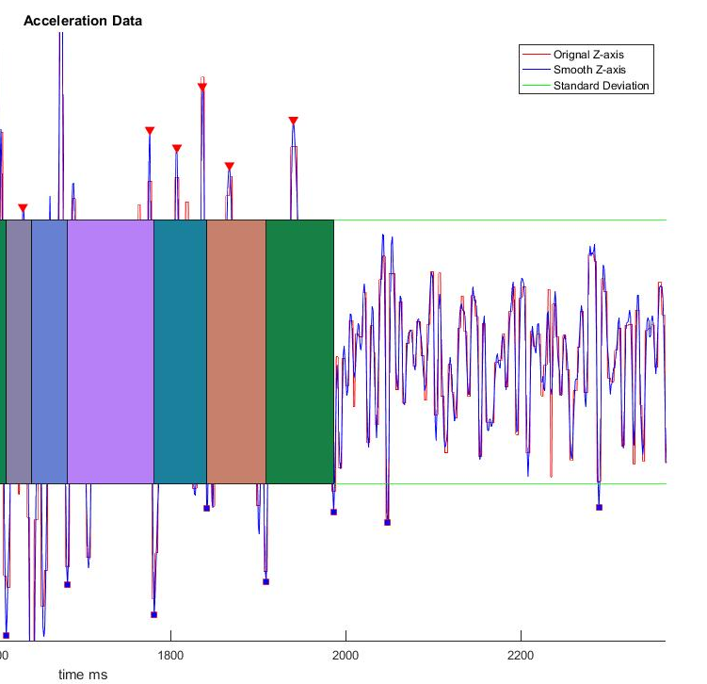
Feature extraction

Slide 23
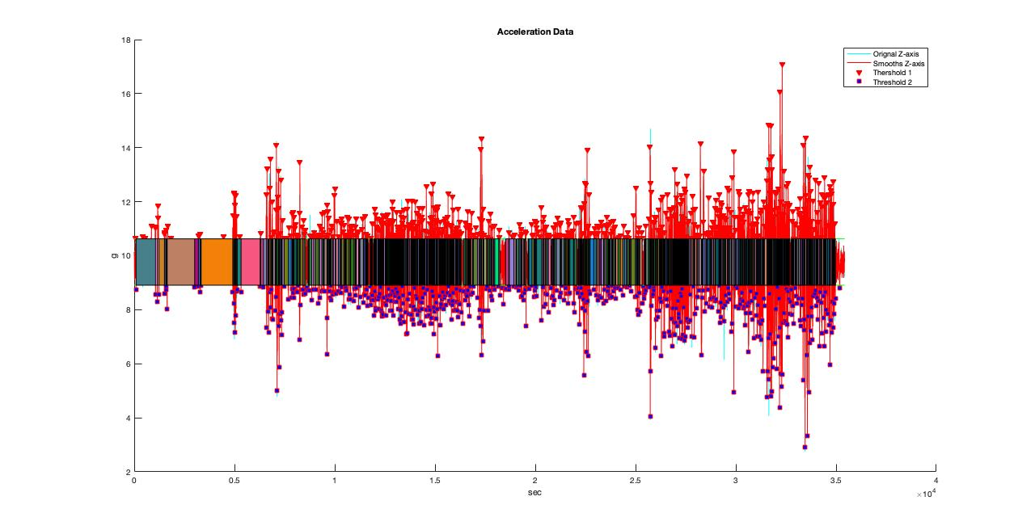
Feature extraction

Slide 24
Feature extraction
Smooth Acceleration along z-xais
Calculate standard deviation, mean
standardDeviationOfZM = standardDeviationOfZ + meanOfZ
standardDeviationOfZNegM = meanOfZ – standardDeviationOfZ
Time between one deceleration to the next deceleration or one acceleration to next acceleration is considered single anomaly
Find the max in the local wavelength, calculate and label the data on the basis of severity

Slide 25
Feature set
Mean
Standard deviation
Min
Max
Length
Step duration in ms
Root mean square
Entropy
Energy
FFT

Slide 26
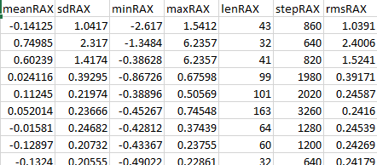
Feature Set
Raw Acceleration 3D
Gyroscope 3D
Using the feature values obtained from Z axis of the acceleration same values are considered to be the features in other sensor axis.
This makes it 10 features for each axis totaling 30+30 = 60 features in feature set for all the observations are written to a csv file.

Slide 27
Experiments and results
Class distribution
Decision tree
Gradient boosting decision tree

Slide 28
Class distribution
Using the peaks axis values are classified into the 5 categories.
peak < 10.0 = minor bumps or anomalies
peak > 10.0 && peak < 10.5 = some discomfort
peak > 10.5 && peak < 11.0 = moderate discomfort
peak > 11.0 && peak < 11.5 = major discomfort
peak > 11.5 = worst anomalies

Slide 29
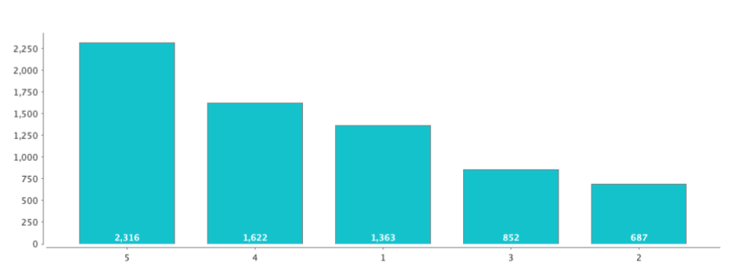
Class distribution

Slide 30
Decision tree
We used decision tree for this research because of the following reasons:
Decision trees have the ability of selecting the most discriminatory features from the feature list hence we needed a technique that can cater the most important factors in the data.
It also discover nonlinear relationships and interactions in the data which is important.
Since decision tree is white box compared to KNN, NN etc. which are black box, hence its easier to understand meaning, relations in the deduced results.
Visualization is always easier in decision trees

Slide 31
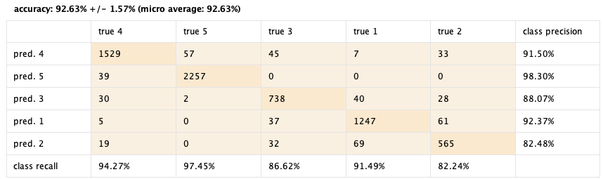
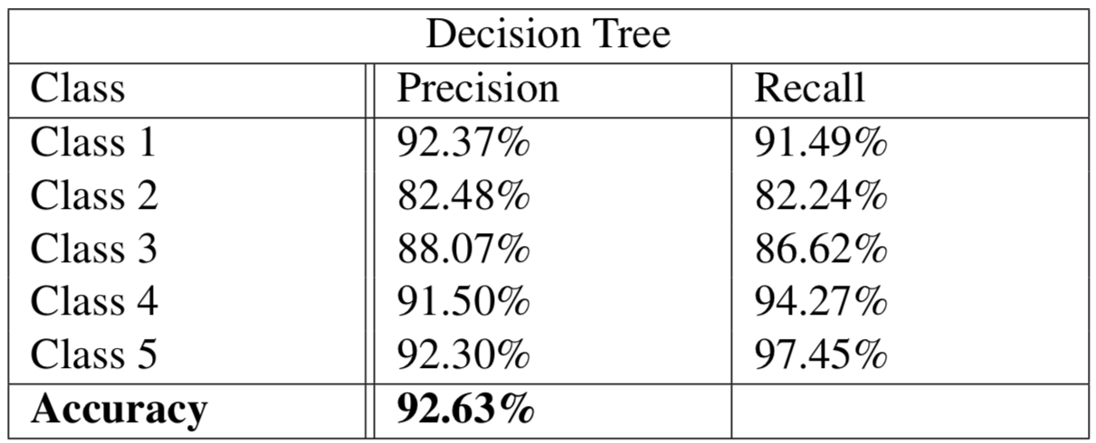
Decision tree confusion matrix

Slide 32
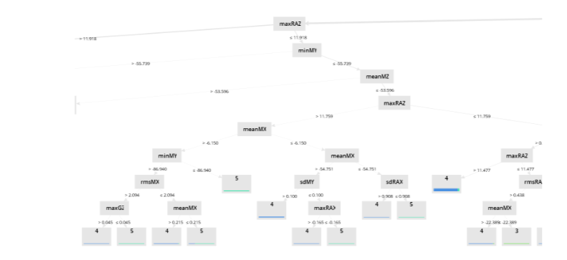
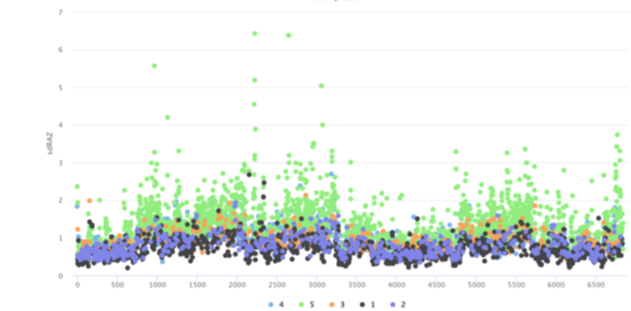

Slide 33
Gradient boosting decision tree
GBDT is an ensemble of multiple predictors working together to produce and even optimized results
An ensemble is a combination of multiple predictors (e.g. mean of all predictions) working together in order to produce a final prediction.
Since our modeling relies on multi-class classification too, it was anticipated that GBDT will achieve much better results.

Slide 34
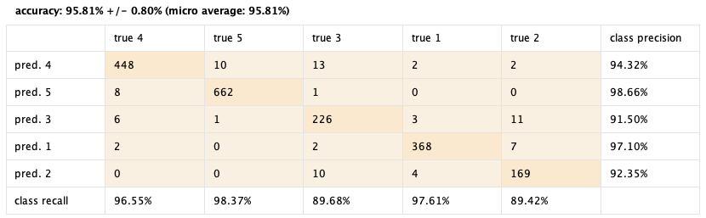
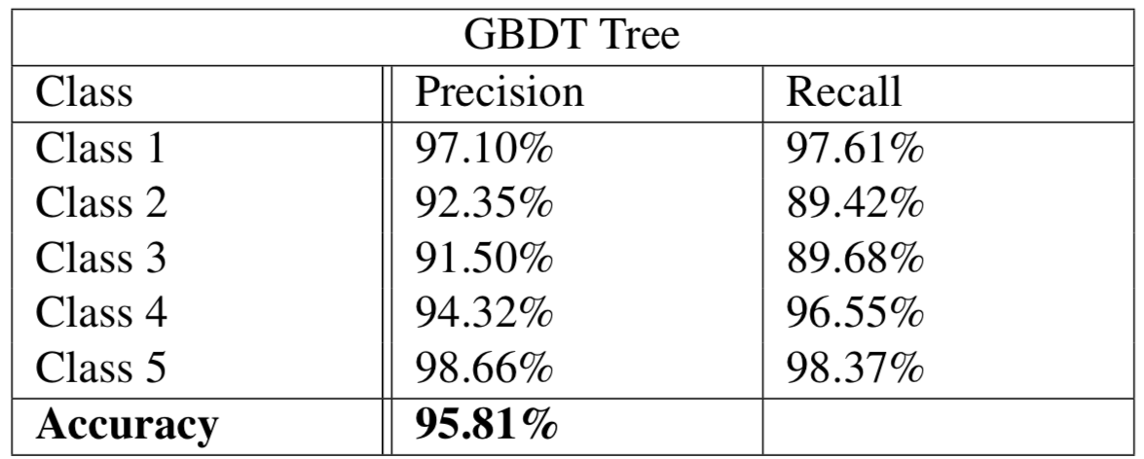
GBDT confusion matrix

Slide 35
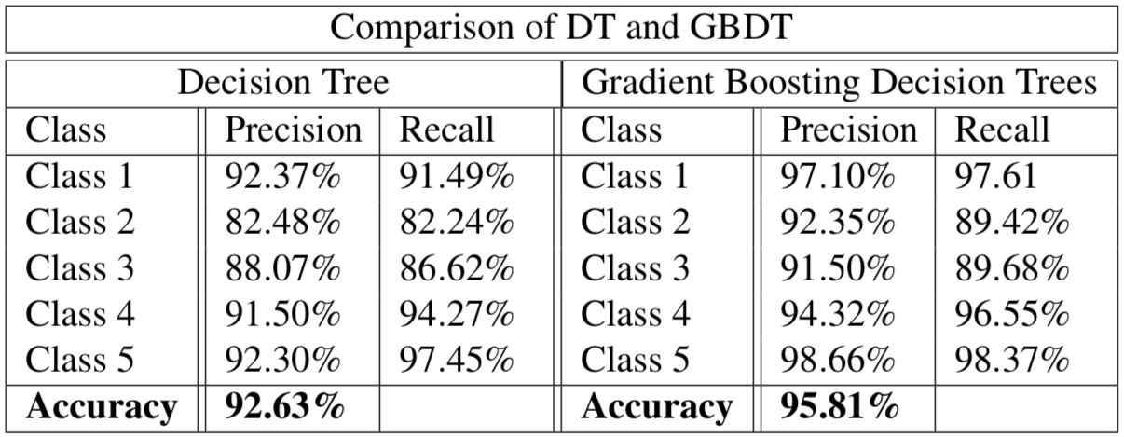
Comparison between DT and GBDT

Slide 36
Applications
Smart cities, data visualization
Timely repairs, online cabs
Driver warning applications
Automated road monitoring
Detecting driving behaviors
Route optimization/route selection

Slide 37
Limitations and conclusion
Conclusion
Proof of concept in developing an android app to collect road surface data
Proposed algorithm effectively compresses the data and points out important features
Features extracted shows significant accuracy
Data set is public and open to contributions at https://github.com/NaumanAslam/roadsurface_dataset_pk.git
Limitations
Speed
Net weight of the vehicle can vary the damping effect
Suspension

Slide 38
references
[1] Yazan A Alqudah and Belal H Sababha. On the analysis of road surface conditions using embedded smartphone sensors. In 2017 8th International Conference on Information and Communication Systems (ICICS), pages 177–181. IEEE, 2017. Cited on pp. 1 and8.
[2] PaulWhitla.Crowdsourcinganditsapplicationinmarketingactivities.Contemporary Management Research, 5(1), 2009. Cited on p. 1.
[3] Andrea Zanella, Nicola Bui, Angelo Castellani, Lorenzo Vangelista, and Michele Zorzi. Internet of things for smart cities. IEEE Internet of Things journal, 1(1):22–32, 2014. Cited on p. 1.
[4] Lounell B Gueta and Akiko Sato. Classifying road surface conditions using vibration signals. In 2017 Asia-Pacific Signal and Information Processing Association Annual Summit and Conference (APSIPA ASC), pages 039–043. IEEE, 2017. Cited on p. 2.
[5] SharadSAdlingeandAKGupta.Pavementdeteriorationanditscauses.International Journal of Innovative Research and Development, 2(4):437–450, 2013. Cited on p. 2.
[6] Guangtao Xue, Hongzi Zhu, Zhenxian Hu, Jiadi Yu, Yanmin Zhu, and Yuan Luo. Pothole in the dark: Perceiving pothole profiles with participatory urban vehicles. IEEE Transactions on Mobile Computing, 16(5):1408–1419, 2016. Cited on p. 3.
[7] Fatjon Seraj, Berend Jan van der Zwaag, Arta Dilo, Tamara Luarasi, and Paul Havinga. Roads: A road pavement monitoring system for anomaly detection using smart phones. In Big data analytics in the social and ubiquitous context, pages 128–146. Springer, 2015. Cited on pp. 8, 10, 11, and 12.
[8] AmrSEl-Wakeel,JinLi,MuhammedTRahman,AboelmagdNoureldin,andHossam S Hassanein. Monitoring road surface anomalies towards dynamic road mapping for future smart cities. In 2017 IEEE Global Conference on Signal and Information Processing (GlobalSIP), pages 828–832. IEEE, 2017. Cited on p. 9.
[9] G Alessandroni, LC Klopfenstein, Saverio Delpriori, M Dromedari, G Luchetti, B Paolini, Andrea Seraghiti, Emanuele Lattanzi, Valerio Freschi, Alberto Carini, et al. Smartroadsense: Collaborative road surface condition monitoring. Proc. of UBICOMM-2014. IARIA, pages 210–215, 2014. Cited on p. 9.

Slide 39
references
[10] Marius Hoffmann, Michael Mock, and Michael May. Road-quality classification and bump detection with bicycle-mounted smartphones. In Proceedings of the 3rd International Conference on Ubiquitous Data Mining-Volume 1088, pages 39–43. CEUR-WS. org, 2013. Cited on pp. 9, 11, 12, and 45.
[11] Yoshiaki Taniguchi, Kodai Nishii, and Hiroyuki Hisamatsu. Evaluation of a bicycle- mounted ultrasonic distance sensor for monitoring road surface condition. In 2015 7th International Conference on Computational Intelligence, Communication Systems and Networks, pages 31–34. IEEE, 2015. Cited on p. 9.
[12] SB Prapulla, Sriram N Rao, and Vivek A Herur. Road quality analysis and mapping for faster and safer travel. In 2017 International Conference on Energy, Communica- tion, Data Analytics and Soft Computing (ICECDS), pages 2487–2490. IEEE, 2017. Cited on p. 10.
[13] Frederico Soares Cabral, Mateus Pinto, Fernao ALN Mouzinho, Hidekazu Fukai, and Satoshi Tamura. An automatic survey system for paved and unpaved road classification and road anomaly detection using smartphone sensor. In 2018 IEEE International Conference on Service Operations and Logistics, and Informatics (SOLI), pages 65–70. IEEE, 2018. Cited on pp. 10, 27, and 28.
[14] Vittorio Astarita, Maria Vittoria Caruso, Guido Danieli, Demetrio Carmine Festa, Vincenzo Pasquale Giofrè, Teresa Iuele, and Rosolino Vaiana. A mobile application for road surface quality control: Uniqualroad. Procedia-Social and Behavioral Sciences, 54:1135–1144, 2012. Cited on p. 10.
[15] Guy P Nason and Bernard W Silverman. The stationary wavelet transform and some statistical applications. In Wavelets and statistics, pages 281–299. Springer, 1995. Cited on p. 10.
[16] Jakob Eriksson, Lewis Girod, Bret Hull, Ryan Newton, Samuel Madden, and Hari Balakrishnan. The pothole patrol: using a mobile sensor network for road surface monitoring. In Proceedings of the 6th international conference on Mobile systems, applications, and services, pages 29–39. ACM, 2008. Cited on p. 11.
[17] Android Studio. Android studio. The Official IDE for Android, 2017. Cited on p. 13.

Slide 40
references
[18] Sensormanager | android developers. https://developer.android. com/reference/android/hardware/SensorManager. (Accessed on 05/29/2019). Cited on p. 14.
[19] Nishkam Ravi, Nikhil Dandekar, Preetham Mysore, and Michael L Littman. Activity recognition from accelerometer data. In Aaai, volume 5, pages 1541–1546, 2005. Cited on p. 15.
[20] Richard W DeVaul and Steve Dunn. Real-time motion classification for wearable computing applications. 2001 Project Paper, 2001. Cited on p. 15.
[21] F Foerster, M Smeja, and J Fahrenberg. Detection of posture and motion by ac- celerometry: a validation study in ambulatory monitoring. Computers in Human Behavior, 15(5):571–583, 1999. Cited on p. 15.
[22] Christopher Barthold, Kalyan Pathapati Subbu, and Ram Dantu. Evaluation of gyroscope-embedded mobile phones. In 2011 IEEE International Conference on Systems, Man, and Cybernetics, pages 1632–1638. IEEE, 2011. Cited on p. 16.
[23] Laurence Moroney. An introduction to firebase. In The Definitive Guide to Firebase, pages 1–24. Springer, 2017. Cited on p. 17.
[24] Top five best selling cars of 2018 in pakistan - dna news agency. http://www. dnanews.com.pk/top-five-best-selling-cars-2018-pakistan/. (Accessed on 05/30/2019). Cited on p. 24.
[25] Rajiv Kumar, Abhijit Mukherjee, and VP Singh. Community sensor network for monitoring road roughness using smartphones. Journal of Computing in Civil Engi- neering, 31(3):04016059, 2016. Cited on pp. 27 and 45.
[26] Ronald W Schafer et al. What is a savitzky-golay filter. IEEE Signal processing magazine, 28(4):111–117, 2011. Cited on p. 27.
[27] MehryarMohri,AfshinRostamizadeh,andAmeetTalwalkar.Foundationsofmachine learning. adaptive computation and machine learning. MIT Press, 31:32, 2012. Cited on pp. 28 and35.

Slide 41
references
[28] S Rasoul Safavian and David Landgrebe. A survey of decision tree classifier method- ology. IEEE transactions on systems, man, and cybernetics, 21(3):660–674, 1991. Cited on p. 35.
[29] Ahmad Ashari, Iman Paryudi, and A Min Tjoa. Performance comparison between naïve bayes, decision tree and k-nearest neighbor in searching alternative design in an energy simulation tool. International Journal of Advanced Computer Science and Applications (IJACSA), 4(11), 2013. Cited on p. 36.
[30] Guolin Ke, Qi Meng, Thomas Finley, Taifeng Wang, Wei Chen, Weidong Ma, Qiwei Ye, and Tie-Yan Liu. Lightgbm: A highly efficient gradient boosting decision tree. In Advances in Neural Information Processing Systems, pages 3146–3154, 2017. Cited on p. 36.
[31] Ping Li. Robust logitboost and adaptive base class (abc) logitboost. arXiv preprint arXiv:1203.3491, 2012. Cited on p. 36.
[32] Felix Jungermann. Information extraction with rapidminer. In Proceedings of the GSCL Symposium Sprachtechnologie und eHumanities, pages 50–61. Citeseer, 2009. Cited on p. 38.
[33] David Martin Powers. Evaluation: from precision, recall and f-measure to roc, informedness, markedness and correlation. 2011. Cited on p. 39.

Slide 42
Thank you!

