Slide 1

Pothole Detection and Mapping System.
Noman Rafique
BSCS-18-12

Slide 2
Contents:
Introduction
Motivation
Literature Survey
Problem Statement
Approach
Software / Hardware Requirements
Conclusion

Slide 3
Introduction:
What is a Pothole?
Problems caused by Potholes.
Need for Pothole detection System for Road Safety.

Slide 4
Motivation:
Rainfall
Road Accidents
Inevitable Wear and Tear

Slide 5
Literature Survey:
Automated Wireless Detection Using Wireless Sensor Modes.
Continuous Road Damage Detection Using Regular Service Vehicles
Accident Detector Using Wireless Communication.

Slide 6
Problem Statement:
Potholes are very harmful
Safety and comfort of Road users and commuters.
Bad Road Network

Slide 7
Approach:
Collect Road images
Detect Pothole based on VGG NET
Optical device mounted on vehicle.
Use of Wi-fi and GPS.

Slide 8
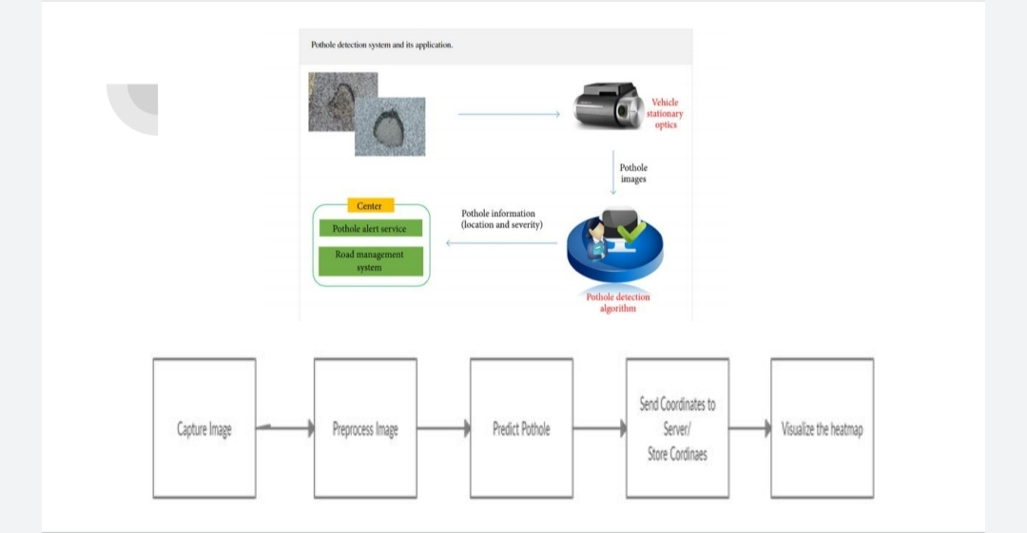

Slide 9
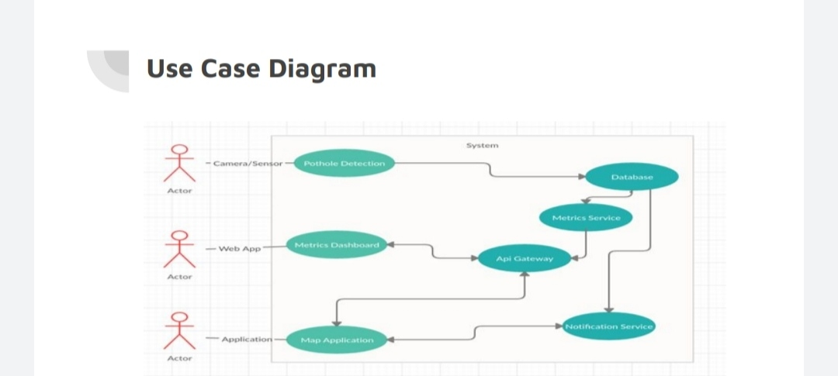

Slide 10
Software/ Hardware Requirements:
Optical Camera/ Pi Cam:
Raspberry Pi Microcontroller:
GPS Module
GSM Module
GPRS System
Cloud Service

Slide 11
Conclusion:
This Project will serve as a useful approach to automate
pothole and accident detection and reporting. It will enable to create and maintain updated database of detected potholes. It
serves as a helpful approach for the government authority. It
reduces the time taken to manually search and locate potholes.
The project provides a user friendly interface. Our goal is to
focus on customers, services and integration for end users. It
reduces the man power required. It provides accurate
information about the location.

