Slide 1
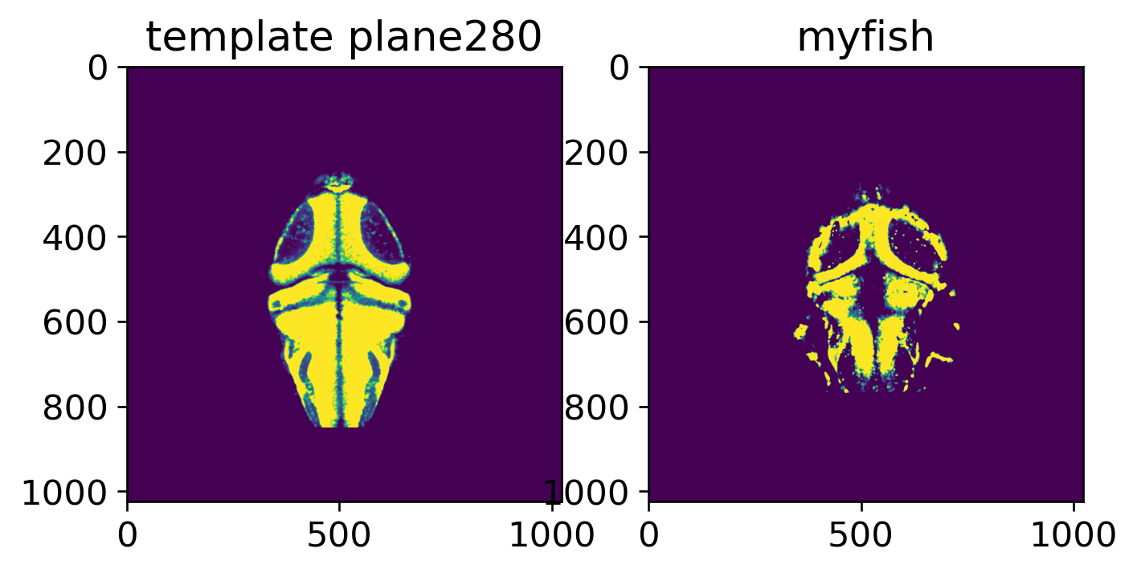
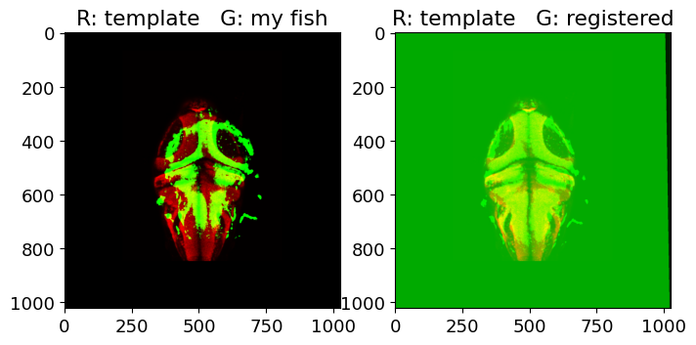
Alignment.ipynb workflow
Cleo 2025/03/09
STEP1: Align best plane
A. find best planes + modify display parameters
B. Two step registration to pseudo align myfish to template
First_register_plane
(best anatomical marker)
downsample
embed
gaussian smooth
threshold: vmin/vmax
myfish
Registrations:
(scalePanalty,
Iterations_0,
Iterations_1)
Template that best matches the first_register plane
downsample
trim: y_low/top_cutoff
embed
gaussian smooth
threshold: vmin/vmax
template
Transformation parameter 0

Slide 2
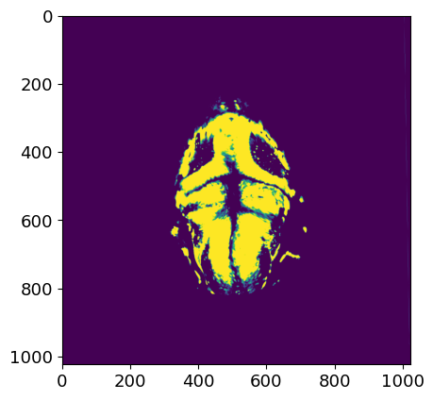
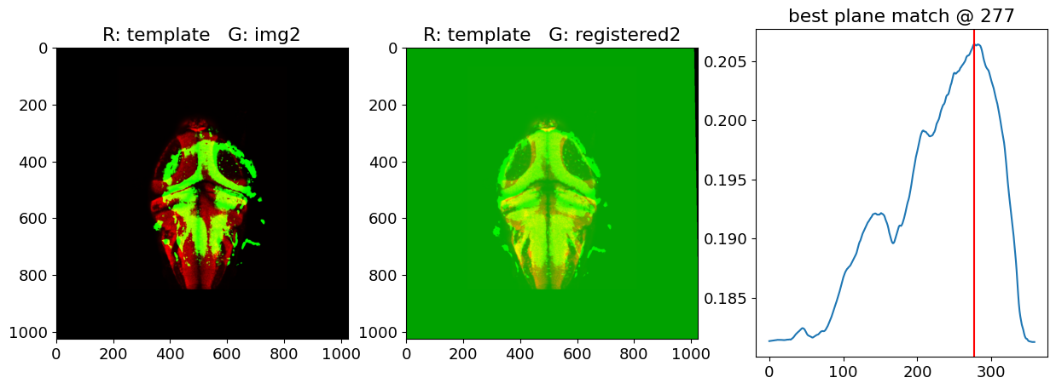
Alignment.ipynb workflow
Cleo 2025/03/09
STEP2: Find best z alignments
A. Find best z alignment for the first_registered_plane
Transformation parameter 0
myfish: first_registered_plane
dice similarity
downsample
trim: y_low/top_cutoff
embed
gaussian smooth
threshold: vmin/vmax
template
template
template planes

Slide 3
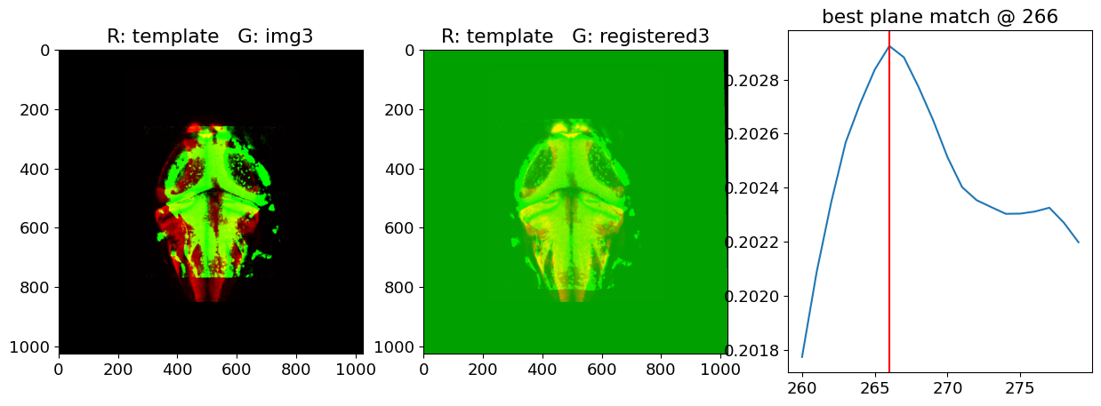
Alignment.ipynb workflow
Cleo 2025/03/09
STEP2: Find best z alignments
B. Find best z alignment for other planes according to z offset from the first plane
*for each plane
Transformation parameter 0
myfish:
other planes
dice similarity
Xum
ventral
Prev. matched z
downsample
trim: y_low/top_cutoff
embed
gaussian smooth
threshold: vmin/vmax
+/- Yum
template
template
template planes

Slide 4
Alignment.ipynb workflow
Cleo 2025/03/09
STEP3: Find best transformation based on the newly aligned z
Option A. transformation_parameter 0 looks great, no need for further transformation
Transformation parameter 0
Transformation parameter 1-n
copy
Option B. transformation_parameter 0 looks great, no need for further transformation
*for each plane, repeat STEP1

Slide 5
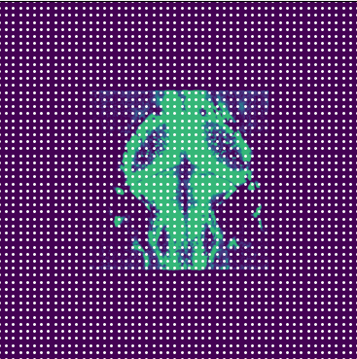
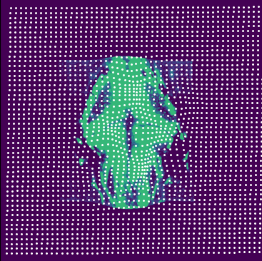
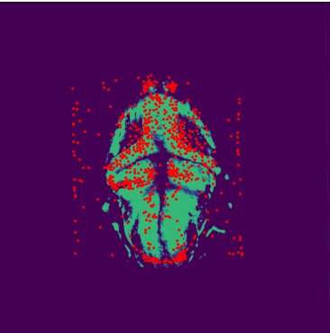
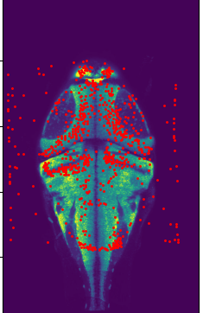
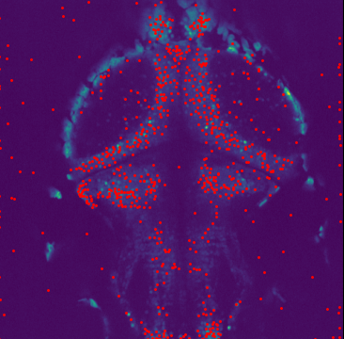
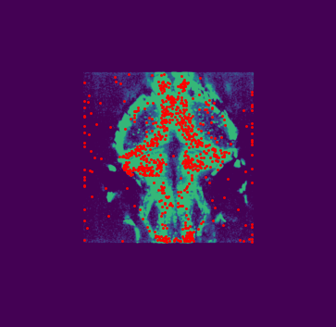
Alignment.ipynb workflow
Cleo 2025/03/09
STEP4: Find all the neurons’ new locations in the Atlas
A. Create a location dictionary between img and the transformed img
Atlas space
Transformation parameter
B. Down sample and embed all the neuron locations
Atlas space
Atlas space
downsample
embed
Location
trnasformation
dictionary
upsample
disembed
Region
assignment

Slide 6
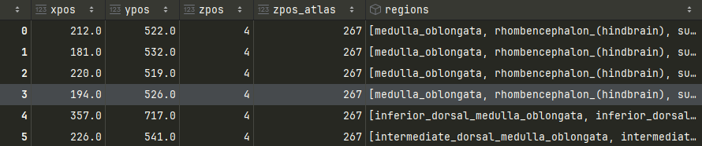
Alignment.ipynb workflow
Cleo 2025/03/09
Final output: ready to be read by fish class
params:.txt
{'vmin': 200,
'vmax': 300,
'vmin_template': 20,
'vmax_template': 100,
'y_top_cutoff': 65,
'y_low_cutoff': 850,
'downsample': 1,
'gaussian_sigma': 1,
'template_path': 'C:\\Data\\MapZBrainATLAS\\T_AVG_HuCD.tif',
'scalePanalty': 100,
'iterations_0': (512, 512),
'iterations_1': (100, 10),
'new_pos_reference': 'X'}
new_pos.csv

