Slide 1

German Credit Risk Analysis
Group 7

Slide 2
Team Introduction
1. Rohan Shah (202218002)
2. Karan Parashar (202218004)
3. Mohammed Nauman (202218010)
4. Rutul Patel (202218036)
5. Harshit Shah (202218040)

Slide 3
About this project
Understanding Problem
Statement
Exploratory Data Analysis
Conclusion
Dataset Description
Applying Machine Learning model

Slide 4
Problem Statement
To minimize loss from the bank’s perspective, the bank needs a decision rule regarding who to give approval of the loan and who not to. An applicant’s demographic and socio-economic profiles are considered by loan managers before a decision is taken regarding his/her loan application.

Slide 5
About this project
Understanding Problem
Statement
Exploratory Data Analysis
Conclusion
Dataset Description
Applying Machine Learning model

Slide 6
Dataset Description
Age (numeric)
Sex (text: male, female)
Job (numeric: 0 - unskilled and non-resident, 1 - unskilled and resident, 2 - skilled, 3 - highly skilled)
Housing (text: own, rent, or free)
Saving accounts (text - little, moderate, quite rich, rich)
Checking account (text - little, moderate, quite rich, rich)
Credit amount (numeric, in DM - Deutsch Mark)
Duration (numeric, in month)
Purpose (text: car, furniture/equipment, radio/TV, domestic appliances, repairs, education, business, vacation/others)
Risk (text - Good or Bad)

Slide 7
About this project
Understanding Problem
Statement
Exploratory Data Analysis
Conclusion
Dataset Description
Applying Machine Learning model

Slide 8
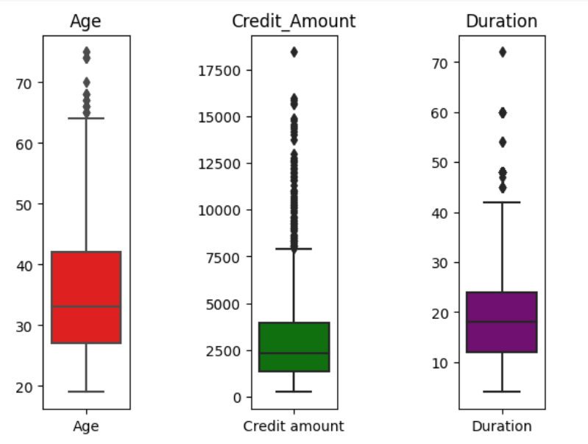
Exploratory Data Analysis
As we can see from the boxplot, we can find 5 number summary about the numerical columns present in our dataset.
In Age column, we can see that median is at 33 years. And 75% of customers are below age 42 years.
Credit Amount is highly skewed data. Where 75% of customers are below 4000 DM.
Median Duration is 18 months.

Slide 9


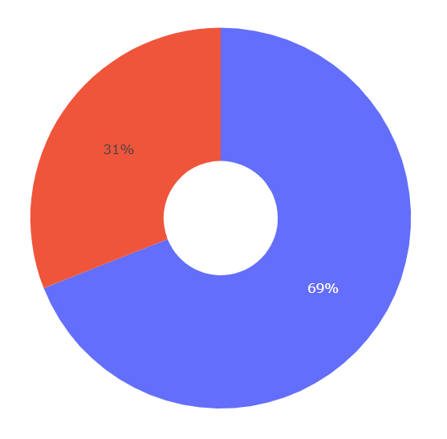
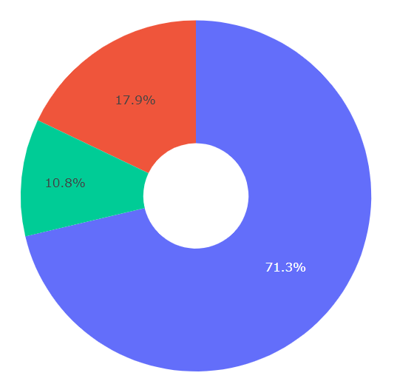
Distribution of Gender in data
Distribution of Housing

Slide 10
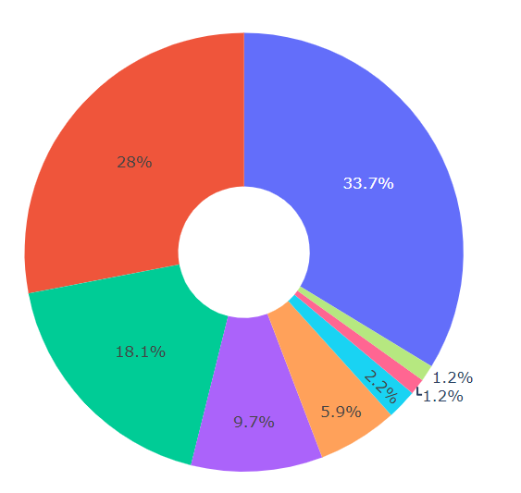
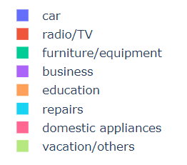
Distribution of Purpose
As we can see from the graph, Car and Radio/TV occupies 61.7% of share in our data.

Slide 11
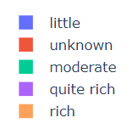
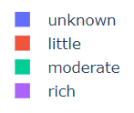
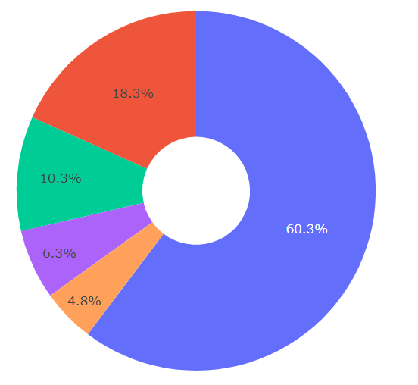
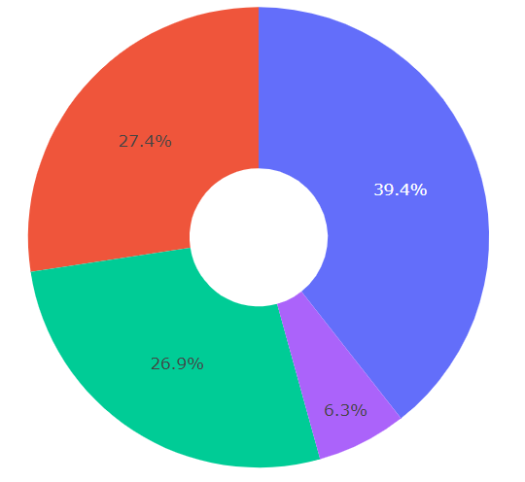
Distribution of saving account
Distribution of checking account

Slide 12
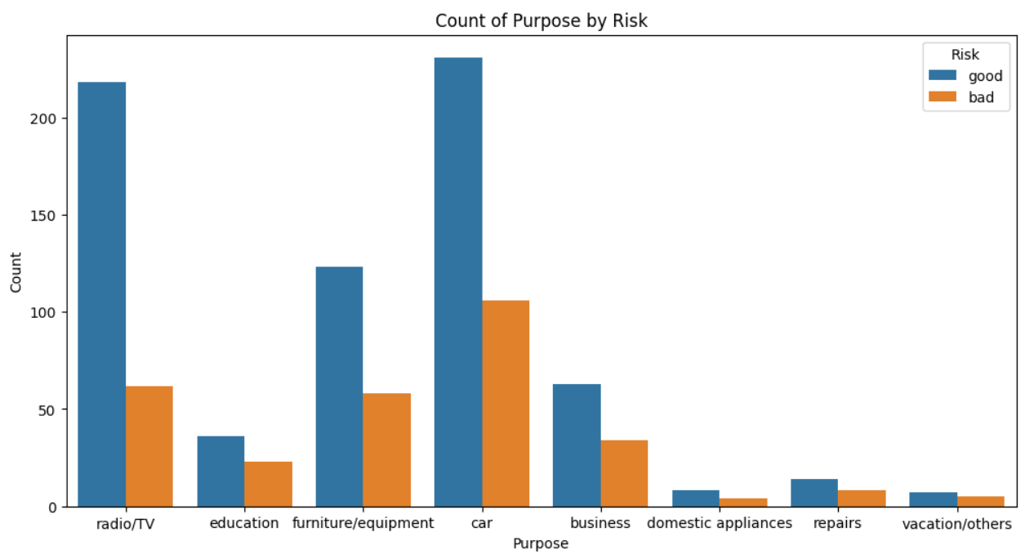

Slide 13
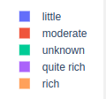
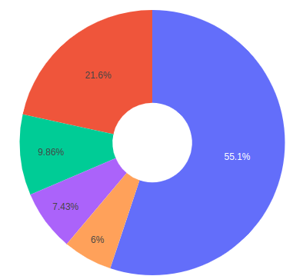
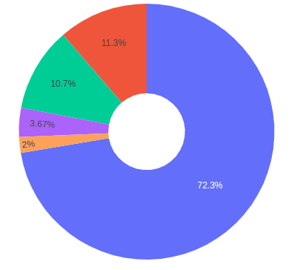
Comparison between Good Vs Bad Risks
Saving Account (Good Risk)
Saving Account (Bad Risk)

Slide 14
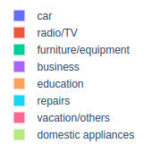
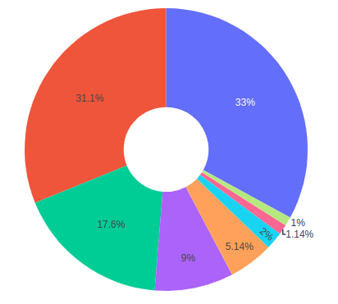
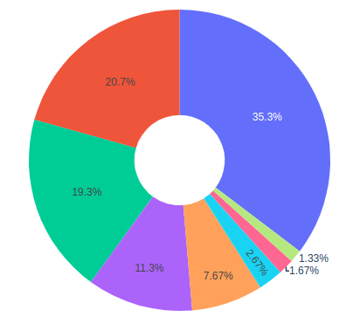
Comparison between Good Vs Bad Risks
Purpose (Good Risk)
Purpose (Bad Risk)

Slide 15
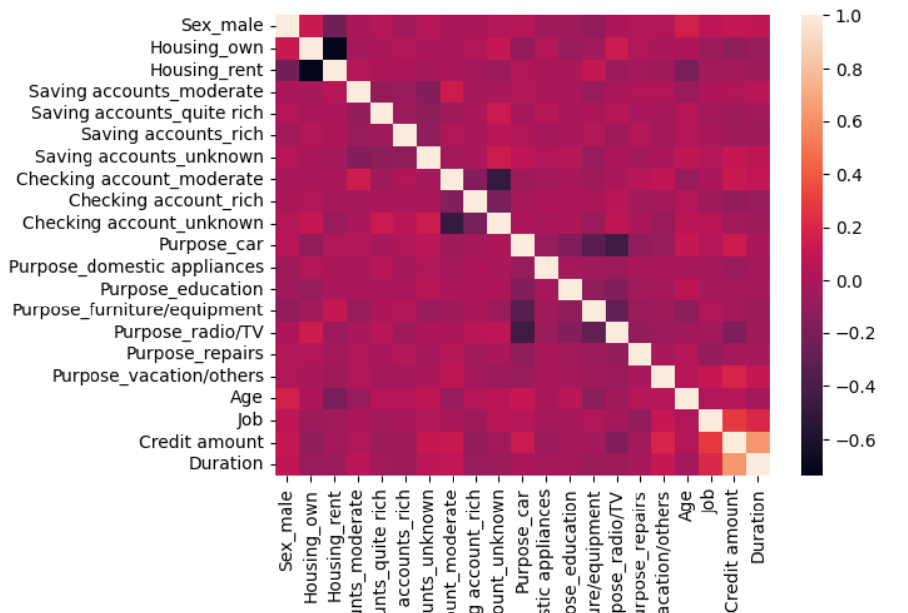
There is not direct correlation between two variables.

Slide 16
About this project
Understanding Problem
Statement
Exploratory Data Analysis
Conclusion
Dataset Description
Applying Machine Learning model

Slide 17
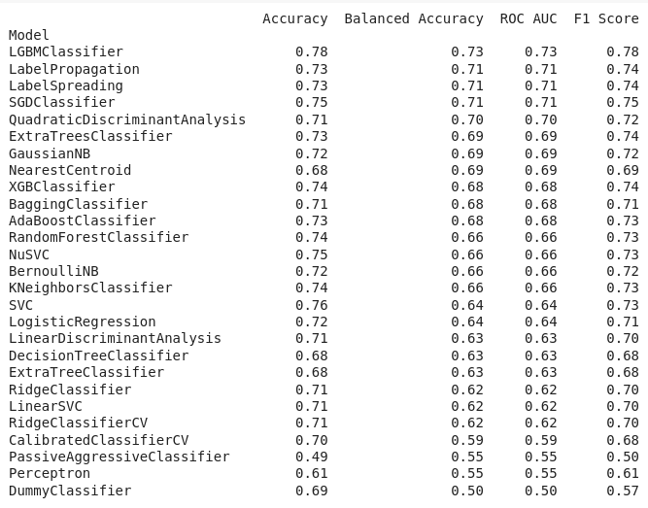
Applying Machine Learning Models

Slide 18
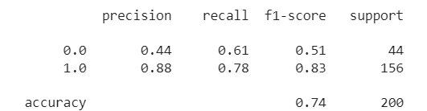
Random Forest Report

Slide 19
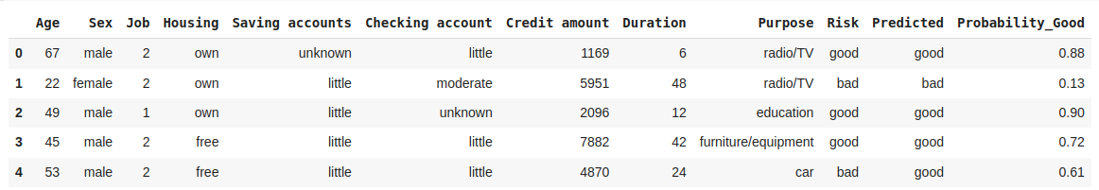
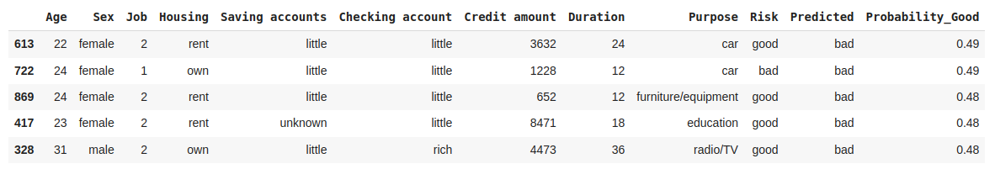

Slide 20
Predicting Purpose with it’s Good Risk Probability
Good risk probability means probability that the risk taken by bank will end up as good.
Let a details of new customer be:
Now bank want to predict for which purpose we can give that customer loan and with Good_Risk probability

Slide 21
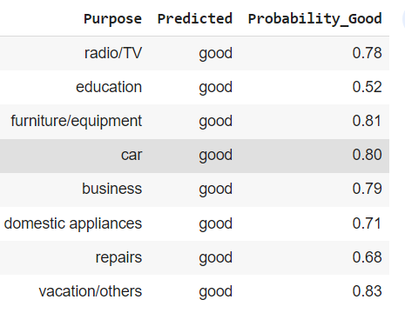
We can see that, there 81% chances that loan given to new customer for ‘Furniture/Equipment’ purpose will end up as Good Risk with 80% probability. Means it is safer to the customer loan
Where giving same customer, loan for ‘Education’ purpose’ is not a good option because there are only 52% chances of it to result in Good Loan.

Slide 22
About this project
Understanding Problem
Statement
Exploratory Data Analysis
Conclusion
Dataset Description
Applying Machine Learning model

Slide 23
Conclusion
After applying a machine learning model (Random Forest)
1. When the probability of loan repayment exceeds 70%, it is generally considered appropriate to proceed with granting the loan.
2. In cases where the probability falls between 50% and 70%, it is advisable to gather additional data and information to make a more informed decision regarding loan approval.
3. However, if the probability of repayment is less than 50%, it is recommended to refrain from granting the loan.

Slide 24
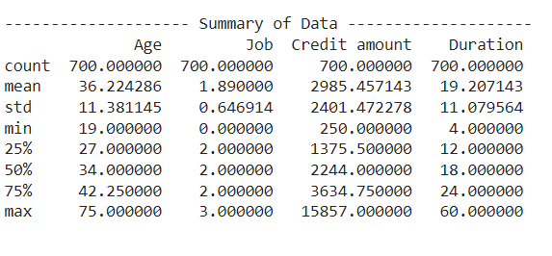
Conclusion
4. We can say that Credit amount between 1375 DM to 3634 DM are likely to become good risk.
5. Similarly if we provide loan for duration between 12 months to 24 month, it is likely to become the good risk.

Slide 25
Conclusion
5. Importance of variable in ML model:
Age : 18.5%
Credit Amount : 22.4%
Duration : 16%

Slide 26
Thank You

