Slide 1
EE-CE 301 · SIGNALS AND SYSTEMS · SUMMER 2026
PD2: Audio Signal Processing, Code Analysis & Results
Running Code1 on AudioA: sampling, spectrum analysis, and investigating filter choice
SECTION M1 · GROUP 1
Abdulrahman Shabkouh
Nasser AlQinai
Ahmed AlHabib
Notes:
Good morning. We are Group 1, Section M1. This is our PD2 presentation: analysis of Code1 applied to AudioA, covering how the code works, the results it produces, and why the filter stage behaves the way it does.

Slide 2
INTRODUCTION
Introduction and Objectives
1
2
3
Understand the code
Run it on AudioA
Explain the results
Analyze Code1 block by block: audio import, time-domain plot, FFT spectrum, low-pass filter design, and filtering.
Execute the code on the assigned recording (Fs = 48 kHz) and present the four plots it produces.
Interpret each plot and investigate whether the given filter is a good choice, and why the output shows it is not.
The key learning goal: a filter can be mathematically defined yet fail in practice, so good filter choice matters.
Presenter: Abdulrahman Shabkouh
EE-CE 301 · PD2 · 2
Notes:
Abdulrahman: PD2 covers Part 2 of the project. We were given Code1 and AudioA. Objectives: understand what each block of the code does, run it on the audio file, present the plots, and explain why the results look the way they do, especially the filter stage.

Slide 3
REQUIREMENTS
Criteria and Constraints
Criteria: what success looks like
Constraints: what we must work within
•
Every stage of Code1 explained: what it does and why
•
Assigned code: Code1, run as given and unmodified
•
All four output plots presented with correct interpretation
•
Assigned audio: AudioA, sampled at Fs = 48 kHz
•
Filter quality assessed with evidence from the plots
•
Filter parameters fixed by the code: 9th-order Butterworth, cutoff 0.02·fmax with fmax = 8000 Hz
•
The failure mode diagnosed and a fix proposed
•
MATLAB as the simulation environment
Presenter: Abdulrahman Shabkouh
EE-CE 301 · PD2 · 3
Notes:
Abdulrahman: Success means every plot is presented and explained, and the filter behavior is diagnosed with evidence. Constraints: we must use the given Code1 unmodified, the assigned AudioA file, and MATLAB.

Slide 4
CODE STRUCTURE
Code1 Flowchart
Process
Input / Output
Decision
Design LPF: butter(9, 0.02·fmax/(Fs/2))
Read AudioA: audioread, Fs = 48 kHz
Inspect response: freqz(b, a)
Plot time-domain signal x(t)
Apply filter → plot filtered spectrum
→
FFT + fftshift → two-sided spectrum
Filter behaves correctly?
Plot frequency-domain signal
No: investigated on slides 8–10
Presenter: Abdulrahman Shabkouh
EE-CE 301 · PD2 · 4
Notes:
Abdulrahman: The code is a straight pipeline: read the audio, plot it in time, FFT with fftshift to get the two-sided spectrum, design the low-pass filter with butter, inspect it with freqz, apply it with filter, and plot the filtered spectrum. The decision at the end is the question we investigate: did the filter behave correctly?

Slide 5
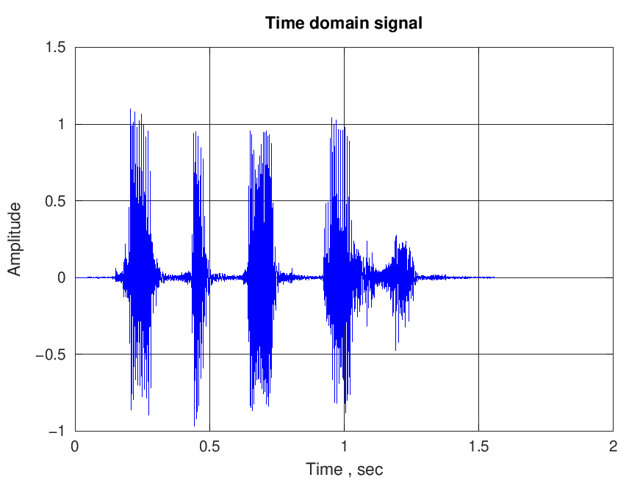
RESULTS · PLOT 1
AudioA in the Time Domain
•
≈ 1.6 s of speech containing five distinct energy bursts
•
Bursts = spoken words/syllables; gaps = silence between them
•
Peak amplitude ≈ ±1: the recording is normalized, no clipping
•
Sampled at Fs = 48 kHz, i.e. 48,000 samples per second
AudioA waveform: amplitude vs time
Presenter: Nasser AlQinai
EE-CE 301 · PD2 · 5
Notes:
Nasser: The recording is about 1.6 seconds of speech: five distinct bursts, each burst a word or syllable, separated by near-silence. Amplitude is normalized within ±1. This is what we expect from a clean speech recording.

Slide 6
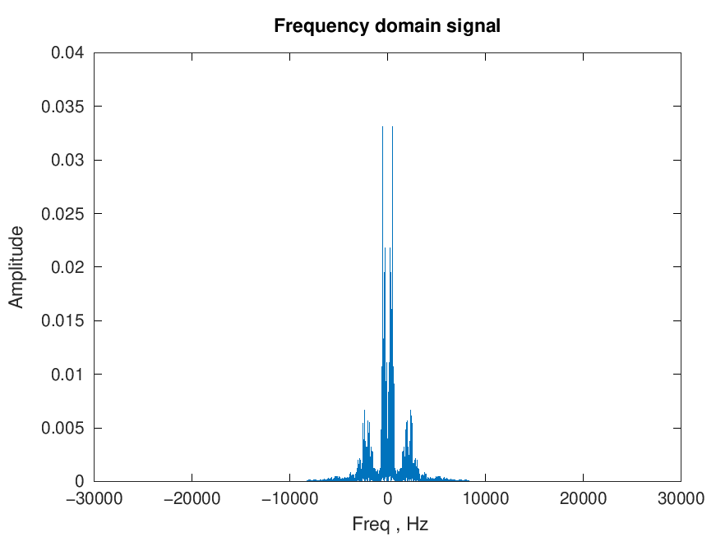
RESULTS · PLOT 2
AudioA in the Frequency Domain
•
Symmetric about 0 Hz: the signature of a real-valued signal
•
Energy concentrated below ≈ 8 kHz: the speech band
•
Axis spans ±24 kHz = Fs/2, the Nyquist frequency
•
Fs = 48 kHz > 2·fmax, so the sampling theorem is satisfied with ample margin
Two-sided magnitude spectrum via FFT + fftshift
Presenter: Nasser AlQinai
EE-CE 301 · PD2 · 6
Notes:
Nasser: The two-sided spectrum from fftshift is symmetric around 0 Hz, as it must be for a real signal. Energy is concentrated below about 8 kHz, typical for speech. The axis extends to ±24 kHz, which is Fs/2: the Nyquist frequency. Since the content stops well below 24 kHz, sampling at 48 kHz satisfies the sampling theorem with a wide margin.

Slide 7
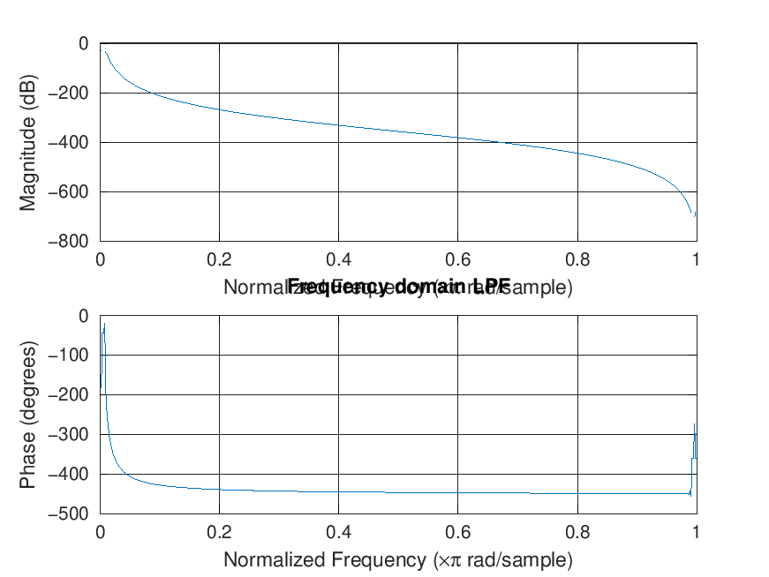
RESULTS · PLOT 3
The Designed Low-Pass Filter
•
Expected: flat 0 dB passband, then a sharp roll-off at the cutoff
•
Observed: no passband at all; magnitude falls immediately, reaching −400 dB and below
•
Phase response is similarly distorted
First warning sign: this response is not a usable low-pass filter.
freqz output: magnitude (top) and phase (bottom) of the 9th-order Butterworth LPF
Presenter: Nasser AlQinai
EE-CE 301 · PD2 · 7
Notes:
Nasser: freqz shows the designed filter's response, and it is the first warning sign. A healthy low-pass filter shows a flat 0 dB passband, then a roll-off. Here there is no flat passband at all: magnitude starts falling immediately and drops hundreds of dB. The phase plot is equally distorted. The filter as designed does not look like a usable low-pass filter; Ahmed will explain why.

Slide 8
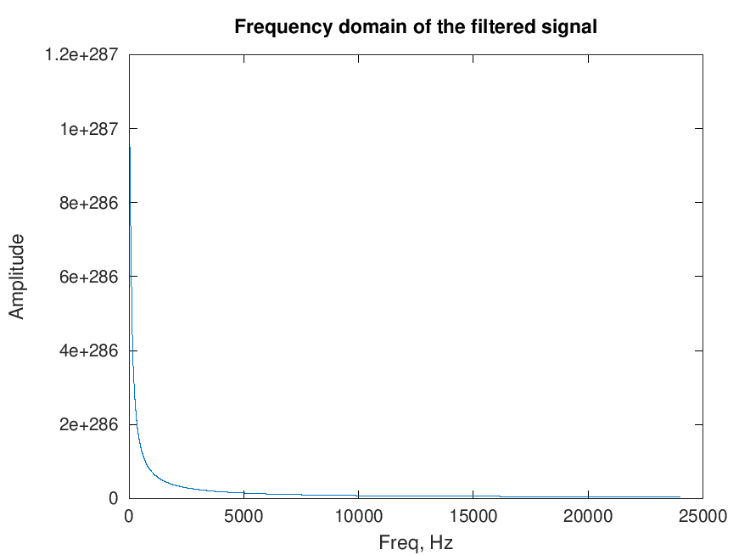
RESULTS · PLOT 4
The Filtered Signal: Numerical Blow-Up
•
Input amplitude: ≈ 0.03. Output amplitude: ≈ 10²⁸⁷
•
A filter can attenuate or amplify slightly; it cannot produce a gain of 10²⁸⁷
•
Values approach the double-precision limit (≈ 1.8×10³⁰⁸): the output is diverging, not filtering
The filter is numerically unstable: the output is meaningless.
Spectrum of the filtered signal: amplitude scale reaches 1.2×10²⁸⁷
Presenter: Ahmed AlHabib
EE-CE 301 · PD2 · 8
Notes:
Ahmed: After applying the filter, the spectrum shows amplitudes around 10 to the power 287, astronomically large, close to the largest number a computer can represent. A filter can only attenuate or slightly amplify; it can never multiply a signal by 10^287. This is not a signal anymore; it is numerical divergence. The filter is unstable in implementation.

Slide 9
DISCUSSION
Why the Filter Fails
% Line 38 of Code1: [b, a] = butter(9, 0.02*fmax/(Fs/2), 'low'); % fmax = 8000, Fs = 48000
1 · The cutoff is extreme
2 · Order 9 makes it unstable
3 · The recursion diverges
Normalized cutoff = 0.02 × 8000 / 24000 ≈ 0.0067·π : only 160 Hz out of a 24 kHz range. That removes nearly all speech content by design.
A 9th-order design at that cutoff crowds all nine poles just inside z = 1. The transfer-function coefficients become ill-conditioned, so rounding errors push poles outside the unit circle.
An unstable pole means each output sample amplifies the last, growing exponentially until it hits ≈ 10²⁸⁷. This is exactly what plot 4 shows.
This is a genuine numerical-analysis result, not a software fluke, and it matches the course's stated goal of investigating good filter choice.
Presenter: Ahmed AlHabib
EE-CE 301 · PD2 · 9
Notes:
Ahmed: The root cause is one line. The normalized cutoff is 0.02 times 8000 over 24000, about 0.0067, i.e. 160 Hz out of a 24 kHz range. A 9th-order Butterworth at such an extremely narrow cutoff places all nine poles crowded just inside z = 1. In transfer-function form the polynomial coefficients become so ill-conditioned that rounding errors push poles outside the unit circle, and the recursion diverges. This is a known numerical limitation, not an Octave or MATLAB bug.

Slide 10
DISCUSSION
What a Good Filter Choice Looks Like
Use second-order sections
Lower the order
Choose a sensible cutoff
[sos,g] = butter(9, Wn, 'low'); y = sosfilt(sos, x)*g;
[b,a] = butter(2, Wn, 'low');
Wn = 4000/(Fs/2); % 4 kHz
At order 2–3 the same cutoff is numerically safe even in transfer-function form, at the cost of a gentler roll-off.
To keep speech intelligible the cutoff belongs near the top of the speech band (~3–4 kHz), not at 160 Hz.
SOS form factors the filter into stable 2nd-order stages, immune to the coefficient ill-conditioning that broke the TF form.
Good filter choice = matching type, order, cutoff, and implementation form to the signal and the task.
Presenter: Ahmed AlHabib
EE-CE 301 · PD2 · 10
Notes:
Ahmed: Three practical fixes. First, use second-order sections: butter with the 'sos' output stays numerically stable at any order. Second, reduce the order: a 2nd or 3rd order filter at the same cutoff is stable even in TF form. Third, question the cutoff itself: if the goal is to keep speech, the cutoff should sit near the top of the speech band, e.g. 3–4 kHz, not 160 Hz. Good filter choice means matching type, order, cutoff AND implementation form to the task.

Slide 11
TEAMWORK
Reflections on the Team
Trust the plots, question the code
Debugging as a team
Theory meets floating point
One member traced the code line by line, one researched Butterworth stability, and one reproduced the fix: dividing the investigation made the diagnosis fast.
A filter that is stable on paper can diverge in double precision. This project connected classroom theory to real numerical engineering.
Our first instinct was that we ran the code wrong. Reading the plots carefully (a 10²⁸⁷ amplitude) proved the code itself was the story.
Presenters: All members
EE-CE 301 · PD2 · 11
Notes:
All: Each member takes one card. Keep it specific: what this part of the project actually taught us.

Slide 12
CLOSING
Conclusion and Future Remarks
1.
The analysis stages of Code1 work correctly: AudioA's spectrum sits below 8 kHz, so Fs = 48 kHz satisfies the sampling theorem.
2.
The filtering stage fails: the 9th-order Butterworth design at a ≈0.0067π cutoff places a pole just outside the unit circle, so the output diverges to ≈10²⁸⁷ instead of a clean low-pass result.
3.
Future work: re-run the analysis with a corrected filter (second-order sections, a lower order, or a cutoff nearer 3–4 kHz) and compare the recovered audio quality against the original recording.
Presenters: All members
EE-CE 301 · PD2 · 12
Notes:
All: Recap: the code's analysis stages work correctly and confirm the sampling theorem; the filter stage fails because a 9th-order Butterworth at a 0.0067π cutoff is numerically unstable in transfer-function form; the fix is SOS form, lower order, or a sensible cutoff. Future work: apply the corrected filter and compare audio quality. Thank the audience.

