Slide 1


Madea
Progressive WEB APP FOR MEDIA STREAMING Team members :
Amit nautiyal
Tarun bhatia

Slide 2
Content :
Introduction of Topic
Our objectives
Glimpse of our project (UX design+Git)
Milestones
Timeline
QNA

Slide 3
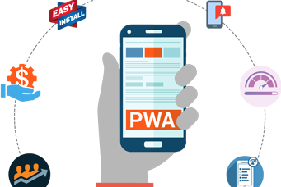
Introduction of Topic
What is a PWA ?
They are basically web applications (Website) but have look and feel like other native mobile apps. The progressive web app enabled websites can offer functionalities such as working offline, push notifications, and device hardware access.
Various advantages of using PWA includes its interactive
features like Progressive ,Responsive ,Load Time ,App-like ,Fresh,
Safe ,Engaging ,Installable ,Linkable.

Slide 4
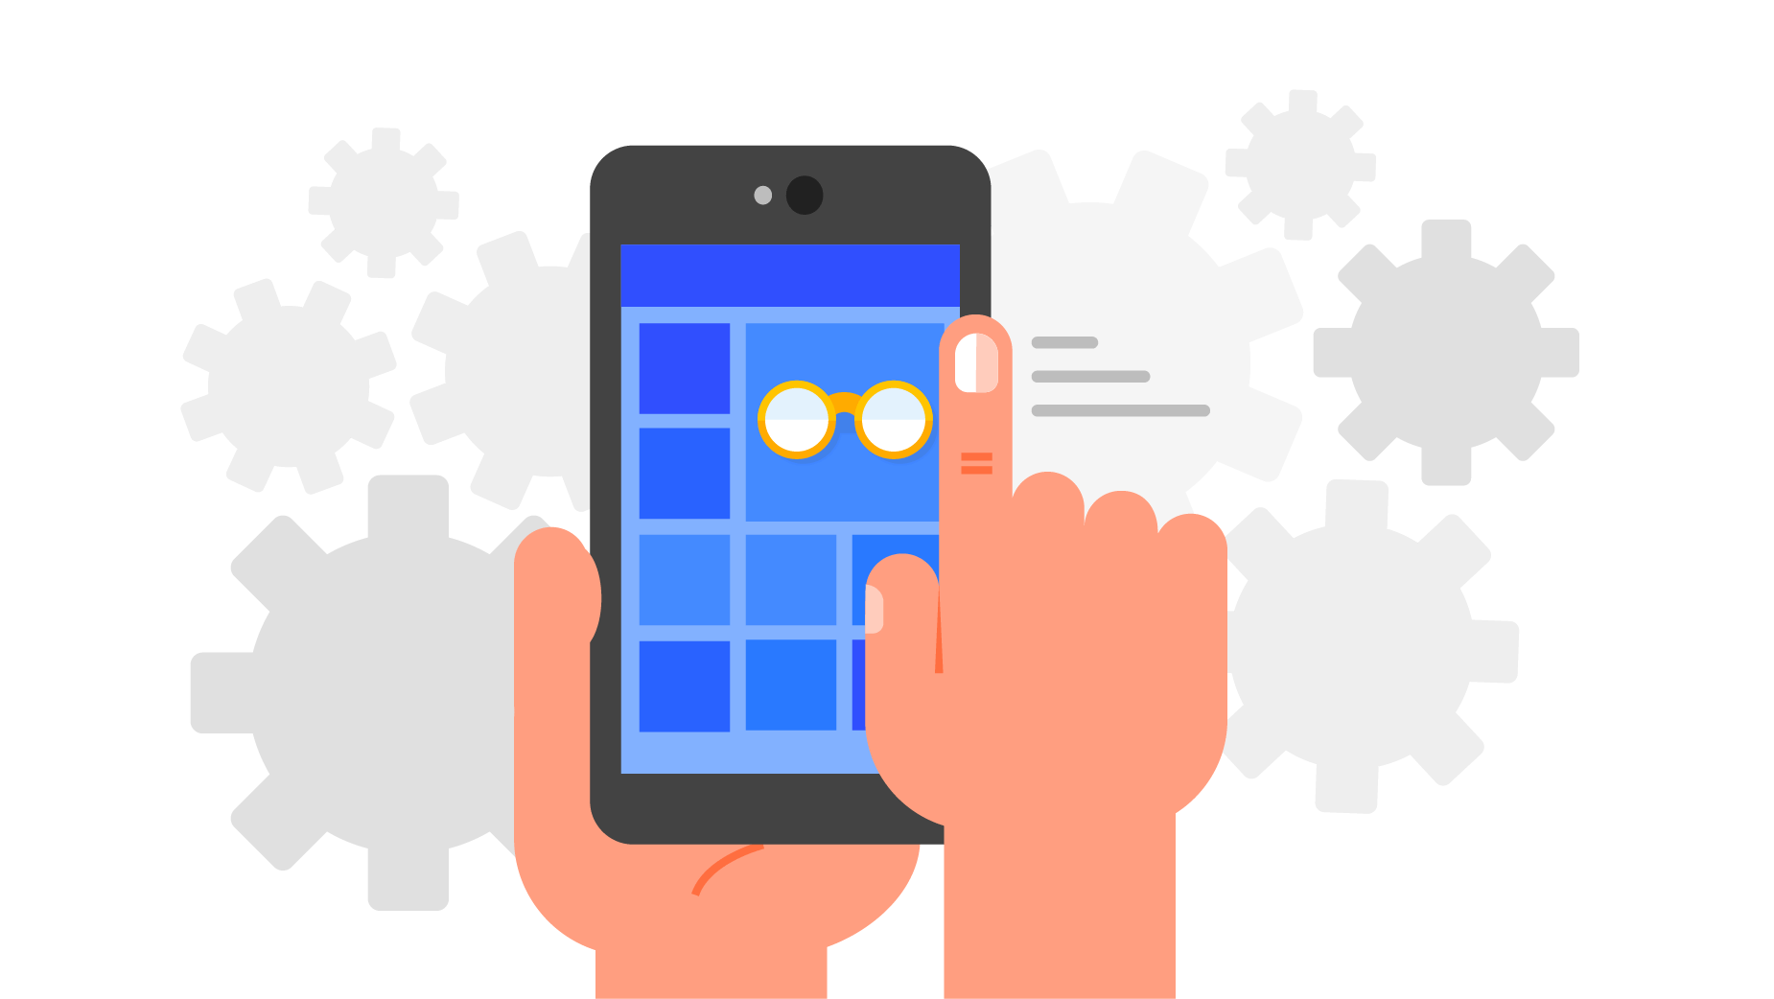
Our Objectives
To Develop an interoperable PWA for media playback, which includes a catalogue and media player .
To develop download and offline playback functionality for adaptive streams.
To develop the downloading functionalities for media streams
present in the website.
Test in different browsers and devices and PWA should work
well in all the environments.
Perform scalability test for the final product in order to test
the ability of the application to scale up or scale down the
number of user requests or other such performance measure attributes.

Slide 5
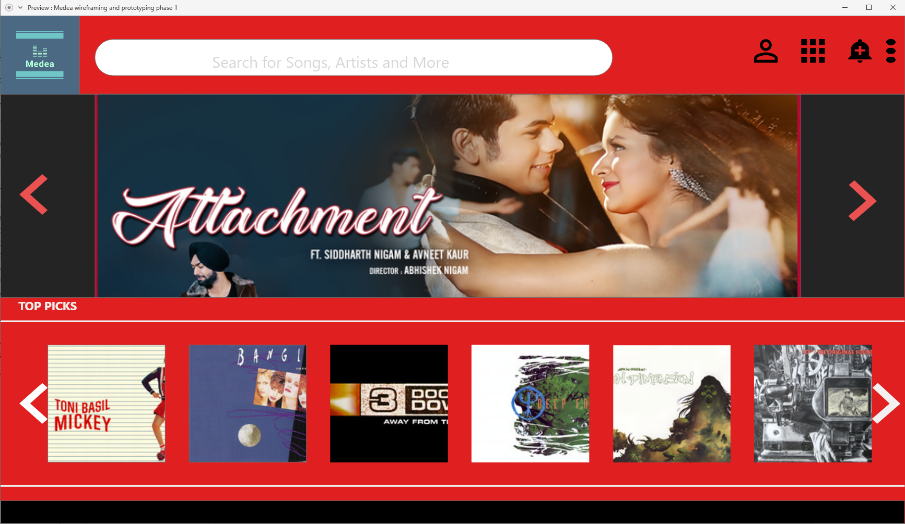
Glimpse of our project (Wire framing)
UX design for some basic components of our applications:
Index page or the first page :

Slide 6
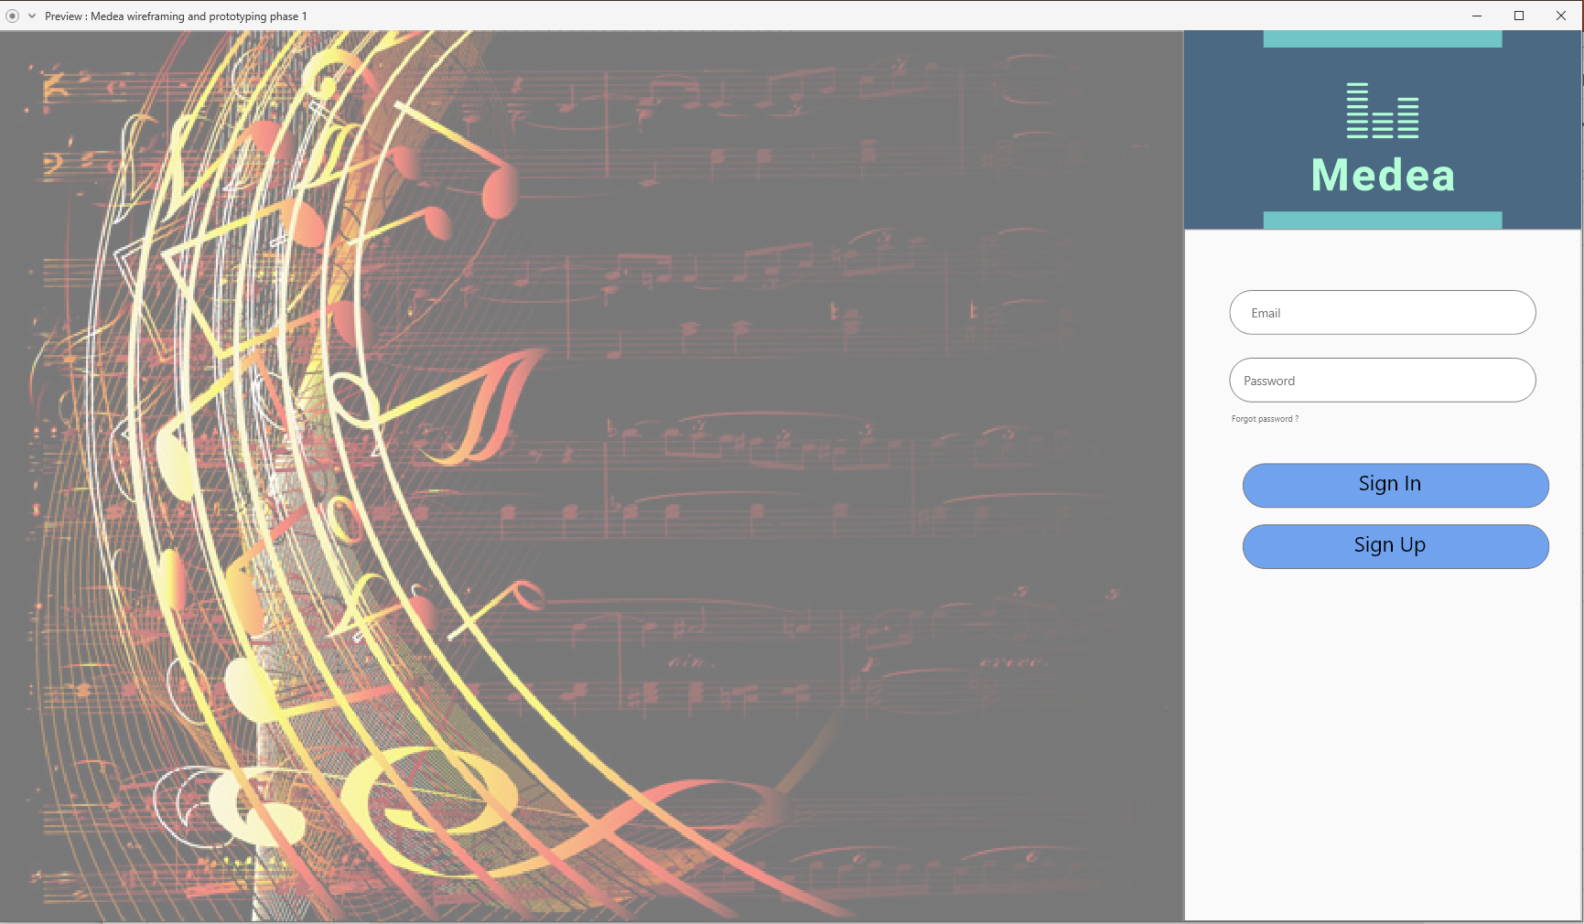
Glimpse of our project (Wire framing)
UX design for some basic components of our applications:
Signup page :

Slide 7
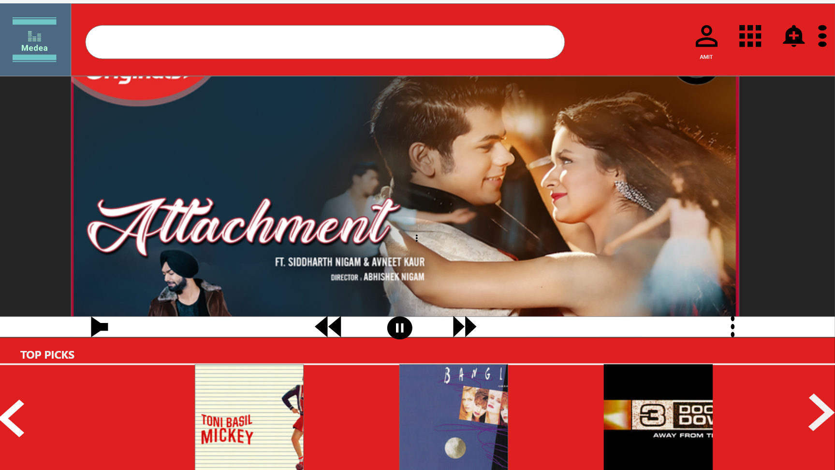
Glimpse of our project (Wire framing)
UX design for some basic components of our applications:
Media player with recommendations for user:

Slide 8
Glimpse of our project (Wire framing)
The progress and various other updates regarding the development of this application can be find at our Git repository :
https://github.com/NautiyalAmit/Medea

Slide 9
Milestones

Slide 10
Timeline
12-11-2019
The first presentation of the project , basic UX design and approach to achieve the goals is presented.
17-12-2019
Halftime presentation , we are expected to built some working prototype of the project. Our motive is to build the UI with working video streams in the website .
04-02-2020
Final presentation , the project results are to be presented on this day, we are expected to present the working of the product with the prime functionality .However we are targeting to finish all the tasks by this day .The recommended changes on this day can be made and submitted by 28.02.2020.

Slide 11
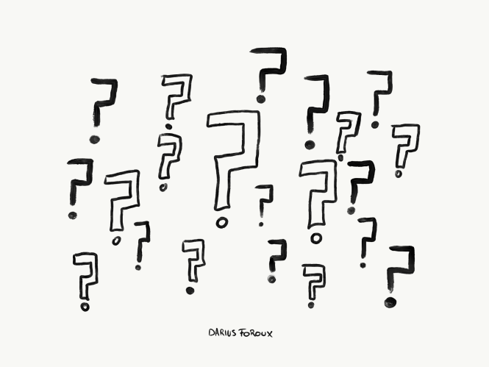
QNA
QUESTIONS ??

Slide 12
Thankyou !!

