Slide 1
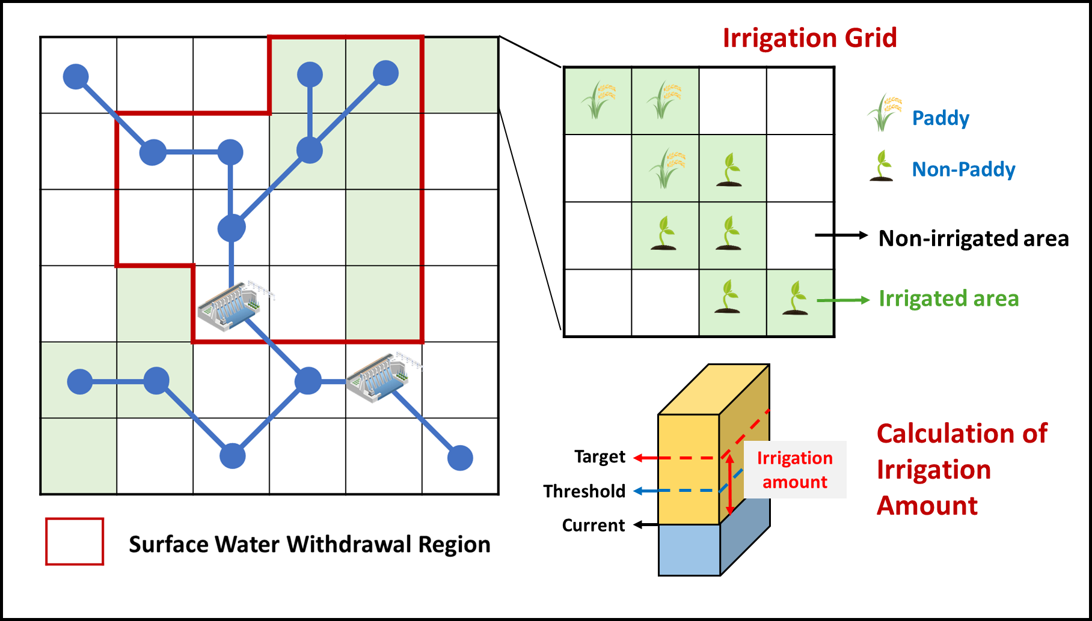



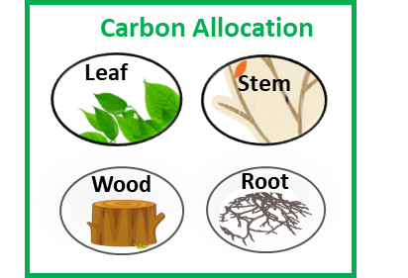






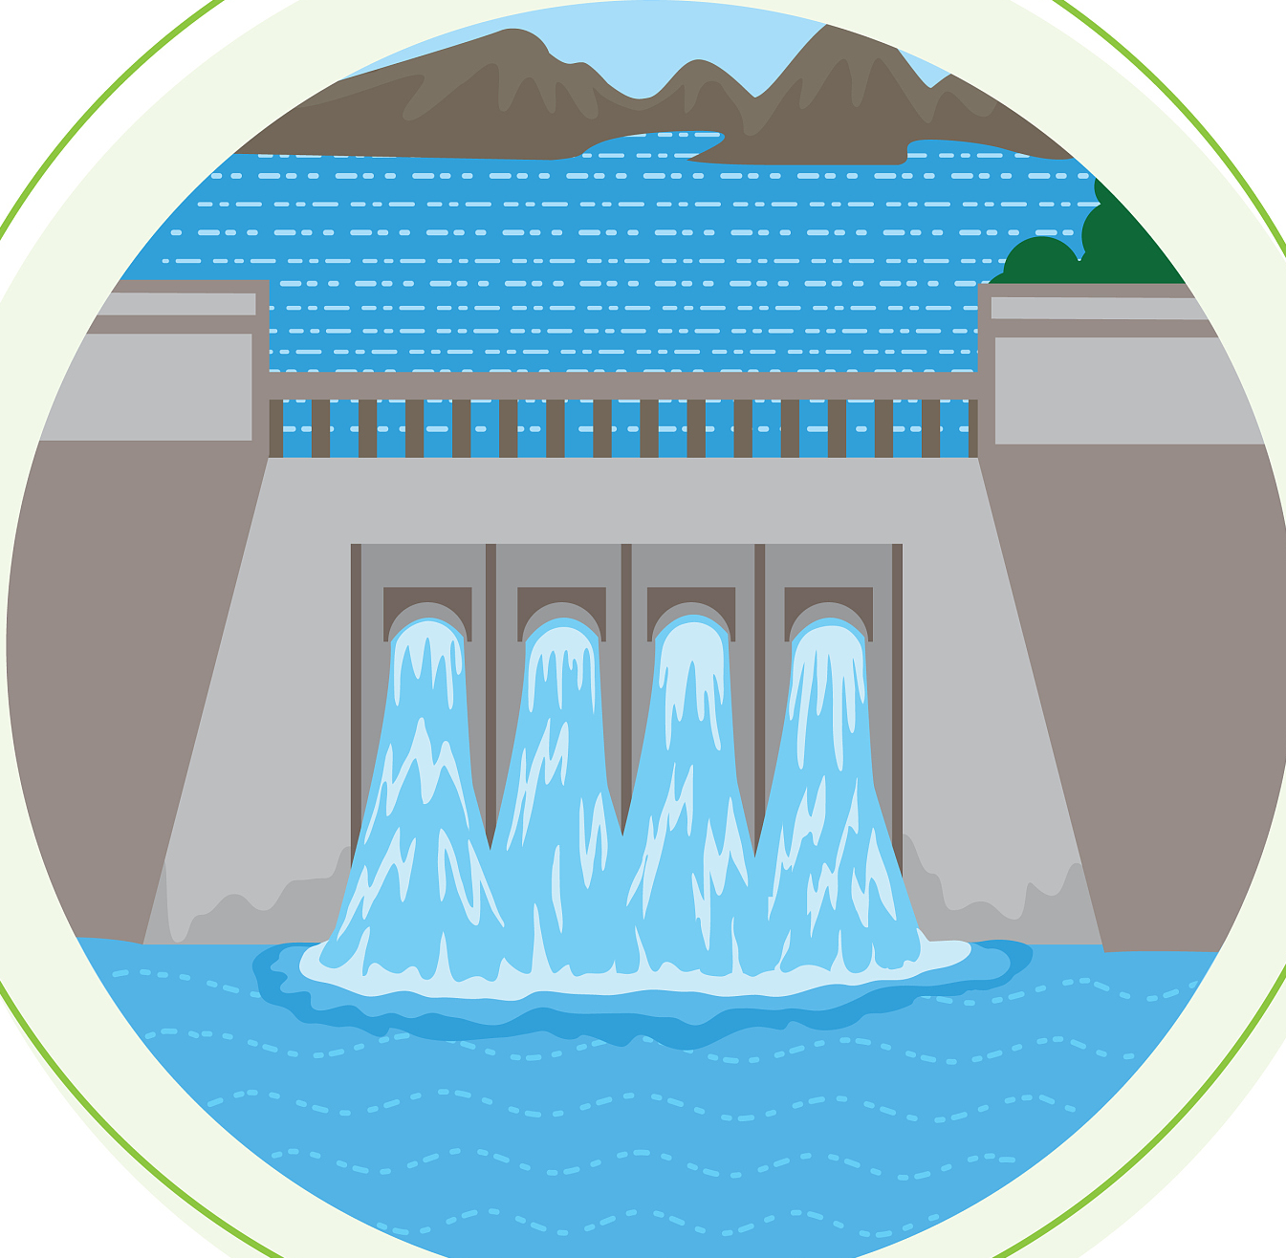
CSSPv3 Land Surface Model
Vegetation
Reflection&
Absorption
Sensible Heat
Hydrologic Process
Transpiration
Solar Radiation
Precipitation
Thermal Process
CO₂ Absorption
Evaporation
②
Stoma
Interception
Radiative Process
Photosynthesis
Ecological Process
Respiration
③
Roof Runoff
Throughfall
Roof
Ponding
Glacial
Reflection&
Absorption
Sublimation
Sublimation
Surface
Evaporation
Soil
Reflection&
Absorption
Surface water withdrawal
Sunlit
Side
Multiple Reflection & Absorption
Shaded
Side
Freeze
Sensible Heat
Groundwater withdrawal
Irrigation
Melt
Melt
Infiltration
Infiltration
Heat
Transfer
Snow
Surface runoff
Surface runoff
Ice Layer
Soil Layers(Sand,Clay,Organic)
Soil Respiration
Root Water Suction
Freeze
Ponding
（Paddy）
Streamflow
&Reservoir Operation
Ponding
Heat
Transfer
Vertical & Lateral
Soil Flow
Carbon pool
Heat
Transfer
Recharge
Melt
Baseflow & Saturation Runoff
Heat
Transfer
Permafrost
Unconfined aquifer
Permeable
Impermeable
①
Urban Land Cover

Slide 2
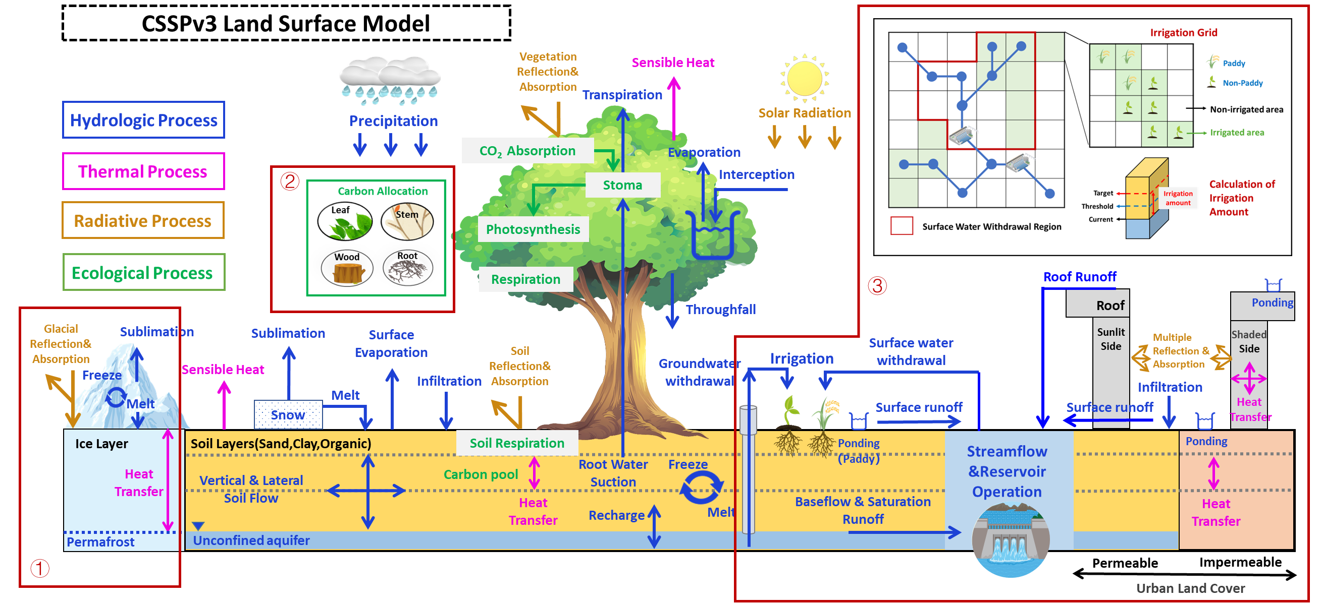

Slide 3
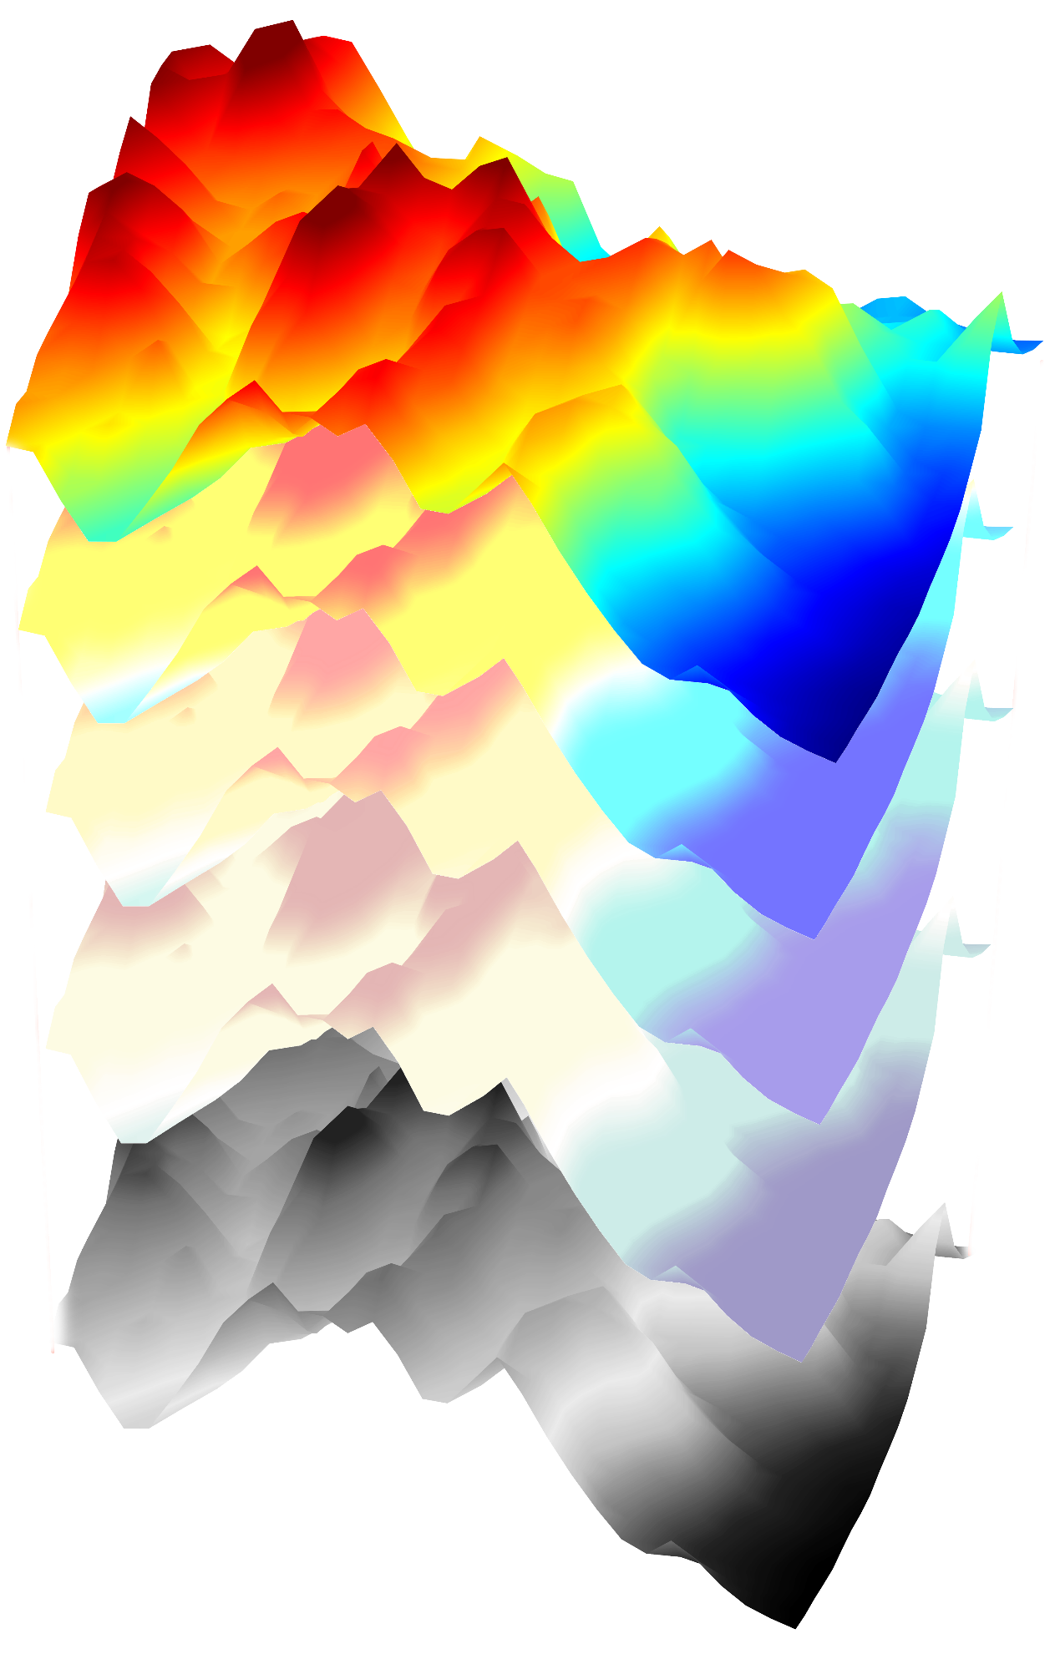
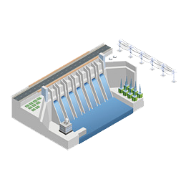
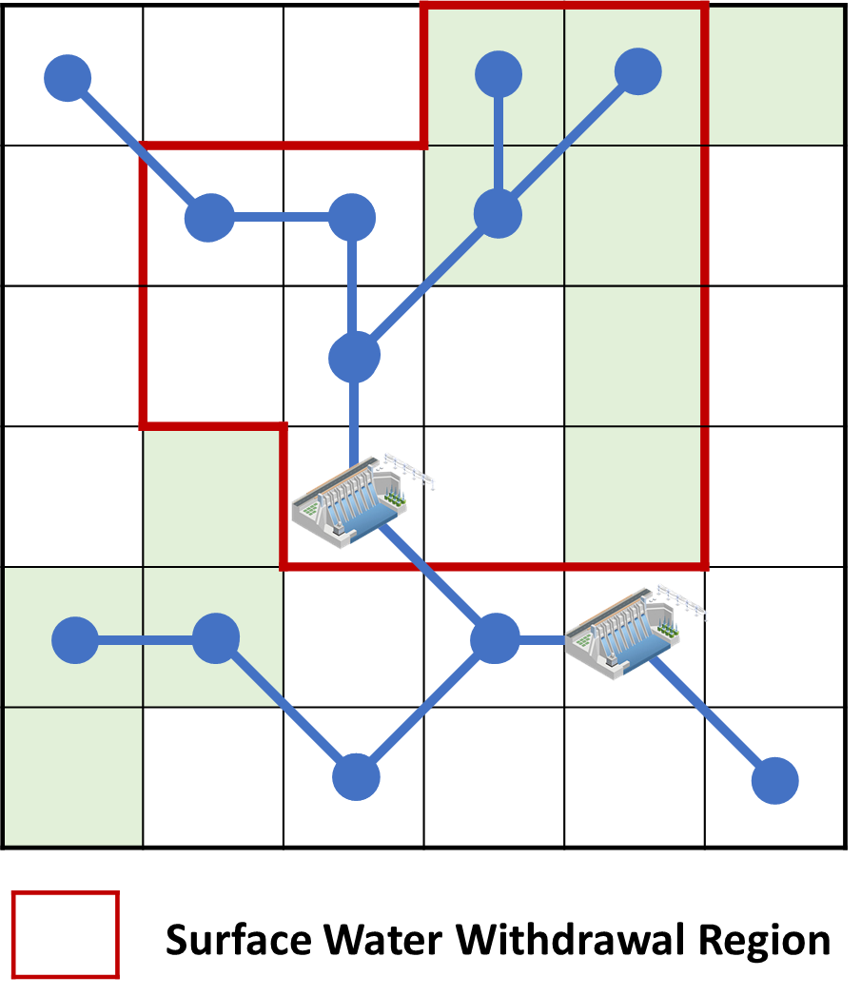
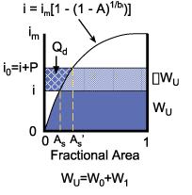
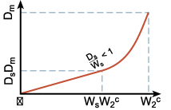
Three-dimensional volume-averaged soil moisture transport (VAST) model
Terrain-following vertical coordiante z*=Z_{G} - z
Subgrid soil moisture variation
3D Richards equation
Soil water lateral transportation
DEM
11 layers (0~5.67m)
Surface Water Withdrawal Region
Irrigation Grid
Variable Infiltration Capacity (VIC)
Paddy
Infiltration Curve
Non-Paddy
Non-irrigated area
Irrigated area
Baseflow Curve
Non-Linear
Linear
Calculation of
Irrigation
Amount
Target
Irrigation amount
Threshold
Current

