Slide 1

EDA Case Study
Navitha M

Slide 2

Business Objectives
This case study aims to identify patterns which indicate if a client has difficulty paying their installments which may be used for taking actions such as denying the loan, reducing the amount of loan, lending (to risky applicants) at a higher interest rate, etc.
This will ensure that the consumers capable of repaying the loan are not rejected. Identification of such applicants using EDA is the aim of this case study.

Slide 3

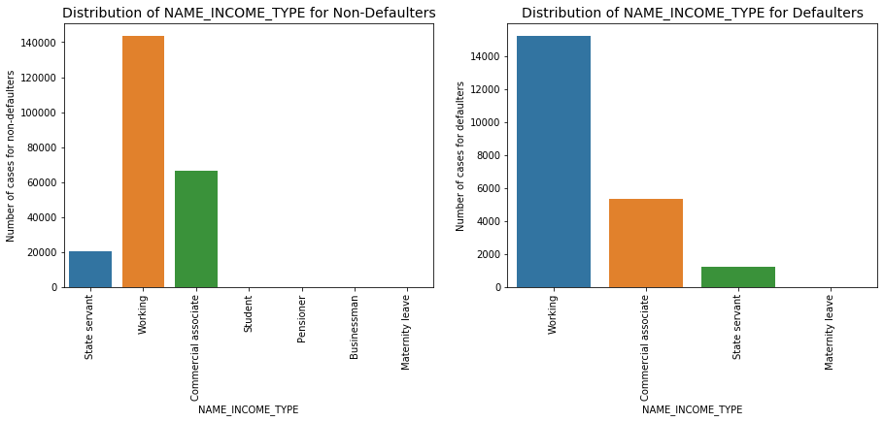
For income type ‘working’ the number of credits are higher than others.
Distribution of Income Type for
Defaulters vs Non Defaulters
Less no of Credits who are on Maternity Leave

Slide 4
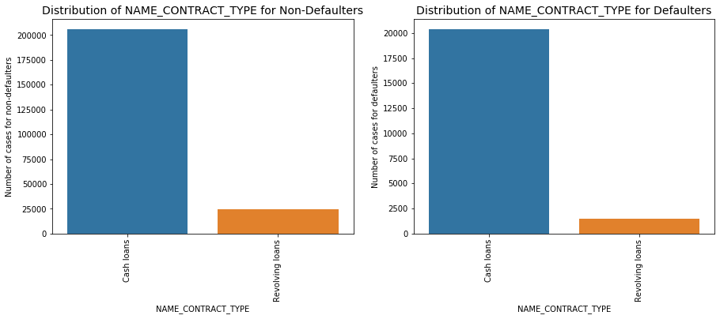
For contract type ‘cash loans’ is having higher number of credits than ‘Revolving loans’ contract type.
Distribution of Contract Type for
Defaulters vs Non Defaulters
The revolving loans are more in the non defaulter list and less in the Defaulter list.

Slide 5
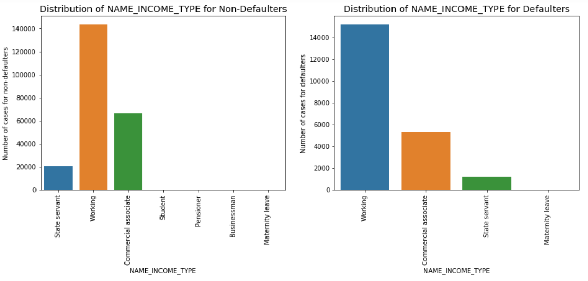
Most of the defaults are from Working population compared to other Income types.
Distribution of Income Type for
Defaulters vs Non Defaulters

Slide 6
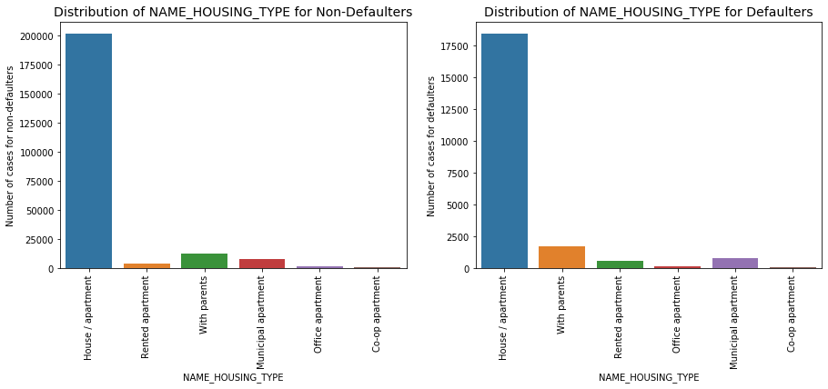
Population living with parents and Rented Apartments have higher default rate as they have higher proportion in the Defaulted population as compared to non defaulted population.
Distribution of Housing Type for
Defaulters vs Non Defaulters
Population in Municipal apartments have more defaulters compared to Non-Defaulters

Slide 7
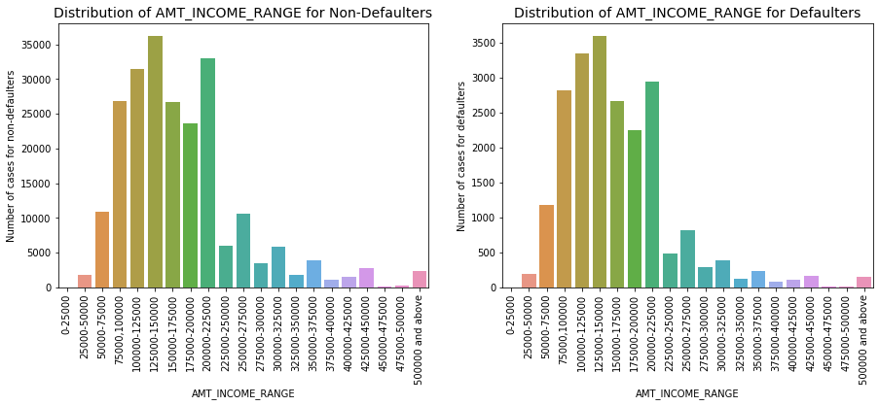
Population living with parents and Rented Apartments have higher default rate as they have higher proportion in the Defaulted population as compared to non defaulted population.
Distribution of Income Range for
Defaulters vs Non Defaulters
Income range 200000 - 225000 are less defaulters compared to defaulted population

Slide 8
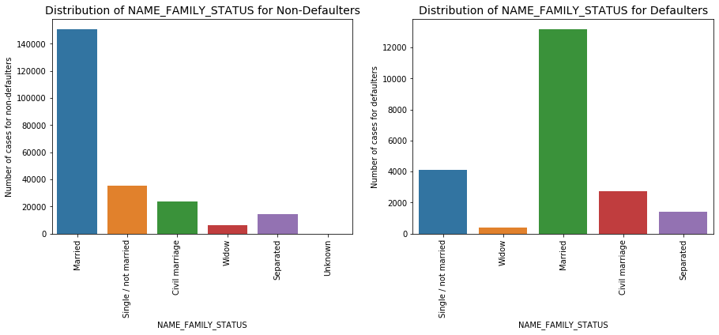
Single/ not married is proportionally higher in defaulted population as compared to non defaulted population.
Distribution of Family Status for
Defaulters vs Non Defaulters

Slide 9
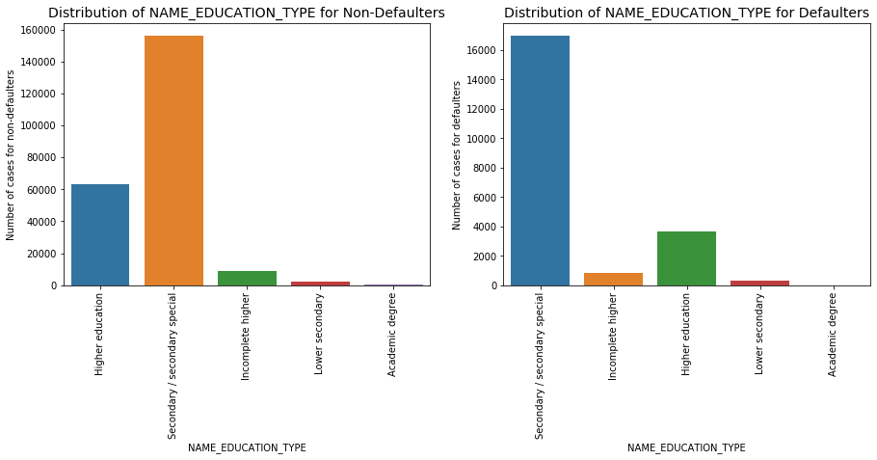
Higher education count is proportionally lesser in defaulted population as compared to non defaulted population.
Distribution of Education Type for
Defaulters vs Non Defaulters
This indicated higher education category are more non-defaulters.

Slide 10
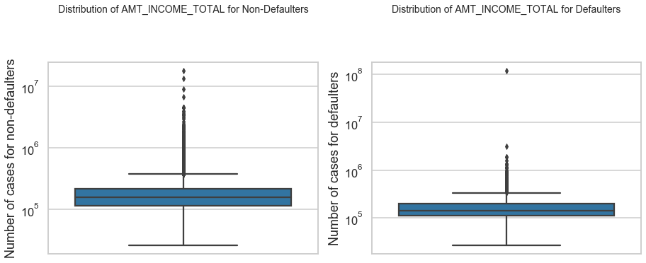
Most of the income are in first quartile
Distribution of Amount Income for
Defaulters vs Non Defaulters

Slide 11
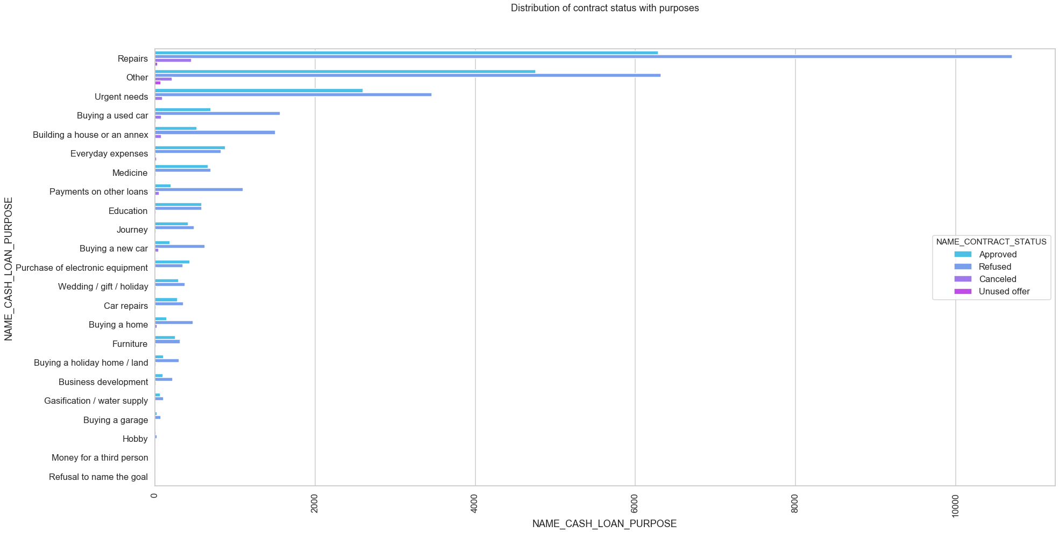
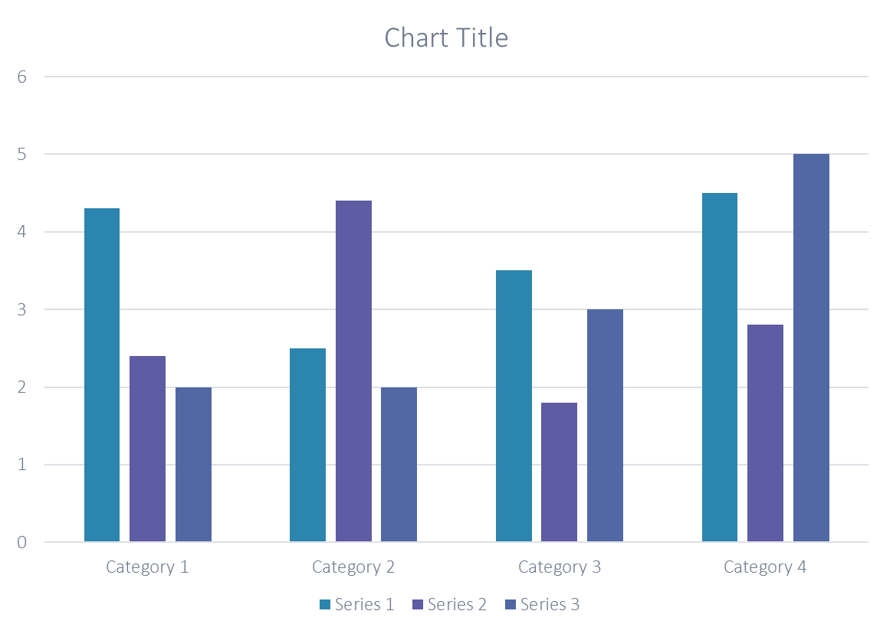
Distribution of Contract Status
Most rejection of loans came from purpose 'repairs’.
For education purposes we have equal number of approves and rejection

Slide 12
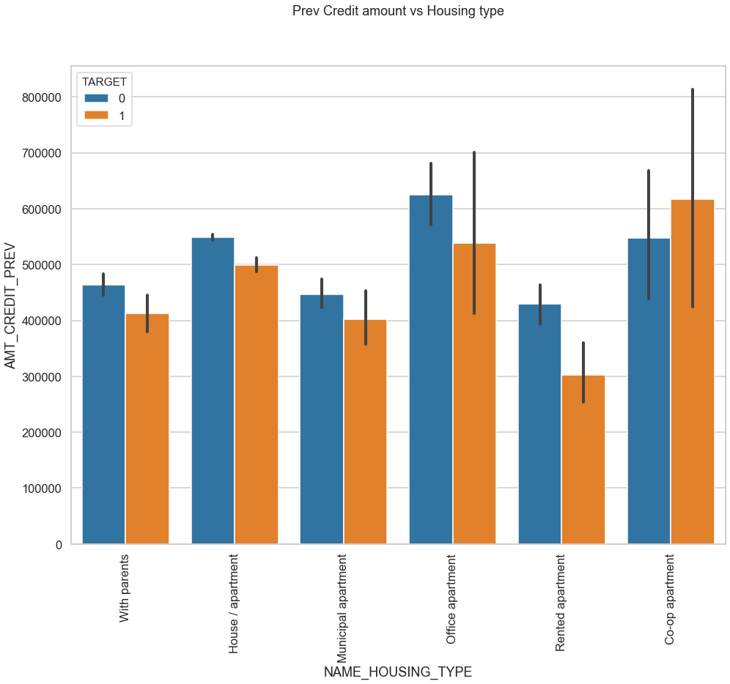
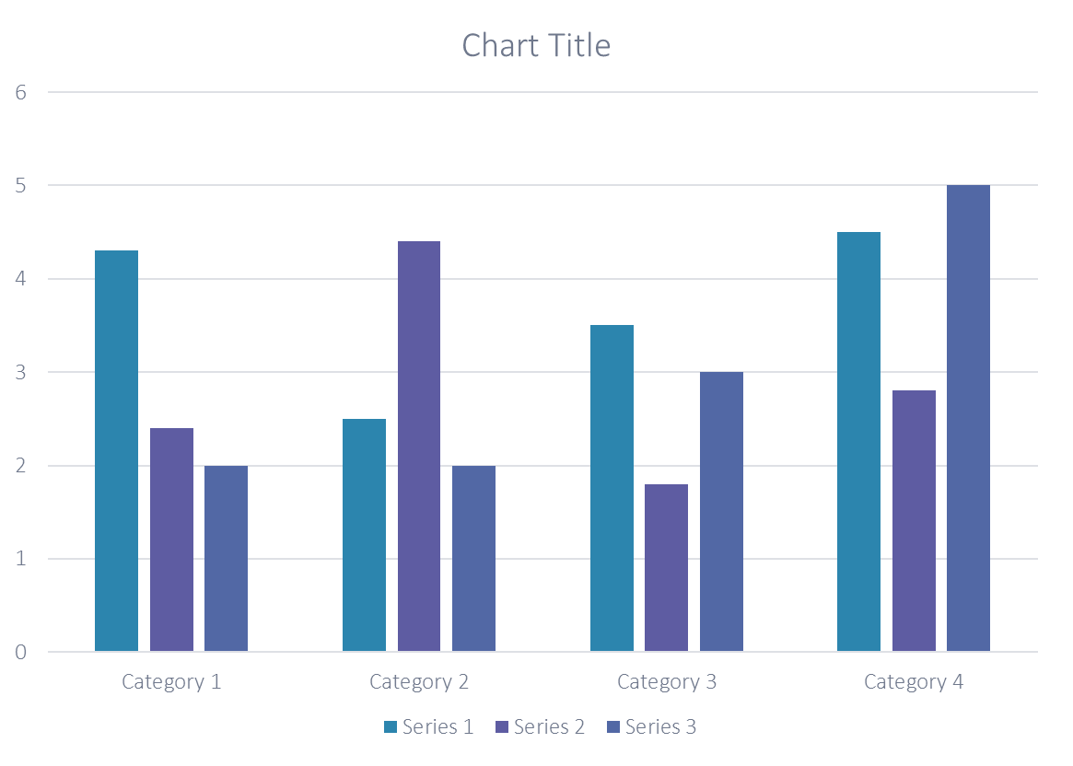
Distribution of Previous Credit amount vs Housing Type
Here for Housing type, office apartment is having higher credit of target 0 which means high non defaulter
co-op apartment is having higher credit of target 1 which means high defaulters.
Bank can focus mostly on housing type with parents or House\apartment or municipal apartment for successful payments.

Slide 13
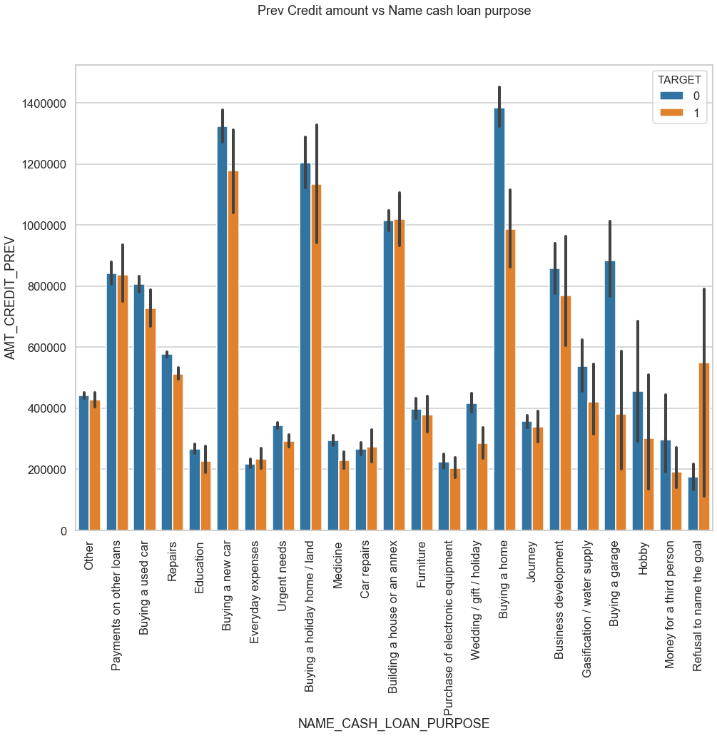
Distribution of Previous Credit amount vs Cash Loan Purpose
The credit amount of Loan purposes like 'Buying a home’, 'Buying a land’, 'Buying a new car' and, 'Building a house' is higher.
Money for third person or a Hobby is having less credits applied for.

Slide 14
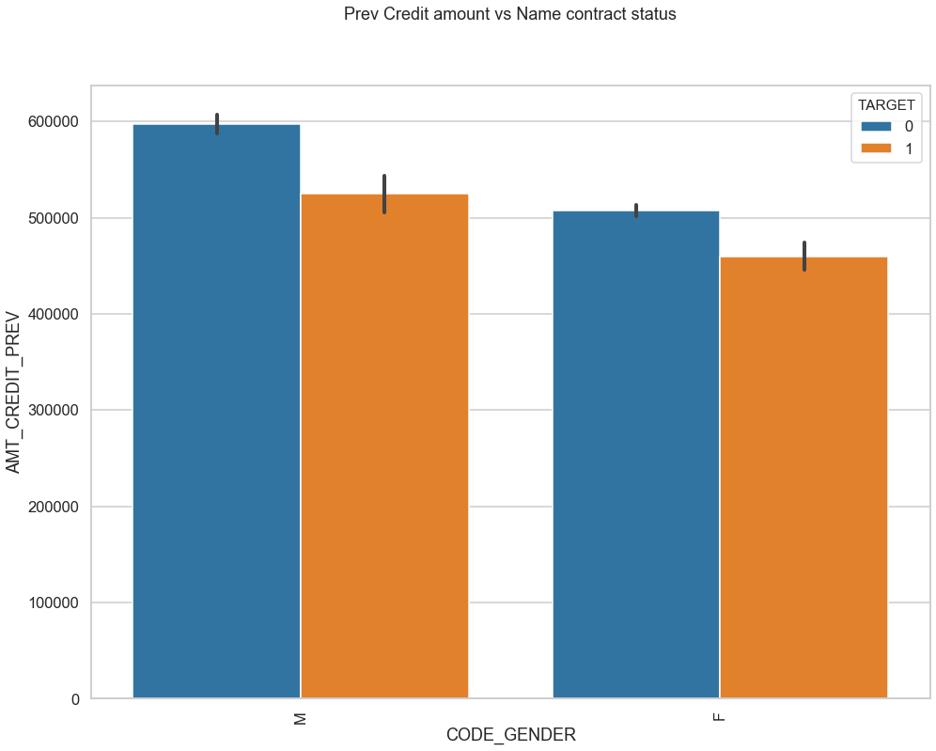
Distribution of Previous Credit amount vs Cash Name Contract status
Male have higher credit amount

Slide 15
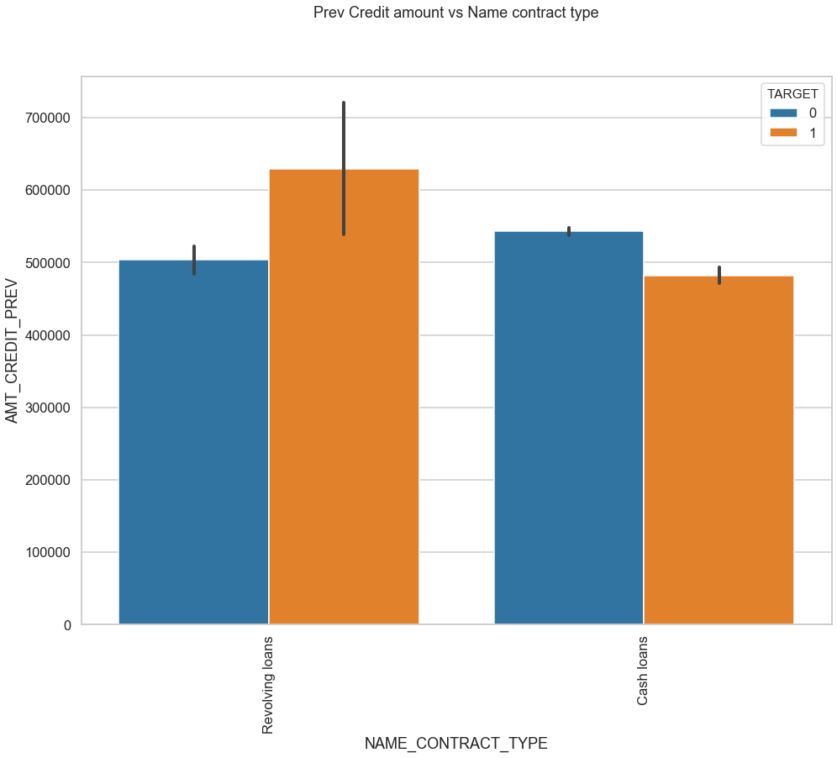
Distribution of Previous Credit amount vs Name Contract status
Revolving Loans have higher defaulters compared to Cash Loans.

Slide 16




Conclusion
Income range 200000 - 225000 are less defaulters compared to defaulted population. Banks can focus on this income range
Banks should focus more on Cash loans than Revolving loans
Banks should focus on education category clients since they have very less default pattern
Bank should focus mostly on housing type with parents or House\apartment or municipal apartment since they have higher successful payment .

