Slide 1
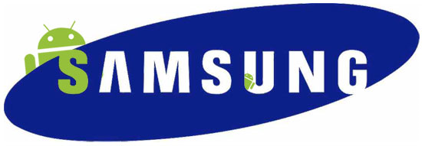
ANDROID APPLICATIONS
Project
Semester Training
By:
Navjot Singh
10703066

Slide 2
At Samsung Software Engineering Lab
Under the guidance of
Mr. Vijay Solanki, Chief Engineer, Samsung SEL, Noida.
Prof. Anil Vashisht, Thapar University.

Slide 3

Samsung has three Software development centres
Samsung Electronics Lab (SEL),Noida
Samsung India Software Centre (SISC) ,Noida
Samsung India Software operations unit (SISO) , Bangalore

Slide 4
Software Engineering Lab (SEL)
Founded in 2007
Mobile Platforms being worked on: BADA, SHP, MMP, NXP, SAP (Samsung AJU platform) and Android.

Slide 5
Work Program
Java Training and Android Training, consisting of classroom sessions and written tests.
Demo Applications for understanding the concepts.
Full Android Applications developed and presented to the Chief.
Teams assigned, according to the performance.

Slide 6
Android
Open Source Software platform from Google and the Open Handset Alliance
Android consists of complete set of software components for mobile devices including:
an operating system
middleware
key mobile applications
API libraries

Slide 7
Features of Android
Open
built on the open Linux Kernel
No difference between 3rd party application and in-built applications.
users are able to fully tailor the phone to their interests.

Slide 8
Breaking down application boundaries
a developer can combine information from the web with data on an individual's mobile phone (such as the user's contacts, calendar, or geographic location) to provide a more relevant user experience.
Fast and easy development
wide range of useful libraries and tools

Slide 9
ANDROID COMPONENTS
Application framework
enabling reuse and replacement of components
Dalvik virtual machine
optimized for mobile devices
Integrated browser
based on the open source Web Kit engine
Optimized graphics
powered by a custom 2D graphics library; 3D graphics based on the OpenGL ES specification (hardware acceleration optional)

Slide 10
SQLite
for structured data storage.
Media support
for common audio, video, and still image formats (MPEG4,H.264, MP3, AAC, AMR, JPG, PNG, GIF)
GSM Telephony (hardware dependent)
Bluetooth, EDGE, 3G, and Wi-Fi (hardware dependent)
Camera, GPS, compass, and accelerometer (hardware dependent)

Slide 11
ANDROID SOFTWARE STACK

Slide 12
Linux Kernel: Core services including
Hardware drivers
process and memory management
Security
Network
Power management
Abstraction layer between the hardware and the remainder of the stack.

Slide 13
Libraries
C/C++ core libraries
Media library
Surface manager
Graphics libraries(SGL and OpenGL for 2D and 3D graphics)
SQLite for native database support
SSL and WebKit for integrated web browser and Internet security.

Slide 14
Android Run Time
Core Libraries - Android includes a set of core libraries that provides most of the functionality available in the core libraries of the Java programming language.
Dalvik Virtual Machine - Every Android application runs in its own process, with its own instance of the Dalvik virtual machine.
Device can run multiple VMs efficiently.
The Dalvik VM executes files in the Dalvik Executable (.dex) format which is optimized for minimal memory footprint

Slide 15
Application Framework
provides the classes used to create Android applications
provides a generic abstraction for hardware access
manages the user interface and application resources.

Slide 16
Android Application Components
ACTIVITY
An activity usually presents a single visual user interface from which a number of actions could be performed.
Typically, one of the activities is marked as the main.
One activity can call another activity through intents.

Slide 17
SERVICE
A service doesn't have a visual user interface, but rather runs in the background for an indefinite period of time.
BROACAST RECEIVER
A broadcast receiver is a component that does nothing but receives and reacts to broadcast announcements.
No user interface.
We can start any activity or perform an action in services and receivers.

Slide 18
CONTENT PROVIDERS
A content provider makes a specific set of the application's data available to other applications.
data usually stored in the file system, or in an SQLite database.

Slide 19
Activity Stack

Slide 20
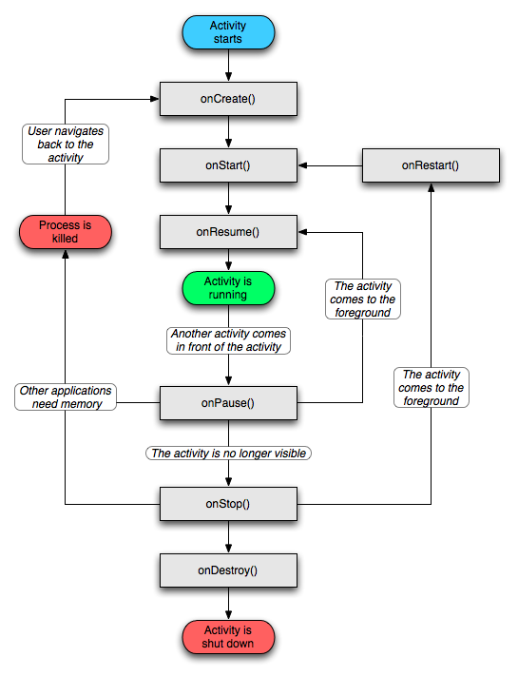
Activity Life Cycle

Slide 21
APPLICATIONS DEVELOPED
Student Information
Contact Tracker
Demo Application for Notifications
Demo Application for Gestures
“Recent Applications” for T Mobile’s SideKick Device.

Slide 22
STUDENT INFORMATION
Insert, modify, delete and search a student’s information from an SQLite database.
Instant search based on:
Name or email id
Degree
Specialization

Slide 23
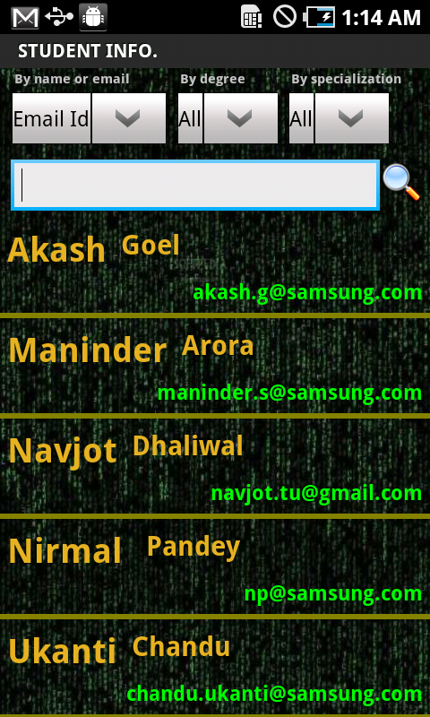
Flow through Snap-Shots
Custom SQLite Database
Custom List View
Custom Adapter
To provide data to list view
Array Lists
For instant searching
Spinners

Slide 24
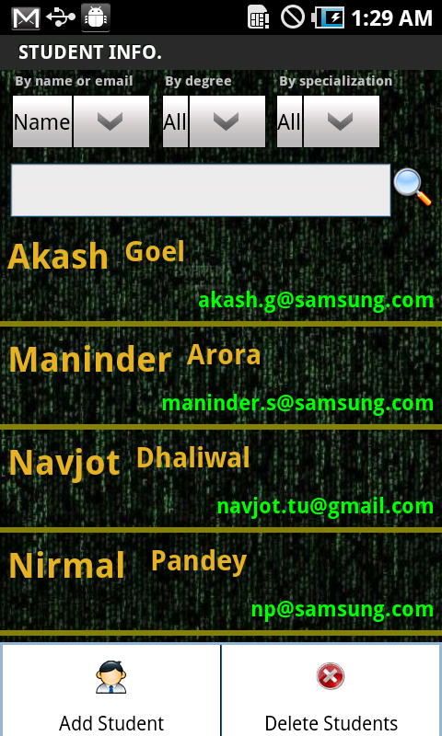
Menu Items

Slide 25
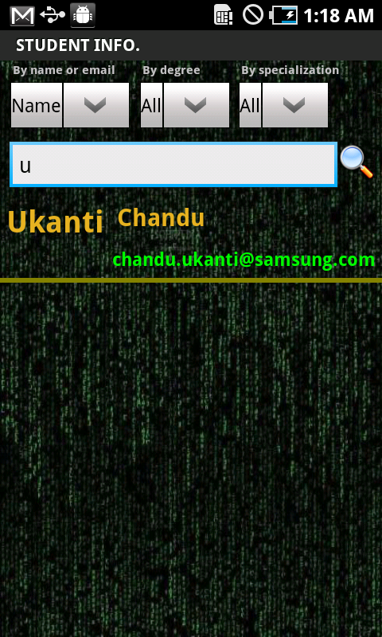
Search by name

Slide 26
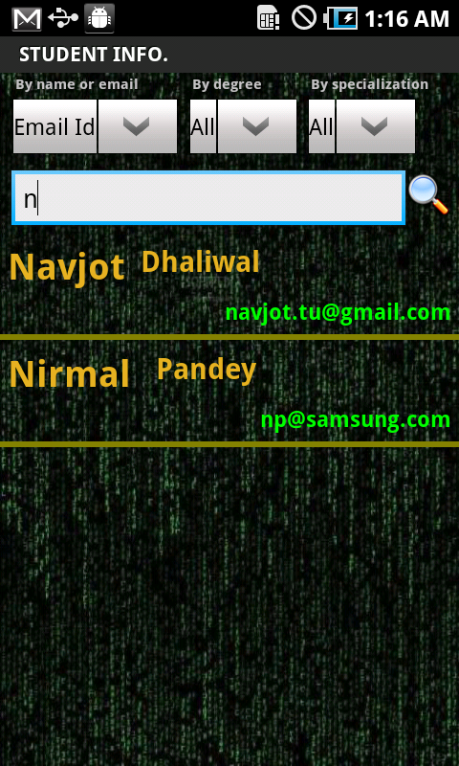
Search by email Id

Slide 27
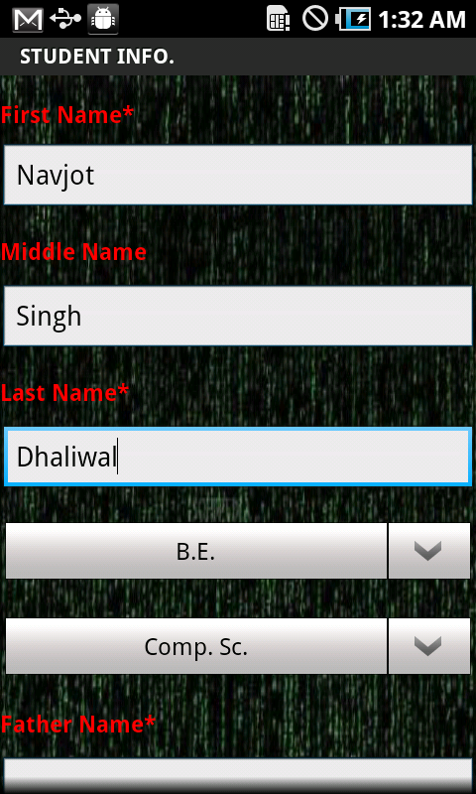
Add Student

Slide 28
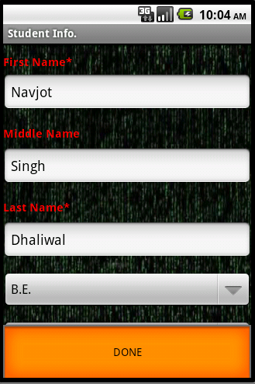
Edit Student

Slide 29
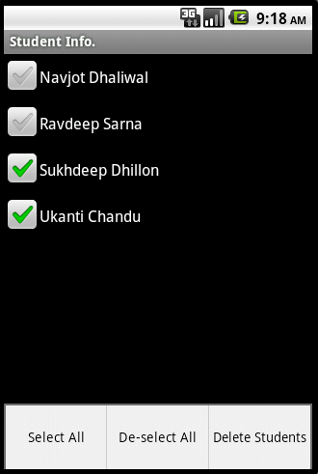
Delete Students

Slide 30
Contact Tracker
Contact Tracker is an Android application that provides the following features:
Option for calling a contact
Maintaining Call and SMS log
Sending a message to a contact
Fetching a contact from default Contact List

Slide 31
ContactsContract API
Extensible database of contact-related information
Contract between the contacts provider and applications.
Tables:
A row in the ContactsContract.Data table can store any kind of personal data, such as a phone number or email addresses.
A row in the ContactsContract.RawContacts table represents a set of data describing a person and associated with a single account

Slide 32
A row in the ContactsContract.Contacts table represents an aggregate of one or more RawContacts presumably describing the same person.
ContactsContract.Groups, which contains information about raw contact groups such as Gmail contact groups.
ContactsContract.StatusUpdates, which contains social status updates including IM availability.
ContactsContract.PhoneLookup, which is used for quick caller-ID lookup

Slide 33
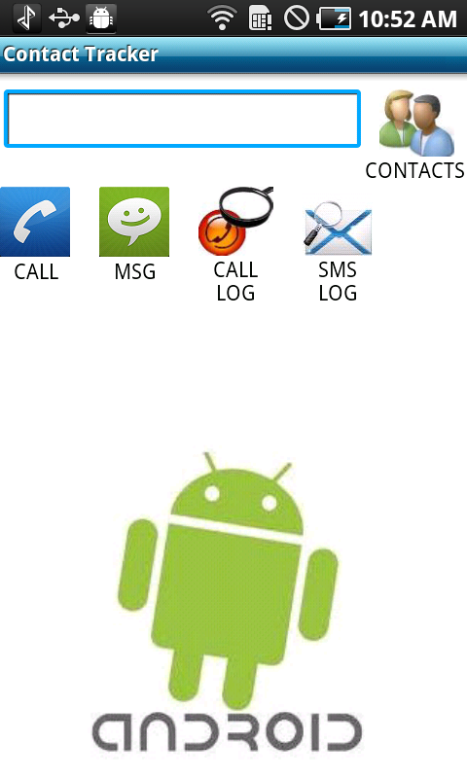
Main Activity

Slide 34
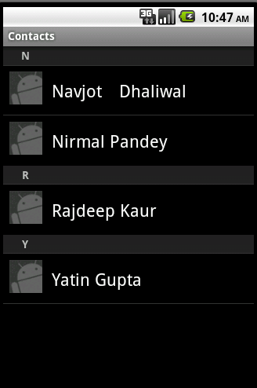
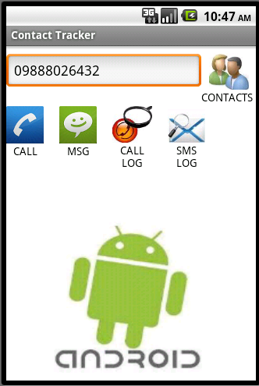

Slide 35
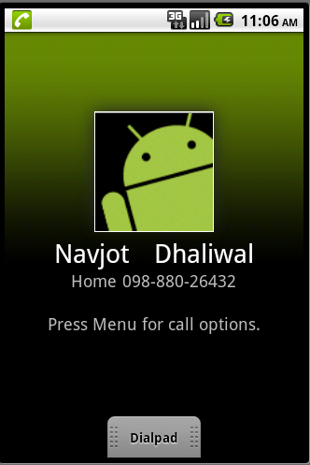
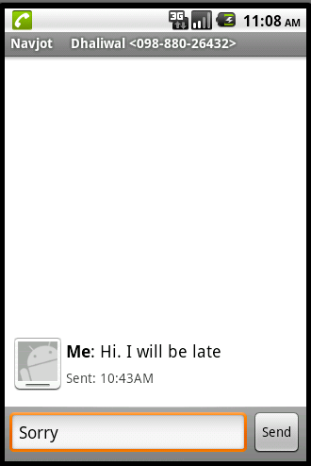
Calling and messaging

Slide 36
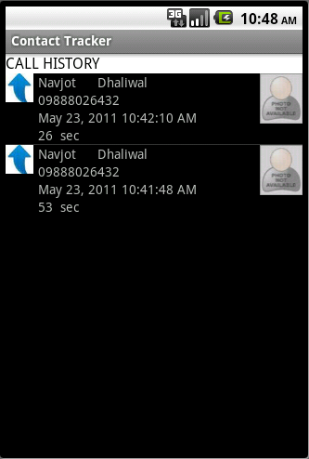
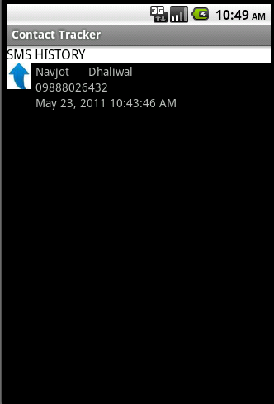
Call and Message Logs

Slide 37
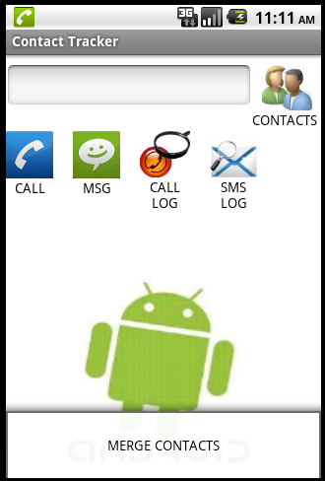
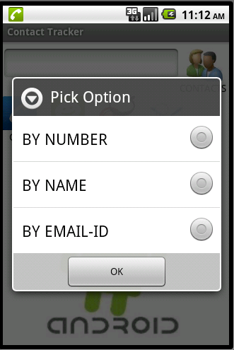
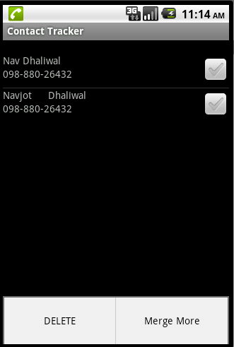
Merging Contacts

Slide 38
DEMO APPLICATION FOR NOTIFICATION
Notification
way of alerting a user about an event that he needs to be informed about or even take some action on getting that information.
Notification on Android can be done in any of the following ways:
Status Bar Notification
Vibrate
Flash lights
Play a sound

Slide 39
Status Bar Notifications
Notification
defines the properties of the status bar notification like the icon to display, the text to display when the notification first appears on the status bar and the time to display.
NotificationManager
an android system service that executes and manages all notifications.

Slide 40
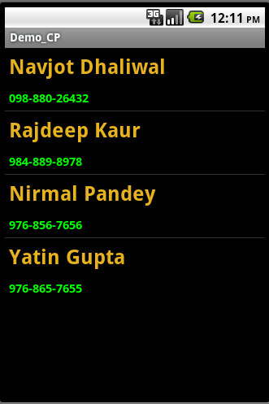
Flow through Snap-Shots
Custom List View
ContactsContract.Data

Slide 41
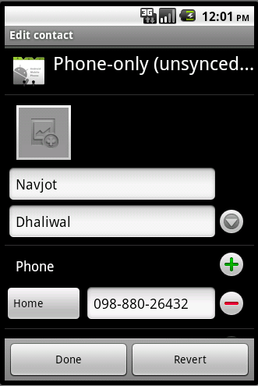
On Click

Slide 42
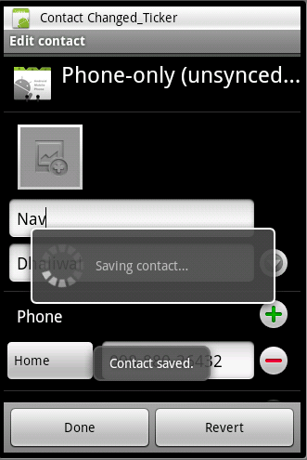
Contact Changed

Slide 43
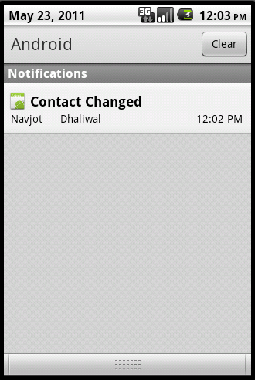
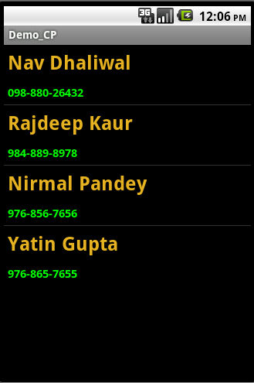
Status Bar Notification and Changed Contact

Slide 44
DEMO APPLICATION ON GESTURES
To handle gestures we use GestureDetector and GestureListener.
Override the methods in GestureListener interface.
onDown
onFling
onLongPress
onScroll
onShowPress
onSingleTapUp
onDoubleTap
onDoubleTapEvent
onSingleTapConfirmed

Slide 45
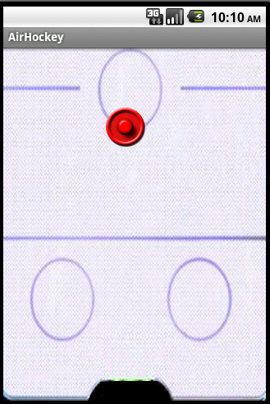
Puck is a bitmap
In onFling method, we call the onDraw method, to draw the bitmap at different points, according to velocity and current position.
Handled the edge movemments.

Slide 46
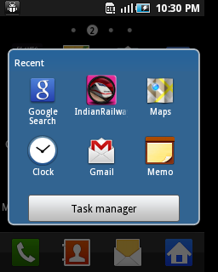
RECENTAPPLICATIONS for T Mobile’s Sidekick
The default application’s main activity is “RecentApplicationsDialog.

Slide 47
ActivityManager
Interact with the overall activities running in the system.
PackageManager
Class for retrieving various kinds of information related to the application packages that are currently installed on the device. You can find this class through getPackageManager().
ActivityManager.RecentTaskInfo
Information you can retrieve about tasks that the user has most recently started or visited.

Slide 48
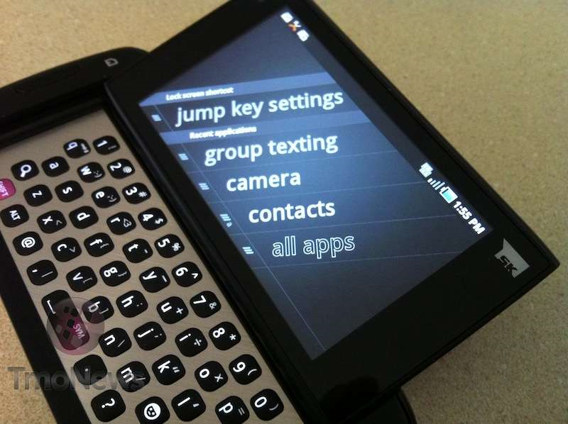

Slide 49
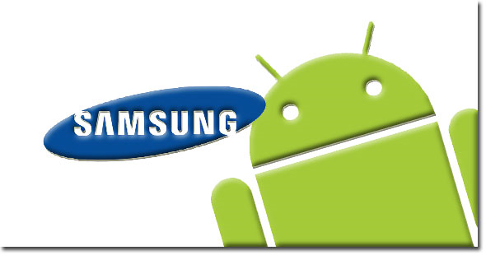
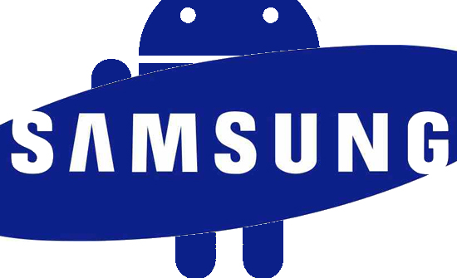
Thank You

